Slide 1
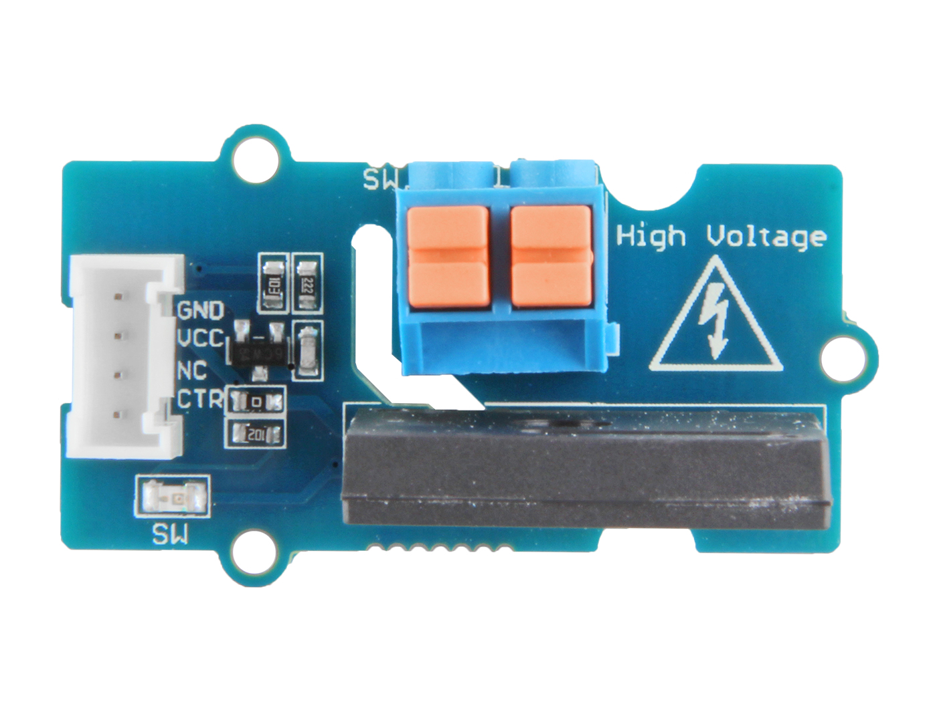






GND: connect this module to the system GND
VCC: you can use 5V or 3.3V for this module
NC: not connected
CTR: input control signal
Load 2: one port of switch to connect to the load wire
Load 1: the other port of switch to connect to the load wire

