Slide 1
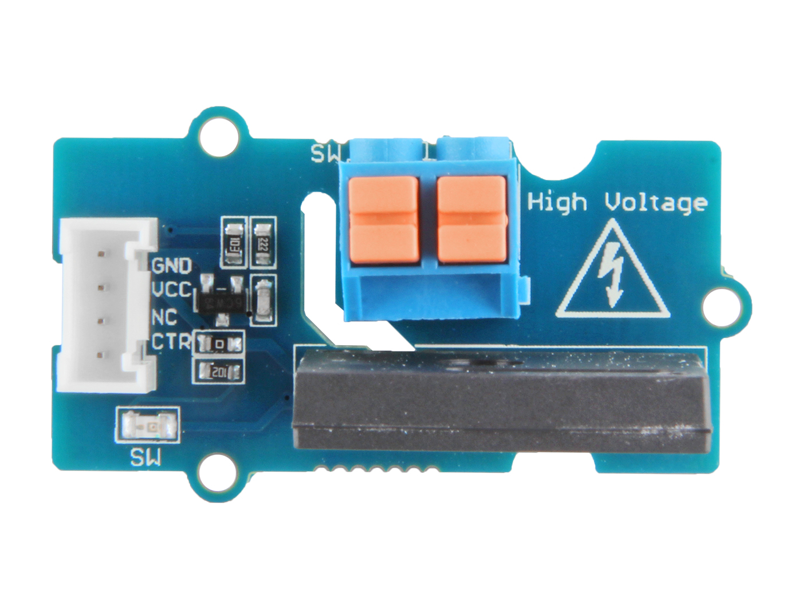






GND: connect this module to the system GND
VCC: you can use 5V or 3.3V for this module
NC: not connected
CTR: input control signal
Load A: one end of the load line
Load B: the other end of the load line

