Slide 1
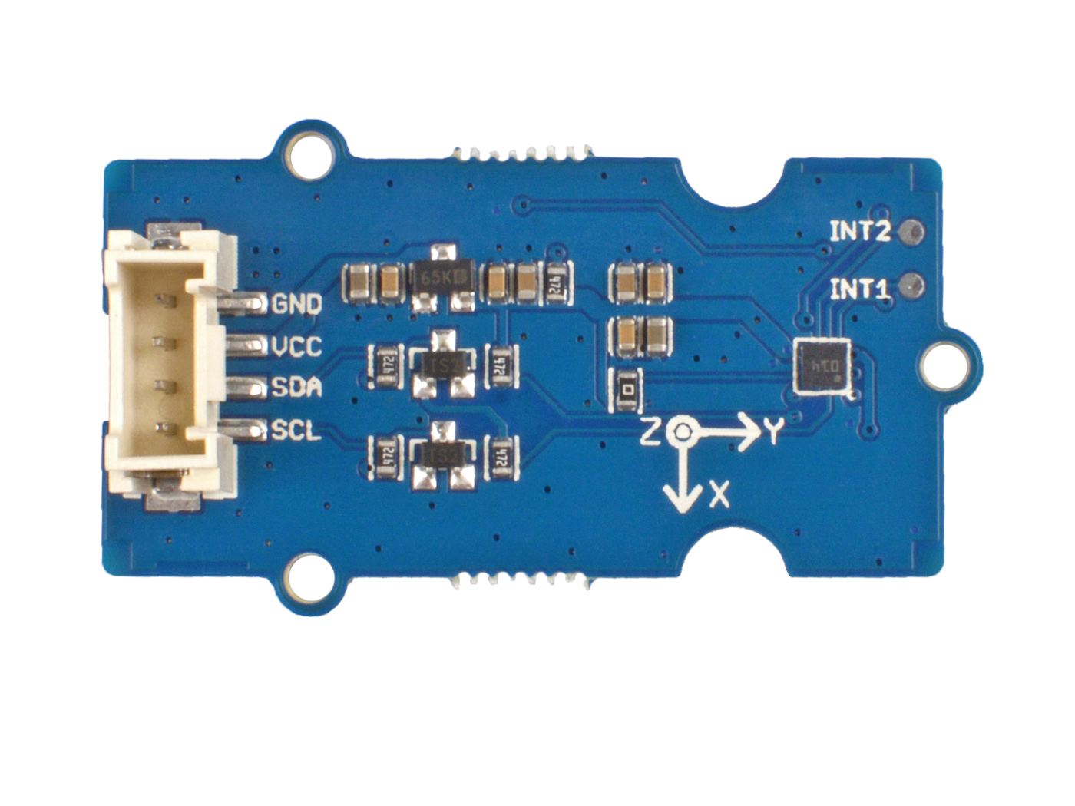







GND: connect this module to the system GND
VCC: you can use 5V or 3.3V for this module
SDA: I²C serial data
SCL: I²C serial clock
INT2: interrupt output 1(Input for external FIFO sync)
INT1: interrupt output 1(Input for external FIFO sync)
The BMA456 module

Slide 2
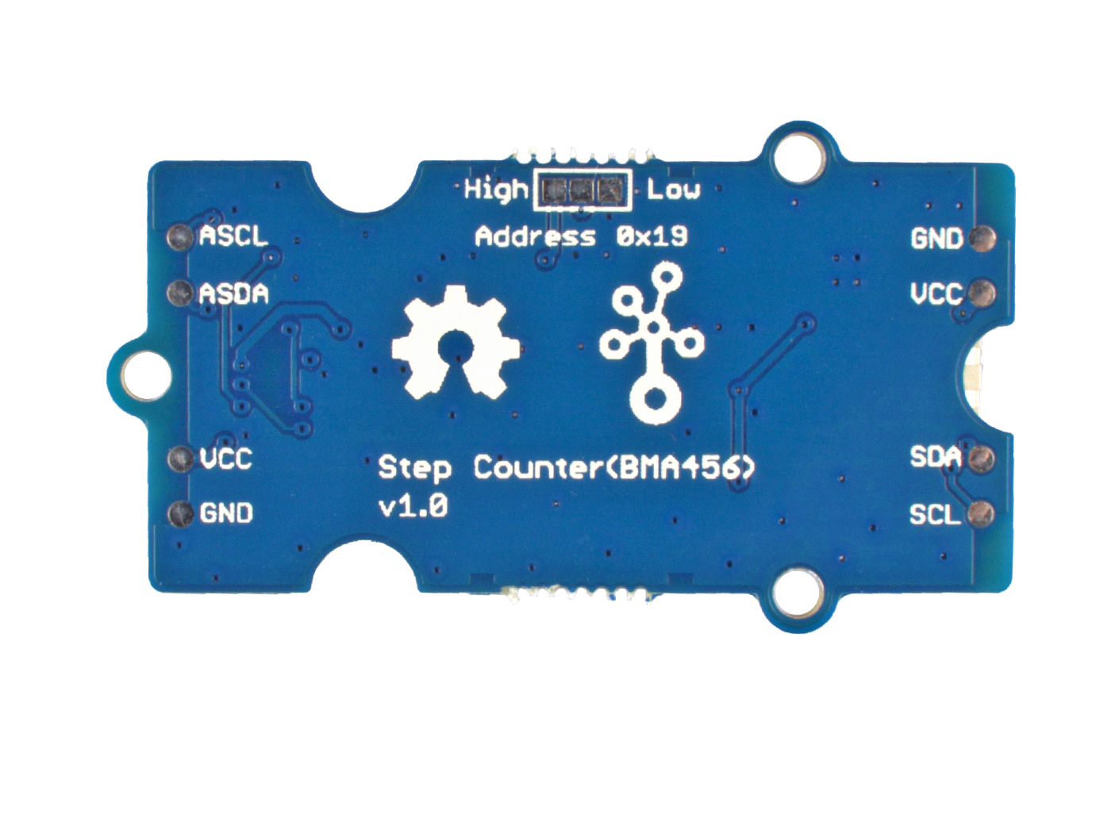
0 x 18
Optional
0 x 19
Default

