Slide 1
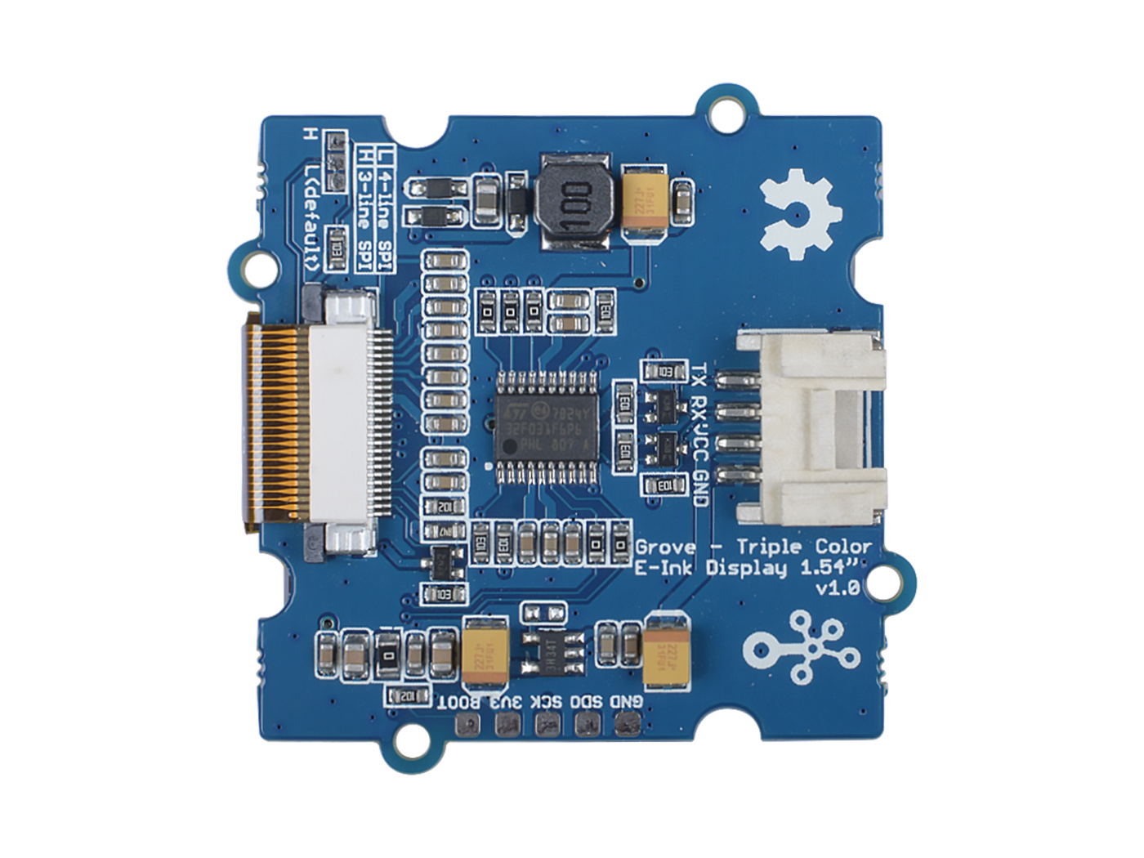
MCU: STM32
INK FPC
Interface
Grove UART
Firmware Download Interface

