Slide 1
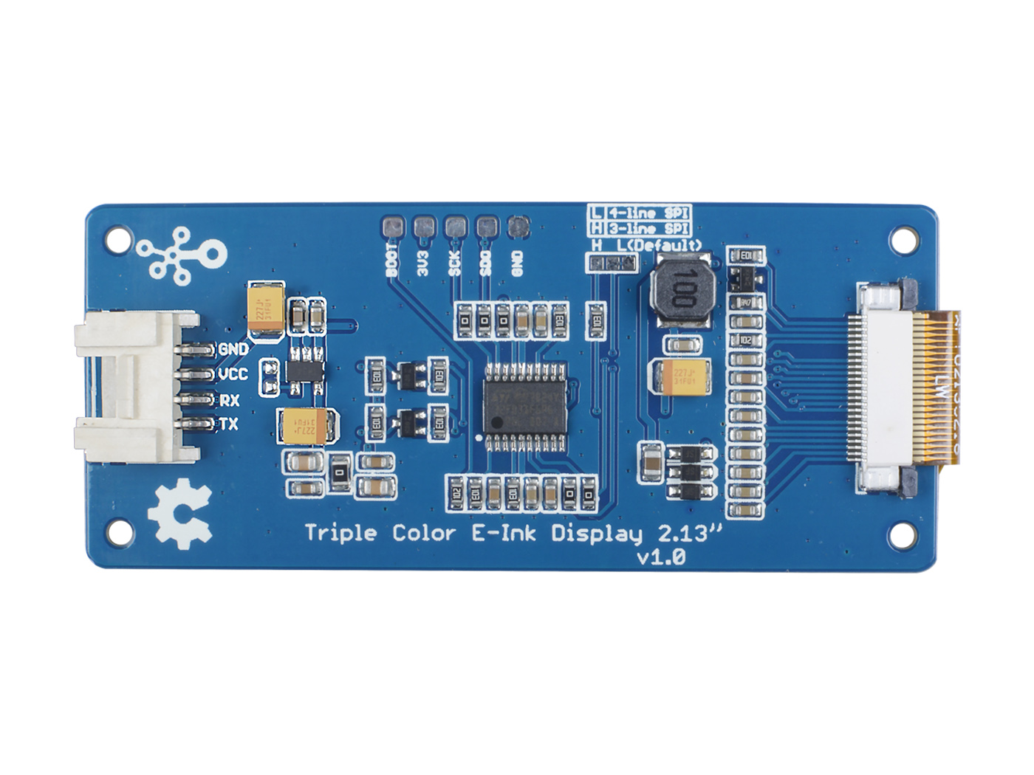
Firmware Download Interface
Grove UART
INK FPC
Interface
MCU: STM32

