Slide 1
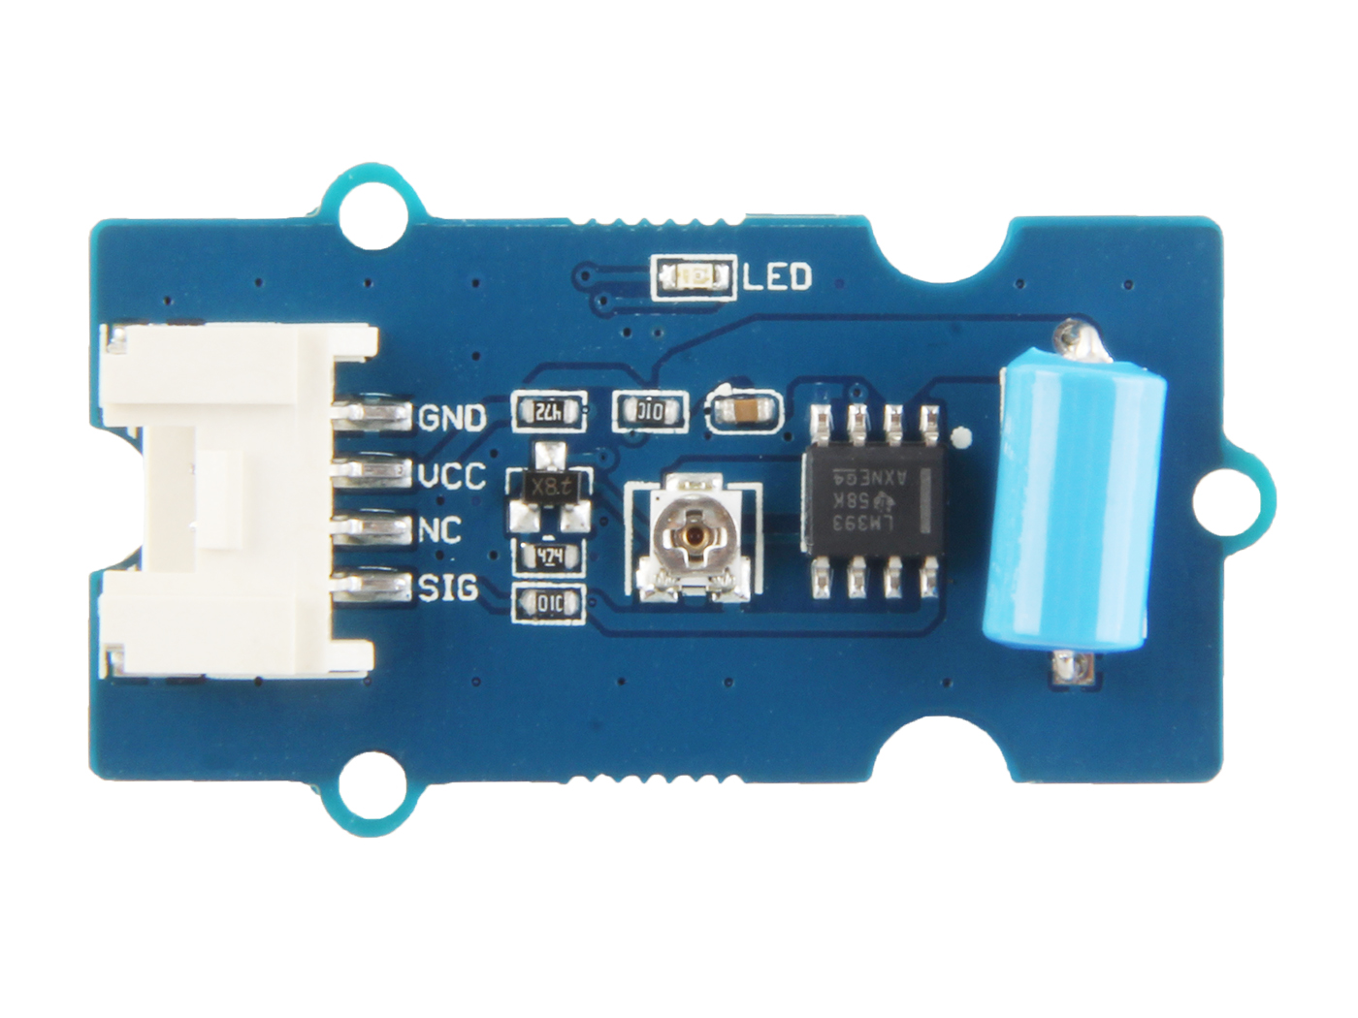









GND: connect this module to the system GND
VCC: you can use 5V or 3.3V for this module
NC: none connected in this module
SIG: output the Vout voltage signal
Potentiometer: you can use a screwdriver to rotate the potentiometer which controls the sensitivity of this sensor.
GND: the GND pin of the potentiometer.
Vsen: the lower the voltage of Vsen, the higher the sensitivity
VCC: the VCC pin of the potentiometer.
SW-420: the Vibration Sensor

