Slide 1
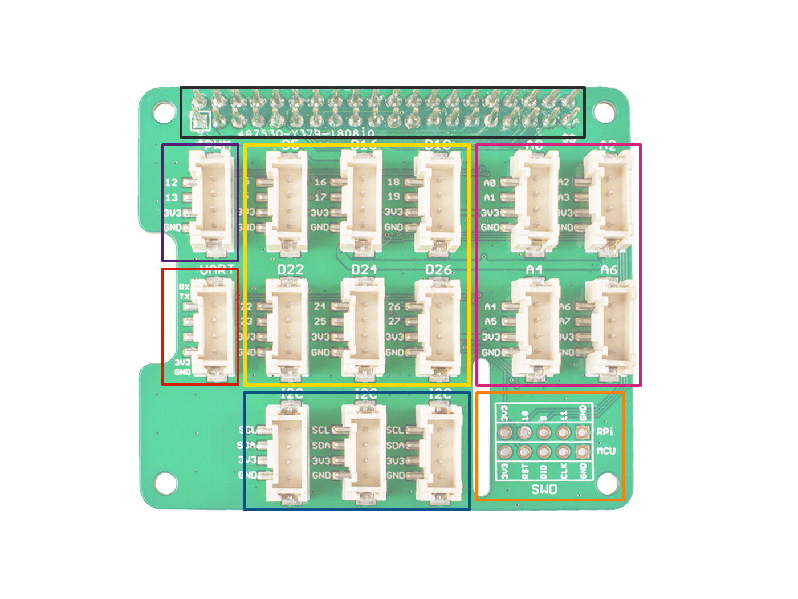
GPIO
Digital
PWM
Analog
UART
GPIO
I2C
SWD

