Slide 1
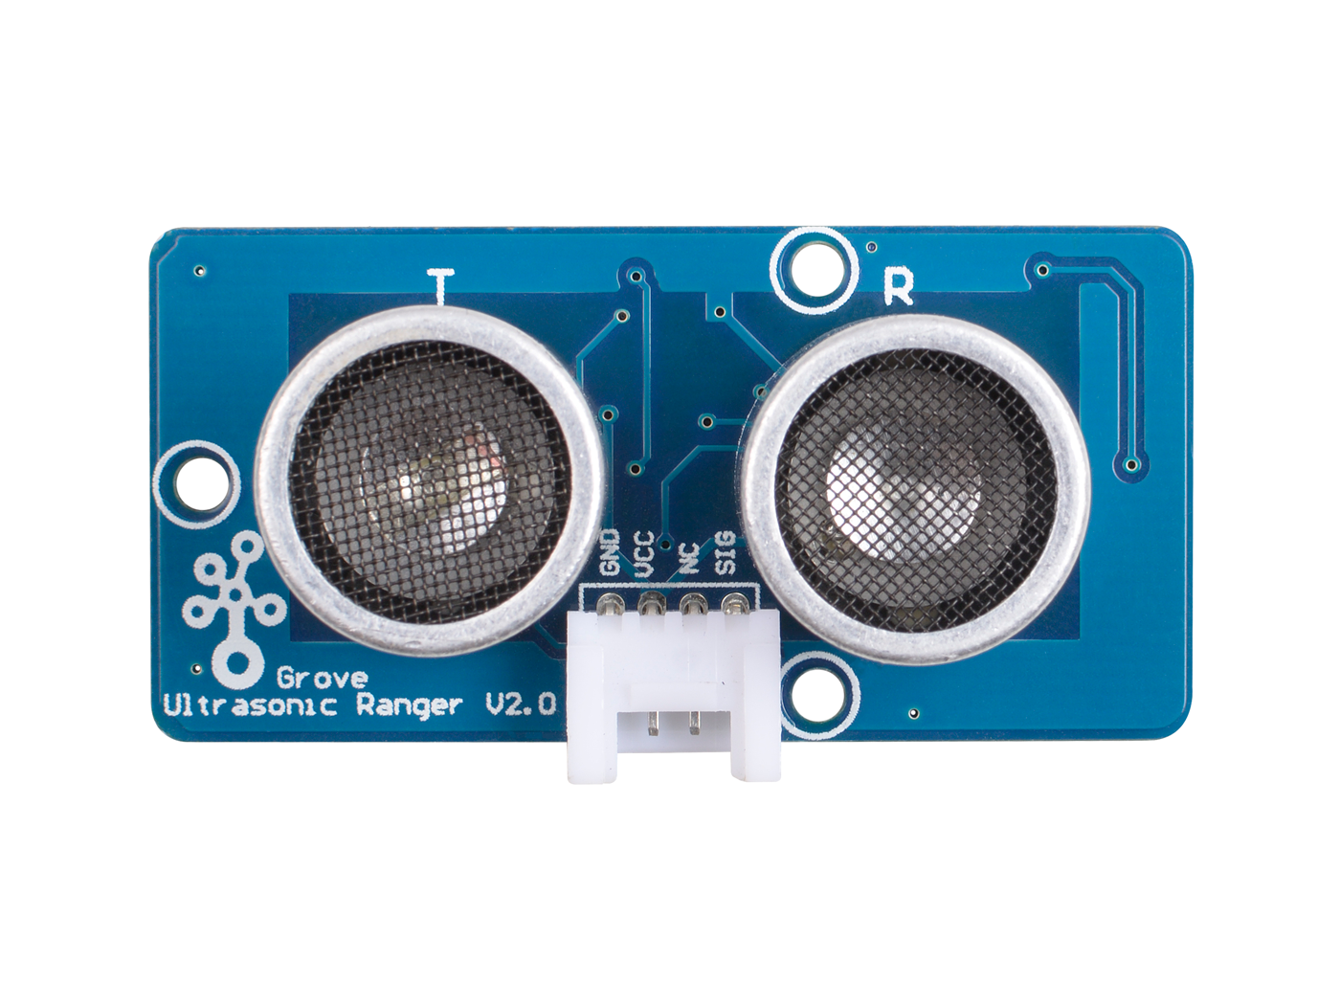
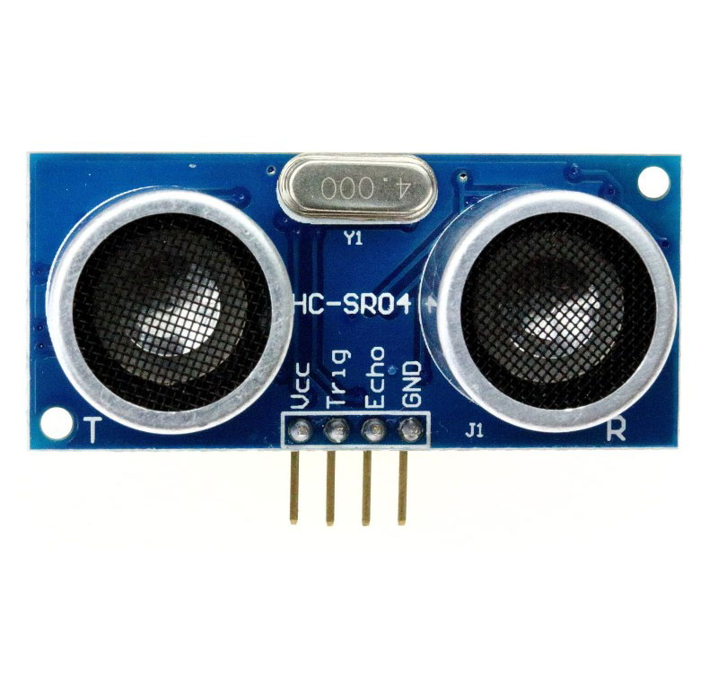
Grove - Ultrasonic Distance Sensor
HC-SR04
VS
3.3v
5v
5v
SIG for both
Transmitter and Receiver
Trig for
Transmitter
Echo for
Receiver

