Slide 1
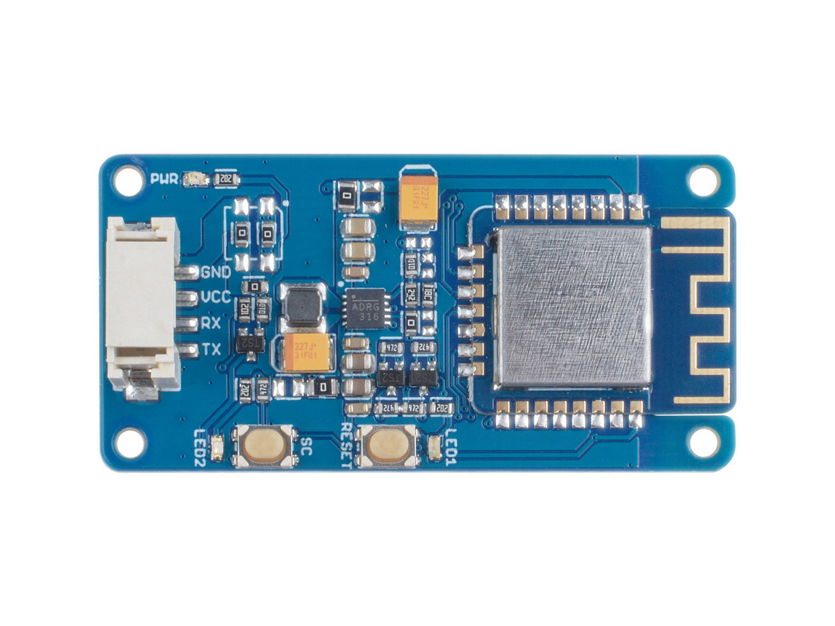





W600 Module
Reset Button:
Reset the W600 chip
Config Button:
Configure network connection or disconnect
Reset Button:
On-board wifi antenna
Grove UART:
Soft Uart, Avr chip use D2/D3 by default/ SAMD21 chip use serial1

