Slide 1
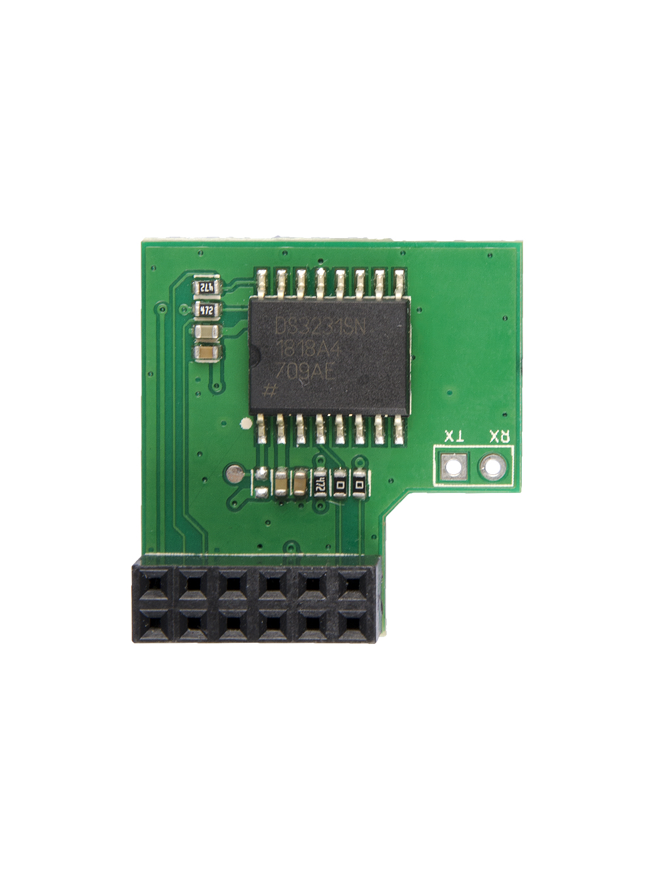
RX
TX
3V3
SDA_3V3
SCL_3V3
GPIO9
GND
S/INT
5V
5V
GND
TX
RX
RST

