Slide 1
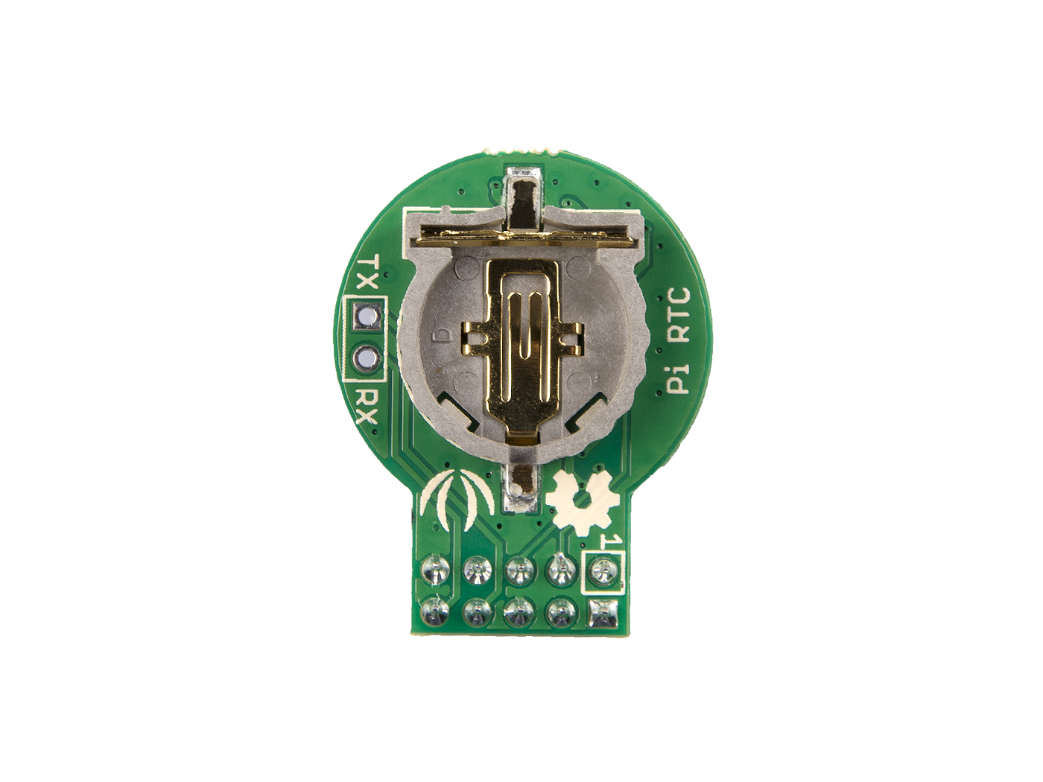
TX
RX
GND
GPIO7
SCL_3V3
SDA_3V3
3V3
RX
TX
GND
5V
5V

