Slide 1

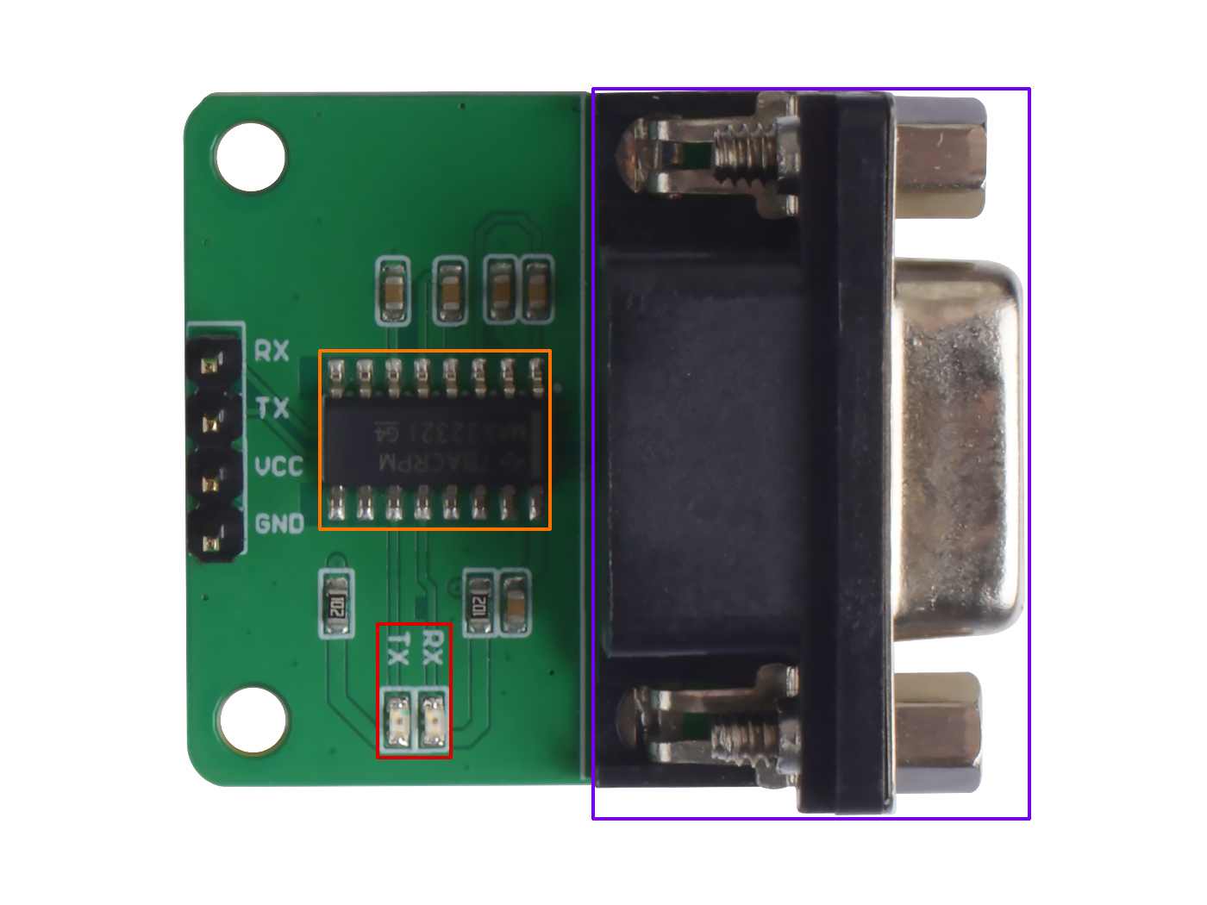






RX: connect to the device TX
TX: connect to the device RX
VCC: you can use 5V or 3.3V for this module
GND: connect this module to the system GND
Max3232 chip
LED indicator
DB9 Port

Slide 2
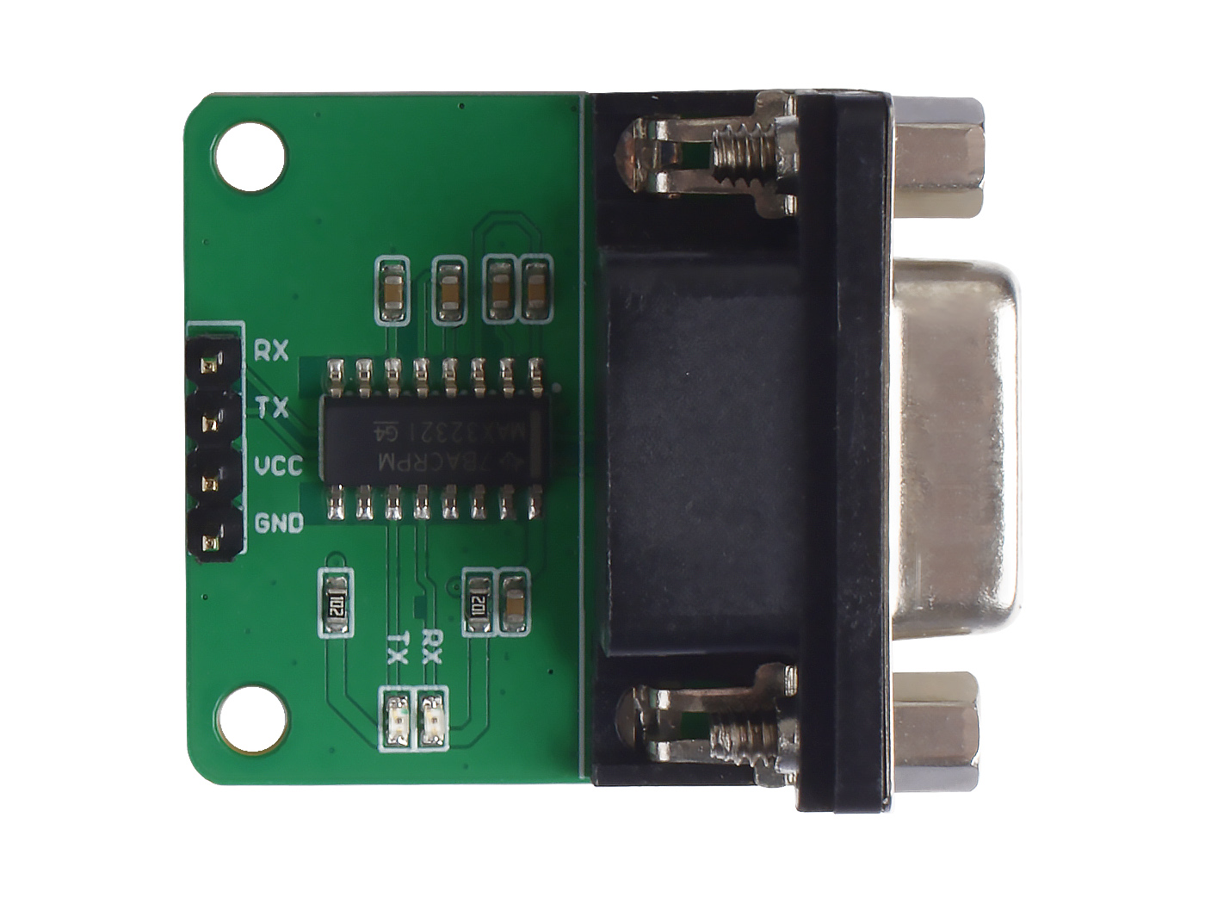
TTL Device
RS232 Device
TX
RX
VCC
GND

