Slide 1
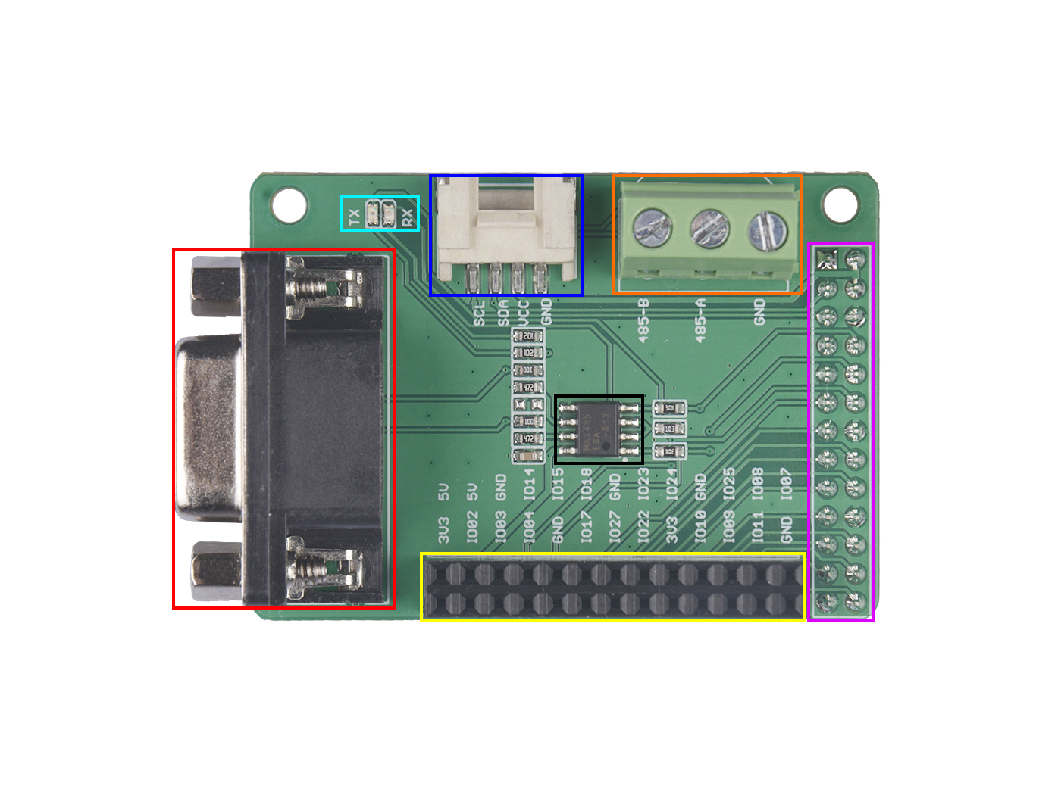
Grove I2C
LED Indicator
485 Screw Terminal
2×13 Female Header
To Raspberry
RS485
DB9
Max485
2×13 Female Header

Slide 2
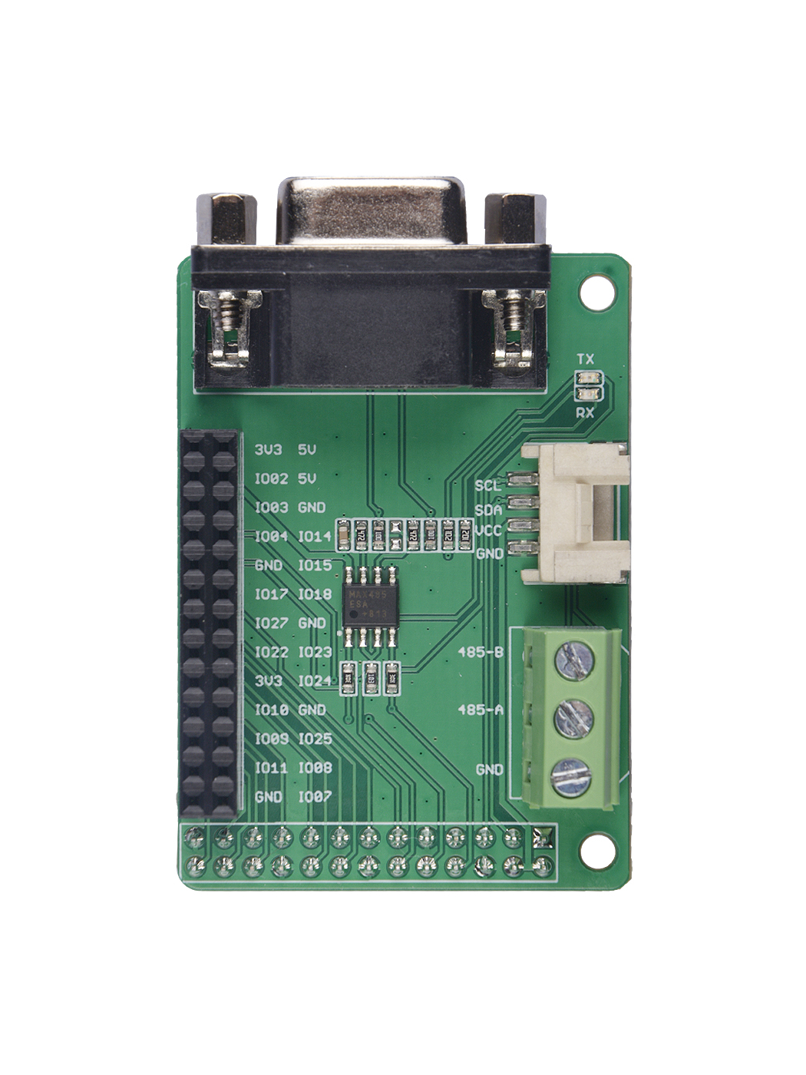
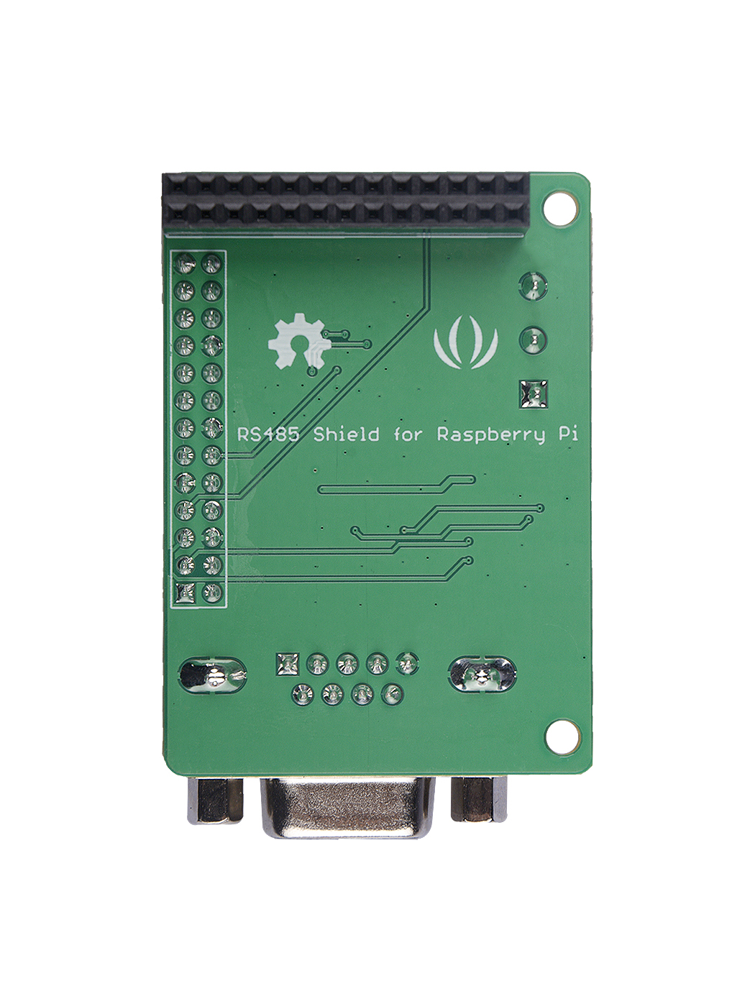
P25
P1
P25
P1

