Slide 1
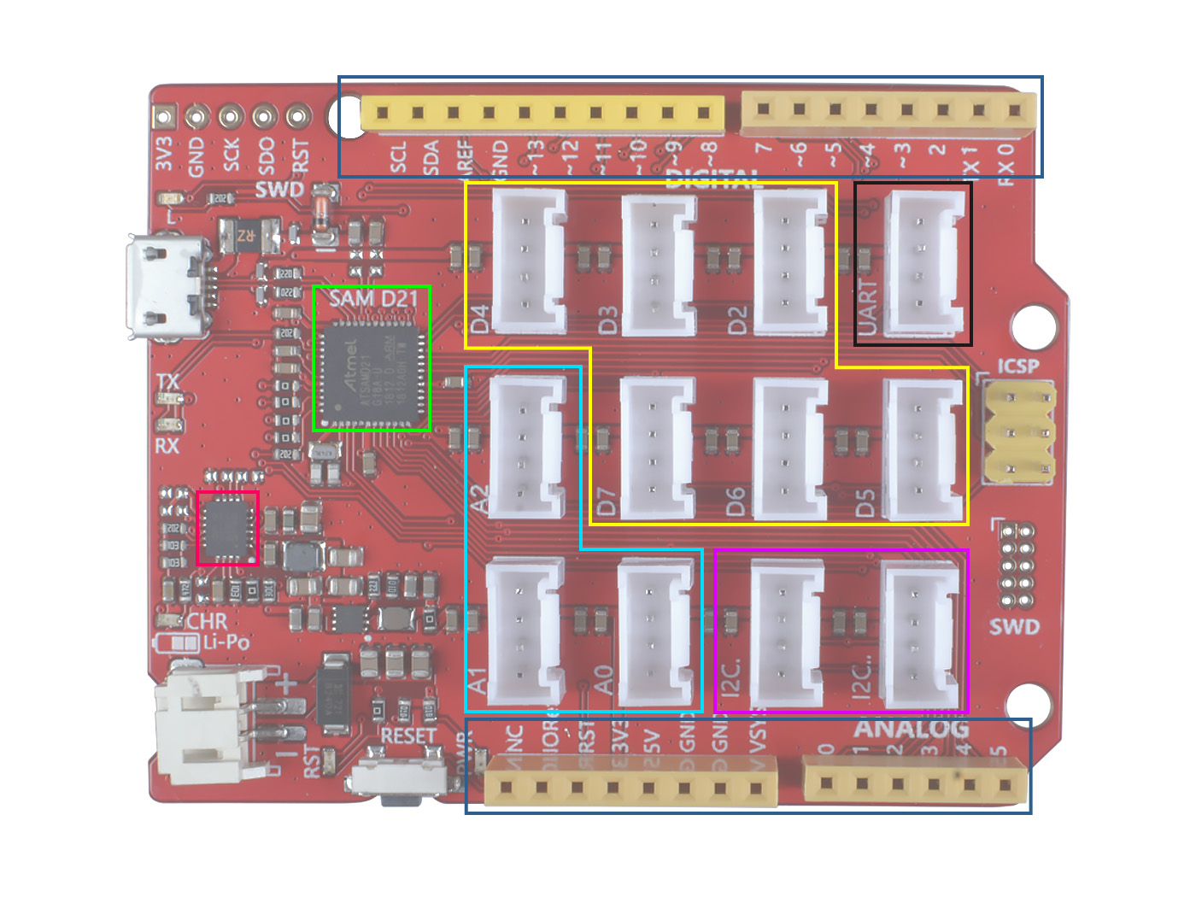
SAM D21
Header
Digital
Micro-USB
UART
ICSP
Power IC
I2C
Li-Po Header
Reset
Header
Analog

