Slide 1

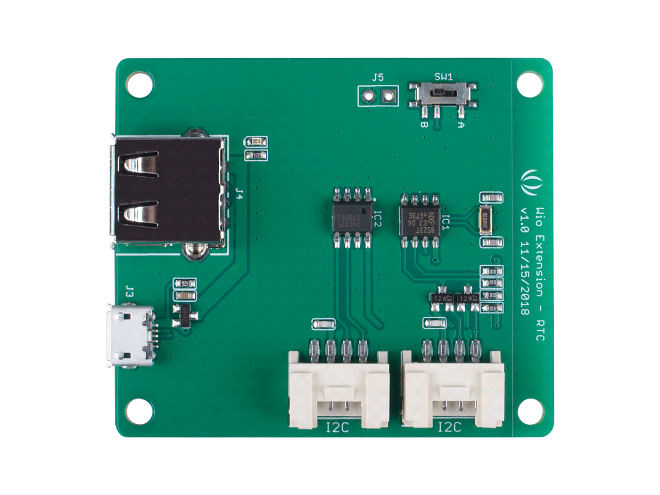



Switch: manually turn on/off the external output power
I2C Grove Port: access to RTC and EEPROM via I2C
Micro USB: Powering the module
USB: Provide 5V power for external output

