Slide 1
EMERGENCY AND RESCUE SERVICE

Slide 2
Outline
Introduction
Objectives
Project Function
Software Required
Testing
Future works
Conclusion

Slide 3
Introduction

Slide 4
OBJECTIVES
Get user current location.
Reducing deaths rate of road accidents. Example vehicle crash, injuries during accident.
During fire outbreak, it reduces the damage by contacting authority in a short time duration.
It helps Mauritian to be well prepare to tackle emergencies.
Improve the life quality of Mauritians.
It is a user friendly project.

Slide 5
FUNCTIONALITIES
User send a message and receive a confirmation message.
Server send an SOS message to the authority concern.
No specific message format is needed.
Via geolocation, user location coordinates is send to authority.
User receives the user number.
No keyword is detected?

Slide 6
Software required
Visual Studio 2017 with Cordova.
Ozeki SMPP SMS Gateway.
Ozeki Server 6

Slide 7
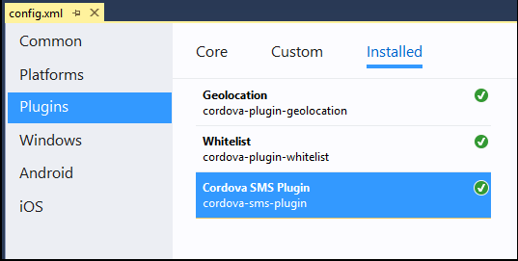
VISUAL STUDIO
Installed Plugin

Slide 8
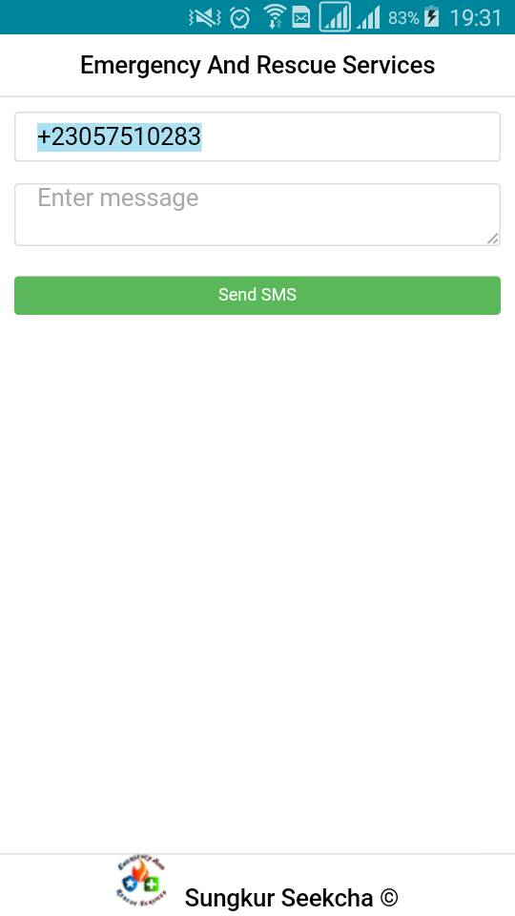

VISUAL STUDIO
Click on Device
The Application Interface
Notes:
Developer function with help of usb cable we can run it on our device
Display on our mobile

Slide 9
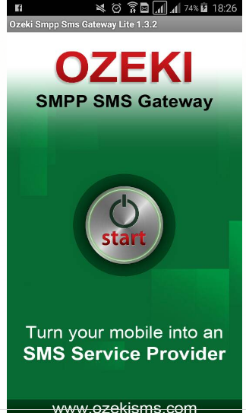
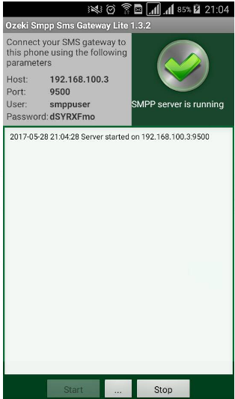
OZEKI SMPP SMS GATEWAY
What is Ozeki SMPP SMS Gateway?
Notes:
A peer to peer protocol used to connect your pc to the GSM service provider. This is how msg is snd and received

Slide 10

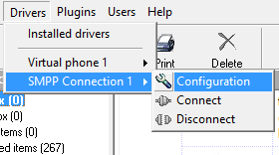
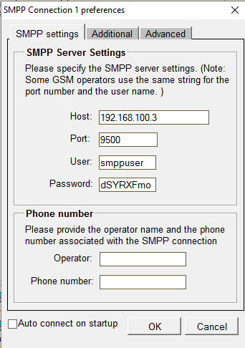
OZEKI SERVER
Configuration of SMPP

Slide 11
TESTING

Slide 12
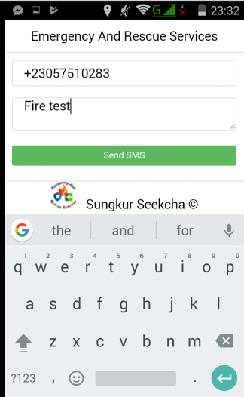
User sends message
Notes:
Hardcode number

Slide 13
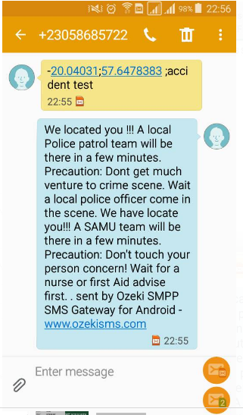
User receives a Message
Notes:
This is how the server gets our coordinates
And reply the user back that the msg was receive

Slide 14
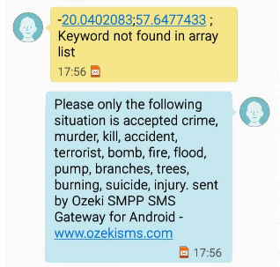
User
User send wrong keyword.
Notes:
Sever does not detects any key word

Slide 15
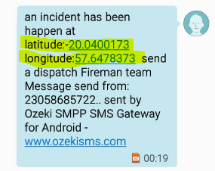
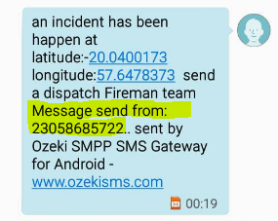
Authority
Receives your coordinates
Receives sender number

Slide 16
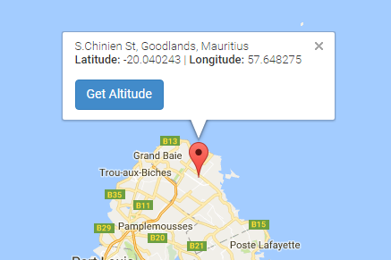
AUTHORITY
Testing if coordinates on google map
Notes:
After inserting the coordinates on a google map, the extra address of the user is shown

Slide 17
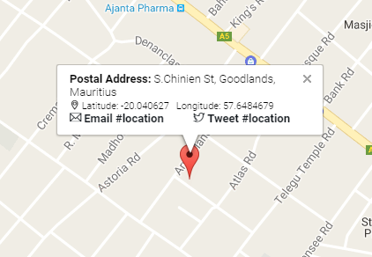
FUTURE WORK
Send address instead of sending coordinates by using postal address lookup google.
Making it a full fledge emergency app.

Slide 18
CONCLUSION

Slide 19
REFERENCE
., L. (2016, August). Frère et soeur périssent dans un incendie à Triolet | Leur mère : «Je n’ai plus aucune raison de vivre». Retrieved from 5plus Dimanche: http://www.5plus.mu/faits-divers/frere-et-soeur-perissent-dans-un-incendie-triolet-leur-mere-je-nai-plus-aucune-raison
Valerie K. (2017, May 22). Le Journal MBC 1.

