Slide 1

plwm
Barnabás Zahorán
<zahoranb@proton.me>
An X11 window manager
written in Prolog

Slide 2

The project
Dynamic tiling window manager for X11 (like dwm)
v0.5 is stable for daily use
Written in SWI-Prolog
Porting underway to Scryer Prolog
github.com/Seeker04/plwm

Slide 3
Declarative window management
Started as a proof of concept
Grew to be a working solution
Novelty: first WM written in Prolog
(to my best knowledge)

Slide 4
Initial concerns
Performance?
Scalability of code?
Interoperability?
Tooling?
Determinism?
Is Prolog practical for tasks far from its primary uses?

Slide 5
Configuration
A breeze in Prolog thanks to its declarative nature
We simply consult a source file
Can be reloaded at any time
Dynamic predicates to change settings on the fly
Settings are simple facts usually, but can contain computation
We can define custom predicates to execute later

Slide 6
Features
Fast and lightweight
12 tiling layouts, floating and fullscreen windows
Dynamic workspaces: create, rename, reindex, delete them
Multi-monitor support
Simple animations
Hooks
Command menus and FIFO → custom user logic and scriptability

Slide 7
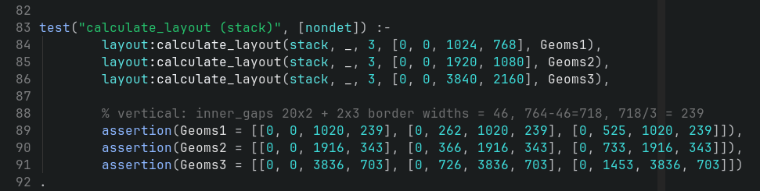
Building relations for a WM
calculate_layout(Layout, Mon, WinCnt, Bounds, Geoms)
Primitives:
monocle: all windows maximized to Bounds size
stack: WinCnt evenly sized wins on top of each other
hstack: same as stack but horizontally
Other 9 layouts are built up from these

Slide 8
Testing
In Prolog the code tests itself
Assertion: we usually make all arguments ground
Mocking: easy with dynamic predicates/globals
PlUnit: not essential, but has some nice QoL like
coloured output
result aggregation
setup & cleanup steps for each test

Slide 9
Quirks
Prolog is crazy good at prototyping
simple syntax and semantics, REPL, GC, higher-order predicates
→ fast to develop and iterate
Weak type system
it actually wills us towards simpler solutions
and not overengineered ones
Debugging is a little cumbersome
though it’s more of a WM nuance than a Prolog one
Module system
is a little all over the place...

Slide 10
Porting to Scryer
Credit: Bennet Bleßmann @Skgland
Fork: github.com/Skgland/plwm/
We have an ongoing draft pull request
Status:
We can build for both SWI and Scryer
SWI retains functionality, but needs some testing
Core window management works in the Scryer version! Testing is underway and issues are being fixed

Slide 11
Porting to Scryer
Tasks and pitfalls
Missing predicates present only in SWI
Non-ISO compliant syntax in some existing code (e.g. ambiguity)
Stricter argument types in Scryer
FFI to C is conceptually different:
SWI: we write bindings in C using SWI-Prolog.h
Scryer: we bind from Prolog with library(ffi) using libffi
Module system differences...

Slide 12
Porting to Scryer
Module system
Many predicates in SWI are builtins which we must import
Also, a lot of modules are auto-loaded in SWI
SWI predicates are looked up in the current module and its import module chain (usually current → user → system)
Scryer only looks up predicates in the current modules and in the builtins, so explicit user: qualifications are needed
No conditional declarations in Scryer, i.e. we can’t simply:
:- is_scryer -> use_module(library(iso_ext)) ; true.
Had to jump through some hoops instead (especially for meta predicates)

Slide 13
Porting to Scryer
Scryer functionality was developed and merged specifically for this porting:
library(process) (#3009)
support for non-fixed-width int types for ffi (#3111)
goal_expansion/2
Super handy tool for prototyping and providing functionality for missing SWI predicates

Slide 14
Porting to Scryer
TODOs:
Missing multi-threading (for animations and FIFO)
Signal handling (graceful shutdown on SIGTERM)
Fix known issues (hooks, menus)
More testing...

Slide 15
Back to our concerns...
Performance? – Negligible, plwm feels as snappy as dwm
Scalability of code? – Scaled nicely to 5000 LOC
Interoperability? – Binding to C is easy with FFI in both SWI and Scryer
Tooling? – There’s room for improvements:
LSP, DAP, linting, formatting, package manager (there are initiatives)
Determinism? – Non-determinism was a handy tool and, with well structured code, didn’t get in the way (we can use once/1 where needed)
Is Prolog practical for tasks far from its primary uses? – Yes, in my opinion

Slide 16
Sponsoring this presentation

Slide 17

Trusted Technology Partner for Mission-Critical Systems
Real-World Impact, Global Reach

Slide 18




We’re a trusted IT partner, creating mission-critical, custom software solutions that help large organizations succeed worldwide.
About Astron
Mission
Business areas
Key Facts
25+ years
Energy sector - Electric Power and Natural Gas Industry
of experience
8,25 M Euro
Transportation and Mobility
revenue
1300+
projects delivered
Mobile App Development
80+
skilled professionals
Energy Industry Applications Division
Control Systems Division

Slide 19
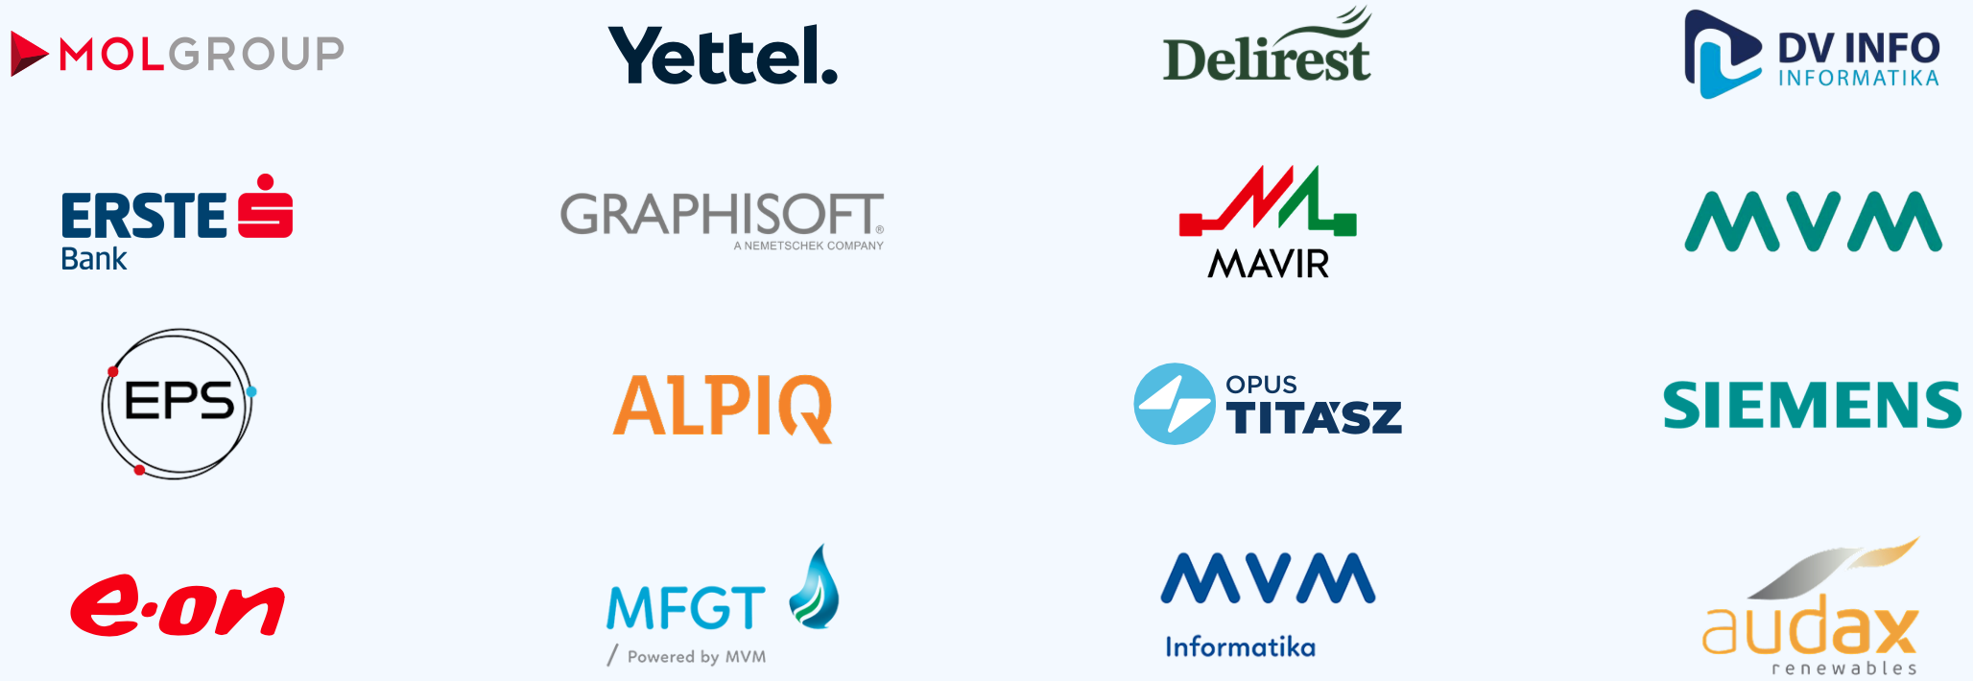
“Trustful, reliable partner with state-of-the-art knowledge.”
Michael Ohrstedt
Head of TMS Mainline Systems, Siemens
Trusted by Industry Leaders

Slide 20


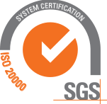

Ensuring reliability, safety, and trust in every solution we deliver.
Information Security &
Compliance at the Core
ISO 9001
ISO 27001
ISO 20000
Quality Management
Information Security Management
IT Service Management

Slide 21

Global Reach

Slide 22


“Astron Informatics is a stable and trusted partner, providing state-of-the-art IT solutions and deep industrial expertise.”
Summary
International project experience
25+ years of field experience
Top-trained software engineers
Long-term partnerships with global leaders such as Siemens, MOL, and Yettel
Ákos Kriston,
CEO, Hungarian Gas Storage Ltd.

Slide 23
Feel free to reach out!
ASTRON INFORMATICS Ltd.
H-1119 Budapest, Budafoki út 56.
www.astron.hu

