Slide 1

Agda formalisation of an elaborator for a language based on simply typed lambda calculus
Zahorán Barnabás
Supervisor:
Kaposi Ambrus
Budapest, 2024

Slide 2
Research goals
Elaborator formalisation
Translating strings to an algebraic description (QIIT) of simply typed λ-calculus
Both the models and translation to be
correct-by-construction
Implement a framework that is transparent and easy to use for educational or future research purposes

Slide 3
Methods
Agda – programming language and theorem prover based on Intuitionistic type theory
Dependent types – first order statements and proofs by Curry-Howard isomorphism
Totality – termination of functions is guaranteed, no unhandled cases or runtime exceptions
agdarsec – parser combinator library
Bidirectional type checking – inference and checking rules

Slide 4
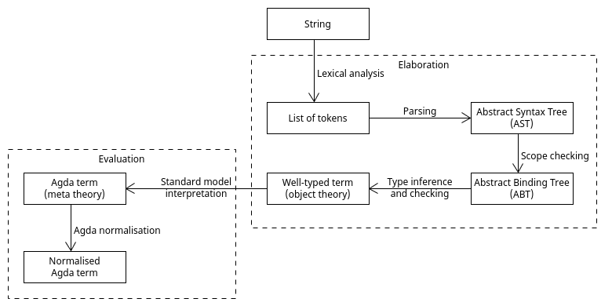
Levels of Abstraction

Slide 5
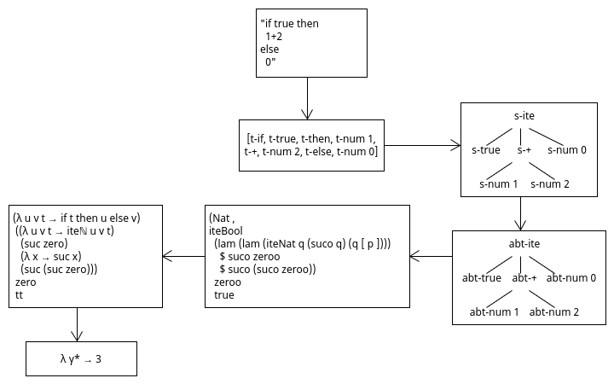
Elaboration example

Slide 6
Implementation
ABT cannot be badly scoped, well-typed terms cannot be badly typed by definition, e.g.:
data ABT (n : ℕ) : Set where
abt-var : Fin n → ABT n
elaborate function returns each level of abstraction until evaluation result or error
compile and eval only return well-typed terms and standard model interpretations
Errors are signaled to the user:
syntax-error, scope-error, type-error

Slide 7
Results
Easy to use framework had been implemented
Modular
Lexer.agda, Parser.agda, Scopecheck.agda, etc.
Extendable
e.g.: new built-in operations _-_, _*_
Performance could be improved in the future
(implicit argument instancing)
Tests and examples in the public repository

