Slide 1
Digital Access in Indian Schools – An Analytical Report
Insights from UDISE 2020-21 Data

Slide 2
Dataset Overview
- 37 Rows, 16 Columns
- 1 Categorical Column (India/State/UT)
- 15 Numerical Columns (School Counts, Percentages)
- No Missing Values
- Focus: Availability of Computer Facilities in Indian Schools

Slide 3
School Classification
- Government Schools
- Government-Aided Schools
- Private Unaided Schools
- Other Schools
Key Data Points:
- Total Number of Schools
- Number of Schools with Computer Facilities
- Percentage of Schools with Computer Facilities

Slide 4
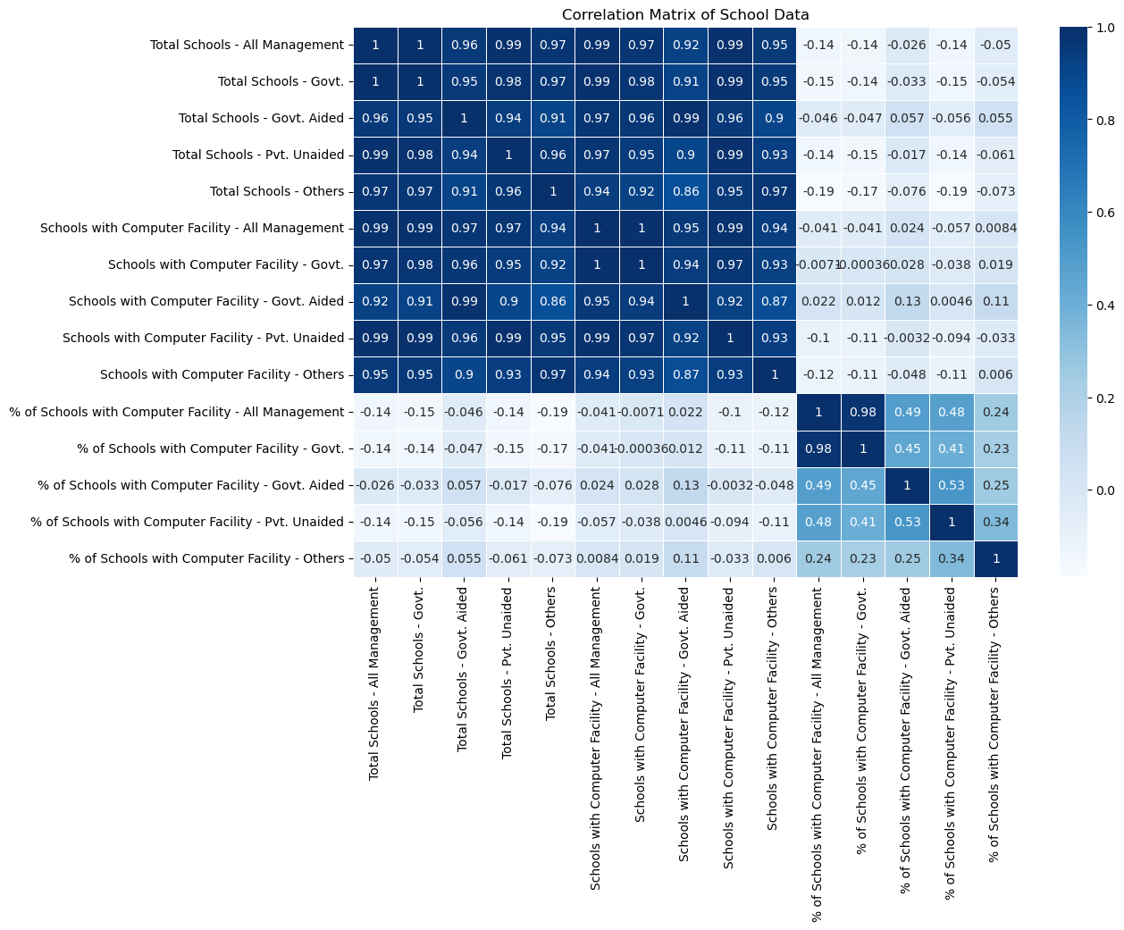
The correlation matrix based on the School Data of Digital Access

Slide 5
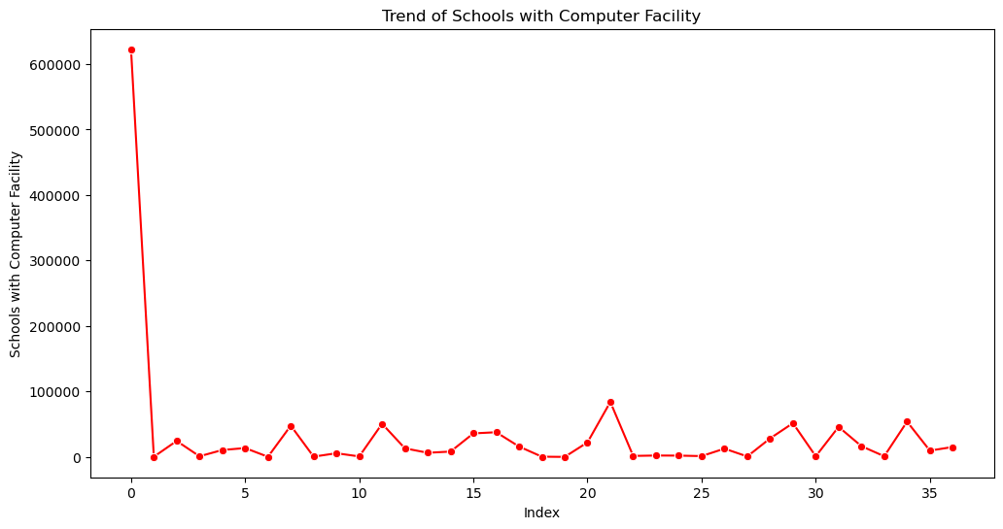
The line Plot is based on the Schools With Computer Availability

Slide 6
Key Statistics
- Total Schools (All Management):
- Range: 45 to 1,509,136
- Average: 81,575 per state
- Schools with Computer Facilities:
- Range: 45 to 622,575
- Average: 33,652 per state
- % of Schools with Computer Facilities:
- Range: 14.49% to 100%
- Average: 53.9%

Slide 7
Management-Type Insights
- Government Schools:
- Computer Availability: 46.8% (Below Average)
- Private Unaided Schools:
- Highest Adoption Rate: 73.96%
- Other Schools:
- Computer Availability: 39.5% (Lowest Rate)

Slide 8
Regional Variations
- High Access States:
- 100% Computer Availability in Some States
- Low Access States:
- Below 15% in Certain Regions
- Urban vs. Rural:
- Urban Areas: Better Infrastructure, Higher Digital Access

Slide 9
Trend Insights
- Digital Divide:
- Government and Rural Schools Lag Behind
- Private Schools:
- Significantly Better Equipped

Slide 10
Policy Implications
- Need for Digital Interventions:
- Target Government and Rural Schools
- Equity in Education:
- Bridge the Digital Divide for Inclusive Growth

Slide 11
Conclusion
- Summary:
- Significant Disparities in Computer Access
- Urgent Need for Policy Action to Ensure Digital Equity
- Next Steps:
- Data-Driven Decision-Making for Future Policy

