Slide 1
BRDF estimator for small-scale geometry

Slide 2

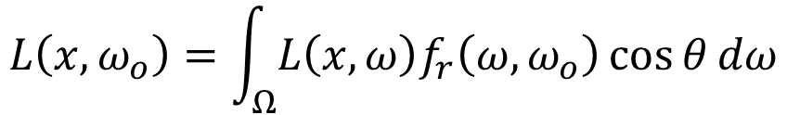
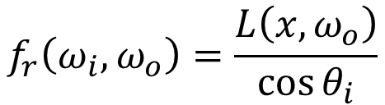

BRDF estimation
$$L\left(x,ω_{o}\right)=\int_{Ω}{L\left(x,ω\right)f_{r}\left(ω,ω_{o}\right)\cos{θ}dω}$$
$$L\left(x,ω\right)=δ(ω−ω_{i})$$
$$L\left(x,ω_{o}\right)=\int_{Ω}{L\left(x,ω\right)f_{r}\left(ω,ω_{o}\right)\cos{θ}dω}=\int_{Ω}{δ\left(ω−ω_{i}\right)f_{r}\left(ω,ω_{o}\right)\cos{θ}dω}$$
$$=f_{r}\left(ω_{i},ω_{o}\right)\cos{θ_{i}}$$
$$f_{r}\left(ω_{i},ω_{o}\right)=\frac{L\left(x,ω_{o}\right)}{\cos{θ_{i}}}$$

Slide 3


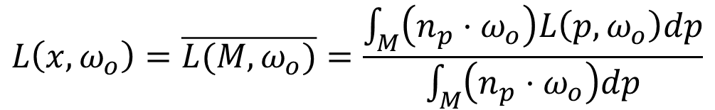



BRDF estimation
$$L\left(x,ω_{o}\right)=\overline{L(M,ω_{o})}=\frac{\int_{M}{\left(n_{p}⋅ω_{o}\right)L\left(p,ω_{o}\right)dp}}{\int_{M}{\left(n_{p}⋅ω_{o}\right)dp}}$$
$$\left(n_{p}⋅ω_{o}\right)=\max{(n_{p}⋅ω_{o},0)}$$
$$\int_{M}{\left(n_{p}⋅ω_{o}\right)L\left(p,ω_{o}\right)dp}=\int_{M}{\left(n_{p}⋅ω_{o}\right)dp\int_{Ω}{L\left(p,ω\right)f_{r}\left(ω,ω_{o}\right)\cos{θ}dω}}$$
$$ω_{o}$$
$$n_{p}$$
$$p$$
$$M$$

Slide 4
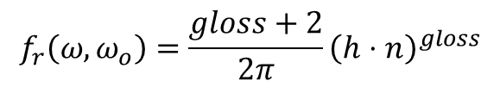
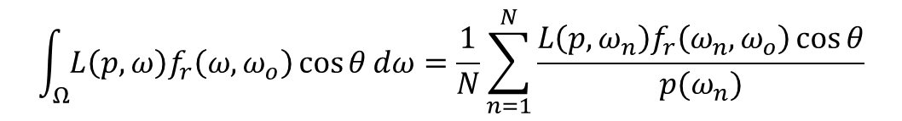


BRDF estimation
$$\int_{Ω}{L\left(p,ω\right)f_{r}\left(ω,ω_{o}\right)\cos{θ}dω}=\frac{1}{N}\sum_{n=1}^{N}{\frac{L\left(p,ω_{n}\right)f_{r}\left(ω_{n},ω_{o}\right)\cos{θ}}{p(ω_{n})}}$$
$$f_{r}\left(ω, ω_{o}\right)=\frac{gloss+2}{2π}{\left(h⋅n\right)}^{gloss}$$
$gloss$を十分大きくとることでspecularを近似
微小表面がマイクロ顕微鏡で見えないレベルの固有の粗さがあると仮定
[Yan et al. SIGGRAPH 2014]と同様
$p(ω_{n})∝f_{r}(ω,ω_{o})$でサンプリング

Slide 5



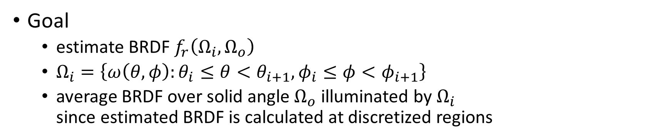



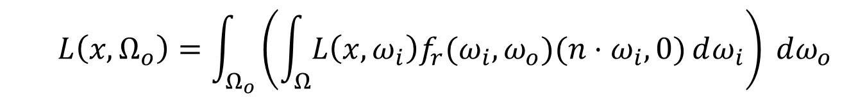


BRDF estimator from small-scale geometry
$$ω=\left(\begin{matrix}\cos{φ}\sin{θ} \\ \cos{θ} \\ \sin{φ}\sin{θ}\end{matrix}\right)$$
Goal
estimate BRDF $f_{r}\left(Ω_{i},Ω_{o}\right)$
$Ω_{i}=\left\{ω\left(θ,φ\right):θ_{i}≤θ<θ_{i+1}, φ_{i}≤φ<φ_{i+1}\right\}$
average BRDF over solid angle $Ω_{o}$ illuminated by $Ω_{i}$ since estimated BRDF is calculated at discretized regions
$$Y$$
$$Ω_{i}$$
$$Ω_{o}$$
$$θ$$
$$X$$
$$φ$$
$$Z$$
$$L\left(x,Ω_{o}\right)=\int_{Ω_{o}}{\left(\int_{Ω}{L\left(x,ω_{i}\right)f_{r}(ω_{i},ω_{o})(n⋅ω_{i},0)}dω_{i}\right) }dω_{o}$$

Slide 6
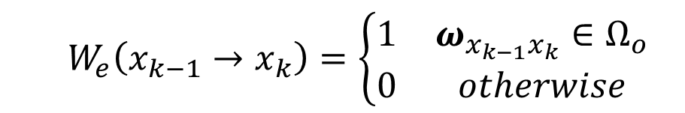

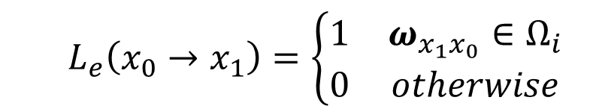

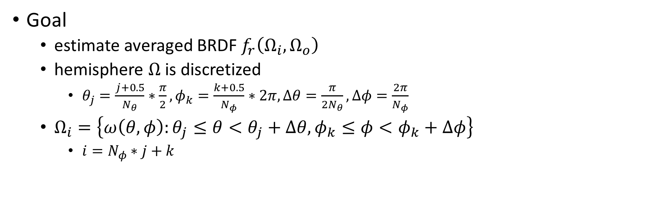



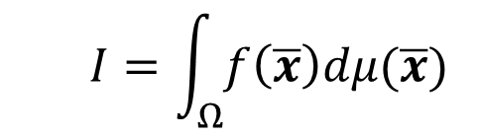


BRDF estimator from small-scale geometry
$$ω=\left(\begin{matrix}\cos{φ}\sin{θ} \\ \cos{θ} \\ \sin{φ}\sin{θ}\end{matrix}\right)$$
Goal
estimate averaged BRDF $f_{r}\left(Ω_{i},Ω_{o}\right)$
hemisphere $Ω$is discretized
$θ_{j}=\frac{j+0.5}{N_{θ}}∗\frac{π}{2}, φ_{k}=\frac{k+0.5}{N_{φ}}∗2π, Δθ=\frac{π}{2N_{θ}},Δφ=\frac{2π}{N_{φ}}$
$Ω_{i}=\left\{ω\left(θ,φ\right):θ_{j}≤θ<θ_{j}+Δθ, φ_{k}≤φ<φ_{k}+Δφ\right\}$
$i=N_{φ}∗j+k$
$$Y$$
$$Ω_{i}$$
$$Ω_{o}$$
$$θ$$
$$X$$
$$φ$$
$$Z$$
$$I=\int_{Ω}{f\left(\overline{x}\right)dμ(\overline{x})}$$
$$x_{0}$$
$$L_{e}$$
$$W_{e}$$
$$x_{4}$$
$$L_{e}\left(x_{0}→x_{1}\right)=\left\{\begin{matrix}1 & ω_{x_{1}x_{0}}∈Ω_{i} \\ 0 & otherwise\end{matrix}\right.$$
$$x_{2}$$
$$W_{e}\left(x_{k−1}→x_{k}\right)=\left\{\begin{matrix}1 & ω_{x_{k−1}x_{k}}∈Ω_{o} \\ 0 & otherwise\end{matrix}\right.$$
$$x_{1}$$
$$x_{3}$$

Slide 7
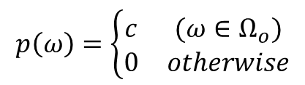
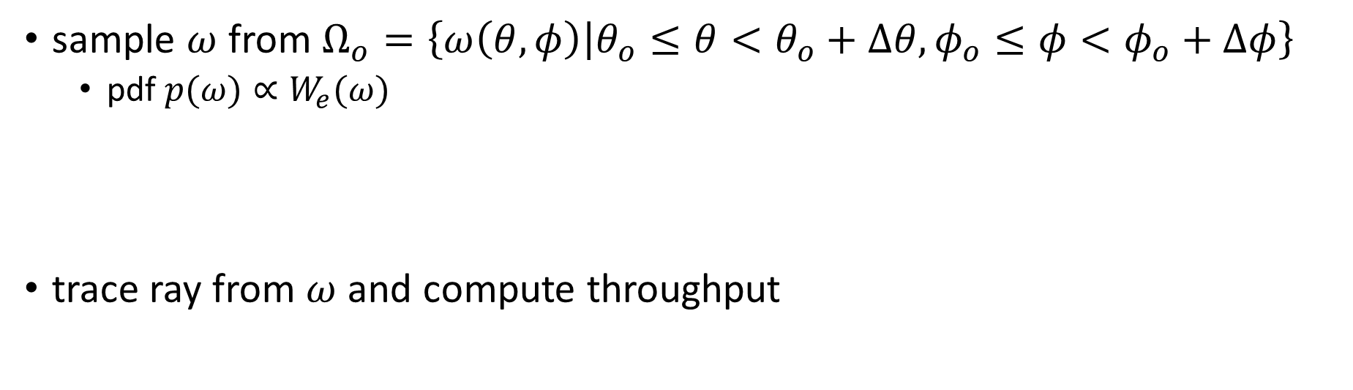

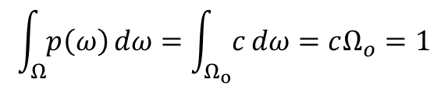
BRDF estimator from small-scale geometry
sample $ω$ from $Ω_{o}=\left\{ω\left(θ,φ\right) | θ_{o}≤θ<θ_{o}+Δθ,φ_{o}≤φ<φ_{o}+Δφ\right\}$
pdf $p(ω)∝W_{e}(ω)$
trace ray from $ω$ and compute throughput
$$p(ω)=\left\{\begin{matrix}\frac{1}{Ω_{o}} & (ω∈Ω_{o}) \\ 0 & otherwise\end{matrix}\right.$$
$$p\left(ω\right)=\left\{\begin{matrix}c & (ω∈Ω_{o}) \\ 0 & otherwise\end{matrix}\right.$$
$$\int_{Ω}{p\left(ω\right)}dω=\int_{Ω_{o}}{c}dω=cΩ_{o}=1$$

Slide 8
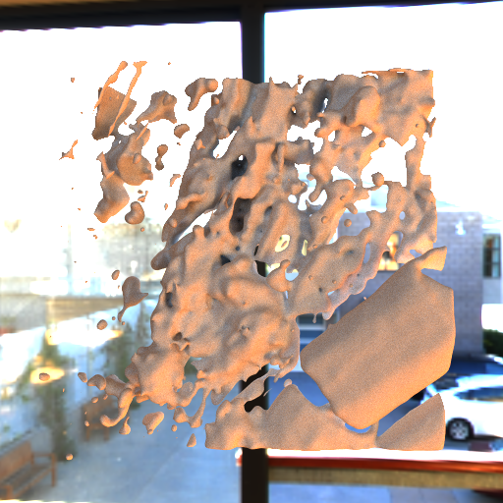
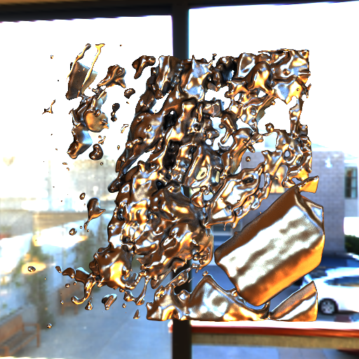
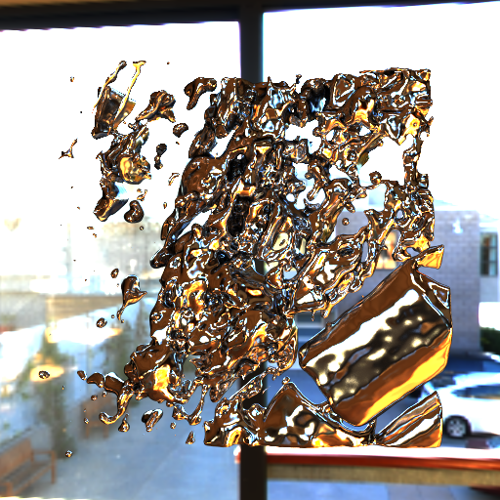
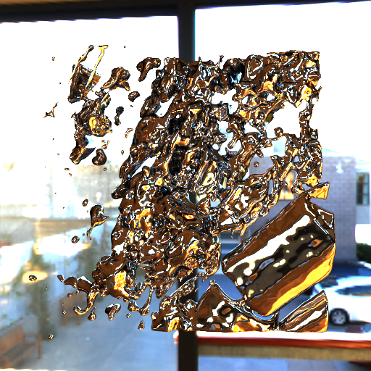
実験2015/10/01
Carrot/GF_01.obj
メッシュを反転

Slide 9
実験2015/10/02
BRDFestimatorの実装・デバッグ

Slide 10
実験2015/10/05

Slide 11
実験2015/10/07
BRDF推定実験
対象物体 平面

Slide 12
実験2015/10/08
Visualize estimated BRDF
render sphere using estimated BRDF under envmap
easiest way to visualize BRDF
TODO : incorporate estimated BRDF into renderer

