Slide 1
Capstone Project
Beer Recommender System
Vishwas Singh
PGP-Data Science, March 2017

Slide 2
Data Collection – Scrapy
We’ve used web scraping tool- Scrapy, a python based web-crawling tool to collect(scrape) the data from the ratebeer.com
We’ve collected the two separate dataset i.e. Beer Information data and Beer Review data.
There are about 1200 beer information collected along with 250,000 reviews.
These scraped data belongs to top 20 beers from each states of U.S.
The dataset contains the other information such as user name & address, overall ratings, beer aroma, beer description, breweries information, weighted average, estimated calories, appearance, taste etc.

Slide 3
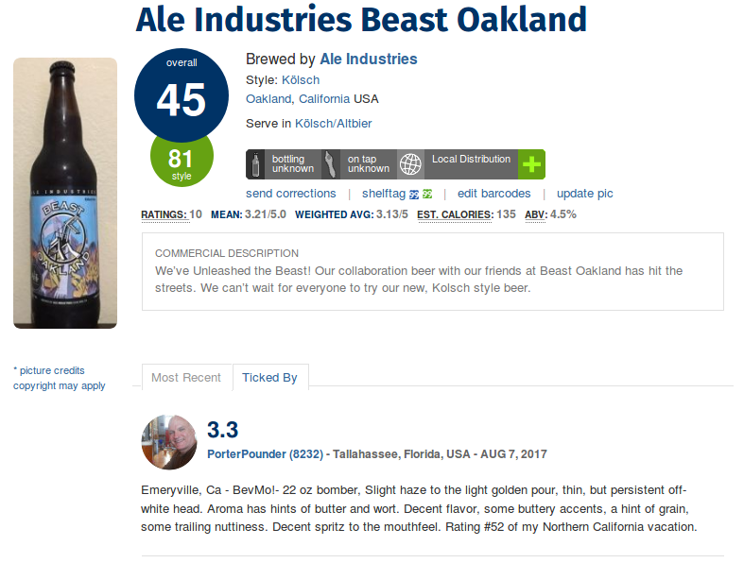

Slide 4
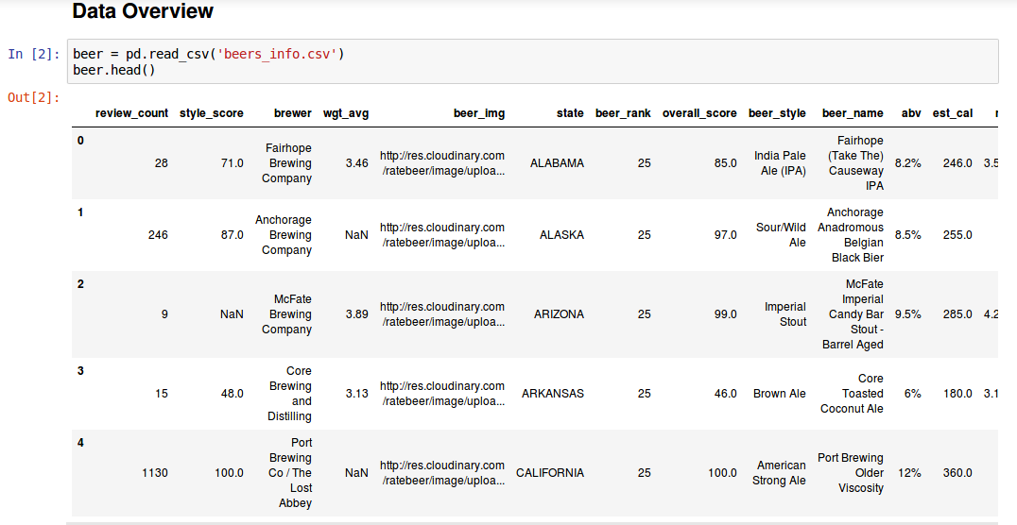

Slide 5
Data-Cleaning
We cleaned datasets column-wise by checking the missing value and then either removing them from the dataset or imputing the other value obtained from the mean of the data(Numerical Columns).
For the review dataset we’ve removed the review column from the dataset to do the missing value imputation, and performed text cleaning separately for review content. (Under Process)
This will generate list of words corresponding to beer name. (under process).

Slide 6
Next Steps
Performing the EDA
Applying the NLP over the dataset
Making an recommender system on two models i.e. Content based and collaborative filtering.

