Slide 1
Configuration & Release Management Process for SDM Pharmacy System

Slide 2
Agenda
  Introduction
  Tools Usage
    Process
    Jenkins Continuous Integration Tool
    WebSphere Code Deployment Tool
    Mercurial Version Management Tool
    Kdiff3 Code Merging Tool
    Sonar Code Quality Tool
  Configuration Management Process
  Automated Code Deployment Process
  Release Management Process
  Key Roles & Responsibilities
  Best Practices / Lessons Learnt
  Challenges Faced

Slide 3

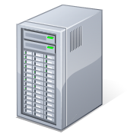


Tools Usage
Read / Pull
Commit Code Changes
Tomcat
2
1
Eclipse (IDE)
Mercurial
(Configure Jobs in Jenkins, Build Jobs, Schedule Automated Builds)
(Code Repository)
Code
Merge
Jenkins
External Plugins
KDiff3
Continuous Integration Server
Maven
(Build)
Uses
3
4
Uses
Mercurial
(Code Pull)
Corbertura
(Execute Junit & Publish Code Coverage report)
Deploy EAR to WAS
Sonar
6
(Run Code Quality Checks using FindBugs,CheckStyle and JavaPMD, Compute & Publish Code Quality Metrics)
5
Sonar DB
(My SQL)
WAS 8.5
Read / Write
Application Deployed using RPM
Pilot Store

Slide 4
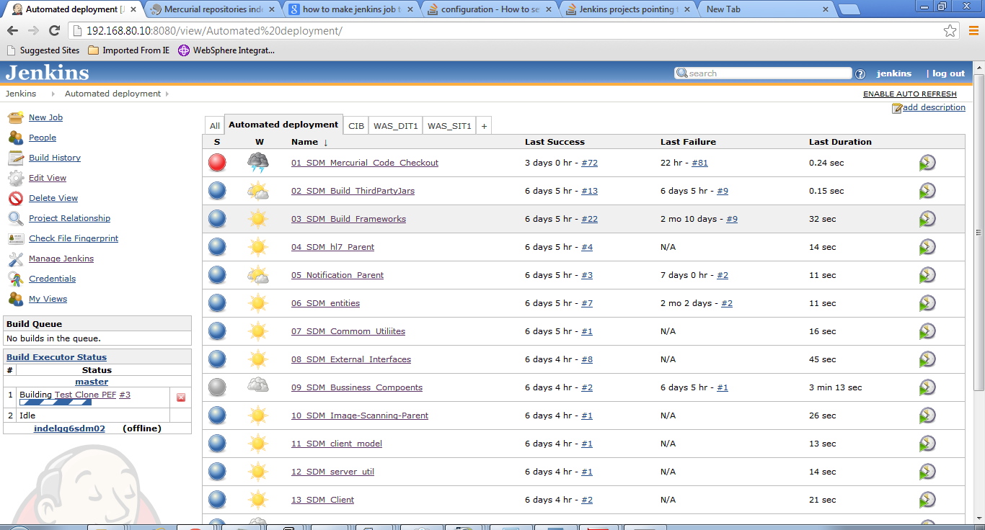
Tools Usage.....Contd...
Jenkins : Continuous Integraion Tool
Jenkins : Continuous Integraion Tool

Slide 5
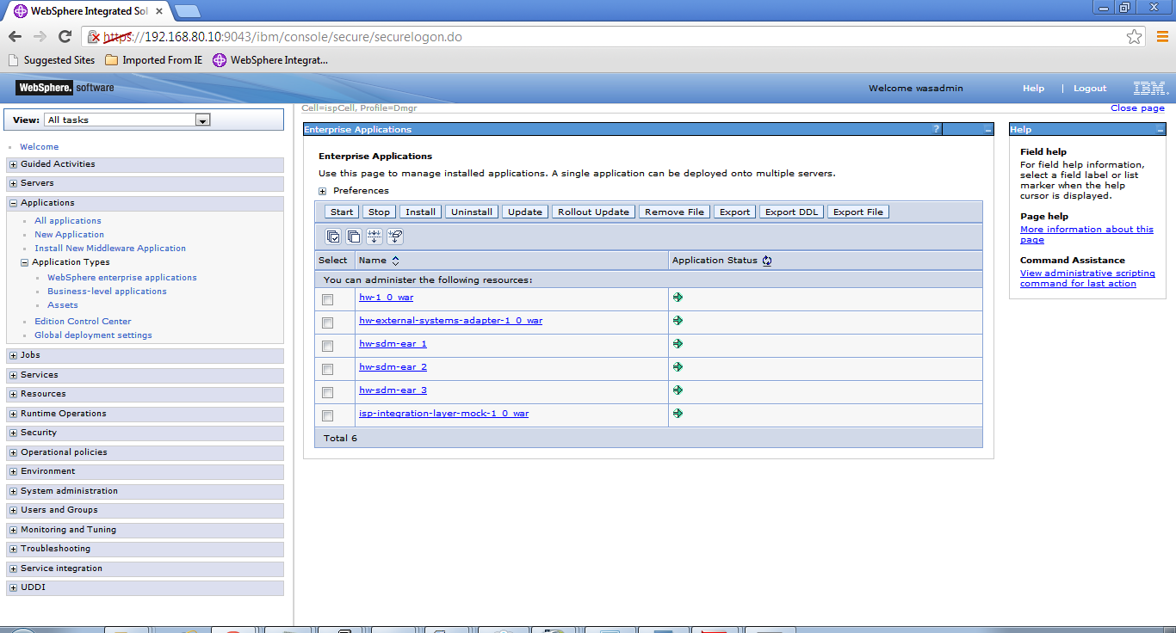
Tools Usage.....Contd...
WebSphere Application Server: Deployment tool

Slide 6
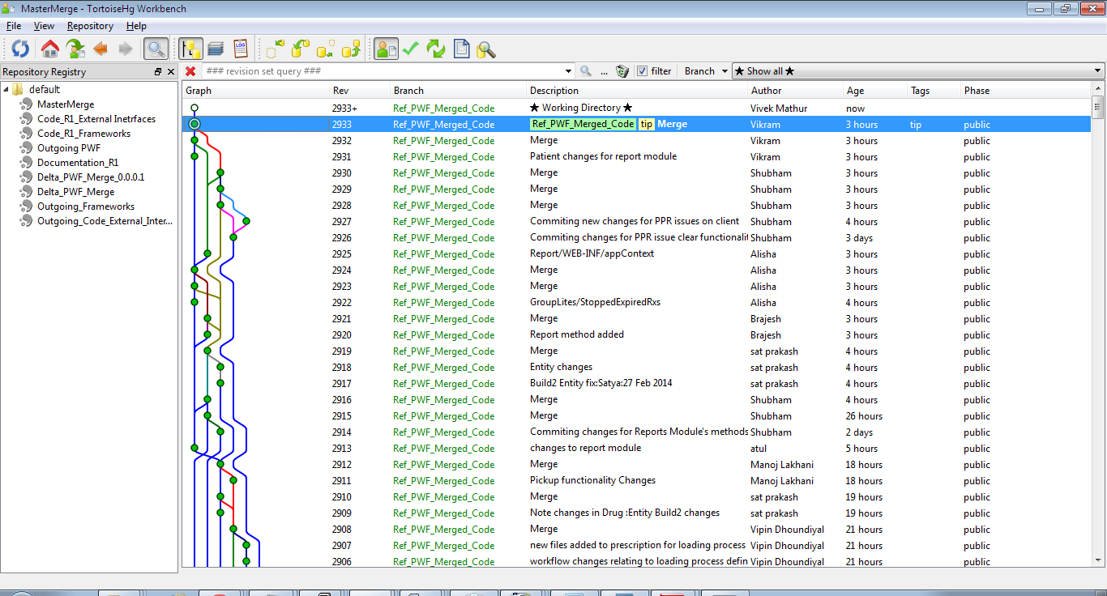
Tools Usage.....Contd...
Mercurial : Version Control Tool

Slide 7
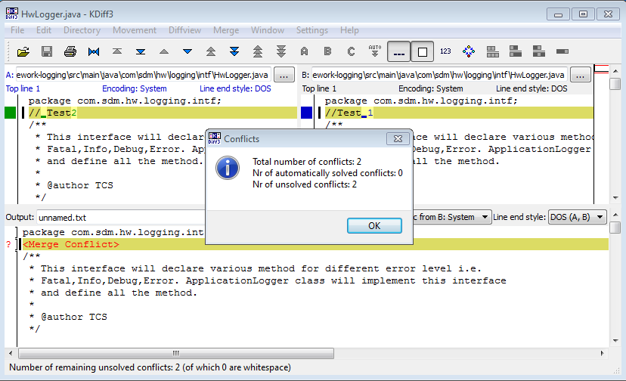
Tools Usage.....Contd...
KDiff3 : Code Merging Tool

Slide 8
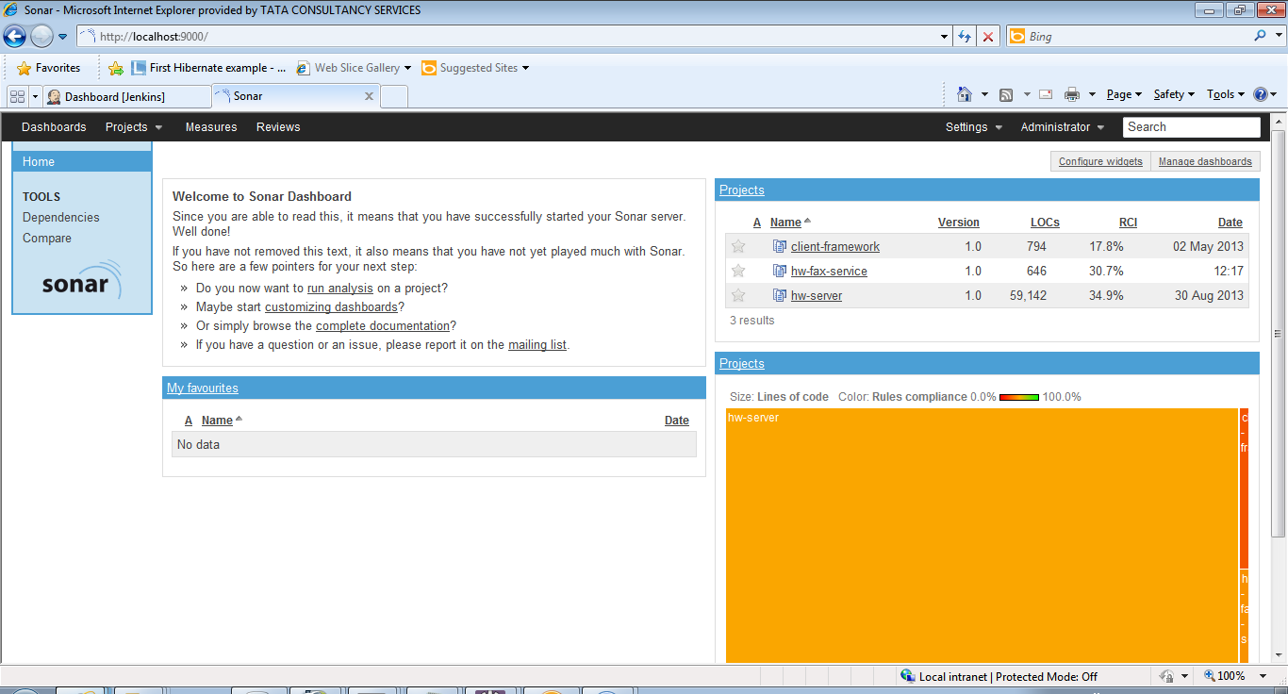
Tools Usage.....Contd...
Sonar : Code Quality Tool

Slide 9
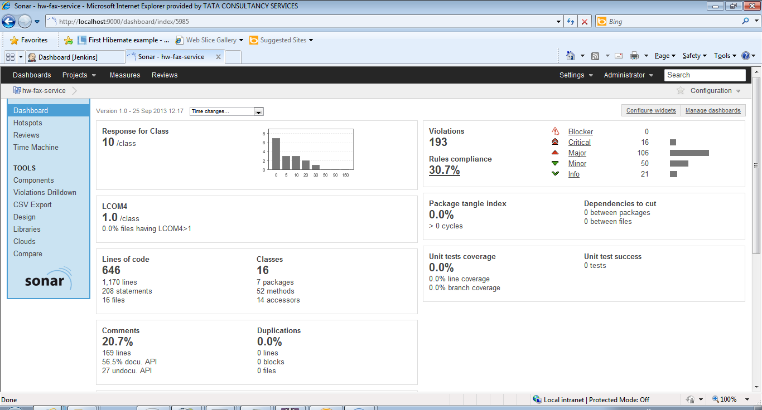
Tools Usage.....Contd...

Slide 10
Configuration Management Process
Code Checkout
Mercurial repository
Synchronize
Pull
Update
Local workspace
Code Checkin
Local workspace
Commit
Push
Mercurial repository

Slide 11
Configuration Management Process…..Contd…
Java Source Code Merge Strategy:
R1.0_Temp_Branch created from R2 main branch.
R1.0.0 Tag Code Merged to R1.0_Temp Branch
Conflicts Resolved by Dev Team
Final Code Deployed to WAS Environments using Jenkins
Automated Sanity Suite ran on the merged code by EQA
Code Certified by EQA
Lock taken on R2 Branch
R1_Temp_Branch Code merged finally with R1 Branch
Code Merging/Conflict Resolution Strategy
[ Tag Detta_Frameworks_1.0.0 ]
Delta_Frameworks_1.0_Temp Branch
Delta_1.0_Temp_Branch Created
Temp branch code merged to R1 Main Branch
Release 1.0 Construction Branch

Slide 12
Configuration Management Process…..Contd…
Code Packaging
WAR 1
WAR 2
WAR 3
[ Bundling WARs into EAR ]
EAR
WAR 4
WAR 5

Slide 13
  Automated Code Deployment Process
Mercurial
Jenkins
WebSphere
Application Server
Code Checkout
Code Build & create EAR
Code Deploy

Slide 14
Release Management Process
  Code is checked out from Main Branch to local machine
  Code is build in local machine
  Code deployed to Offshore DIT WebSphere environment
  Sanity performed on the deployed code
  If Sanity Passes, then code is committed & Pushed to Customer Outgoing Repository
  Code is again built from Outgoing Repository & deployed on WAS box
  If Sanity passes, then respective Tag from various repositories are created.
  SDM Build Book: All the configuration changes are documented in the build book with screenshots.
  Release Notes: Release Note comprises of details of Defects, CRs, Installation/Configuration Steps. Mercurial Tag Details.
  Release Manager send a mail to all concerned stakeholders about the code drop along with the screenshot of Tags from various modules Frameworks, PWF, External Interfaces, DB etc.

Slide 15
Key Roles & Responsibilities
Roles | Responsibilities
Release Manager | Handles the overall release management process. Manage release scheduling. Manage release packages Approve/reject any change request regarding code deployment in Production Environments.
Build Engineers | Create executable install packages (.ear/.war etc.) Validate the build package.

Slide 16
  Best Practices / Lessons Learnt
  For any defect fixing/CR, we are creating a temporary branch and provide access to the concerned team. This way the main branch development doesn’t get halted.
  Conflict Resolution: Creation of temp branch and performing the code merging & conflict resolution helps in the quick turnaround of conflicts and also minimize downtime of main repository & environments.
  Use of automated deployment script in WebSphere had reduced the manual deployment effort of 45 – 50min drastically to just 15min.
  We have created template with Server, Repository, DB details and send it to all associates in ODC whenever we have to perform a deployment. This helps in advanced intimation to the team and team can plan their work accordingly.

Slide 17
  Challenges Faced
  Multiple code push at one point in time is a big challenge in Mercurial. If one associate is pushing his code & other person tries to push the code at same time, then other folk will get abort error.
  Multiple Instance of WebSphere. As the onsite & Offshore Linux server box configuration are not same thus we are facing lot of challenges in creating new instance of WebSphere on the linux box.

Slide 18
Thank You

