Slide 1
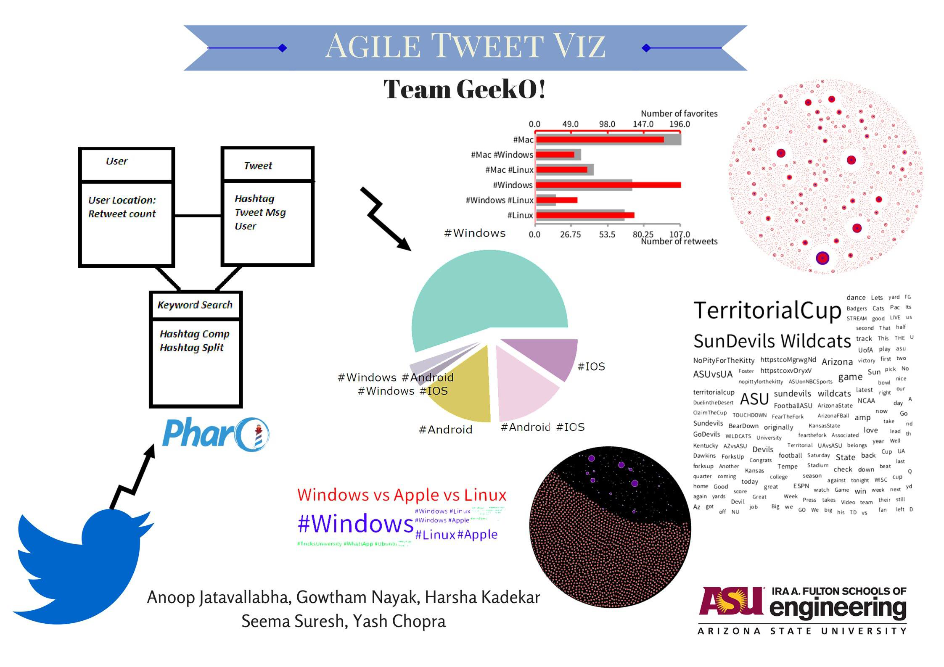
Agile TweetViz Team GeekO
Anoop Jatavallabha
Gowtham Nayak
Harsha Kadekar
Seema Suresh
Yash Chopra

Slide 2
Initial understanding of Requirements
Visualization should be the focus of the application
Initially data should be analyzed considering few hundred tweets only
Any programming language can be used for visualization. (Pharo and Roassal preferred)
It’s a static application (tweets need not be updated periodically)
Analyzing tweets that focuses on software review is suggested.
Application and data storage should be simple i.e. Tweets can be saved in .XML or .CSV format, but the focus should be on visualization of this data.

Slide 3
Assumed Requirements
Fetching data using hashtags.
User input hashtags.
Exploring additional hashtags for fetched tweet
Initially 100 tweets used to analyze data, final tweet count could be any number
Visualized tweets on the basis of
Similarity of tweets
Interconnected hashtags.
Hashtags on the basis of its frequency.
User and his tweets while connecting them.

Slide 4
Positive Agile Effects
Positive
Work load was distributed uniformly with respect to time and among group members.
Lack of initial requirements did not hinder the starting of project, requirements were modified as required.
User stories representation got better over time.
Taiga helped to keep track efficiently.

Slide 5
Negative Agile Effects
Negative
Contrary to agile process, assigning 1 user story to a team member was simpler than assigning tasks from each user story.
Lack of initial requirements did not hinder the starting of project but modified requirements gave the project a different look than initial vision.

Slide 6
Future work
Dynamic flow of application.
Unable to visualize the trends of tweets based on emotions.
Unable to visualize a timeline based tweets.

Slide 7
Conclusion
Continuous learning process -
Introduced to smalltalk
Worked on an agile environment
Learning experience - Requirements Management and Process Management

