Slide 1


DEEP LEARNING FOR COMPUTER VISION
Week11
Dr. Tuchsanai. PloySuwan

Slide 2
https://medium.com/mlearning-ai/semantic-segmentation-with-pytorch-u-net-from-scratch-502d6565910a
https://medium.com/@Chinmay_Paranjape/satellite-imagery-segmentation-using-u-net-4ec7f265ddbe

Slide 3
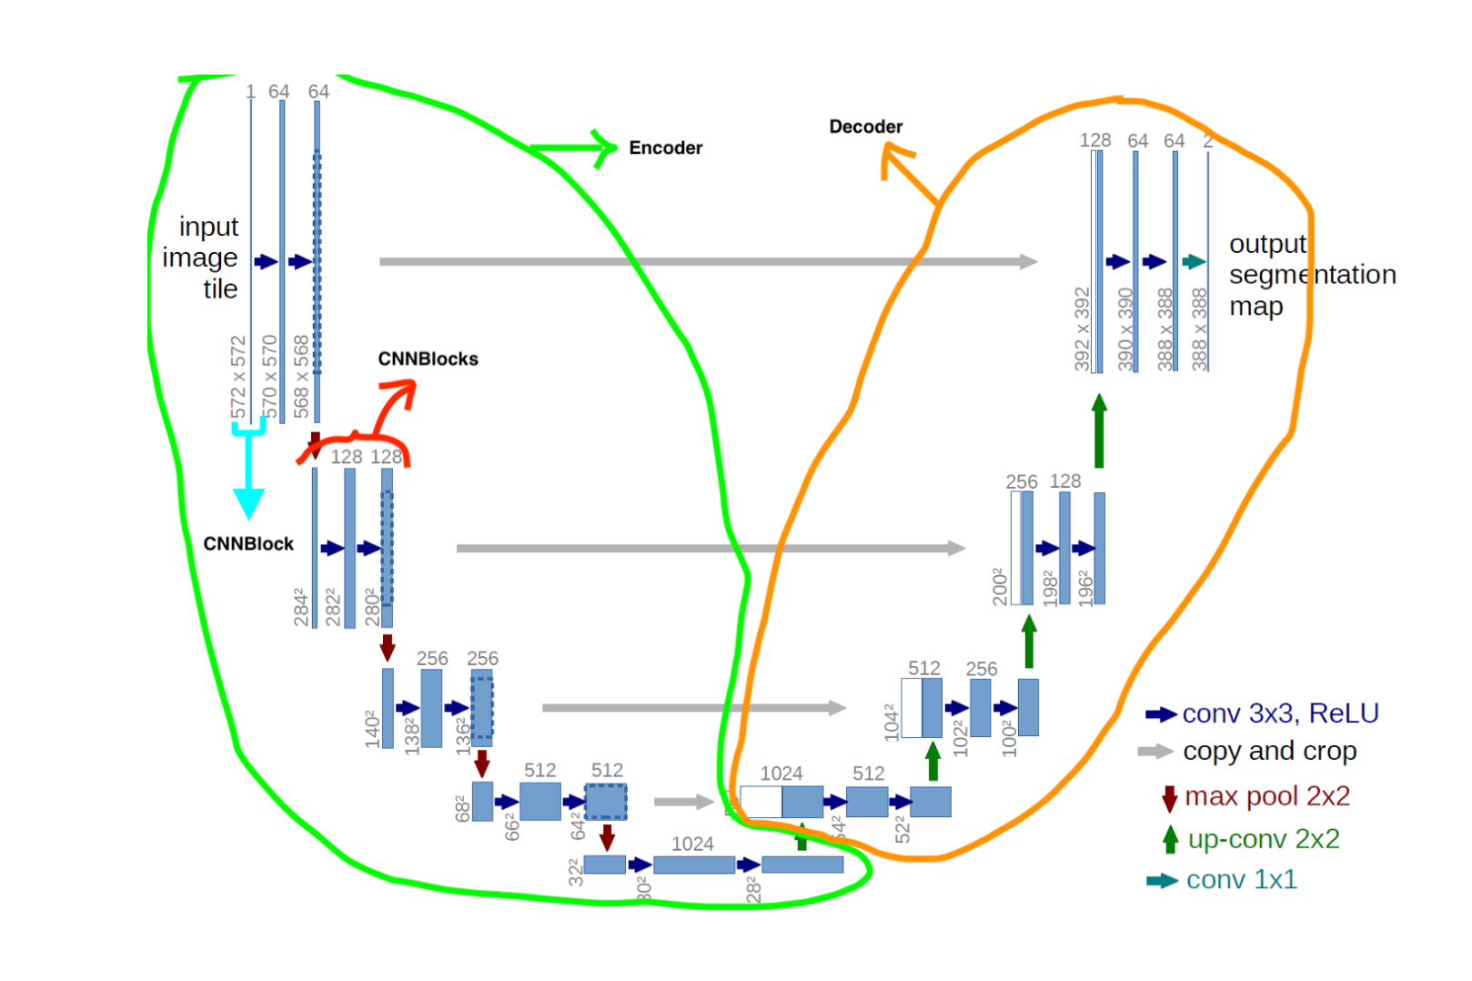

Slide 4
