Slide 1
SMART TRAFFIC MANAGEMENT SYSTEM
Mentor Name :-
Presented By :-
-Mrs. B.Praveena
(Assistant Professor - AI&DS)
- I.Seeni Mohamed (Final Year AI&DS)
- O.A.Mohamed Thoufiq (Final Year AI&DS)

Slide 2
Abstract
Urban traffic congestion has become a pressing issue, leading to increased travel time, fuel consumption, and environmental pollution. Traditional traffic management systems, based on fixed signal timings, often fail to adapt to real-time traffic conditions, resulting in inefficiencies and road safety concerns. This project presents a Smart Traffic Management System designed to simulate and optimize traffic flow using Python and modules such as pygame, threading, time, random, and os.
The system emulates a multi-lane intersection where vehicles and traffic lights are dynamically managed within a graphical environment. By using multithreading, the simulation ensures real-time responsiveness, allowing traffic lights to adapt their timing based on vehicle density. Randomized vehicle generation and dynamic signal control enhance the realism of the model, making it suitable for analyzing various traffic conditions.

Slide 3
Objective
The primary objective of this project is to design and develop a simulated Smart Traffic Management System that dynamically manages urban traffic conditions to improve flow efficiency, reduce congestion, and enhance road safety. The system aims to emulate real-time traffic behavior and adapt signal timings using Python-based modules.
This simulation will be built using Python programming language, integrating multiple modules such as pygame for graphical rendering, time and threading for real-time control, and random for simulating unpredictable traffic behavior

Slide 4
Problem Statement
Urban traffic congestion has become a critical issue in modern cities, leading to increased travel time, fuel consumption, air pollution, and road rage. Traditional traffic control systems, especially those using fixed-time signals, are not responsive to real-time changes in traffic flow. These systems fail to adapt to varying vehicle densities, peak-hour surges, or unexpected events, resulting in inefficiencies and driver frustration.
Additionally, current infrastructure-based adaptive systems are expensive to implement and maintain, limiting their use in developing regions. There is a pressing need for a cost-effective, scalable, and intelligent traffic management solution that can simulate real-world conditions and optimize traffic signal operations dynamically.

Slide 5
Literature Survey
Author | Title | Description | Merits | Demerits
Smith, J. (2020) | A Study on Traffic Light Management Systems | Analyzed traditional traffic light systems and proposed the need for adaptive control. | Identified inefficiencies in fixed-timed systems. | No practical simulation or real-time system implementation.
Li, K. et al. (2021) | Real-Time Traffic Management Using Machine Learning | Developed a machine learning model for dynamic traffic signal control. | Accurate predictions and real-time adjustments. | High computational cost and data complexity.
Gupta, R. (2022) | Simulation-Based Traffic Flow Optimization | Created a traffic signal simulation using custom models and logic. | Showed potential for simulation-based traffic optimization. | Lacked support for pedestrian traffic and multithreading.
Kumar, P. & Rao, A. (2019) | An Adaptive Traffic Light System Using Sensor Inputs | Used vehicle sensors to dynamically adjust traffic light durations. | Real-world integration potential with IoT sensors. | Hardware-dependent; limited user interface and expandability.

Slide 6
Existing Methodology
Traditional Traffic Management Approaches :-
1. Fixed-Time Traffic Signal Control:
Traffic lights operate on pre-set time intervals regardless of actual traffic conditions.
Example: Green light remains on for 60 seconds even if there are no vehicles.
Limitations:
Inefficient during off-peak hours.
Causes unnecessary waiting and congestion.
2. Manually Controlled Traffic Systems:
Traffic police or control room operators manually adjust signals based on observation.
Often used during special events, emergencies, or peak hours.
Limitations:
Labor-intensive and prone to human error.
Not scalable or consistent across large networks.

Slide 7
Existing Methodology
3. Sensor-Based Actuated Signals:
Use sensors (inductive loops, infrared, etc.) embedded in the road to detect vehicles.
Traffic lights change based on vehicle presence and queue length.
Limitations:
High installation and maintenance cost.
Limited flexibility in adapting to rapidly changing traffic patterns.
4. CCTV-Based Monitoring and Control:
Surveillance systems provide real-time video feeds to control centers.
Human operators monitor traffic and adjust signals as needed.
Limitations:
Delayed response due to human decision-making.
Not automated or data-driven.

Slide 8
Proposed Methodology
Proposed Smart Traffic Management System : -
The proposed system is a Python-based traffic simulation environment designed to intelligently manage traffic flow using adaptive signal control. Unlike traditional systems, this simulation is dynamic, modular, and event-driven, aiming to model realistic urban traffic behavior and demonstrate how smart signal control can reduce congestion and improve road safety.
1,Traffic Simulation Engine (Using pygame)
Simulates a grid-based intersection with multiple lanes.
Animates real-time vehicle movement and pedestrian crossings.
Visually represents traffic lights, vehicle positions, and flow directions.

Slide 9
Proposed Methodology
2,Adaptive Signal Control Algorithm
Dynamically adjusts signal timings based on simulated traffic density.
Uses logic to prioritize high-traffic lanes and prevent bottlenecks.
Adapts light durations (green/yellow/red) in each cycle to optimize flow.
3,Real-Time Multithreaded Control (Using threading)
Ensures that vehicle movement, signal updates, and pedestrian actions run concurrently.
Prevents freezing or lagging in the simulation by separating logic threads.
Mimics real-world parallel traffic operations.

Slide 10
Proposed Methodology
4,Traffic Pattern Generator (Using random)
Introduces randomness in vehicle entry points, density, and timing.
Simulates rush hours, low-traffic conditions, and unexpected congestion.
Makes the simulation more realistic and suitable for stress-testing algorithms.

Slide 11
Feasibility Study
1. Technical Feasibility :
The project is technically feasible as it uses widely available and well-documented tools and technologies. The system is developed using Python and libraries such as pygame, threading, os, time, and random, which are lightweight, open-source, and suitable for real-time simulation and graphical modeling.
Simulation Engine: pygame provides a robust framework for rendering 2D simulations with animations.
Concurrency: threading allows for simultaneous vehicle movement and traffic light control, simulating real-time interaction.
Platform Compatibility: The system can be executed on any standard PC or laptop with Python installed, making it accessible and platform-independent.
2. Economic Feasibility :
The system is highly economical due to its reliance on free and open-source software components. There is no need for any expensive proprietary software or specialized hardware.
Software Costs: All tools used (Python and its modules) are free.

Slide 12
Feasibility Study
Hardware Requirements: Runs on low-to-mid specification computers; no need for high-end machines.
Development and Maintenance: Minimal cost involved as the development and testing can be carried out using existing infrastructure.
3. Operational Feasibility :
The project is operationally feasible and easy to run and maintain. The graphical interface provides a clear visualization of traffic flow and signal changes, making the system user-friendly and intuitive.
User Interaction: Basic interface allows the user to observe and analyze traffic behavior and signal adaptation.
Extensibility: The system is modular, enabling future updates such as pedestrian simulation, emergency vehicle priority, or real-time sensor input.
Reliability: Proper use of threading and modular code structure ensures the system is stable and performs well under different traffic scenarios.

Slide 13
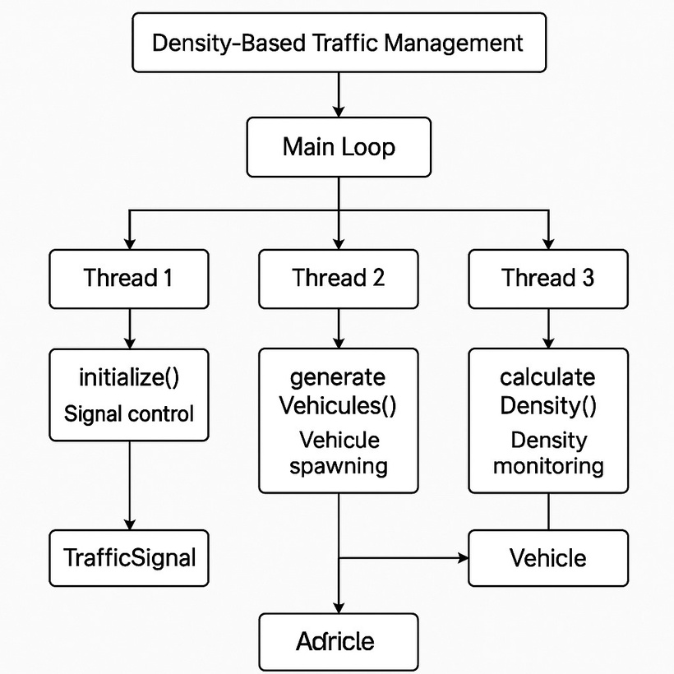
Architecture Diagram
Vehicle

Slide 14
Implementation - Modules
The Smart Traffic Management System is implemented using several core Python modules, each playing a specific role in simulating traffic flow and enabling adaptive control.
1. pygame — Graphical Simulation Interface
Purpose: Used to build and render the visual environment of the traffic system.
Functionality:
Draws roads, intersections, vehicles, and traffic lights.
Animates vehicle movements, signal changes, and pedestrian crossings.
Handles user events (e.g., closing the window or updating simulation).
Benefit: Provides a real-time, visual interface for testing and demonstrating the effectiveness of the traffic algorithm.

Slide 15
Implementation - Modules
2. os — System-Level Operations
Purpose: Manages low-level system operations and file handling (if needed).
Functionality:
Clears the terminal or console between frames (for debug output).
Handles file saving/loading for logs or configuration (optional).
Benefit: Supports backend operations that enhance user experience and debugging.
3. time — Timing and Synchronization
Purpose: Manages timing for traffic light changes, delays, and vehicle movement.
Functionality:
- Controls the duration of red, green, and yellow lights.
- Sets time intervals for vehicle movement steps.
- Synchronizes simulation speed with real-time.
Benefit: Provides realistic pacing and accurate simulation of signal cycles.

Slide 16
Implementation - Modules
4. random — Traffic Behavior Simulation
Purpose: Simulates unpredictability in vehicle arrival and pedestrian movement.
Functionality:
Randomizes vehicle generation at entry points.
Controls the timing of vehicle and pedestrian appearances.
Adds variability to simulate different traffic conditions (e.g., peak vs. off-peak).
Benefit: Makes the simulation dynamic and mimics real-world randomness.
5. threading — Concurrent Operations
Purpose: Allows multiple simulation processes to run simultaneously.
Functionality:
Runs vehicle movement and signal updates in parallel.
Prevents lag or blocking behavior in the simulation.
Enables smoother and more responsive real-time control.
Benefit: Mimics real-world concurrency — essential for modeling real-time systems.

Slide 17
Implementation - Paradigms
The Smart Traffic Management System is developed using multiple software paradigms that support modular, scalable, and real-time behavior. These paradigms ensure smooth interaction between components like traffic signals, vehicles, and pedestrian control systems.
1. Event-Driven Programming :
Definition: A paradigm where the flow of the program is determined by events such as user inputs, signal changes, or timers.
Application in Project:
Responds to simulation events like car arrivals, signal timeouts, and pedestrian requests.
Pygame’s event loop handles user interactions and real-time updates to the GUI.
Example:
If a car enters a lane, the system adjusts traffic signal logic based on vehicle presence.

Slide 18
Implementation - Paradigms
2. Concurrent Programming (Multithreading) :
Definition: Enables multiple processes or functions to run simultaneously, improving responsiveness.
Application in Project:
Threading module is used to run vehicle movement, signal updates, and pedestrian timers in parallel.
Prevents blocking of visual updates during background computations.
Example:
While one thread updates the traffic light, another manages ongoing car movement smoothly.
3. Procedural Programming :
Definition: A programming paradigm based on structured procedures or functions.
Application in Project:
Organizes simulation logic into reusable functions like move_vehicles(), change_signals(), generate_cars().
Keeps the code readable and modular.
Example:
A procedure handles the reset of the traffic light cycle after each simulation loop.

Slide 19
Implementation - Paradigms
4. Simulation Paradigm :
Definition: A technique to imitate real-world processes over time using virtual models.
Application in Project:
Simulates vehicle movement, signal operation, and traffic congestion behavior.
Creates a testbed for analyzing the effect of adaptive signal timing in controlled environments.
Example:
The system models different traffic conditions (e.g., rush hour, light traffic) to test performance.

Slide 20
Implementation - Algorithm
STEP 1: Initialize Environment
Import required modules: pygame, time, random, threading, and os.
Set up pygame window:
Define screen size (e.g., 800x600).
Set title (e.g., “Smart Traffic Management System”).
Create objects:
Intersections and lanes.
Vehicle and pedestrian classes.
Traffic signal objects for each direction (North, South, East, West).
Initialize default signal timing values:
Green time = 15 sec, Yellow = 3 sec, Red = 18 sec.
STEP 2: Simulate Traffic Inputs
Randomly generate vehicles:
Use random.randint() to decide how many vehicles enter each lane.
Assign each vehicle a type (e.g., car, bike, bus) and direction.
Add vehicles to respective lane queues.
Spawn new vehicles periodically:
Set a vehicle entry interval using time.sleep(random.uniform(0.5, 2)).

Slide 21
Implementation - Algorithm
STEP 3: Launch Threads for Real-Time Behavior
Start a thread for each of the following:
Traffic light signal control.
Vehicle movement update.
Pedestrian request handling (optional).
Purpose: Avoid blocking — each task runs independently.
STEP 4: Monitor Vehicle Density
For each lane:
Count number of vehicles waiting (len(lane_queue)).
Track how long the first vehicle has been waiting.
Calculate total density for each direction.
Store the density data for use in signal control.
STEP 5: Adaptive Signal Timing
Decide which direction to prioritize:
Compare lane densities.
Assign longer green time to the lane with the most vehicles.

Slide 22
Implementation - Algorithm
Signal logic:
If density is high:
green_time = 20 sec
If density is moderate:
green_time = 15 sec
If density is low or zero:
green_time = 10 sec
Apply signal changes:
Turn one direction green, others red.
After green, switch to yellow, then red.
Use time.sleep() to maintain timing intervals.
STEP 6: Vehicle Movement
In the vehicle thread:
If signal is green:
Move vehicle forward pixel-by-pixel in the correct direction.
If red or yellow:
Stop vehicle before the stop line.
Remove vehicle once it exits the screen (i.e., reaches the end of the road).
Use pygame.Rect to detect collisions or spacing between vehicles.

Slide 23
Implementation - Algorithm
STEP 7: Update Simulation Display
Continuously clear and redraw:
Road layout
Traffic lights (with updated colors)
Moving vehicles
Pedestrians (if any)
Use pygame.display.update() after every frame render.
Maintain a fixed FPS using pygame.time.Clock().tick(60).
STEP 8: Handle Pedestrian Crossing (Optional Enhancement)
Allow pedestrian to press a simulated button.
Add a short “pedestrian walk” phase after a green signal.
Stop all vehicles during this period.
STEP 9: Repeat Simulation Loop
Loop steps 2 to 8 continuously while simulation is running.
Update signal priorities in each cycle.
Continue simulating real-time behavior and traffic dynamics.
STEP 10: Exit Condition
Allow user to close the simulation using pygame.QUIT.
Clean up resources and exit all threads.

Slide 24
Implementation - Pseudocode
BEGIN
IMPORT necessary modules:
pygame, time, threading, random, os
INITIALIZE simulation window using pygame
INITIALIZE traffic signals with default timings (Green, Yellow, Red)
INITIALIZE vehicle lanes, queues, and movement paths
DEFINE function generate_vehicles():
WHILE simulation is running:
FOR each lane:
IF random condition is met:
CREATE new vehicle object
ASSIGN to appropriate lane
WAIT for random interval before next vehicle spawn
DEFINE function detect_traffic_density():
FOR each direction:
COUNT number of vehicles in lane
RETURN density data

Slide 25
Implementation - Pseudocode
DEFINE function adjust_signal_timings(density_data):
IF density is HIGH:
SET green_time = longer
ELSE IF density is MODERATE:
SET green_time = default
ELSE:
SET green_time = shorter
UPDATE signal timers based on density
DEFINE function control_traffic_signals():
LOOP through directions in rotation:
SET current direction light to GREEN
WAIT for green_time
SET current direction light to YELLOW
WAIT for yellow_time
SET current direction light to RED
DEFINE function move_vehicles():
WHILE simulation is running:
FOR each vehicle:
IF signal is GREEN and path is clear:
MOVE vehicle forward
ELSE:
KEEP vehicle stopped
REMOVE vehicles that exit screen

Slide 26
Implementation - Pseudocode
DEFINE function update_display():
WHILE simulation is running:
CLEAR screen
DRAW road layout, signals, vehicles
UPDATE pygame display
LIMIT frame rate
START threads:
Thread 1 -> generate_vehicles()
Thread 2 -> control_traffic_signals()
Thread 3 -> move_vehicles()
Thread 4 -> update_display()
MAIN LOOP:
WHILE simulation is running:
density_data = detect_traffic_density()
adjust_signal_timings(density_data)
LISTEN for quit event
IF quit event is triggered:
EXIT simulation
END

Slide 27
Testing
1. Unit Testing :
Test individual components and functions in isolation to ensure they work as expected.
Components | Test Case Description | Expected Result
Vehicle Object Creation | Create a car with direction and lane info | Vehicle spawns correctly in the right lane
Traffic Light Logic | Test signal color changes over time | Lights change from green → yellow → red
Timer Function | Validate that delays match configured durations | Timing intervals are accurate (±1 sec)
Vehicle Movement Logic | Ensure vehicles stop on red and move on green | Movement controlled by signal state
Density Detection | Count vehicles in a lane and return density | Accurate count based on lane queues

Slide 28
Testing
2. Integration Testing :
Ensure that combined modules (vehicle movement, signal control, and display) work together smoothly.
Integration Area | Scenario | Expected Result
Signal + Vehicle Sync | Vehicles move only when signals are green | No vehicles pass during red signals
Display + Movement | Vehicle positions update correctly on screen | Smooth animation, no overlap or glitches
Signal Timing + Density | Adjust green time based on number of waiting vehicles | More green time for high-density lanes
Thread Synchronization | Multiple threads run without crashing or freezing | Simulation runs smoothly without lag

Slide 29
Testing
3. System Testing :
Test the full simulation to ensure it behaves correctly under different traffic scenarios.
Scenario | Description | Expected Result
Low Traffic Volume | Few vehicles in each lane | Short green lights, low wait times
High Traffic Volume | Many vehicles in one or more lanes | Long green lights, reduced congestion
No Vehicles in Lane | Empty lane with signal control | System prioritizes lanes with traffic
Pedestrian Mode (Optional) | Simulate pedestrian crossing request | Vehicles stop, pedestrian phase activates

Slide 30
Testing
4. Performance Testing :
Ensure the simulation can handle load and maintain real-time performance.
Metric | Test Case | Success Criteria
Frame Rate Stability | Run simulation for 10+ minutes | Frame rate remains consistent (e.g., 60 FPS)
Memory Usage | Monitor usage during simulation | Memory stays within acceptable range
Thread Efficiency | Monitor thread switching and responsiveness | No thread deadlocks or significant delays

Slide 31
Testing
5. Usability Testing :
Optional — observe how a user interacts with the simulation UI.
Aspect | Goal | Outcome
UI Intuitiveness | Can a new user understand the flow and behavior? | Clear layout, accurate signal indication
Realism of Simulation | Does the behavior feel natural and lifelike? | Users find traffic flow predictable and realistic

Slide 32
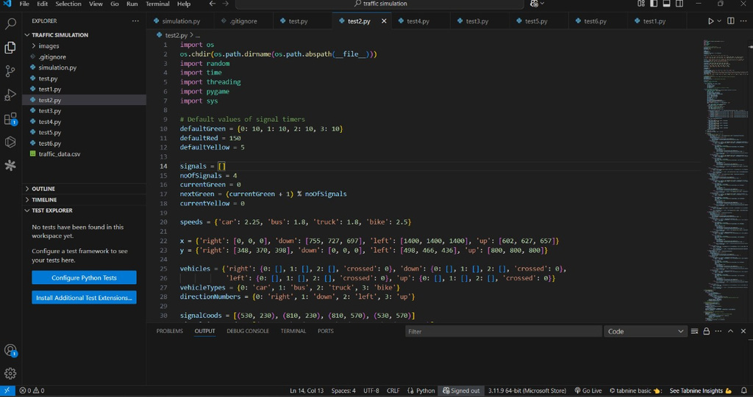
Screenshots
Screenshot of Code

Slide 33
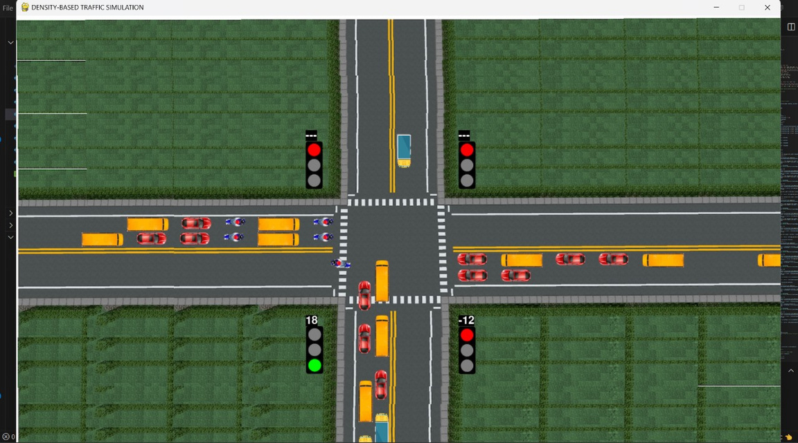
Screenshots
Screenshot of Output

Slide 34
References
Smith, J. (2020). A Study on Traffic Light Management Systems. International Journal of Traffic Engineering, 15(2), pp. 45–52.
Li, K., Zhao, H., & Wen, Y. (2021). Real-Time Traffic Management using Machine Learning. Journal of Intelligent Transportation Systems, 22(4), pp. 289–298.
Gupta, R. (2022). Simulation-Based Traffic Flow Optimization. Traffic Simulation Review, 10(1), pp. 101–108.
Kumar, P., & Rao, A. (2019). An Adaptive Traffic Light System Using Sensor Inputs. International Conference on Smart Cities and Urban Mobility, pp. 134–140.

Slide 35
Future Enhancements
1.Integration with Real-Time Traffic Data:
Incorporating live traffic data from sensors or surveillance cameras can make the system capable of managing actual road conditions, transforming it from a simulation into a deployable real-world application.
2.Machine Learning-Based Prediction:
Future versions can include machine learning models to predict traffic density based on historical data, time of day, or weather conditions, allowing the system to preemptively adjust signal timings for smoother flow.
3.Emergency Vehicle Detection:
Adding a feature to detect emergency vehicles (e.g., ambulances, fire trucks) and prioritize their passage through intersections can significantly enhance safety and response times.

Slide 36
Future Enhancements
4.Pedestrian and Bicycle Lane Integration:
A more sophisticated model could include pedestrian crosswalk signals and dedicated bicycle lanes, managing them with appropriate signal phases to ensure safety for all road users.
5.Web-Based Visualization & Remote Access:
A web interface could allow users to view the simulation remotely, adjust parameters in real-time, and observe traffic flow statistics via dashboards.
6.Enhanced Vehicle Behavior Simulation:
Future simulations can model more realistic vehicle behaviors such as lane changes, turning at intersections, or varying speeds, for a more accurate representation of traffic dynamics.
7.Mobile App Integration:
A companion app could notify users about optimal travel times, congestion alerts, or real-time signal schedules at nearby intersections.

Slide 37
Conclusion
The Smart Traffic Management System successfully demonstrates how simulation and adaptive control can be integrated to improve urban traffic flow. By using Python and modules such as pygame, threading, time, and random, the project emulates a dynamic traffic environment where traffic signals respond to real-time vehicle density.
The simulation provides a clear understanding of how adaptive signal timing can reduce congestion, minimize waiting times, and enhance road safety. The use of multithreading ensures concurrent execution of vehicle movement and signal control, making the system responsive and realistic.

Slide 38
Conclusion
This project lays the groundwork for future enhancements, such as integration with machine learning for predictive traffic behavior, or deployment in real-world traffic systems using sensor data. Overall, the system highlights the potential of smart, software-driven solutions in addressing modern urban traffic challenges.

Slide 39
THANK YOU

