Slide 1

NYC Jobs Data Analysis Project
Evaluating Business Opportunities for New Data Analytics Agency in NYC Public Sector

Slide 2




Project Motivation & Business Focus
Who we are: Newly graduated data engineers aiming to launch a data analytics company targeting NYC’s public sector.
Why NYC jobs data?
NYC government is a major employer for data professionals.
Understanding trends helps us evaluate business opportunities.
Project goal:
Use public jobs data to uncover market needs, skill trends, and salary benchmarks.

Slide 3


Key Research Questions
In this project, we will explore vital inquiries that drive our data analysis. Understanding the public job market trends, sector demand, and employment requirements in NYC will provide valuable insights.
How in-demand are data roles and data engineering skills in NYC government jobs?
Which agencies/departments are hiring for these roles?
What is the salary landscape for these jobs?
What skill trends and requirements are there?
How have postings for these roles evolved over time?
What are the contract types, seniority, and job categories for data roles?

Slide 4


Understanding Dataset Complexity
The initial challenges involved handling missing values, inconsistencies, and duplicate entries. These issues required robust techniques to ensure accurate analysis and insights from the NYC Jobs dataset.
Dataset & Initial Challenges:
Original dataset: Two raw CSV files from NYC jobs portal (~11,000 postings, 30 columns each).
Major obstacles:
Extensive missing/null values—especially in ‘preferred_skills’ (1933 nulls).
Inconsistent formats, especially in date columns: some values as dates, others as general text.
Duplicates by job ID and messy text in job descriptions/skills.
First step: Standardize date columns in CSVs to avoid wrangling headaches.

Slide 5


Data Wrangling & Cleaning Steps
Approach:
Merge and audit datasets, check for missing values and duplicates.
Precise separation of roles into three DataFrames: by business title, by skill keywords, and ‘Others’.
Major data cleaning challenges:
Extensive missing data (e.g., up to 40% nulls in ‘Preferred Skills’).
Duplicates by job ID.
Inconsistent column names and formats.
Messy text/punctuation in skills and titles.
‘preferred_skills’ column contains long, inconsistent text (not lists).
Skills can appear in many forms: “PowerBI”, “power bi”, “SQL/bi”, “power-bi”, “bi”, etc.
Unique cleaning approaches:
Custom functions for column standardization, normalize case and date normalization
regex-based filtering for punctuation removal and handle delimiters (regex: r'\b(\w+)(-|/)(\w+)\b').
Modular outputs split by role and skills.
Careful handling to avoid losing distinctions (e.g., not merging “SQL/Oracle” into “SQLOracle”).
Visual: Show before/after examples of cleaned skill text.
Use of YAML config for fully dynamic I/O paths.

Slide 6

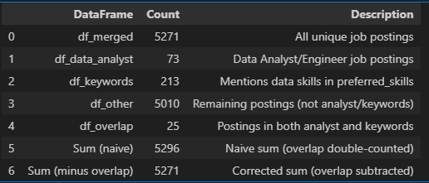
Analyzing Data Separation & Overlap for Clarity
Assessing dataset relationships for informed decision-making
Strategies for Addressing Overlap and Gaps
Two main strategies:
Search ‘business_title’ for job role keywords (e.g., “data analyst”, “data engineer”).
Search ‘preferred_skills’ for defined skill words.
Ensured jobs with missing ‘preferred_skills’ but matching titles are still included as data roles.
Verified final record counts and overlaps (see final checks in data_wrangling.ipynb).
Visual: This table show DataFrame sizes and overlaps.

Slide 7

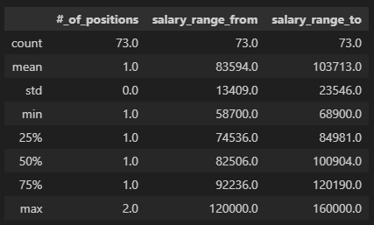
Exploratory Data Analysis (EDA) Techniques
EDA techniques involve summarizing the main characteristics of datasets, using visual methods. They help identify patterns, trends, and anomalies, providing critical insights that drive informed decision-making in NYC job data analysis.
EDA tools:
Pandas, matplotlib, seaborn for grouping, statistics, and visualization.
Summary tables for missing values, column types.
Main exploration axes:
Salary by job type and skills.
Contract type distribution.
Posting trends over time.
Agency hiring patterns.
Descriptive statistics for positions and salary columns in Data Analyst roles

Slide 8

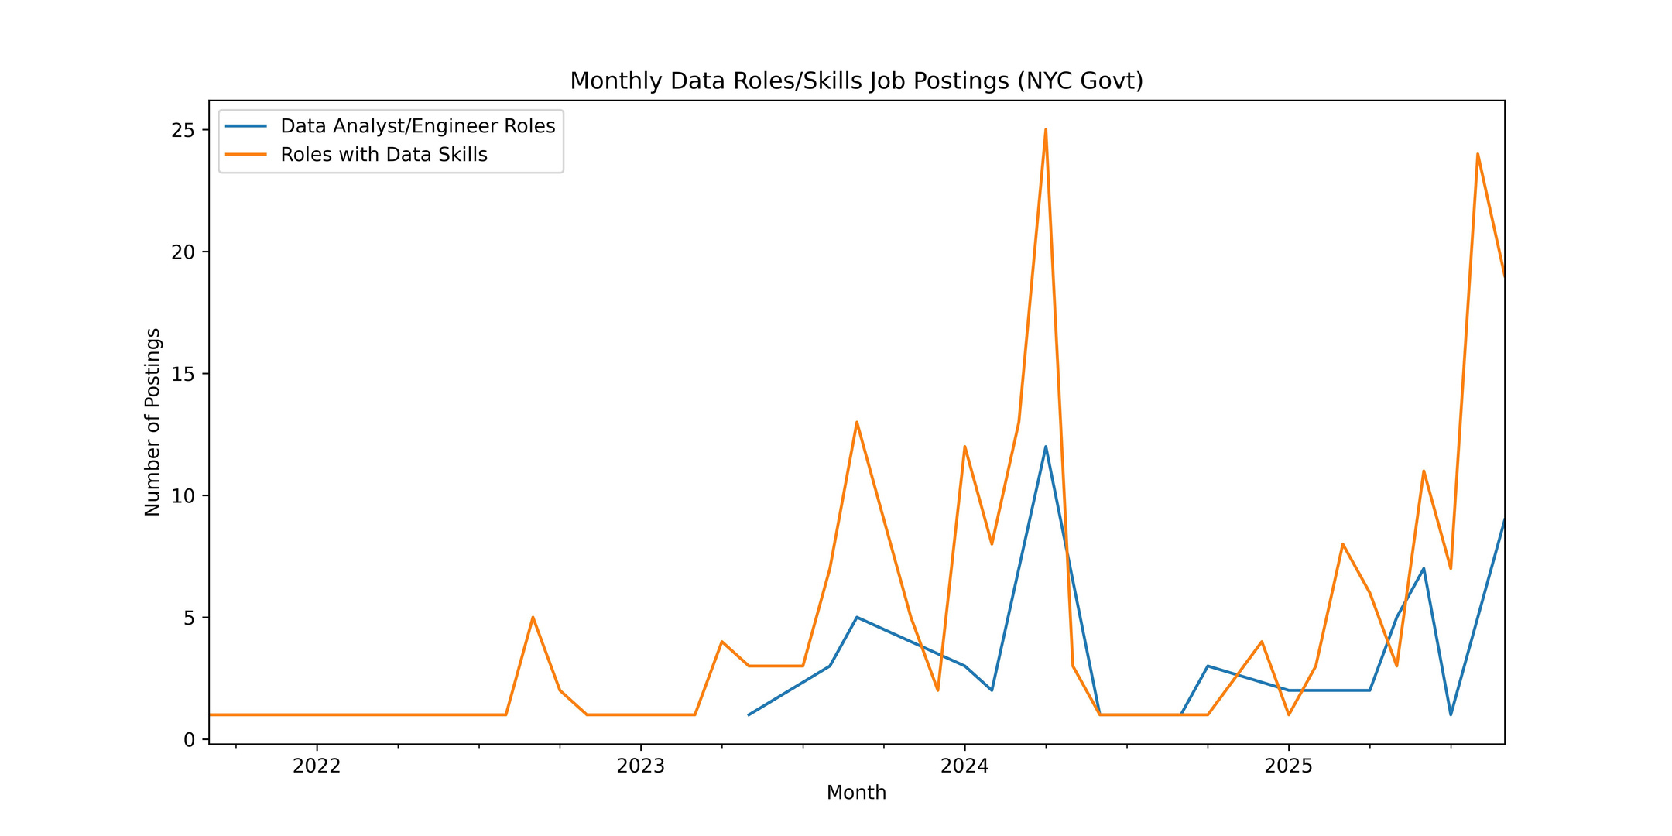

Key Insights from Data Analysis
Our analysis reveals significant trends in job availability across various sectors, highlighting areas for potential growth and informing strategic decisions for workforce development initiatives in NYC.

Slide 9
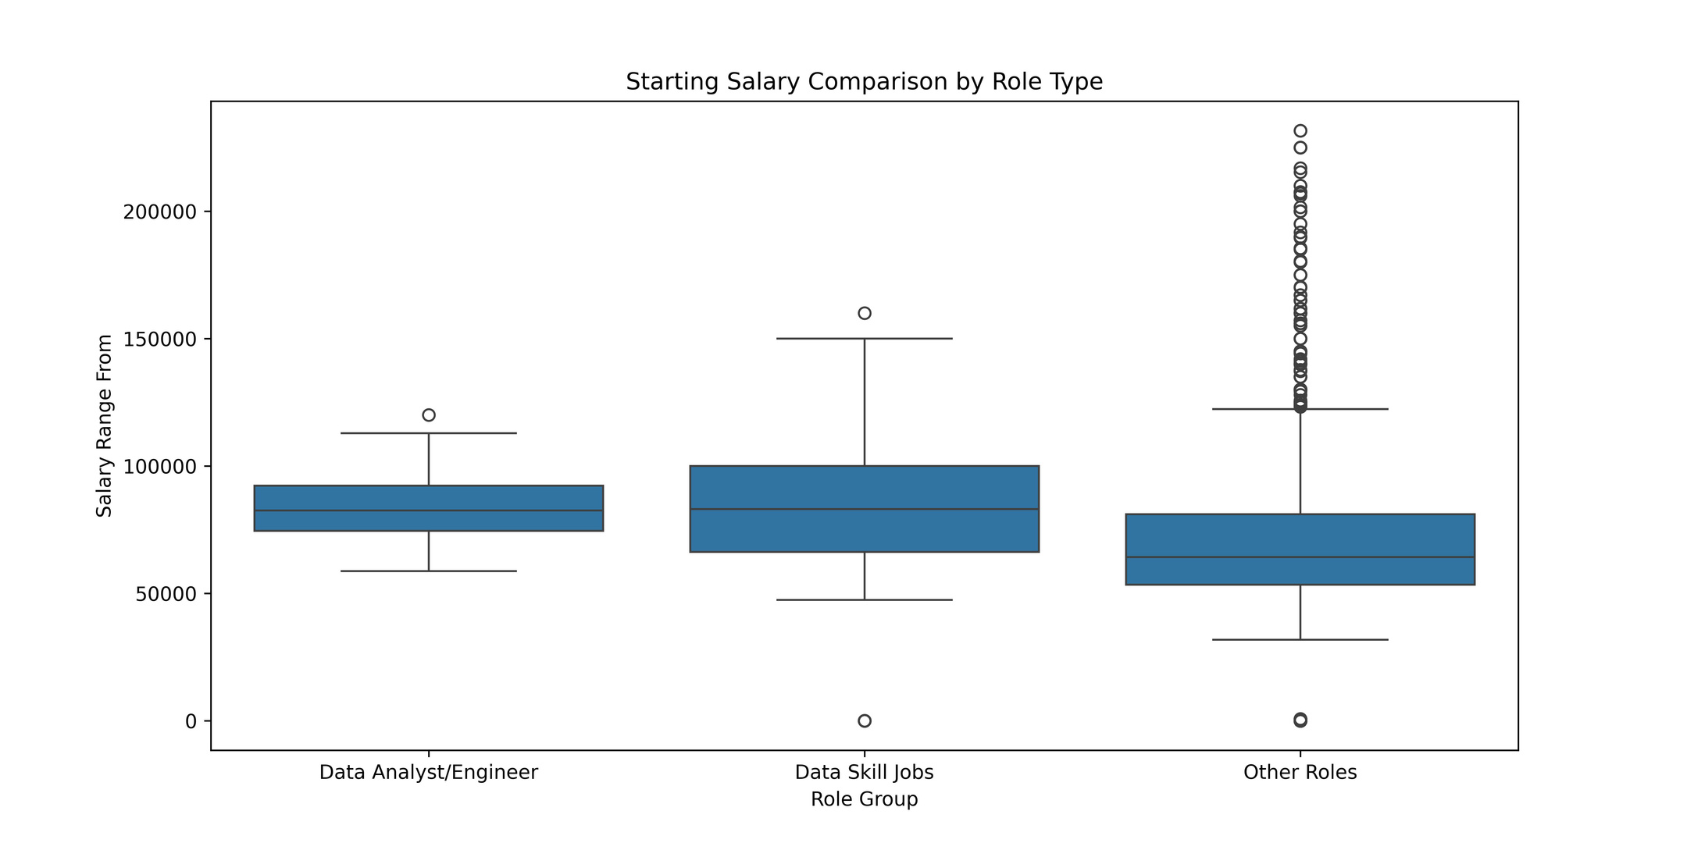
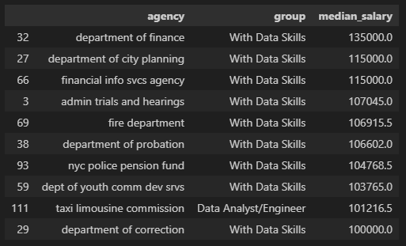
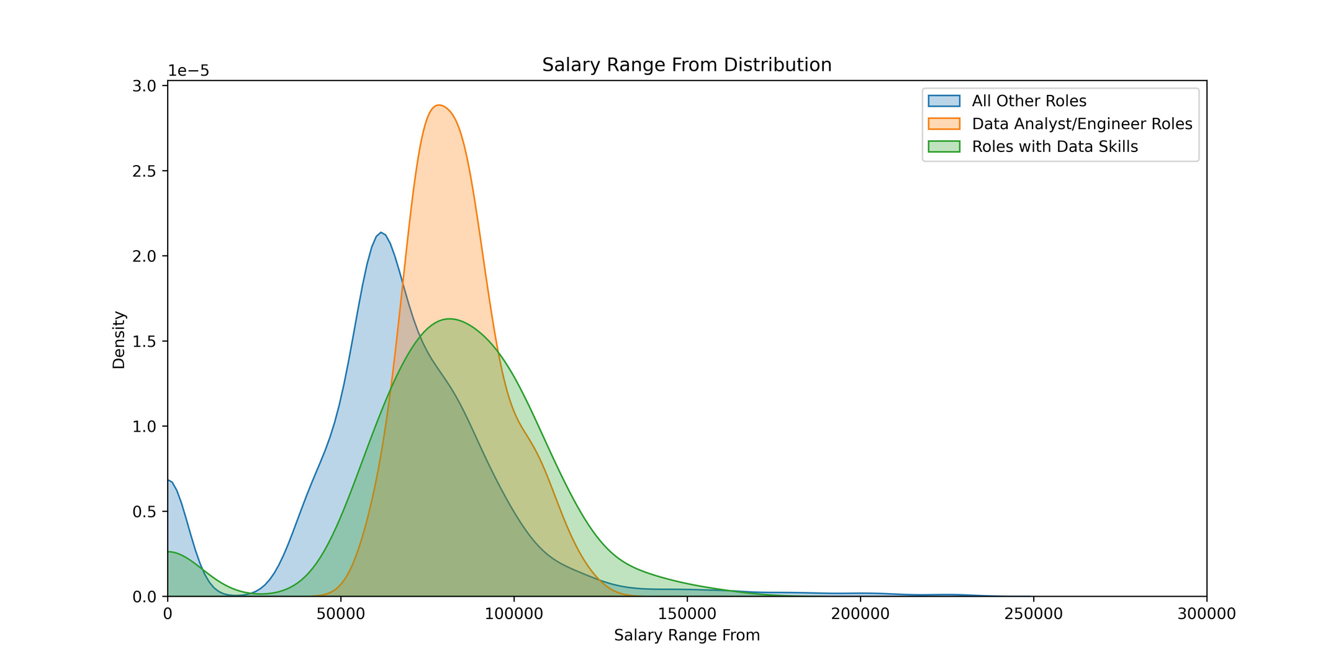
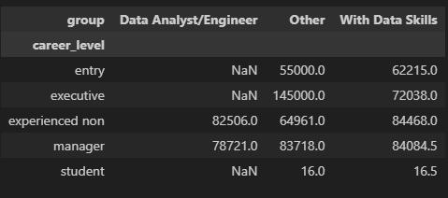
Key Insights from Data Analysis
Salary by agency and group, sorted by highest median salary
Median salary by career level and group

Slide 10
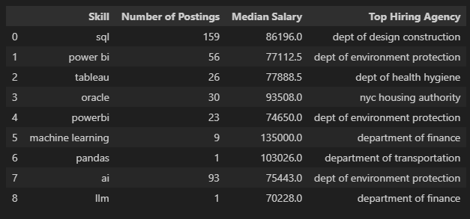
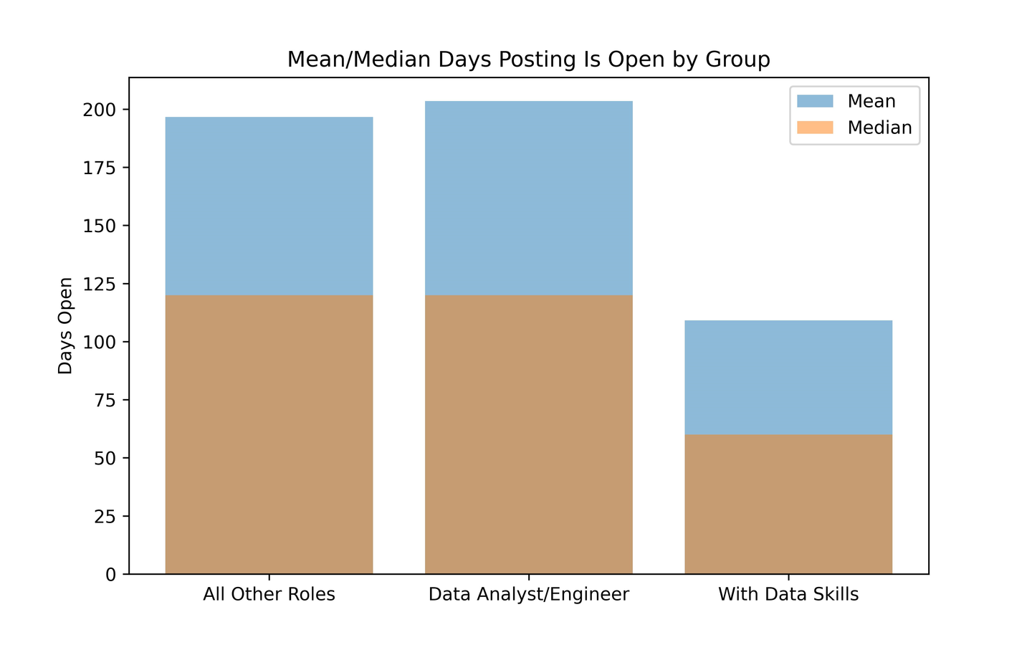
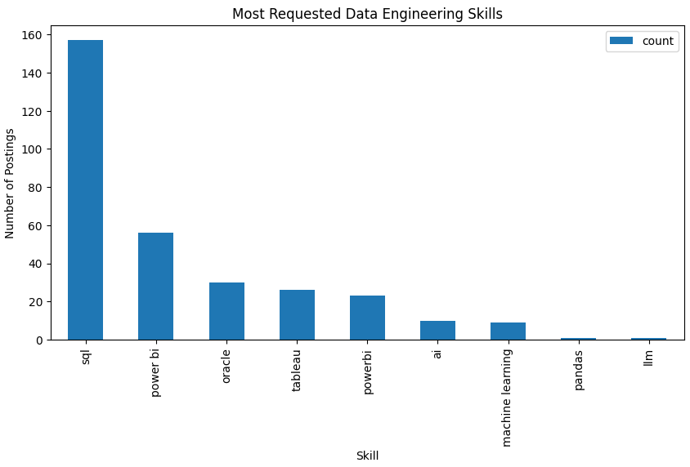
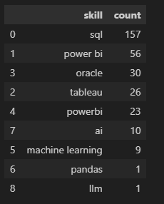
metrics for top skills: number of postings, median salary, top hiring agency
data skills frequency across data skills jobs

Slide 11
Conclusion & Insights
Data Skills Are in High Demand in NYC Government
Across all analyzed NYC government job postings, roles requiring data skills (SQL, Power BI, Tableau, Python, Oracle, etc.) are widespread.
Jobs specifically titled “Data Analyst/Engineer” and those with technical data skills collectively represent a substantial share of positions.
Salary Landscape
Median salaries for data roles and jobs with data skills are both around $82,500, significantly higher than median salaries for other roles.
Agencies hiring for data roles tend to offer competitive compensation, with some positions exceeding $130,000–$160,000 for advanced skills and seniority.
Top Requested Data Skills
SQL is the most requested skill, appearing in the majority of roles with data skills.
Power BI, Tableau, Oracle, and Machine Learning also show significant demand, indicating agencies are investing in modern data platforms and analytics.
Skills like AI, Pandas, and LLMs are emerging but comparatively rare.
Top Hiring Agencies
Agencies most actively hiring for data roles include:
Department of Environmental Protection
Bronx District Attorney
Department of Transportation
Housing Authority
Department of Design and Construction
These agencies together account for the largest share of open positions for Data Analysts/Engineers.
Job Trends Over Time
Both the number of postings for Data Analyst/Engineer roles and broader jobs with data skills have shown steady growth month-on-month, indicating increasing investment in data capabilities across NYC government.
Skill, Salary, and Agency Relationships
Agencies with a high volume of postings are also those offering higher median salaries for data roles.
The strongest salary offers are found in agencies like the Department of Finance and the Department of City Planning.
Summary Table Highlights
Total Data Analyst/Engineer Roles: 73
Jobs With Data Skills: 213
Top Skill: SQL
Top Hiring Agency: Department of Environmental Protection
Median Salary (Data Analyst & Data Skills): $82,500

Slide 12
Closing Message
NYC government is investing heavily in data talent and technical skills. There is clear evidence of robust hiring, strong salary offers, and a competitive landscape for data roles. For new graduates and entrepreneurs, this sector presents substantial opportunities to deliver value, drive digital transformation, and build partnerships with agencies at the forefront of data-driven public service.

Slide 13

Thank You for Your Attention
We appreciate your engagement and interest in our NYC Jobs Data Analysis project. We welcome any questions or feedback you may have as we strive to improve our understanding of the job market and its implications for the public sector.

