Slide 1

Jobs in NYC
Data analysis-related opportunities
Luis Pablo Aiello
Janna Julian
Sina Yazdi

Slide 2

Introduction & Motivation
Data has become a driving force behind decision-making in both public and private sectors. Understanding how data-related skills shape the job market helps identify career opportunities and skill gaps. This project explores the NYC job market with a focus on data-related roles and how they compare to the broader employment landscape.
Data & Methodology
Source: NYC job postings dataset (2021–2025) from https://data.gov/ and thedata.cityofnewyork.us
Processing: Cleaned and merged multiple CSV files
New features: Average salary, days a posting stayed open
Categorization: General roles, roles with data skills, Data Analyst/Engineer roles
Analysis: Distribution, salary, growth trends, and skills demand

Slide 3

Hypotheses
Sector Distribution: Job postings are concentrated in a few dominant sectors.
Salary Structure: Higher experience requirements lead to higher salaries.
Growth & Demand: Data-related postings grow faster than other job categories.
Salary Premium: IT and cybersecurity salaries exceed the market median.
Skills Focus: Tech jobs emphasize technical skills, while non-tech roles emphasize soft skills.

Slide 4
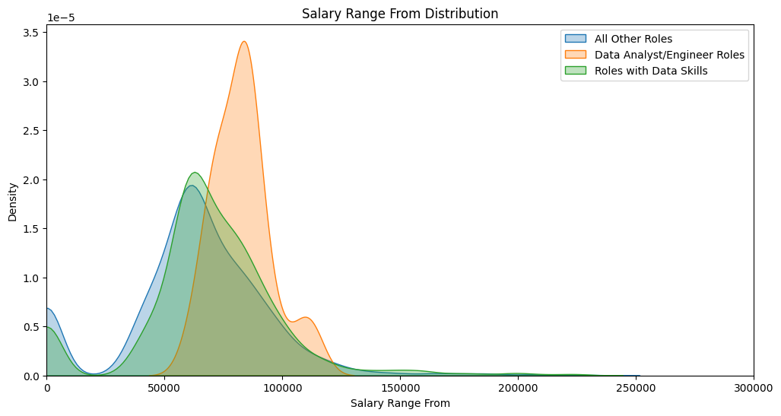
Salary Distribution Across Roles
Insight: Data-related roles offer slightly higher starting salaries compared to general roles. Most postings fall between $60,000 and $100,000 annually, highlighting competitive compensation for data skills.
There’s a clear salary gap between tech/data jobs and the rest of the market — indicating higher demand and skill requirements in those fields.

Slide 5
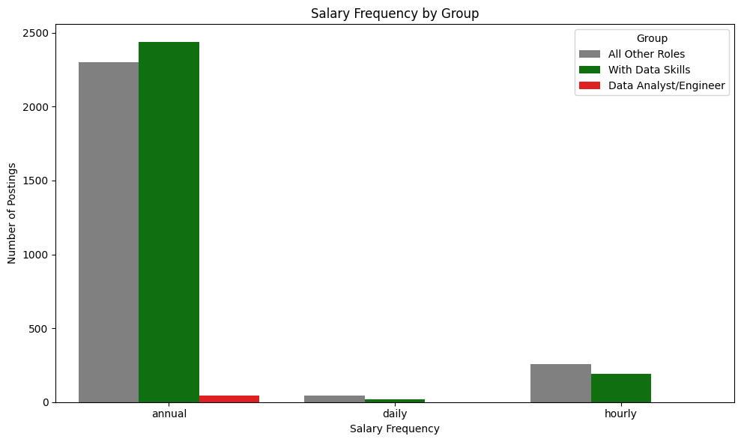
Salary Frequency
Insight: Most positions — especially those requiring data skills — are salaried annually. Hourly or daily positions are rare, reflecting the full-time, stable nature of data-related work
This suggests that data-focused jobs are predominantly long-term, salaried positions, reflecting their higher skill requirements and professional status.

Slide 6
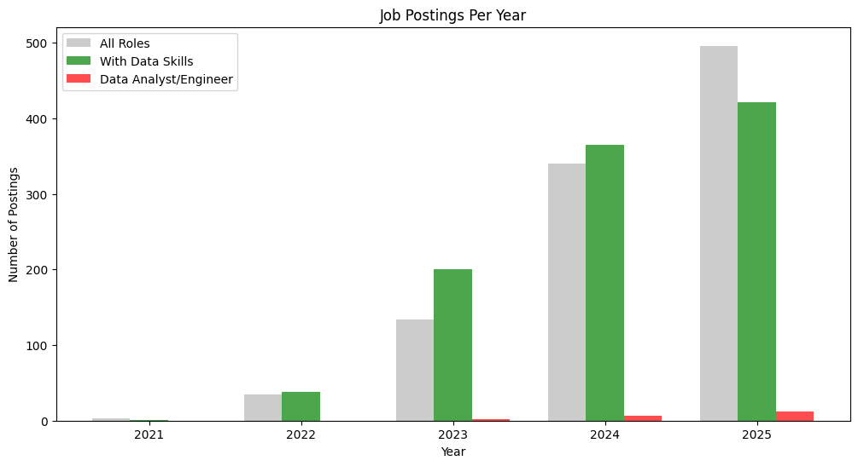
Job Postings Over Time
Insight: Data-related job postings have grown steadily, particularly since 2023. This trend reflects the increasing digital transformation of public services and rising demand for data professionals
Postings requiring data skills (green) have grown sharply and consistently, often outpacing overall job growth, which highlights the increasing demand for data literacy across sectors. Although Data Analyst/Engineer roles (red) remain a smaller share, they are also rising steadily, showing continuous demand for specialized talent. Overall, the trend confirms that tech and data-related skills are becoming central to the job market’s evolution.

Slide 7
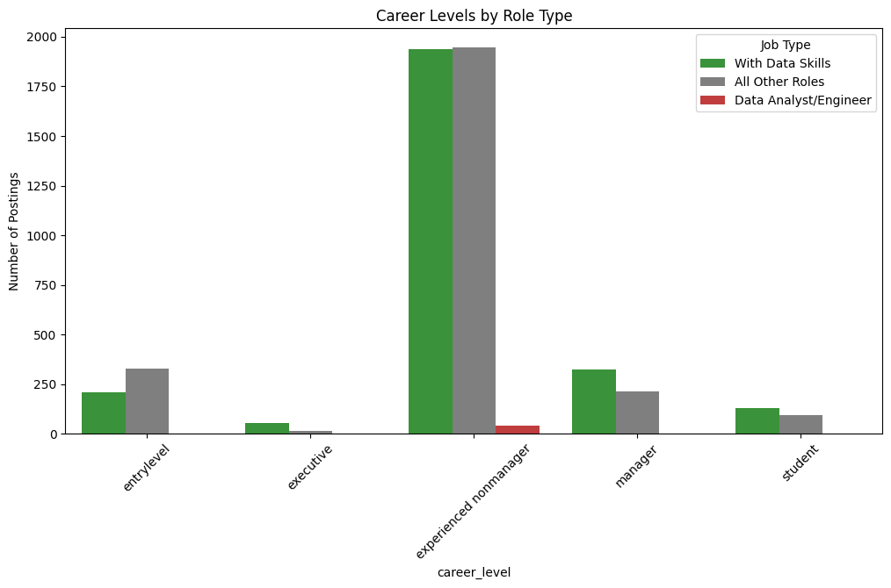
Career Levels
Insight: Most data-related roles target experienced professionals, but there’s also notable demand for entry-level and managerial positions — indicating opportunities for career growth and specialization.
Entry-level roles are much fewer, and Data Analyst/Engineer positions are mostly concentrated in the experienced range, highlighting the importance of prior expertise in data-related fields. There’s also noticeable demand for manager-level positions requiring data skills, reflecting how data is becoming central to leadership roles.

Slide 8
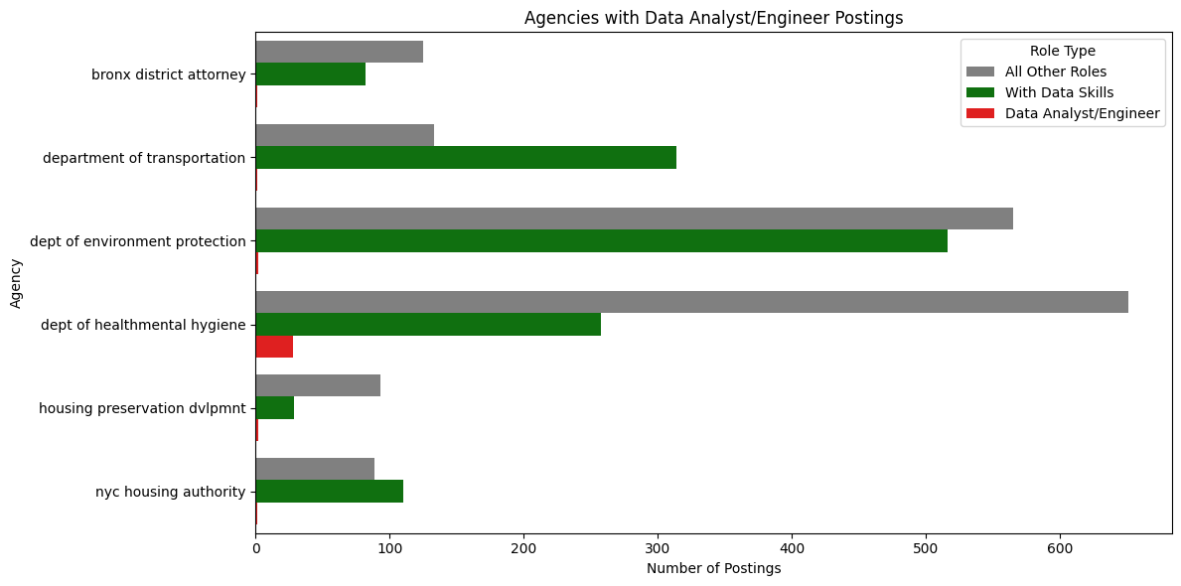
Top Hiring Agencies
Insight: Departments like Health, Environmental Protection, and Transportation lead in hiring for data-related positions, showing the diverse application of data skills across public services.
This chart highlights the NYC agencies with the most job postings, especially those involving data-related roles. Agencies like the Department of Environmental Protection and the Department of Health and Mental Hygiene lead in overall postings and also show strong demand for positions requiring data skills. Although Data Analyst/Engineer roles (red) remain a small share, their presence in these major agencies shows that data expertise is increasingly essential across public services, particularly in sectors dealing with infrastructure, health, and environment.

Slide 9
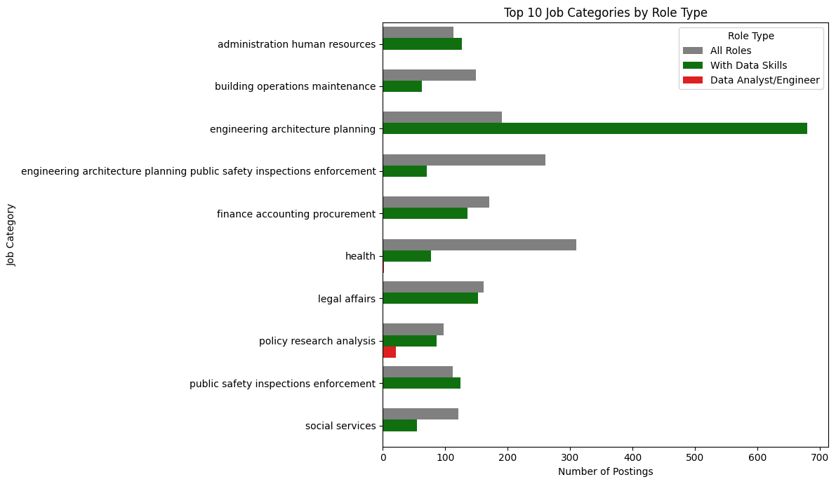
Top Job Categories
Insight: Engineering, architecture, and planning dominate job postings with data-related skills. Policy, legal, and social services also show strong demand, confirming that data skills are needed across many domains.
Even though Data Analyst/Engineer roles remain a smaller share, their presence across diverse fields shows that data expertise is becoming critical beyond traditional tech sectors, influencing planning, policy, and public services.

Slide 10
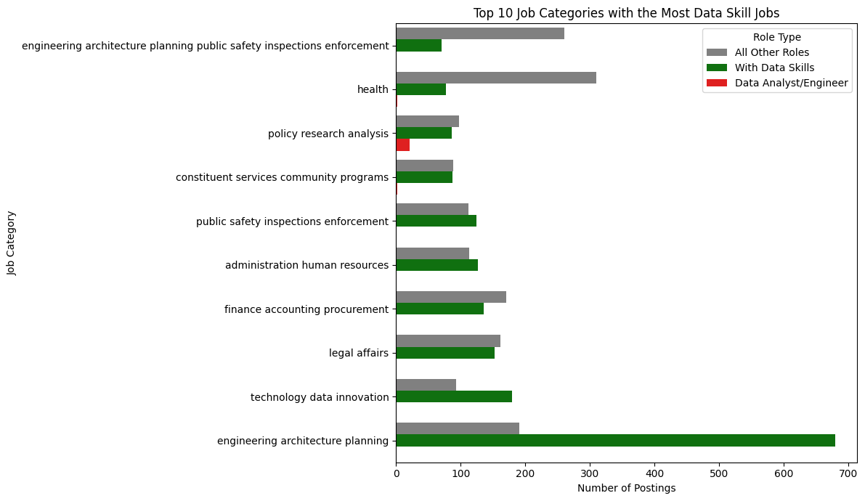
Top Categories Requiring Data Skills
Insight: Engineering and public safety lead demand for data skills, followed by health and finance. This highlights how data literacy is becoming essential even in traditionally non-technical fields
Engineering, architecture, and planning lead by a large margin, followed by sectors like technology, finance, and public safety, highlighting how crucial data capabilities are in infrastructure, innovation, and decision-making. Even fields such as health, legal affairs, and community services show strong demand, indicating that data skills are now essential across both technical and non-technical areas. This confirms the growing importance of data literacy across the public sector.

Slide 11
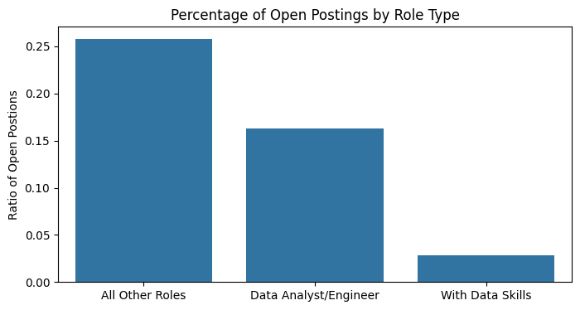
Open vs. Closed Positions
Insight: Data-related roles tend to fill more quickly than general positions, indicating high demand and competitive hiring. General roles remain open longer, possibly due to broader availability.
The general roles have the highest proportion of positions still open, suggesting higher ongoing demand. Data Analyst/Engineer roles also have a notable share of open postings, indicating continuous need for specialized talent. In contrast, roles requiring data skills have a much smaller share of open positions, which may mean they are filled more quickly or involve more targeted and efficient hiring.

Slide 12
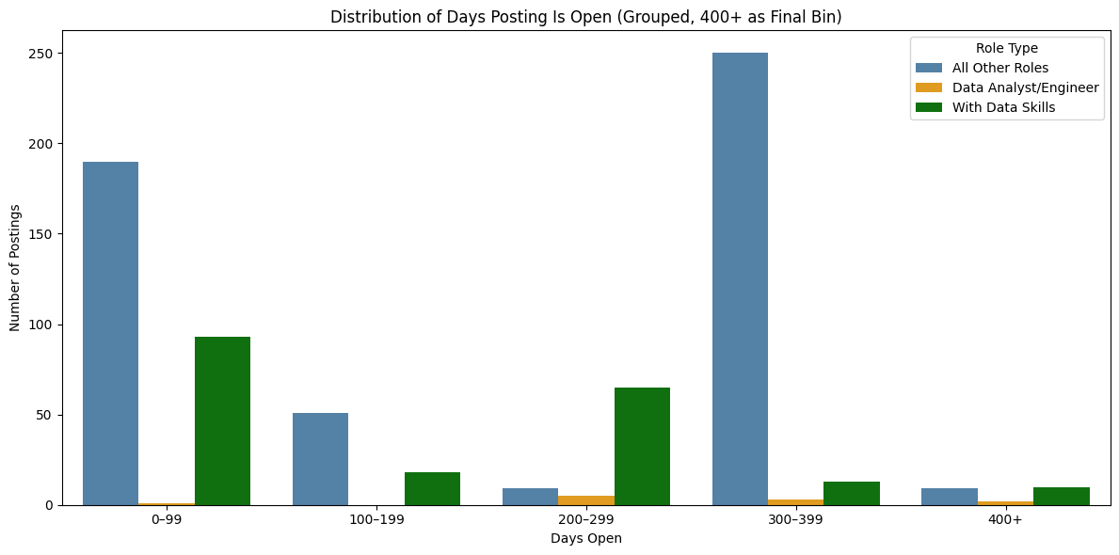
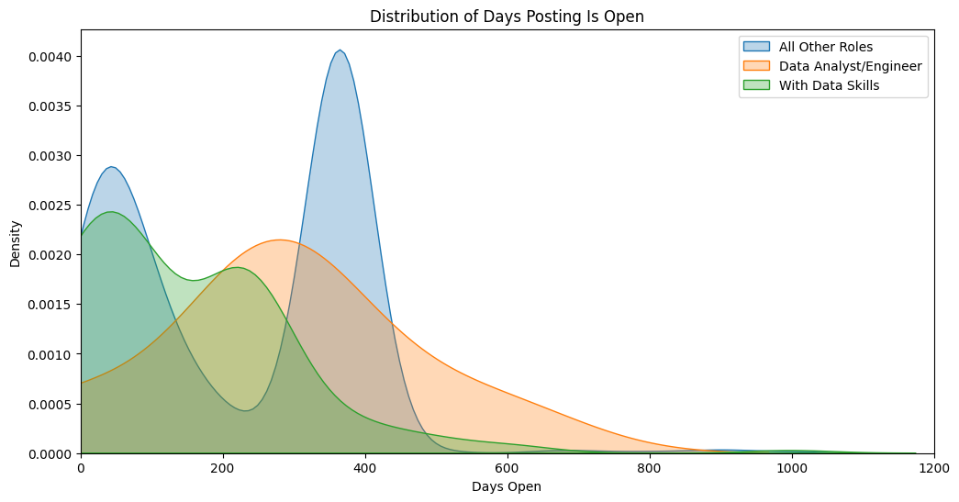
Days Open Distribution
Insight:
These charts show how long job postings stay open across different role types. General roles tend to stay open significantly longer, often beyond 300 days, suggesting slower hiring processes or lower urgency. In contrast, roles requiring data skills are usually filled much faster, with most postings closing within the first 100 days. Data Analyst/Engineer roles fall in between, staying open longer than data-related roles overall but still closing faster than most general positions. This highlights how demand and hiring speed differ across job types, with data-focused roles likely being filled more quickly due to their specialized nature and high demand.

Slide 13
Key Findings
Demand for data skills is growing faster than overall job growth.
Data-focused roles consistently offer higher salaries.
Most data roles are targeted at experienced professionals.
Data skills are required across diverse sectors.
Data roles are often filled faster, indicating strong demand.
Recommendations & Next Steps
Expand training programs to help entry-level talent enter data roles.
Build partnerships with top hiring agencies to meet workforce needs.
Extend analysis to include private sector data.
Explore predictive models to anticipate future skill demands.

Slide 14
Limitations & Future Work
Data focuses on public sector postings.
Some postings lacked minimum salary or closure data.
Future work could include deeper skill text analysis and predictive modeling.
Conclusion
Data-related roles are reshaping NYC’s job market — offering higher pay, faster hiring, and expanding across industries. For aspiring data professionals, these insights reveal both growing opportunities and the critical skills needed to succeed.

Slide 15
Questions?

Slide 16

Thank you for your attention!

