Slide 1
PrestigeCars Normalized Database
Ridhwan Ibrahim
Giorgos Stefanis
Seeram Govindan
Hasan Husseini
Youlun Wang
Michael Cipriani

Slide 2
Project Overview
Original PrestigeCars Database was not normalized
Tables contained NULL values and lacked check constraints
The goal of the project was to rebuild the tables using udts, FQDNs, FQTNs and use two valued predicate logic.
Each group member was responsible for normalizing one table group in the DB

Slide 3
Project Lifecycle
First we had to decide on schemas to define Business Glossary Domains (FQDNs)
Next we defined UDTs that enforced consistent data types and incorporated business meaning
Each group member then normalized assigned tables, eliminating nulls and two valued predicate logic
ERD was then created to document table relationships and domain usage

Slide 4
Schemas and their meaning
We separated UDTs into schemas that represent business glossary domains
Schema Name | Business Glossary Domain
PersonalInformation | Human identity attributes
FinancialInformation | Amount / Monetary values
PII | Personally Identifiable Information
Manufacturing Information | Vehicle Manufacturing data
VehicleInformation | Core vehicle characteristics
TransactionInformation | Sales transaction identifiers
ELT Information | Data-quality control types

Slide 5
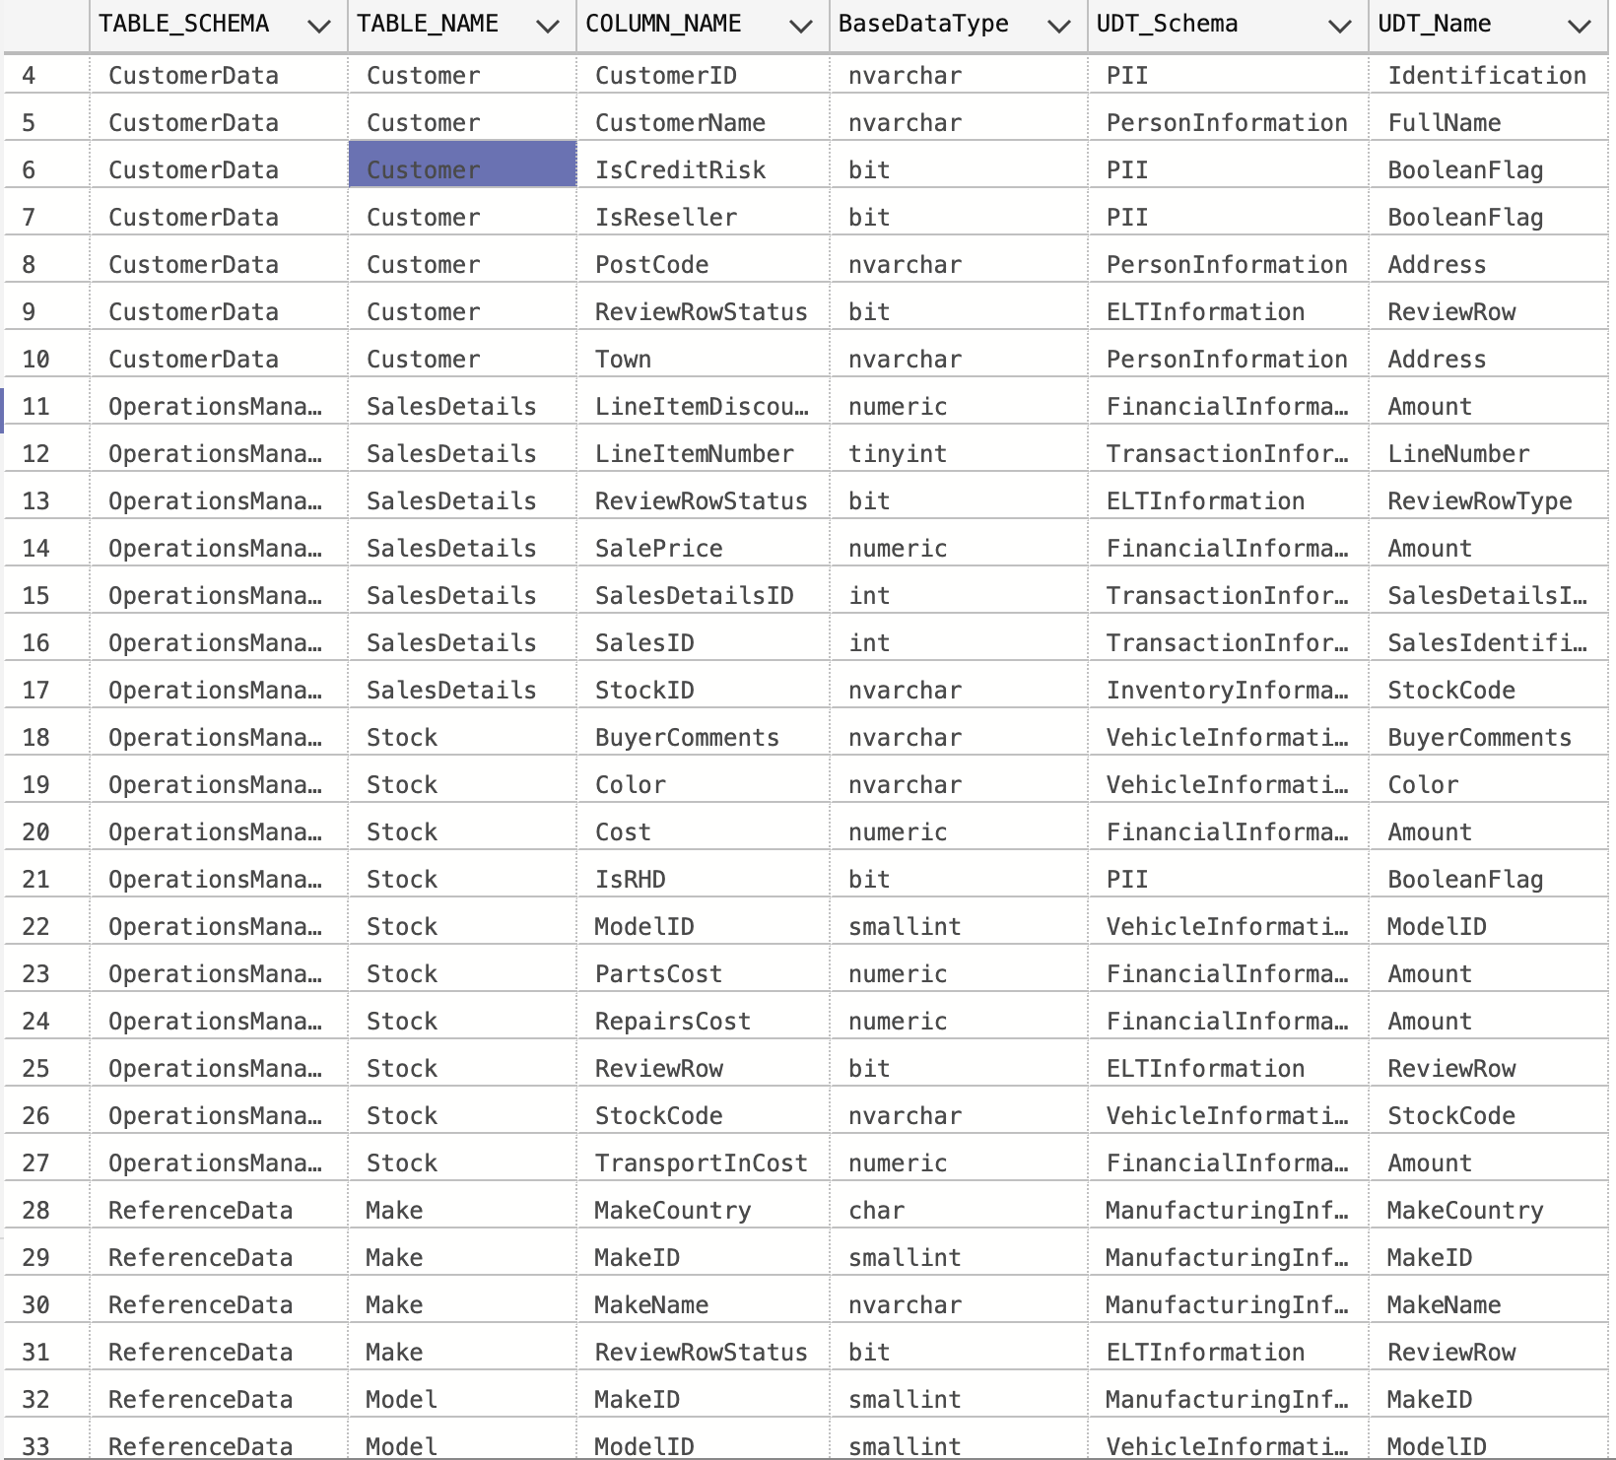
UDT Reuse Across the System
In order to demonstrate consistency and uniformity, we confirmed that our User-Defined Data Types (FQDNs) are utilized across several tables.

Slide 6
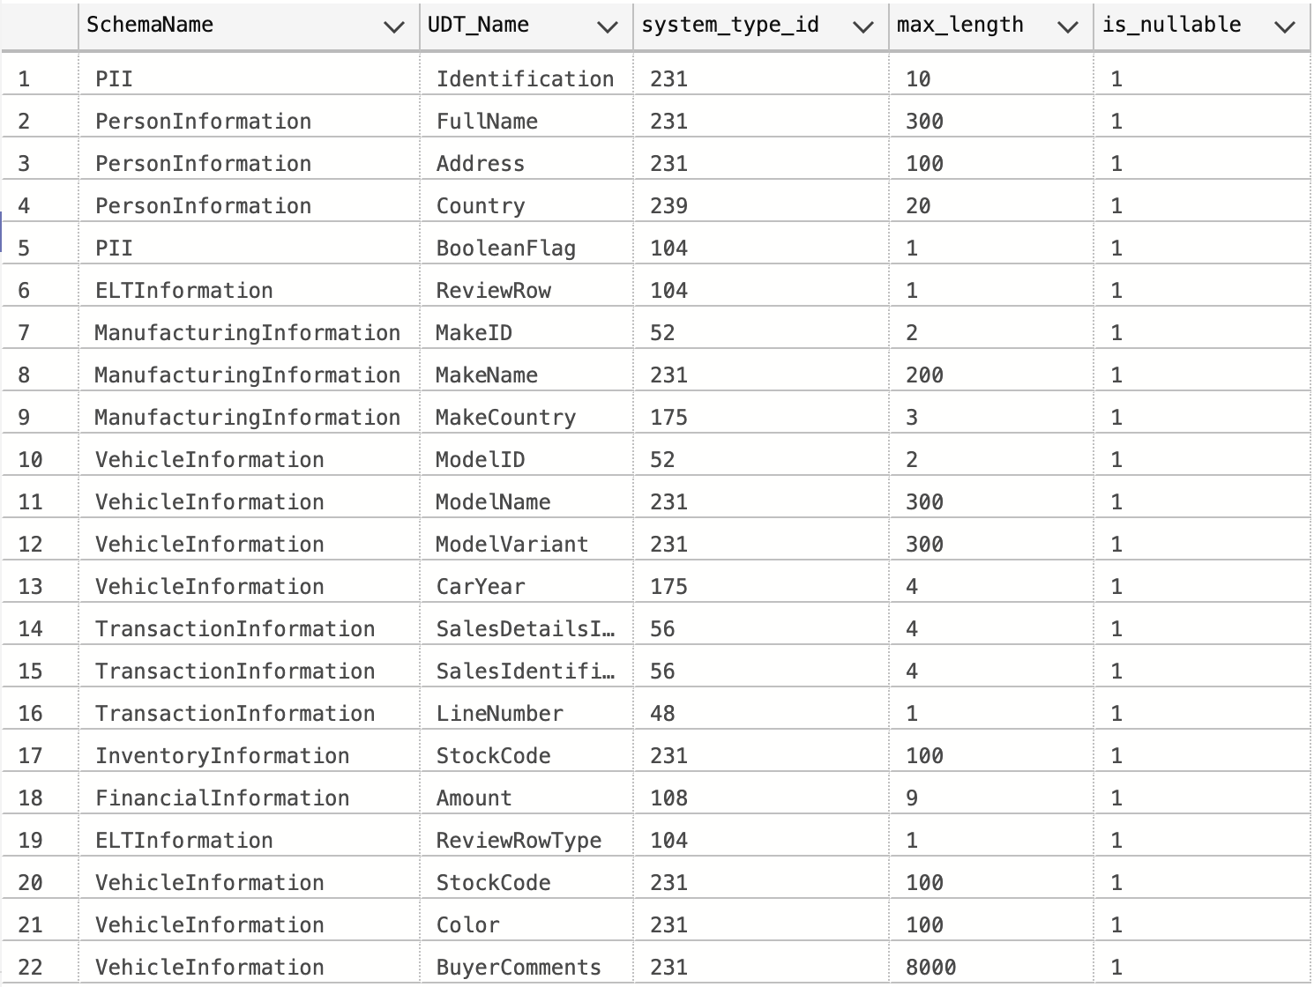
How Our UDTs Encode Business Meaning
Every UDT name is not meaningless, rather than reflecting a technical field type, the TypeName represents an actual business notion.
Every UDT contains:
  The appropriate dimensions and accuracy
  Validation of domains
  Default values that avoid NULL
  The schema defines the domain scope.

Slide 7
Hierarchy & use of UDT names
Our team established a shared Business Glossary Domain Library, where UDT was defined once and reused across the entire DB.
This ensured consistent meaning and consistent datatypes and consistent constraints wherever the domain appears.

Slide 8
Subsystem Schemas (FQTN)
OperationsManagement – Stock, Sales, Workflow
ReferenceData – Country, Budgets
Data – Legacy structures
Output – Reporting extracts
SourceData – Raw ingestion tables

Slide 9
OperationsManagement.Stock
OperationsManagement was chosen schema because it describes the enterprise domain where a stock table belongs.
Stock table describes physical inventory which is used primarily in operations of the company.
Udts were created based on existing schemas to enforce a certain type.
Example:
  VehicleInformation.StockCode → uniquely identifies each vehicle.
    VehicleInformation.ModelID → ties stock to vehicle specifications.
Default values also ensured no attribute is entered as a NULL
COALESCE converted missing inputs into default inputs

Slide 10
Constraints and Default values used
Constraints enforce specific values that make sense for the business
  Example: (Cost >= 0)
UDT-level rules (booleanFlag)
Default Values eliminate NULLs and enforce two-valued logic
  Default 0.00 for Amount
  Default 0 for BooleanFlag
  Default "Unknown" for text fields
  Default "1900-01-01" for unknown dates

Slide 11
ReviewRow
We count how many NULLS were encountered
If NULLS exist, then ReviewRow is set to 1
If ReviewRow = 0 then it is clean, no need for substitutions
Else if ReviewRow = 1, there is at least one NULL value that as replaced
This identifies which rows were originally clean as well as review cleaned rows.

Slide 12
Data cleansing strategy
Our ELT pipeline converts nullable inputs into well-defined default values using domain UDT rules and flags any substituted rows using the ReviewRow bit, ensuring two-valued predicate logic for reliable downstream processing.
Every column uses COALESCE in order to prevent NULL and enforce the default values.

Slide 13
Views
We created views to present normalized tables and data
Our views display FQTNs and FQDs only, hiding the raw legacy structure
This ensures the consistency of column naming convention, and elimination of 3-valued predicate logic through its conversion into 2-valued predicate logic
The views allow users to interact with the normalized data without needing to understand the overall domain structure.

Slide 14
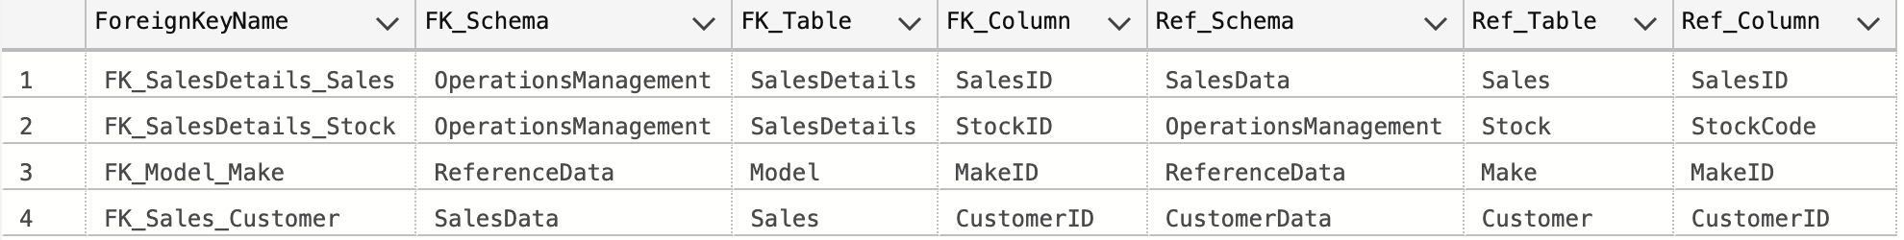
Foreign Keys
Foreign Key Relationships
SalesDetails → Sales
  Linked by SalesID to ensure each detail belongs to a valid sale
SalesDetails → Stock
  Linked by StockID to prevent selling items that don’t exist in stock
Model → Make
  Ensures each model belongs to an existing manufacturer
Sales → Customer
  Linked by CustomerID to make sure every sale references a valid customer

Slide 15
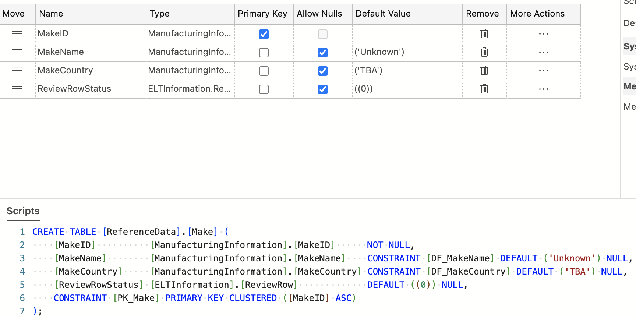
Make

Slide 16
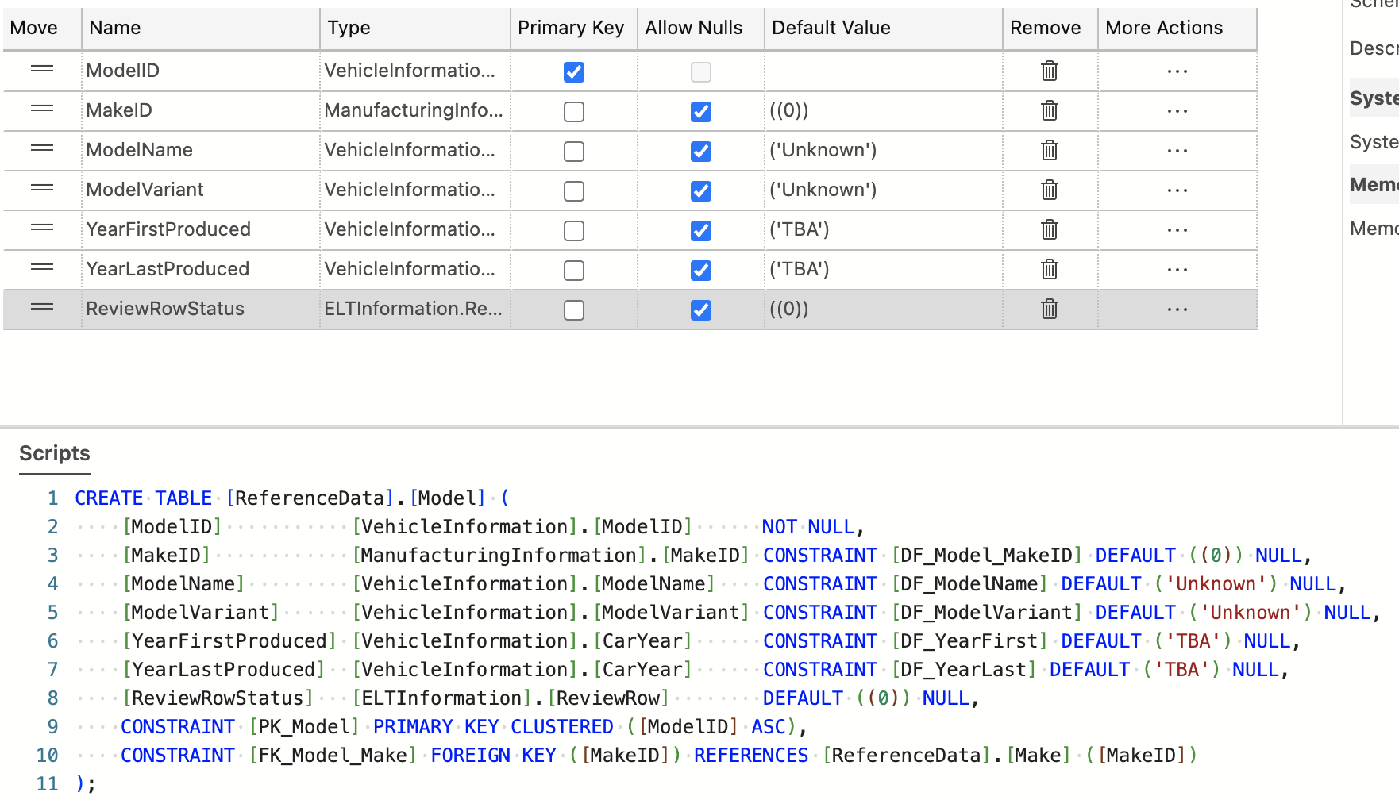
Model

Slide 17
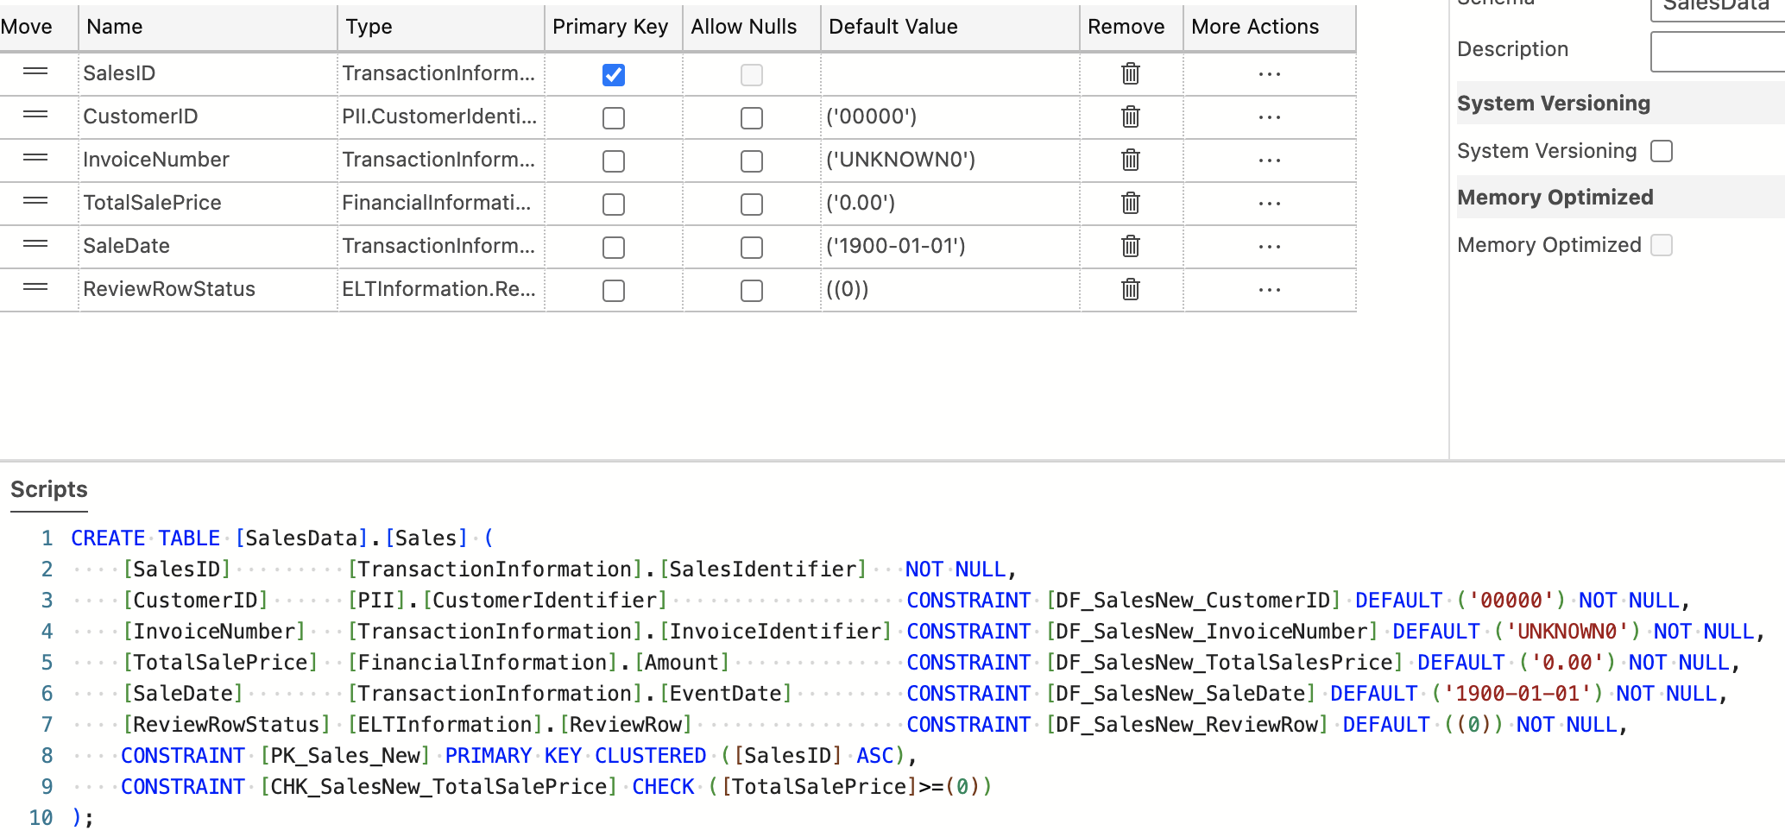
Sales Data

Slide 18
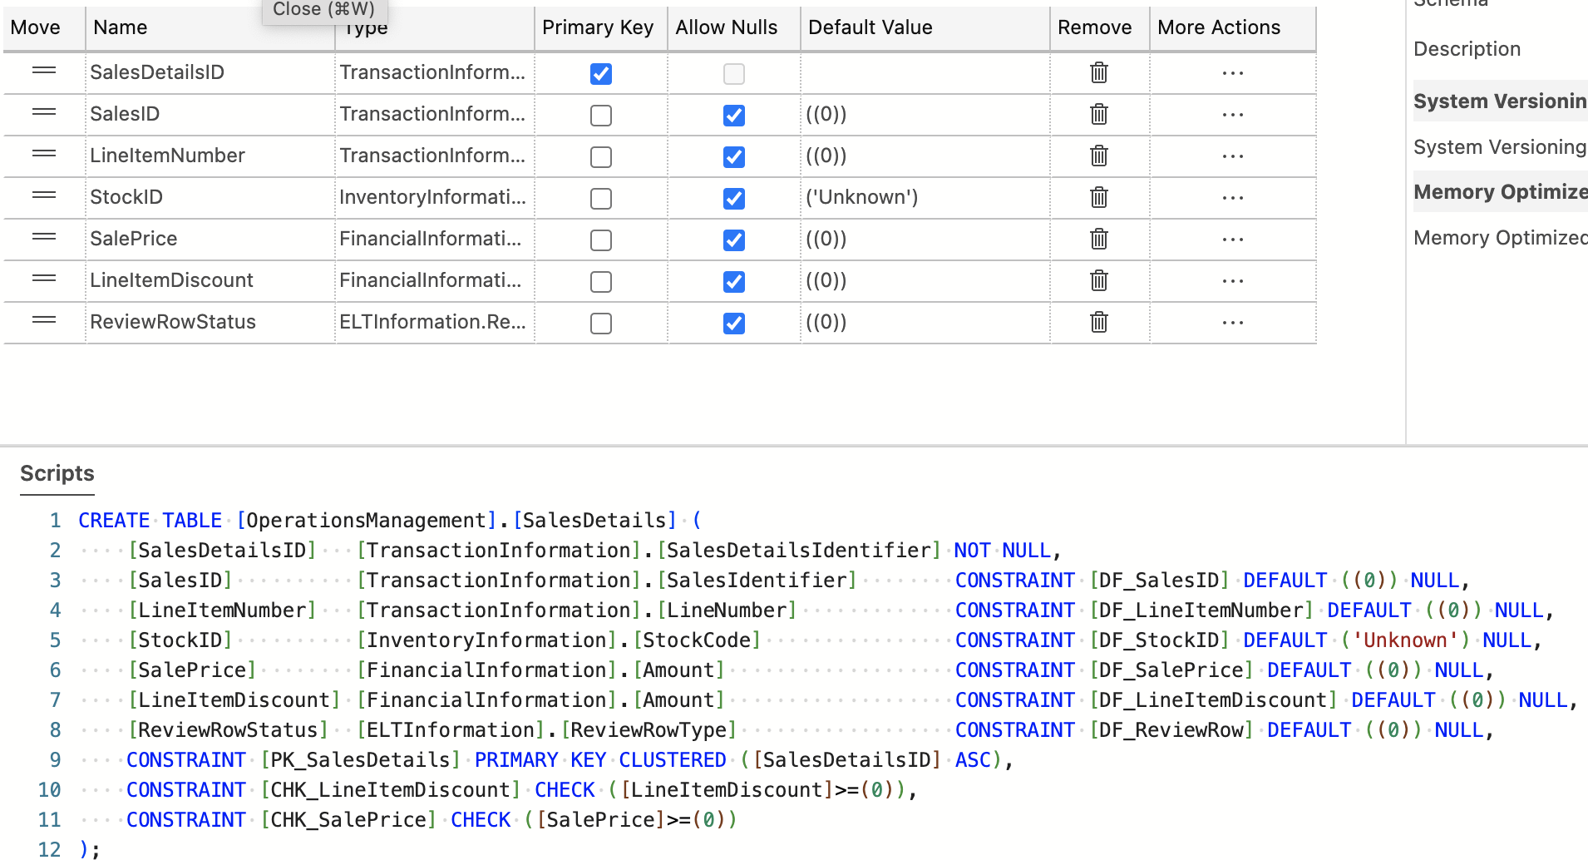
SalesDetail

Slide 19
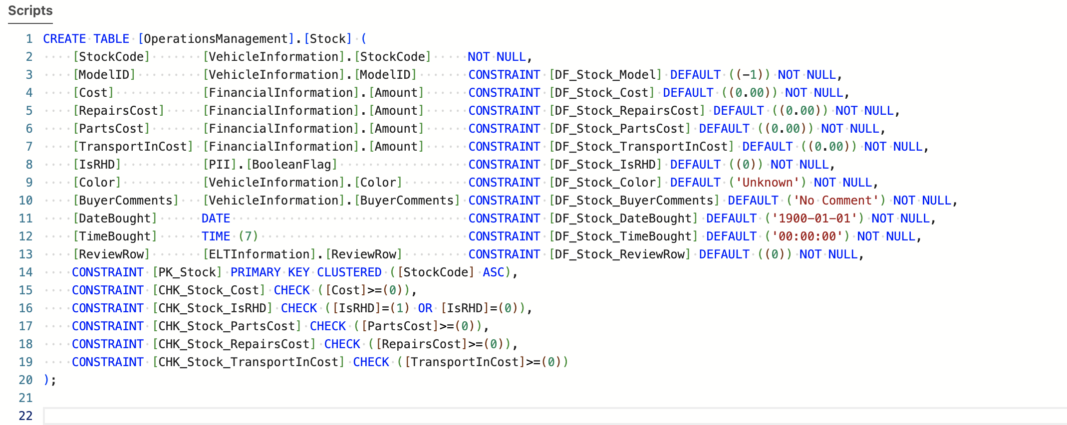
Stock

Slide 20
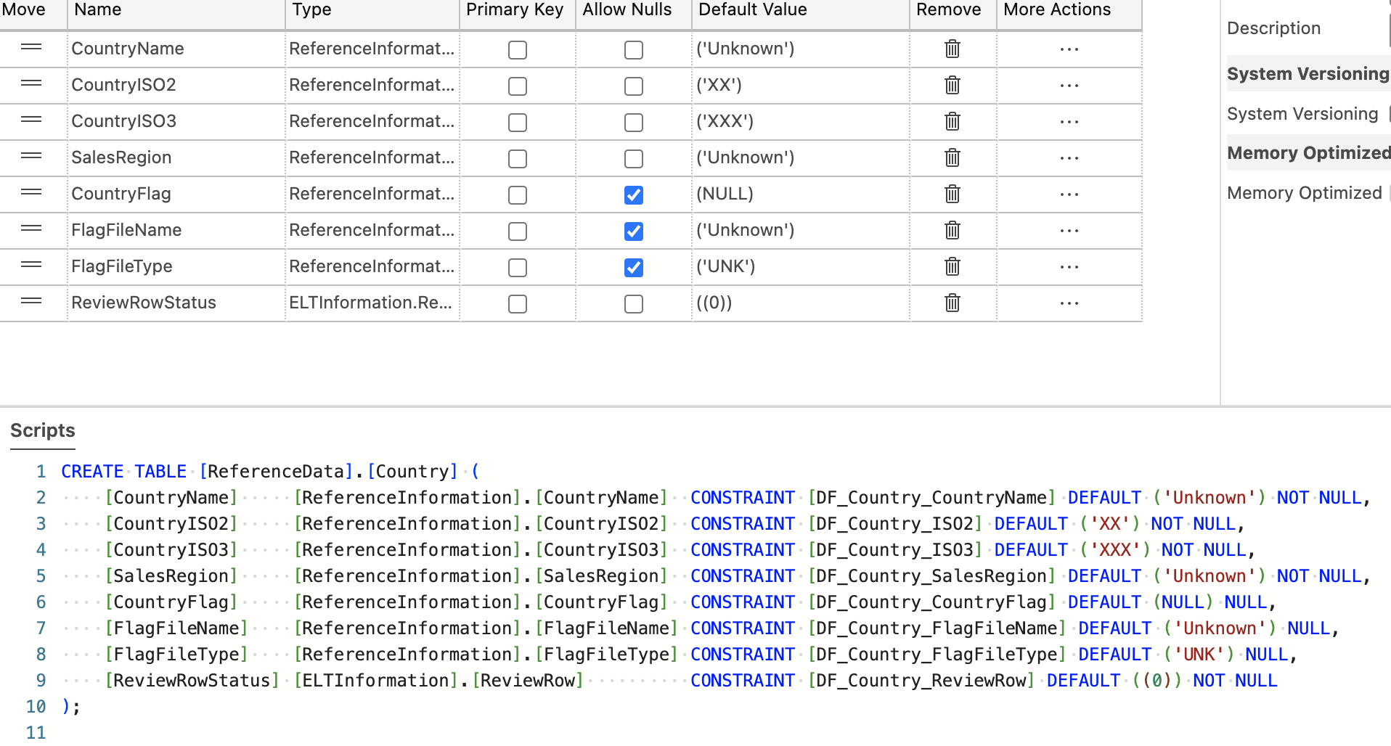
Country

Slide 21
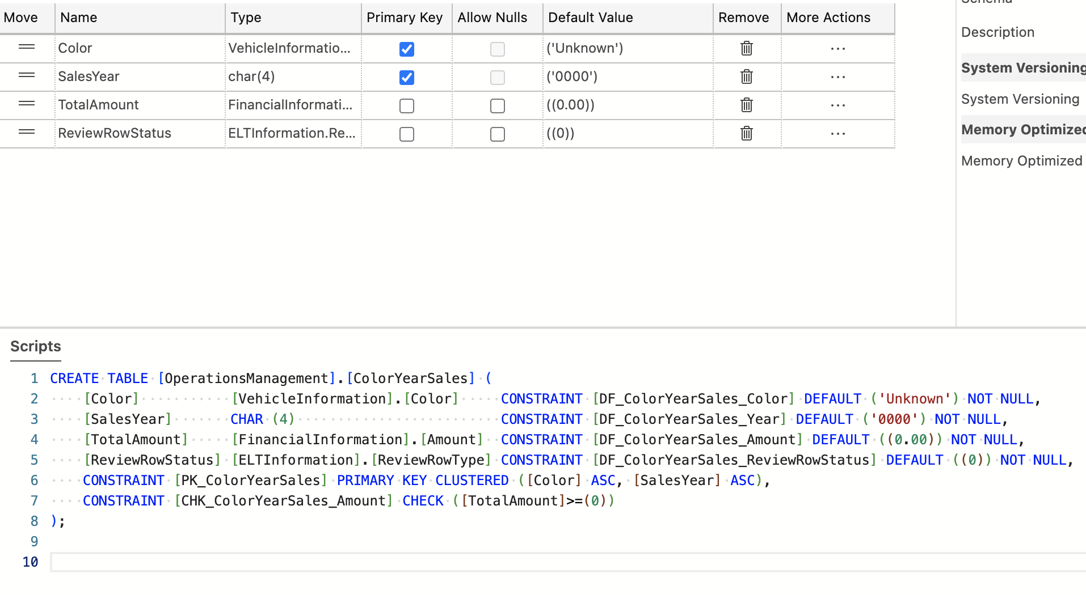
Pivot Table

Slide 22
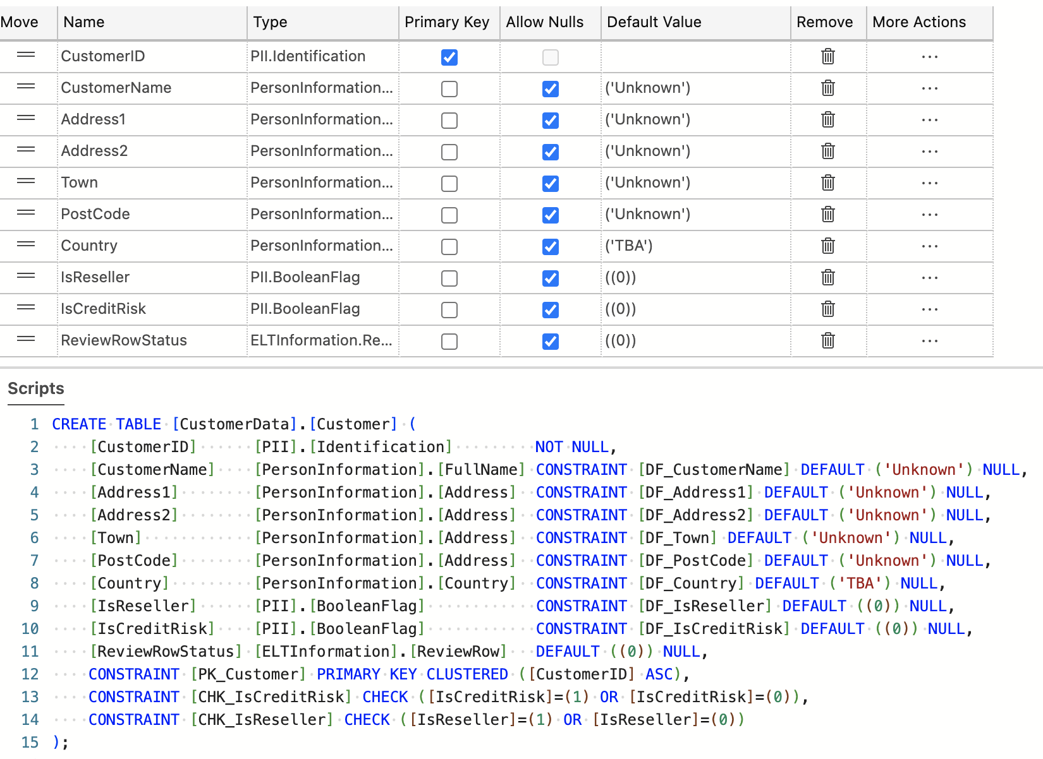
CustomerData.Customer

Slide 23
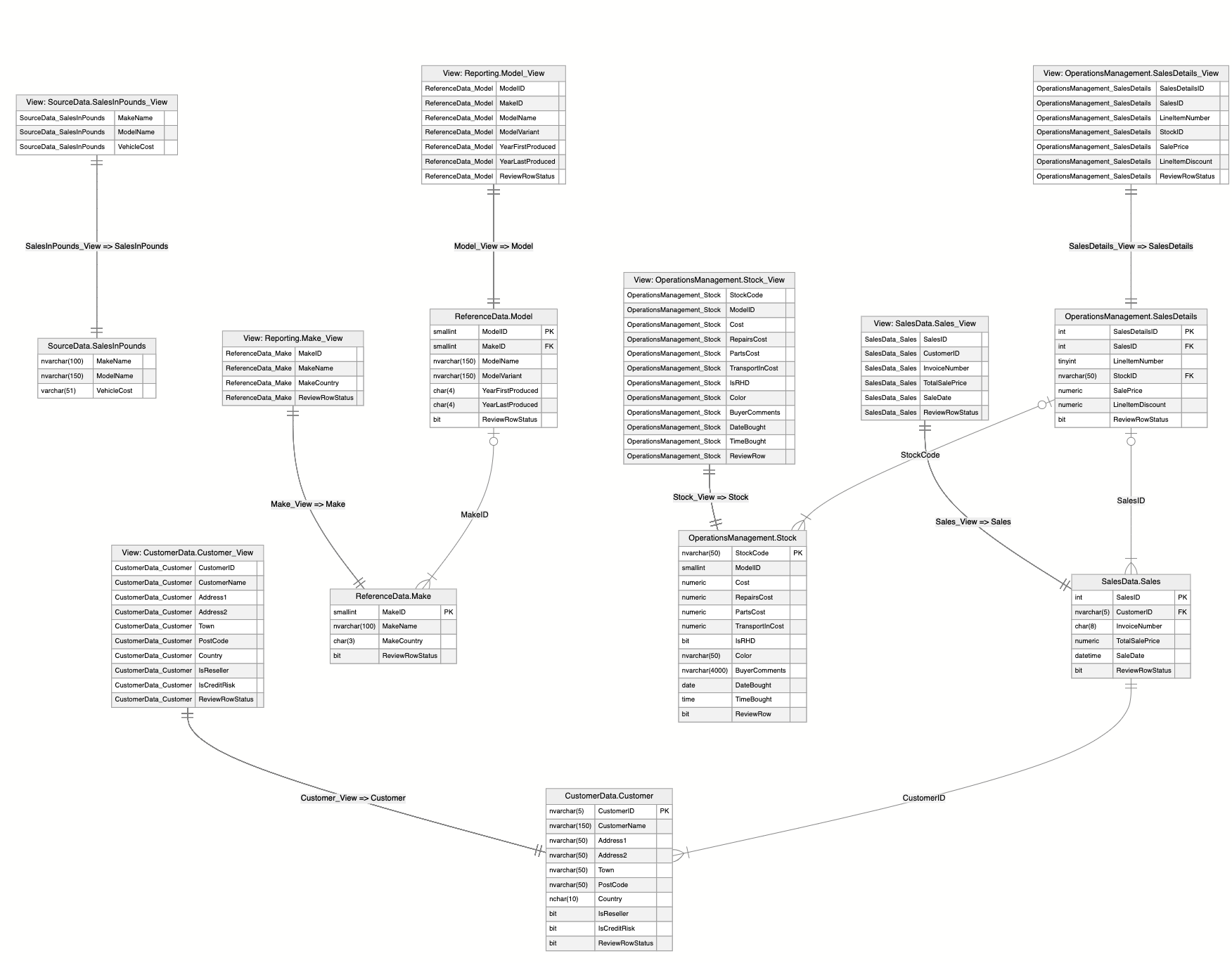

Slide 24
Conclusion
We refactored and normalized the PrestigeCars database using taxonomy
Implemented UDTs FQDs and FQTNs to inject business meaning into the schema
Eliminated nulls to enforce 2-value predicate logic
Implemented ReviewRow for ELT data quality tracking
Produced an ERD showing cross system alignment through shared UDTs
We ended up with a taxonomized, normalized, and standardized version of PrestigeCars.

