Slide 1
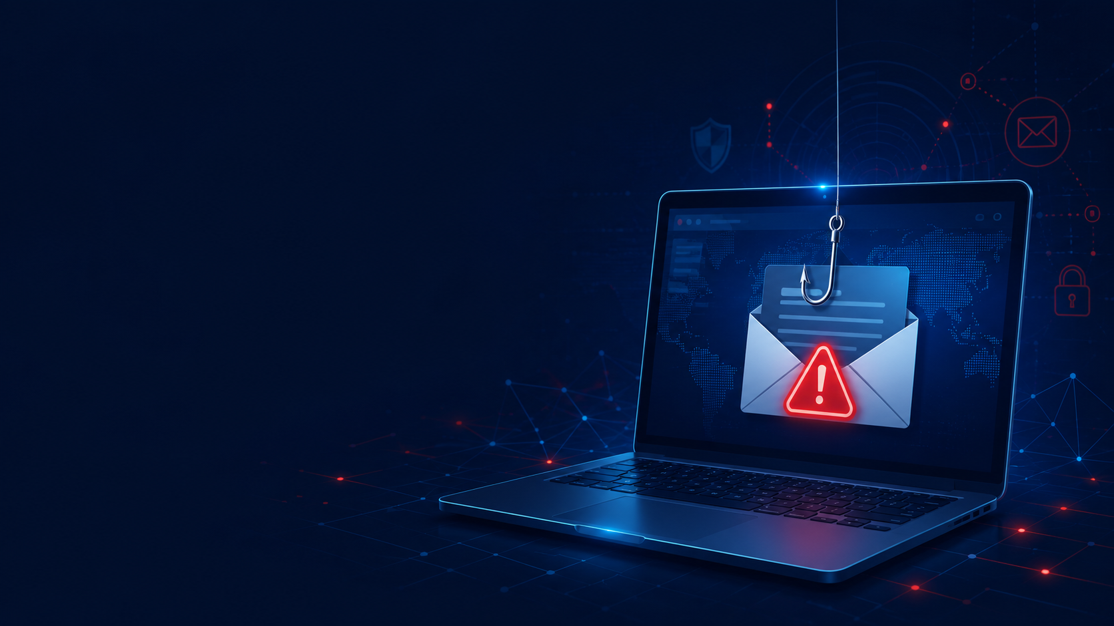
CYBERSECURITY TASK 2
Phishing Awareness
Training
Recognizing and preventing online scams, fake emails, and fraudulent websites.
Prepared for internship completion
Phishing Awareness Training
01

Slide 2
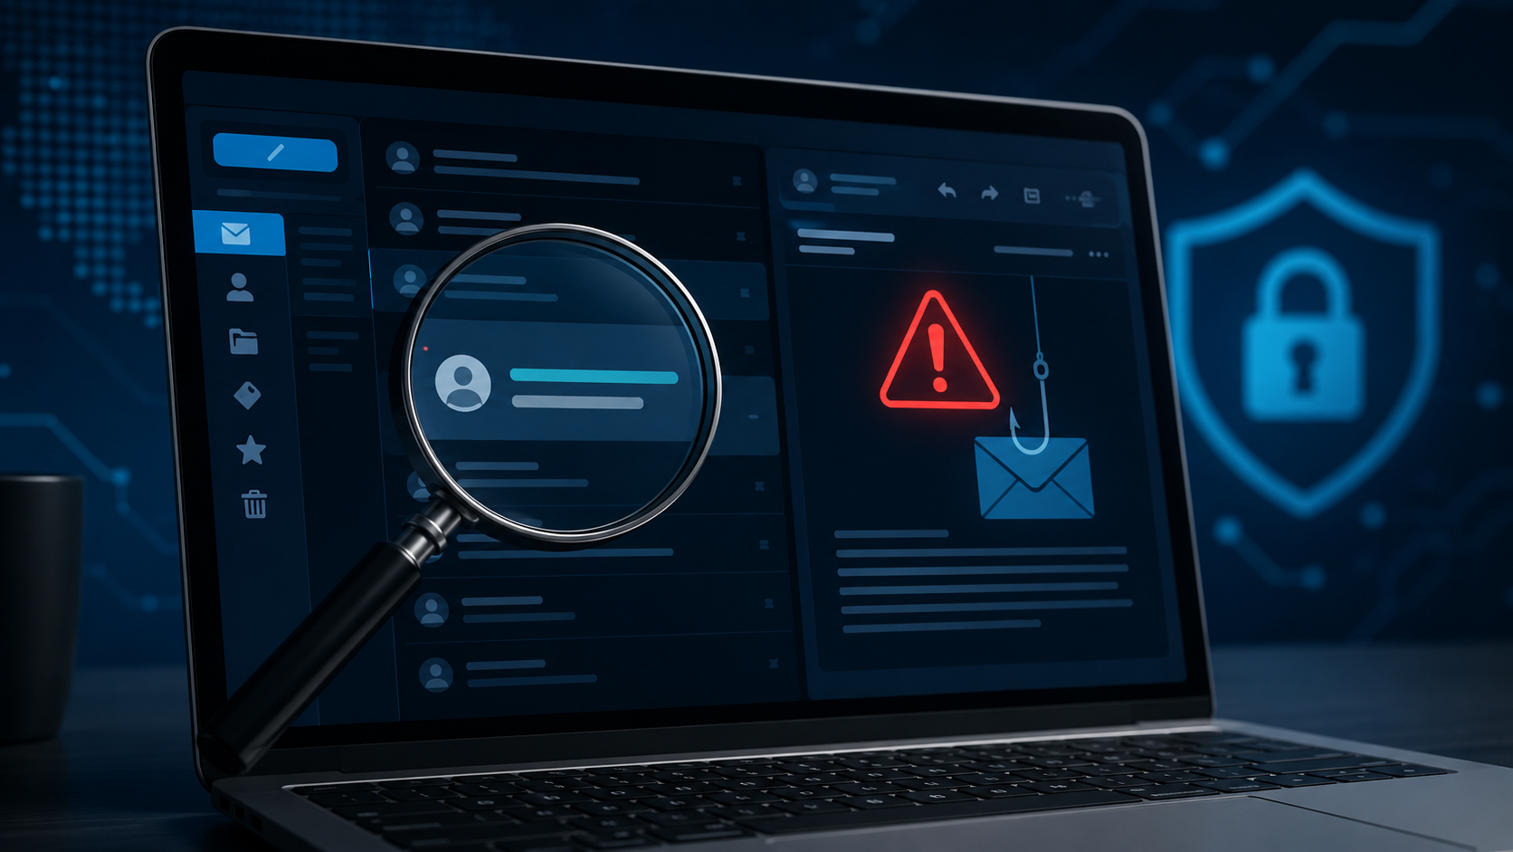
What is Phishing?
A deception-based cyberattack that targets human trust.
Phishing is a cyberattack where attackers use fake emails, messages, websites, or calls to trick people into sharing sensitive information.
The attacker does not break the system first - they trick the user first.
Attackers usually try to steal:
Passwords and login credentials
OTP codes and verification links
Bank or card details
Personal or company information
Phishing Awareness Training
02

Slide 3

Why Phishing is Dangerous
One wrong click can create serious personal and organizational damage.
Account takeover
Attackers gain access to email, social media, or work accounts.
Phishing works because it creates pressure, fear, curiosity, or false trust.
Financial loss
Bank details, card data, or OTPs can be stolen.
Data leakage
Private or company information can be exposed.
Malware infection
Fake attachments may install harmful software.
Phishing Awareness Training
03

Slide 4
Common Types of Phishing
Attackers use different channels, but the goal is usually the same.
Email Phishing
Fake emails with links or attachments
Smishing
Phishing through SMS or chat messages
Vishing
Fraud through phone calls
Spear Phishing
Targeted attack on a specific person
Clone Phishing
A copied email with a malicious link
Same goal: steal information or install malware
Phishing Awareness Training
04

Slide 5
How to Recognize Phishing Emails
Look for warning signs before clicking anything.
Red flags in the email:
From: security-alert@paypaI-help.com
Suspicious sender address
Subject: Your account will be blocked today!
Urgent pressure or fear
Dear User,
We detected unusual activity. Click the link below and verify your password and OTP immediately, otherwise your account will be permanently suspended.
Verify Now: paypaI-secure-login.com
Grammar or spelling mistakes
Unknown link or attachment
Generic greeting like “Dear User”
Before you click: verify the sender and URL
Phishing Awareness Training
05

Slide 6
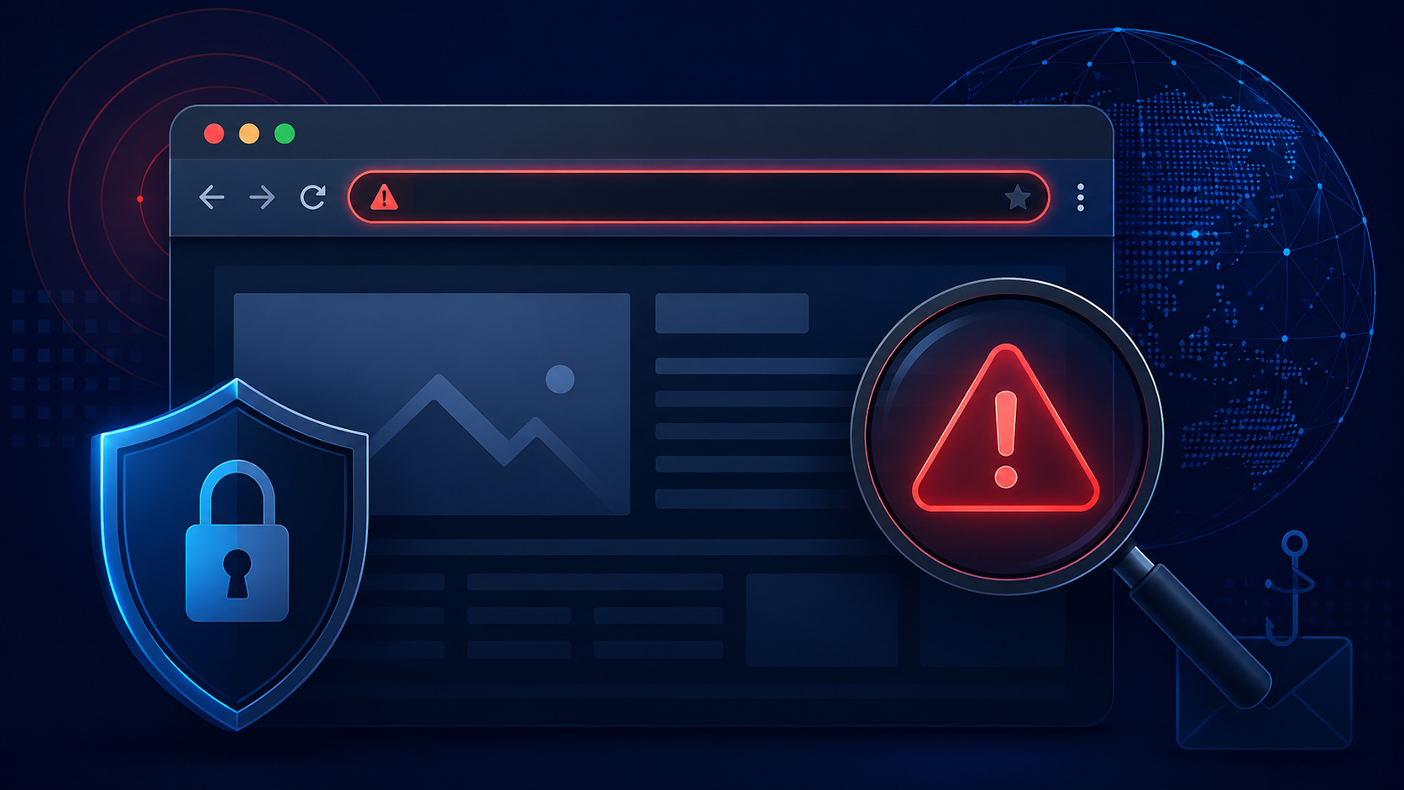
Fake Website Signs
A fake website often looks real, but the URL gives it away.
Check these signs:
⚠ https://amaz0n-login-security.com
1
Wrong spelling in domain name
Amazon Account Verification
2
No clear company identity
Enter your email, password, and OTP to continue.
3
Too many pop-ups or pressure
4
Asks for password, OTP, or card data
Verify Now
5
Looks similar, but URL is not official
Phishing Awareness Training
06

Slide 7
Social Engineering Tactics
Phishing targets emotions as much as technology.
Urgency
“Your account closes in 24 hours.”
Fear
“Your bank account has been hacked.”
Greed
“You won a free iPhone.”
Authority
“Message from your manager or bank.”
Curiosity
“See your exam result here.”
Trust
Uses a familiar brand or person.
Rule: slow down before reacting
Phishing Awareness Training
07

Slide 8
Real-World Example
Fake bank email asking for login credentials and OTP.
Scenario
A user receives an email claiming that their bank account has been locked. The email asks the user to click a link and enter username, password, and OTP.
Lesson: never use email links for banking login. Type the official website manually.
What actually happens?
The website looks similar to the real bank website.
The URL is fake.
The attacker steals login information.
Verify first. Click later.
The user may lose access or money.
Phishing Awareness Training
08

Slide 9
Best Practices to Avoid Phishing
Simple habits can prevent most phishing attacks.
✓
Do not click unknown links
✓
Check sender email carefully
✓
Never share password or OTP
✓
Avoid unknown attachments
✓
Use official websites manually
✓
Enable two-factor authentication
✓
Use strong unique passwords
✓
Keep browser and antivirus updated
✓
Report suspicious emails
Phishing Awareness Training
09

Slide 10
What to Do After Clicking a Phishing Link
Fast action can reduce the damage.
1
Change your password immediately
2
Enable two-factor authentication
3
Scan your device for malware
4
Check account activity and sessions
5
Inform your bank, company, or support team
6
Report the phishing message
7
Change reused passwords on other sites
Do not ignore it - act quickly.
Phishing Awareness Training
10

Slide 11
Interactive Quiz Activity
A short quiz checks understanding after the training.
Recommended quiz format: 10 MCQs in Google Forms.
Sample Question
Quiz topics
Purpose of phishing attacks
What should you check first before logging in to a website from an email link?
Signs of phishing emails
Fake website identification
A. Background color
B. URL / domain name
C. Font size
D. Image quality
Social engineering tricks
Safe online behavior
Correct answer: B
Phishing Awareness Training
11

Slide 12
Conclusion
Phishing attacks are common, but awareness and careful verification can prevent most incidents.
Verify sender and domain before clicking.
Do not share passwords, OTPs, or sensitive data.
Report suspicious emails and act quickly if exposed.
Thank You
Stay alert. Think before you click.
Phishing Awareness Training
12

