Slide 1


Shark Poker bot
Sefa Sahan

Slide 2

How difficult is it to calculate poker combinations?
How does the Shark Poker bot perform these calculations?
Some example of Shark Poker Bot game.
What are the limitations of the Shark Poker bot?
What are the prospects for the Shark Poker bot?
outlines

Slide 3
difficulties to calculate poker combinations
Ranking of the cards
Behavior of the other players
Size of the pot and bets
Number of players
Notes:
Calculating poker combinations can be quite difficult due to the complexity of the game and the many different factors that need to be taken into account. These factors can include the ranking of the cards, the size of the pot and bets, the behavior of the other players, and the number of players. To calculate these combinations accurately, a poker bot needs to use mathematical algorithms and statistical analysis.

Slide 4
Shark Poker bot Calculations
Cards Combinations Calculations
Human Behaviors Calculations
Size of the pot and bets Calculations
Notes:
Cards Combinations Calculations are at the core of Shark Poker's powerful engine. The bot uses advanced algorithms to analyze every possible combination of cards that can be dealt and calculates the probability of winning for each one. This enables the bot to make smart decisions and optimize its gameplay, giving it a significant edge over human players.
On the other hand, Human Behaviors Calculations, which involve analyzing human players' behavior and tendencies, are equally important but more challenging to implement. Despite the lack of accessible data, Shark Poker is continually improving its ability to recognize patterns and adapt to different playing styles. While this is an ongoing challenge, it is also an exciting opportunity for further development in the future.
The size of the pot and bets is a crucial factor in poker. To calculate the probability of winning a hand, the bot must consider the current pot size and the size of the bets. By analyzing this data, the bot can make more informed decisions, such as whether to fold, call, or raise. Our Card Shark Poker bot is designed to incorporate the size of the pot and bets into its calculations, giving it a more comprehensive understanding of the game and improving its overall performance.
Overall, Shark Poker's focus on both Cards Combinations Calculations and Size of the pot and bets calculations makes it a formidable opponent at the poker table, combining raw analytical power with advanced behavioral analysis to stay one step ahead of the game.

Slide 5
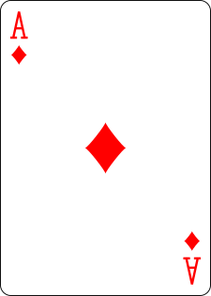
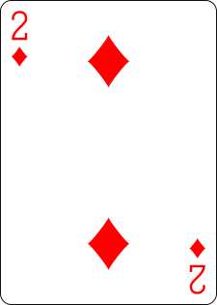
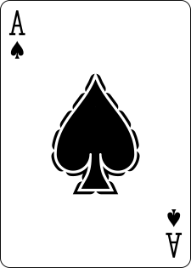
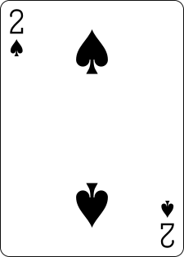
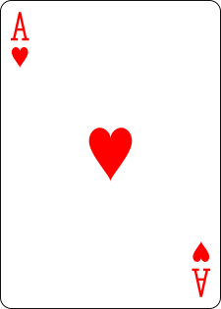
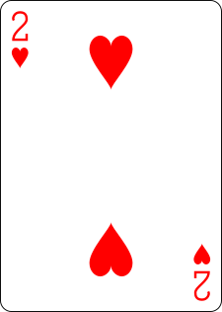
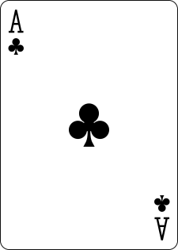
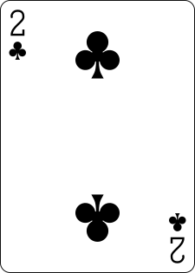
Card Combinations Calculations
Pre Flop Combinations
n choose k = n! / (k! * (n-k)!)
52 choose 2 = 52! / (2! * (52 - 2)!) = 1326
169
1326
Notes:
The number of possible combinations of 2 cards out of 52 is given by the formula: 52 choose 2, which equals 1.326. This means that there are 1.326 possible combinations of cards that the bot can have in the pre-flop stage.
However, we can reduce this number by eliminating combinations that are equivalent. For instance, if the bot has Ace of diamond and 2 of diamond, it does not need to calculate the win rate for Ace of hearts and 2 of hearts, as these are equivalent hands. By applying this rule, we can reduce the number of combinations from 1.326 to 169.

Slide 6
Card Combinations Calculations
Pre Flop Combinations
Player cards combinations 50 choose 2 = 50! / (2! * (50 - 2)!) = 1225
Community cards combinations 48 choose 5 = 50! / (5! * (50 - 5)!) = 1,712,304
For each poker hand 1,225 * 1,712.304 = 2,097,572,400 simulations
Shark Poker simulate 1,225 * 10,000 = 10,225,000 simulations
Total 10,225,000 * 169 = 1,728,025,000 simulations
Notes:
Shark Poker performs a massive number of simulations - 1,225,000 simulations for each of the 169 different possible starting hands. That's a total of 207,025,000 simulations for pre-flop calculations alone.
The simulations performed by Shark Poker involve calculating the combinations of player cards and community cards separately, which is done using mathematical formulas such as n choose k. The results of these simulations are used to calculate the odds of winning for each possible hand.
Thanks to Shark Poker's advanced algorithms and computing power, players can trust the accuracy of its calculations and make more informed decisions during gameplay.

Slide 7
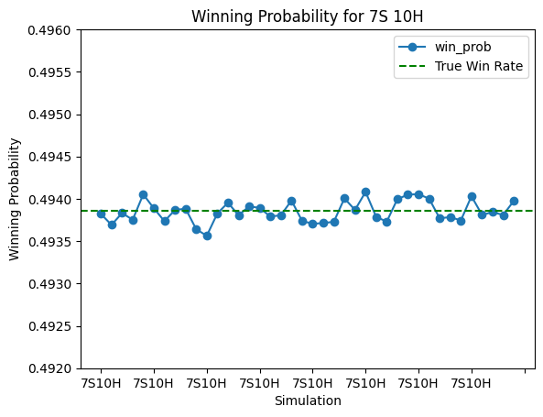
Card Combinations Calculations
Pre Flop Combinations
Mean: 0.4938
Standard deviation: 0.0001
Minimum: 0.4936
Maximum: 0.4941
Median: 0.4938
Real:0.4938546659938889
Notes:
Shark Poker, has been designed to excel at calculating the odds of winning a hand. By performing over 207 million simulations for pre-flop status, the bot has achieved an incredibly high level of accuracy in predicting the outcome of a hand. This is reflected in the chart and statistics have provided, which show the winning probability for the 7 of spade and 10 of Hearts hand across multiple simulations.
In addition to the chart, we have also calculated important statistics, such as the mean and standard deviation, to provide a more comprehensive understanding of the data. These statistics allow us to gauge the reliability and consistency of our bot's calculations, giving us confidence in its performance.
Overall, Shark Poker's ability to perform complex calculations and provide accurate predictions is a testament to the power of artificial intelligence in the world of poker. With further refinement and development, we believe our bot has the potential to revolutionize the way poker is played and won.

Slide 8
Card Combinations Calculations
Flop Combinations
Bot cards combinations 52 choose 2 = 52! / (2! * (52 - 2)!) = 1326
Three Community cards 50 choose 3 = 50! / (3! * (50 - 3)!) = 19,600
Bot hand + 3 community card 1,326 * 19600 = 25,989,600 combinations
After used same reduce combinations method like pre flop
Need to calculate 270,395 combinations for Flop
Notes:
The Flop Combinations calculation is a critical aspect of Shark Poker's success. With a total of 52 cards in the deck, the bot must consider all possible combinations of two cards for itself, and three community cards on the flop. This gives a massive total of 19,600 flop combinations to analyze. When combined with the bot's two-hole cards, the total number of possible combinations soars to a staggering close to 26 million. However, the Shark Poker bot's sophisticated algorithms employ a reduction method, significantly reducing the number of combinations that need to be analyzed to just 270 thousand.

Slide 9
Card Combinations Calculations
Flop Combinations
Player cards combinations 47 choose 2 = 47! / (2! * (47 - 2)!) =1,081
Community cards combinations 45 choose 2 = 45! / (2! * (45 - 2)!) = 990
For each flop combinations 1,081 * 990 = 1,070,190 simulations
Shark Poker for each flop 1,081 * 100 = 108,100 simulations
Total 108,100 * 270,395 = 29,229,699,500 simulations
Notes:
With over 29 billion simulations, Shark Poker's data set is a powerful tool for accurately predicting the outcome of Texas Hold'em poker games. By calculating every possible combination of player and community cards for each flop, Shark Poker has created a robust data set that enables it to accurately predict the odds of winning for any given hand. With this level of accuracy and attention to detail, Shark Poker is a force to be reckoned with in the world of online poker.

Slide 10
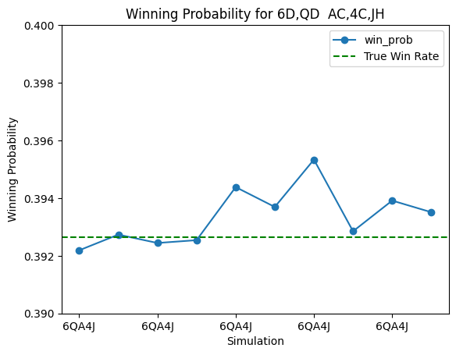
Card Combinations Calculations
Flop Combinations
Mean: 0.3934
Standard deviation: 0.0009
Minimum: 0.3922
Maximum: 0.3953
Median: 0.3932
Real:0.39265233962909424
Notes:
The Shark Poker, accurately predicts the outcome of a hand after the flop. Through over 29 billion simulations for the flop, winning strategies have been developed and the reliability of the bot's calculations have been analyzed.
The provided chart and statistics demonstrate the consistency of the bot's calculations, providing players with invaluable insights into the strengths and weaknesses of different hands.

Slide 11
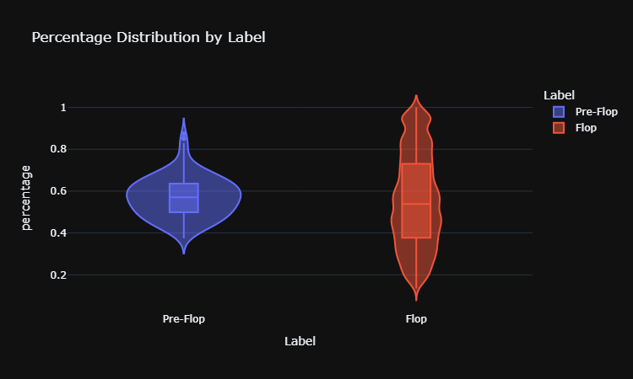
distribution of Pre flop and flop Win rate

Slide 12
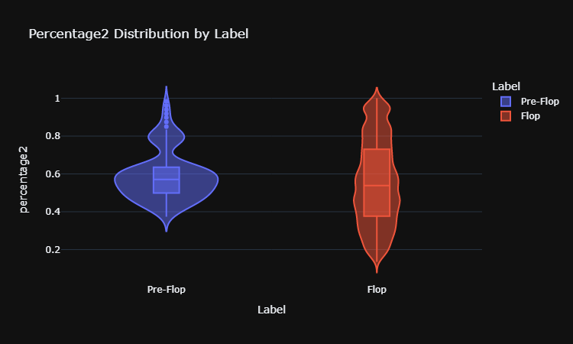
After manipulate Pre flop

