Slide 1
BOOK OF DANIEL

Slide 2
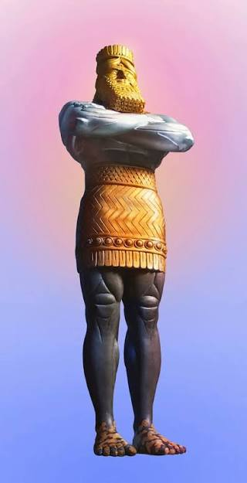

Slide 3
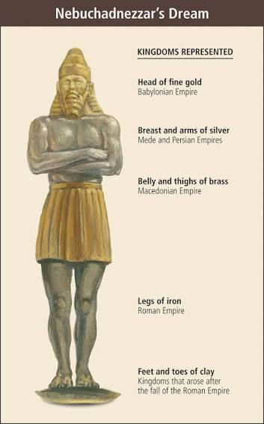

Slide 4
BABYLON EMPIRE
KINGS B.C. 625 – 538
1. NEBOPOLUZER 625 – 605
2. NEBUKKADNEZAR 605 – 562
3. EVIL- MERODECK 562 – 559
4. NERIGLISSAR 559 – 556
5. LABHASHI- MARDUK 556 – 540
6. NEBONIDAS – BELSASSAR 540 - 538

Slide 5
MEDO- PERSIAN EMPIRE

