Slide 1

Sefunmi Osinaike
Co-founder CEO
3B Electrical and Computer Engineering
@PaveApp_
Notes:
Manage passion. Lack emotional elements, be more enthusiastic, don’t let it take away from the ability for people. The next geberaton of students so they wont know what it was like to experience university without pave. gold

Slide 2
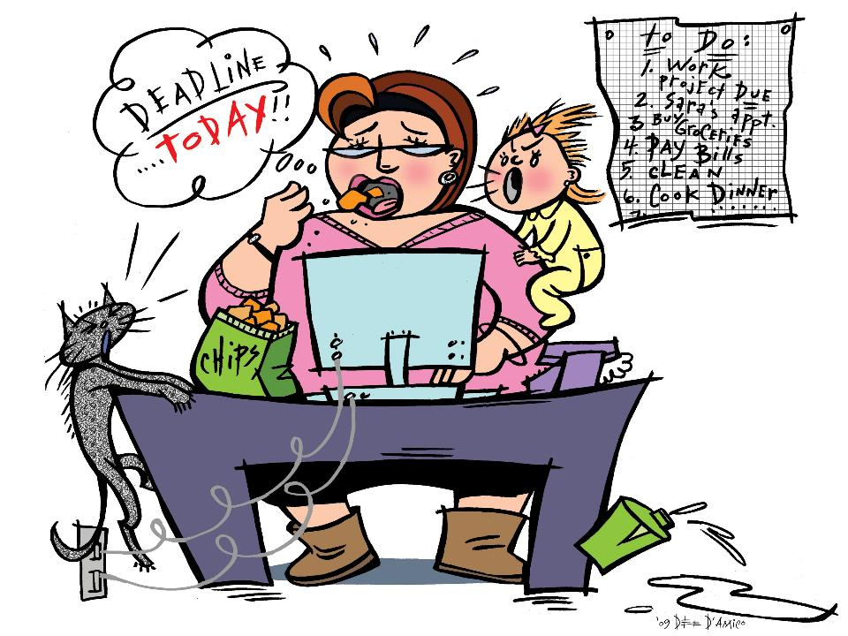
Poor Time Management
Lack of Time
Lack of Time
Bad Preparation

Slide 3
Plan
Focus
Execute

Slide 4

Ultimate Time Management tool to improve and enhance productivity.

Slide 5
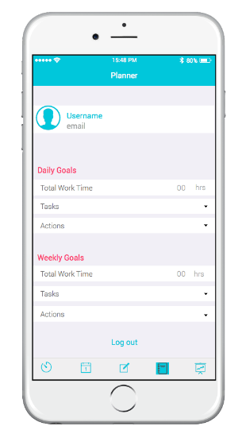
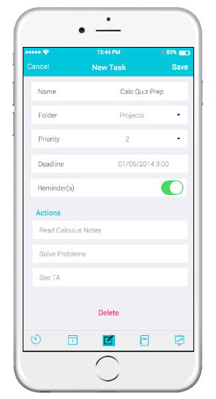
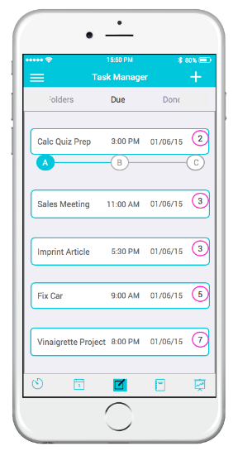
Plan

Slide 6
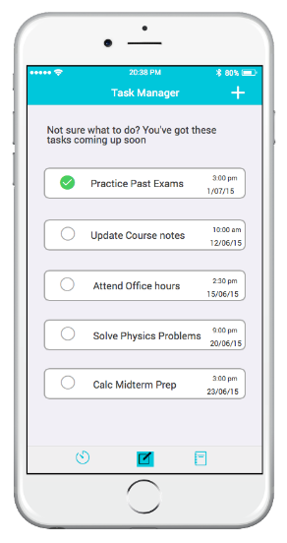
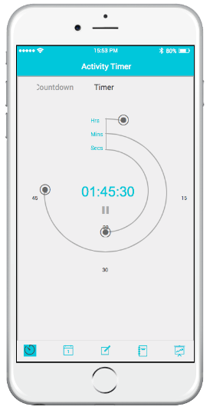
Plan
-
Focus

Slide 7
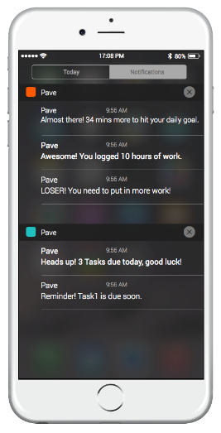
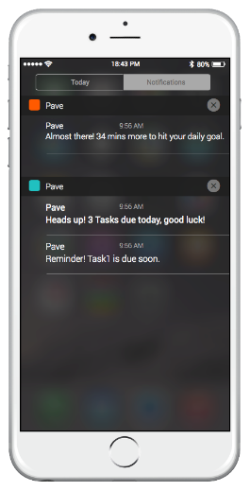
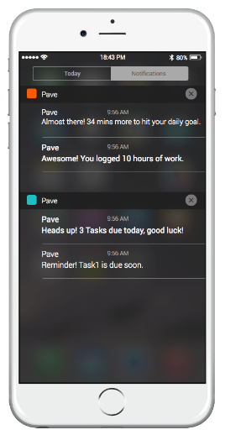
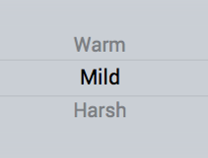
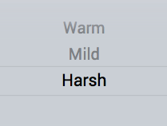
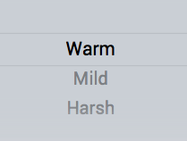

Slide 8
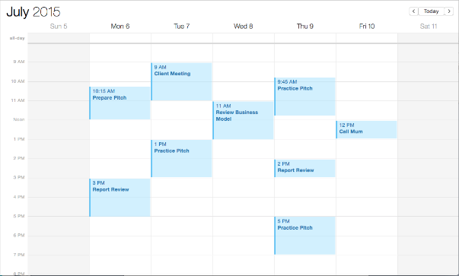
Unique Technology
Criterion: Priority, Due date, Progress, Importance

Slide 9
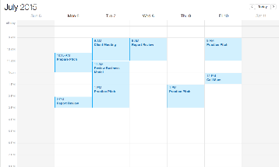
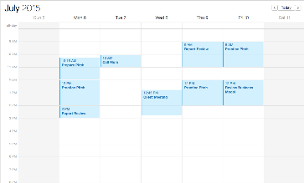
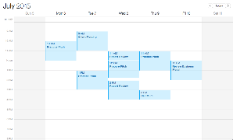
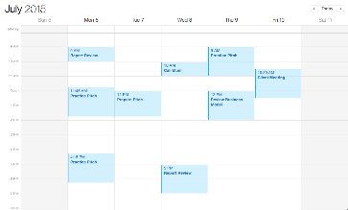
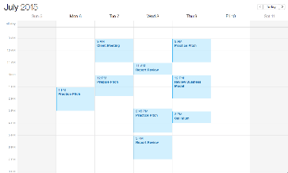
Unique Technology
5 suggestions you can pick from

Slide 10
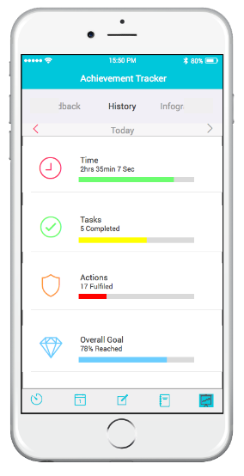
Execute

Slide 11

Pave
Commitments
Priorities
Deadlines
Improved Decision Making
Lower Anxiety
Productivity and Efficiency

Slide 12

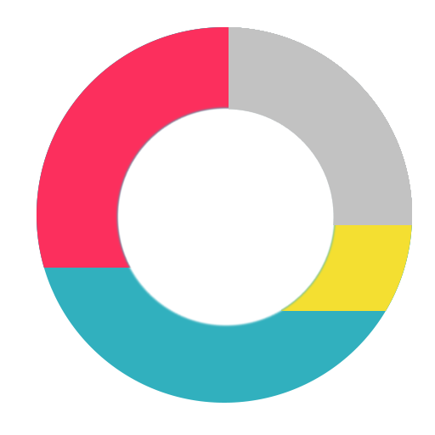
Market
-Personal Projects
-Part time jobs
-Involved with clubs
-Volunteers
uWaterloo
-External Organizations
Varsity and Intramurals
Pro Subscription: $1.99 per month

Slide 13
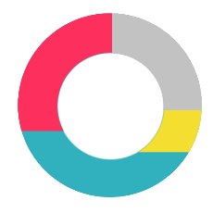
Market
U of T
York
Ryerson
McMaster
Western
U Ottawa

Slide 14
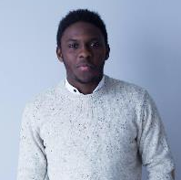
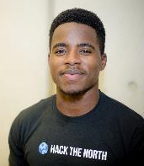
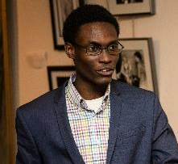
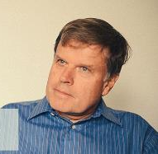
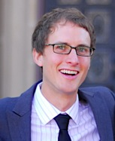
Team
Sefunmi
Ian
Joshua
Larry Smith
Dr Stephen L. Smith

Slide 15


Simplified Productivity
@PaveApp_

