Slide 1
BMP50 astrocytes: morphology → RNA programs
Predict transcriptional state from imaging
(bulk RNA-seq builds the frozen atlas; morphology drives inference)

Slide 2
Question
• What does BMP50 do to astrocyte transcription over time (ctrl → 4h → 24h → 72h → 7d)?
• Which coordinated gene programs move: BMP signaling, cell cycle, reactive state, lineage, late maturation?
• Imaging is cheap and rich in shape — can morphology alone recover those bulk RNA programs?
• If yes: how? (predict time from morph, then look up a frozen RNA atlas — not cell-matched RNA)
• Does skeleton morphometry itself equal the cytoskeleton gene program? Or are they related but offset in time?

Slide 3
Design: morphology → RNA (RNA atlas built once)
• Imaging pipeline: U-Net / Cellpose-style segmentation → single-cell crops → CellProfiler + skeleton morphometrics
• Pool cells to slice features (medians, p90s, cluster fractions, optional cell-level time helper)
• Stage 1 — morph → time: L2 multinomial logistic regression with nested CV (~92% slice accuracy)
• Stage 2 — time → RNA: predicted_RNA = P(time|morph) · frozen bulk atlas (programs + genes)
• Bulk RNA-seq (DESeq2 VST) only builds/validates that atlas — it is not an input when you predict on new FOVs
• No cell-matched RNA: imaging slices and bulk wells share time labels only

Slide 4
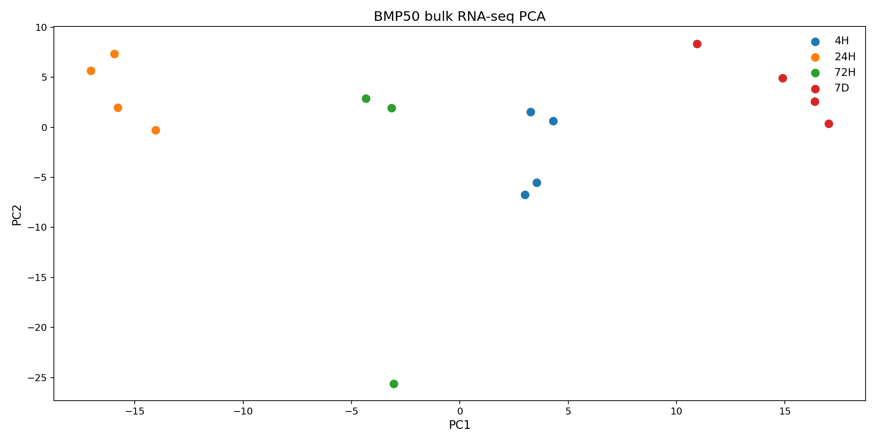
Bulk RNA-seq PCA: samples separate by BMP50 time
Transcriptional state changes continuously along the time course — the atlas we will later mix from morphology.

Slide 5
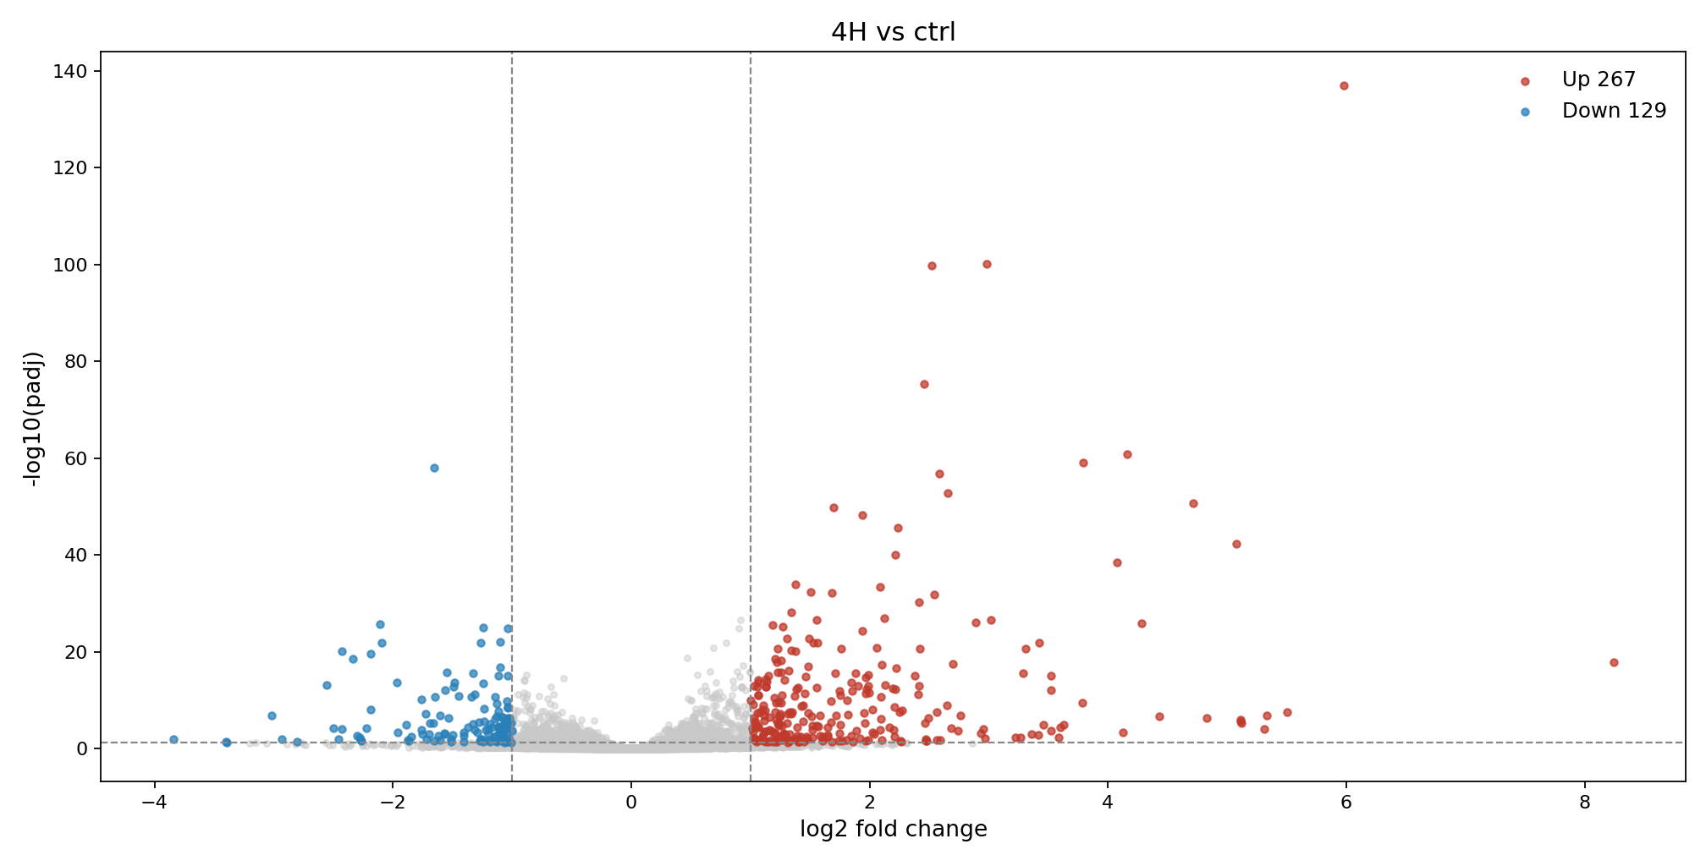
Volcano: 4H vs ctrl (padj<0.05, |LFC|≥1) — label genes by hand
Red = significantly up; blue = significantly down. No gene labels (add interactively).

Slide 6
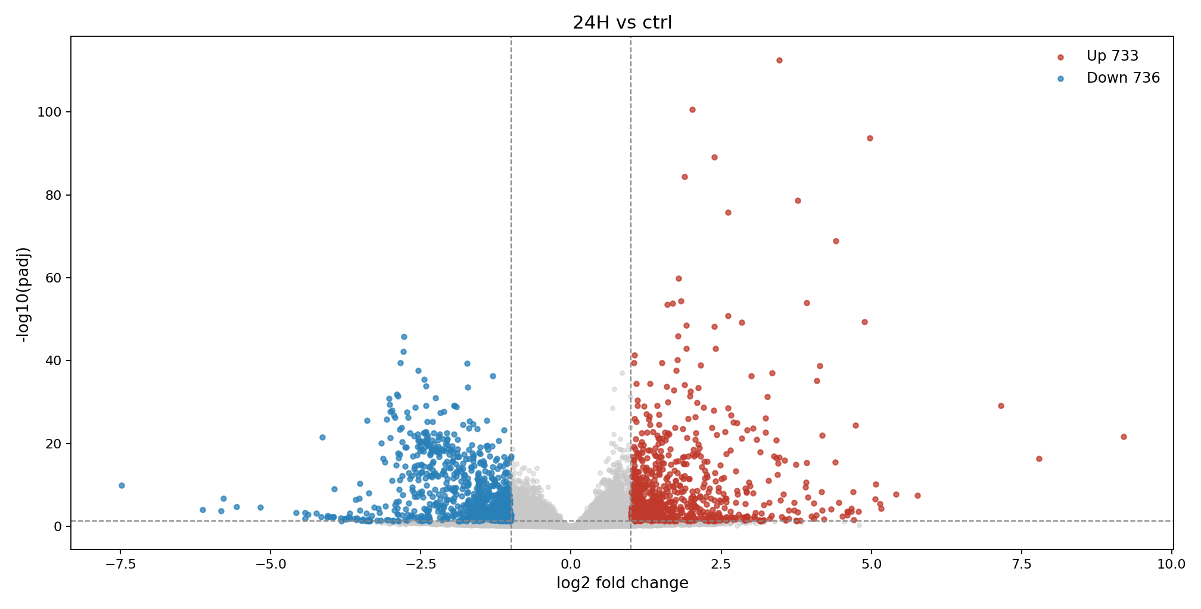
Volcano: 24H vs ctrl (padj<0.05, |LFC|≥1) — label genes by hand
Red = significantly up; blue = significantly down. No gene labels (add interactively).

Slide 7
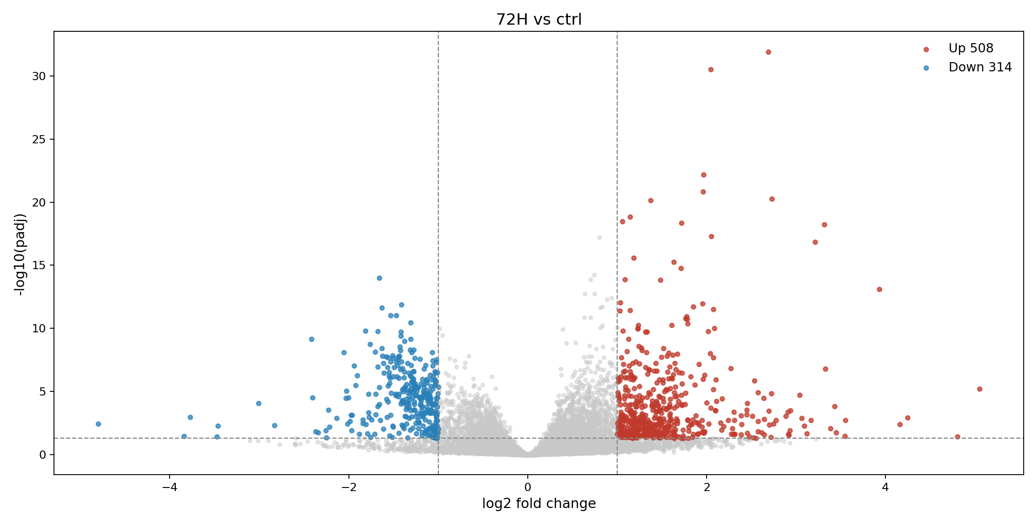
Volcano: 72H vs ctrl (padj<0.05, |LFC|≥1) — label genes by hand
Red = significantly up; blue = significantly down. No gene labels (add interactively).

Slide 8
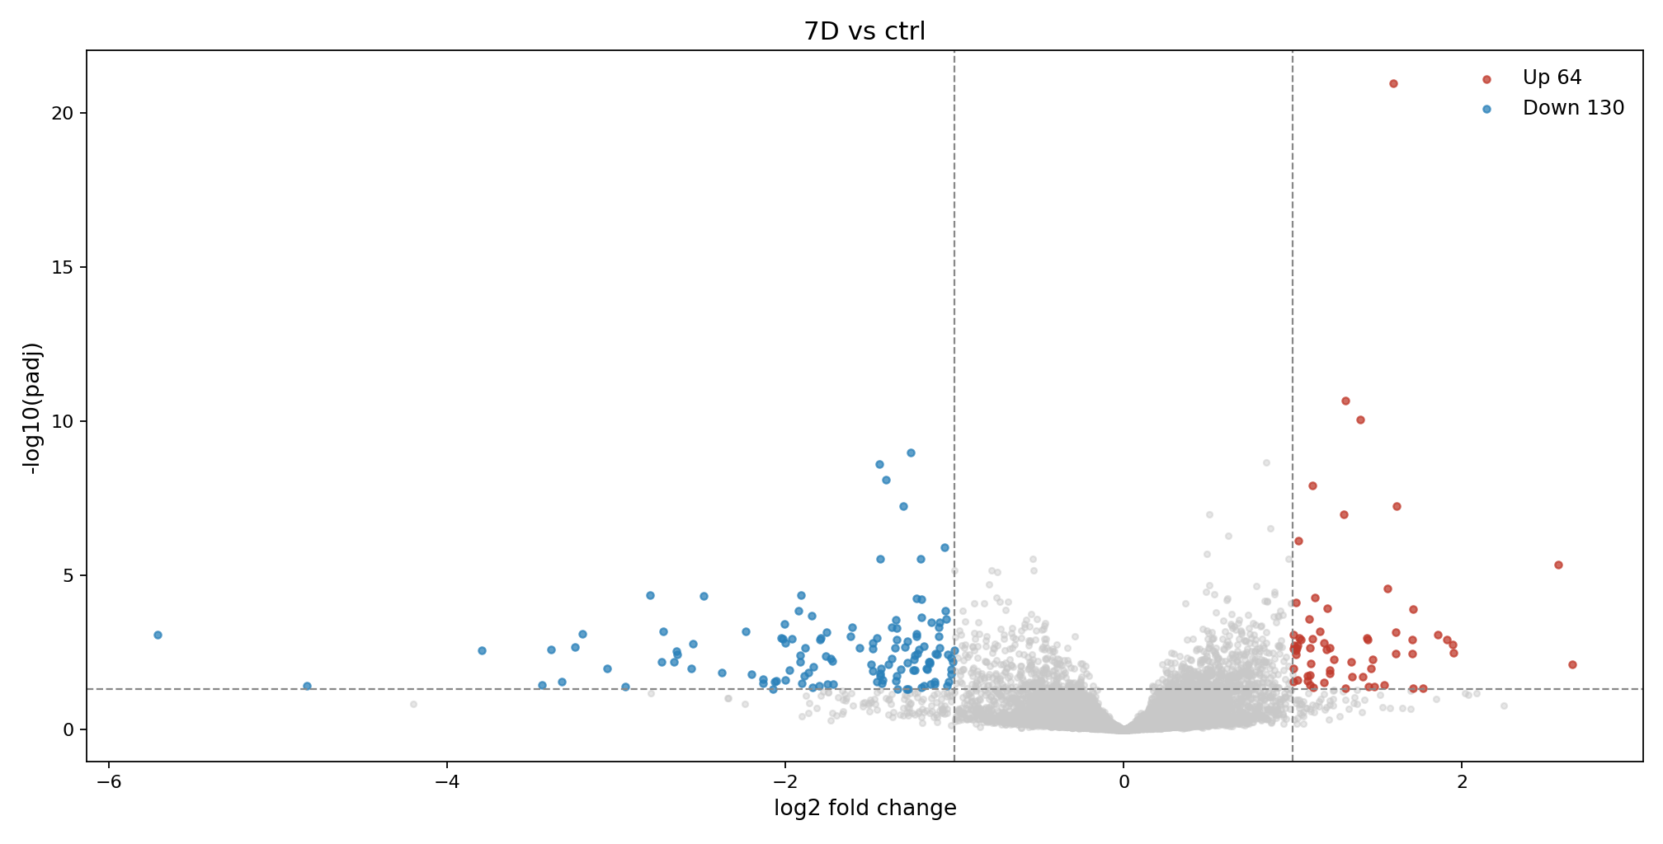
Volcano: 7D vs ctrl (padj<0.05, |LFC|≥1) — label genes by hand
Red = significantly up; blue = significantly down. No gene labels (add interactively).

Slide 9
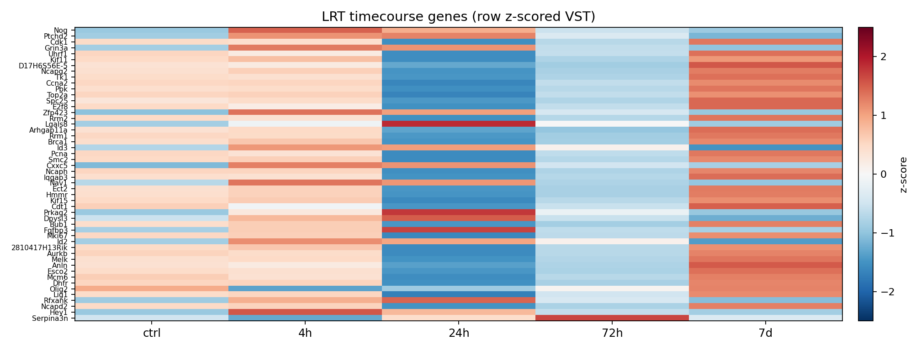
LRT timecourse heatmap (wide): genes × time
Row z-scored mean VST. Shows coordinated blocks: early BMP, mid arrest, late recovery/maturation.

Slide 10
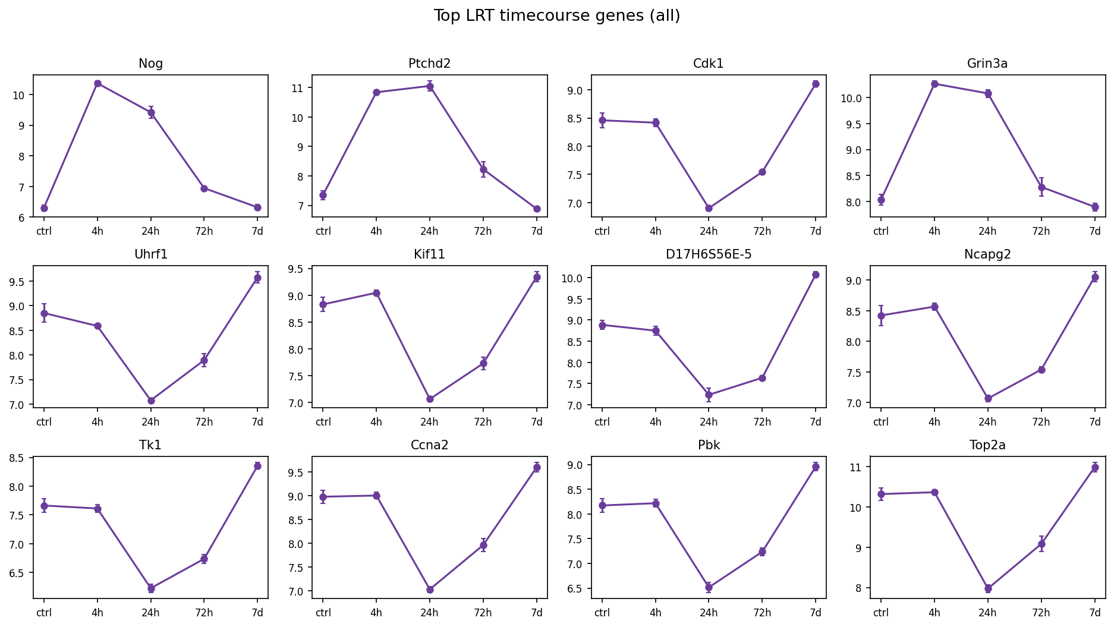
Top LRT genes — all trajectories together

Slide 11
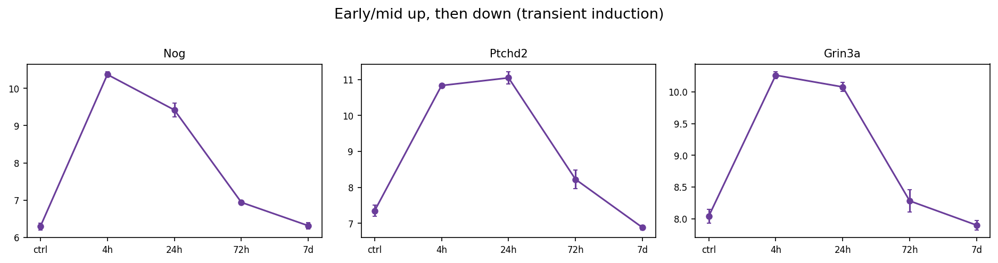
LRT group: up then down (transient induction)

Slide 12
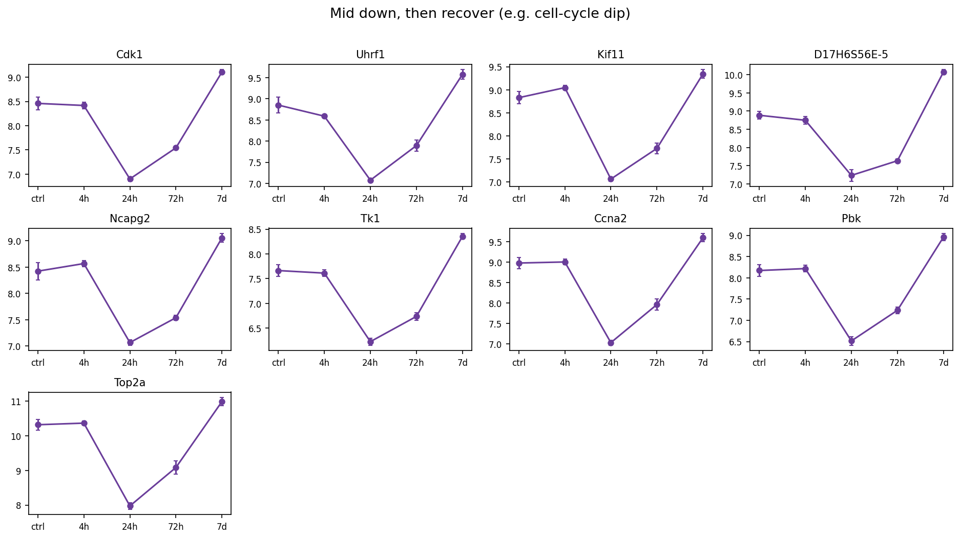
LRT group: down then up (mid dip / recovery)

Slide 13
RNA biology snapshot — what BMP50 is doing
• Early (4h): classic BMP/SMAD pulse — Id1/Id3, Smad6/7, Nog strongly induced; oligodendrocyte-lineage TFs (e.g. Olig2) suppressed. This is “BMP is on.”
• Mid (24h): dominant genome-wide pattern is transient — proliferation genes (Mki67, Top2a, Ccna2…) drop (arrest), then largely recover by 7d. Gfap also rises mid-course but is not sustained forever.
• Mid–late (72h): reactive / injury-like and immune-adjacent axes move (Stat3, Lcn2/Serpina3n, MHC class I, complement). Homeostatic astrocyte function genes (uptake / K+ / connexin) can rise here too.
• Late (7d): a distinct maturation / thyroid-hormone-related set turns on (Dio2, Slco1c1, Thy1, Nnat). Very few genes are sustained in the same direction at every timepoint (Smad6 up; Dll1 down).
• Takeaway for imaging: morphology should be able to tell early vs mid vs late states if shape tracks these transitions — then we can recover the corresponding RNA programs.

Slide 14
Bridge: how morphology maps onto RNA programs
• A program is a gene-set score from bulk RNA (mean VST of curated genes → z-score → average by time). Example: cytoskeleton = Vim, Nes, actin/MT/Rho genes — not a skeleton length pixel count.
• We curated ~14 programs (BMP_Id, cell_cycle, reactive_GFAP, cytoskeleton, OPC_pdgfra, late_7d, immune axes, glutamate/ion, ECM…). Bulk RNA defines the atlas once.
• Morphology never reads genes. It only predicts P(time). We then mix the frozen atlas: predicted_program = Σ P(time) × atlas(time).
• That is why purple curves are smoother than black: uncertain time blends neighboring states — healthy generalization, not failure.
• Direction of the model: morph features → time → RNA programs (RNA is lookup, not input at inference).

Slide 15
Morphology → time: nested CV (what we trust)
• We do not quote a single train/test on the same slices without nesting.
• Honest result: nested top-35 feature selection inside each fold → ~92% slice accuracy for time.
• Avoid the leaky ~98% run where features were chosen using all slices before CV.
• Confusion matrices look impressive but still reflect CV folds of this one experiment — treat as supportive, not definitive external validation.
• What matters next: once time is predicted, RNA programs mix from the atlas.

Slide 16
Top morph features for time — grouped
• Cell-helper time votes (stable in 5/5 folds): mean_Pcell_ctrl, mean_Pcell_4h, mean_Pcell_24h, mean_Pcell_72h — average per-cell time probabilities pooled to the slice.
• GFAP / Channel_0 intensity: p90_Intensity_IntegratedIntensity_Channel_0, median_Intensity_IntegratedIntensity_Channel_0, related edge/max/std intensity — how strongly GFAP lights up.
• Outline / shape (Zernike & moments): p90/median AreaShape_Zernike_* (e.g. 6_0, 2_2, 5_3, 7_7, 4_4, 6_6, 8_0…), NormalizedMoment_3_0 — compact summary of process silhouette.
• Mass displacement / other channels: median/p90 Intensity_MassDisplacement_Channel_1/2, LowerQuartileIntensity_Channel_2, IntegratedIntensityEdge_Channel_2 — intensity geometry beyond raw GFAP sum.
• Population mix: frac_cluster_1, frac_cluster_2 (and sometimes 4) — which morphological clusters dominate the FOV.
• Skeleton / branching (selected often but not always): median_nontrunk_branch_points, p90_nontrunk_branch_points — process complexity; useful for time, but (later) not a 1:1 cytoskeleton-RNA proxy.

Slide 17
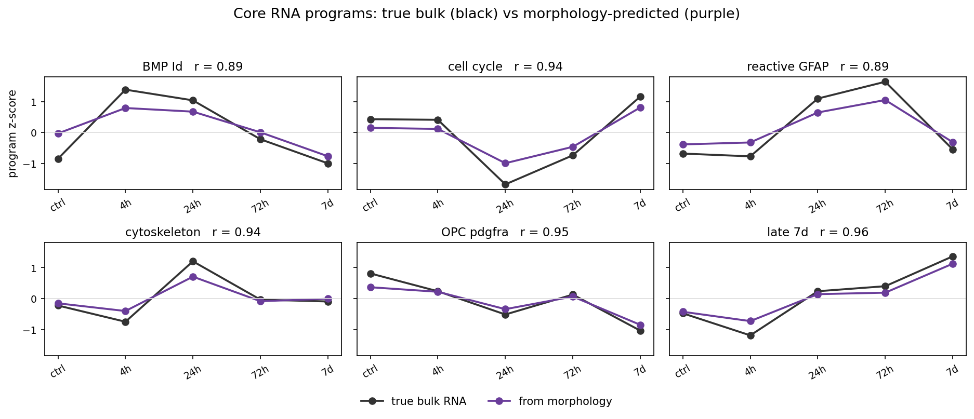
Core story (3×2): true bulk vs morph-predicted programs
Black = true bulk program by time; purple = morphology via P(time)·atlas. r on each panel = recovery strength.

Slide 18
What does the r on each panel mean?
• For each program, every imaging slice gets a predicted score from morphology (via P(time)).
• We compare that prediction to the true bulk program score for the slice’s real timepoint.
• Pearson r ≈ how well the morph-derived scores track the true time-course of that program across slices.
• High r (e.g. late_7d 0.96, cytoskeleton 0.94) means morphology recovers that program’s trajectory well.
• This is NOT “genes measured in the image” — it is atlas mixing after time prediction.

Slide 19
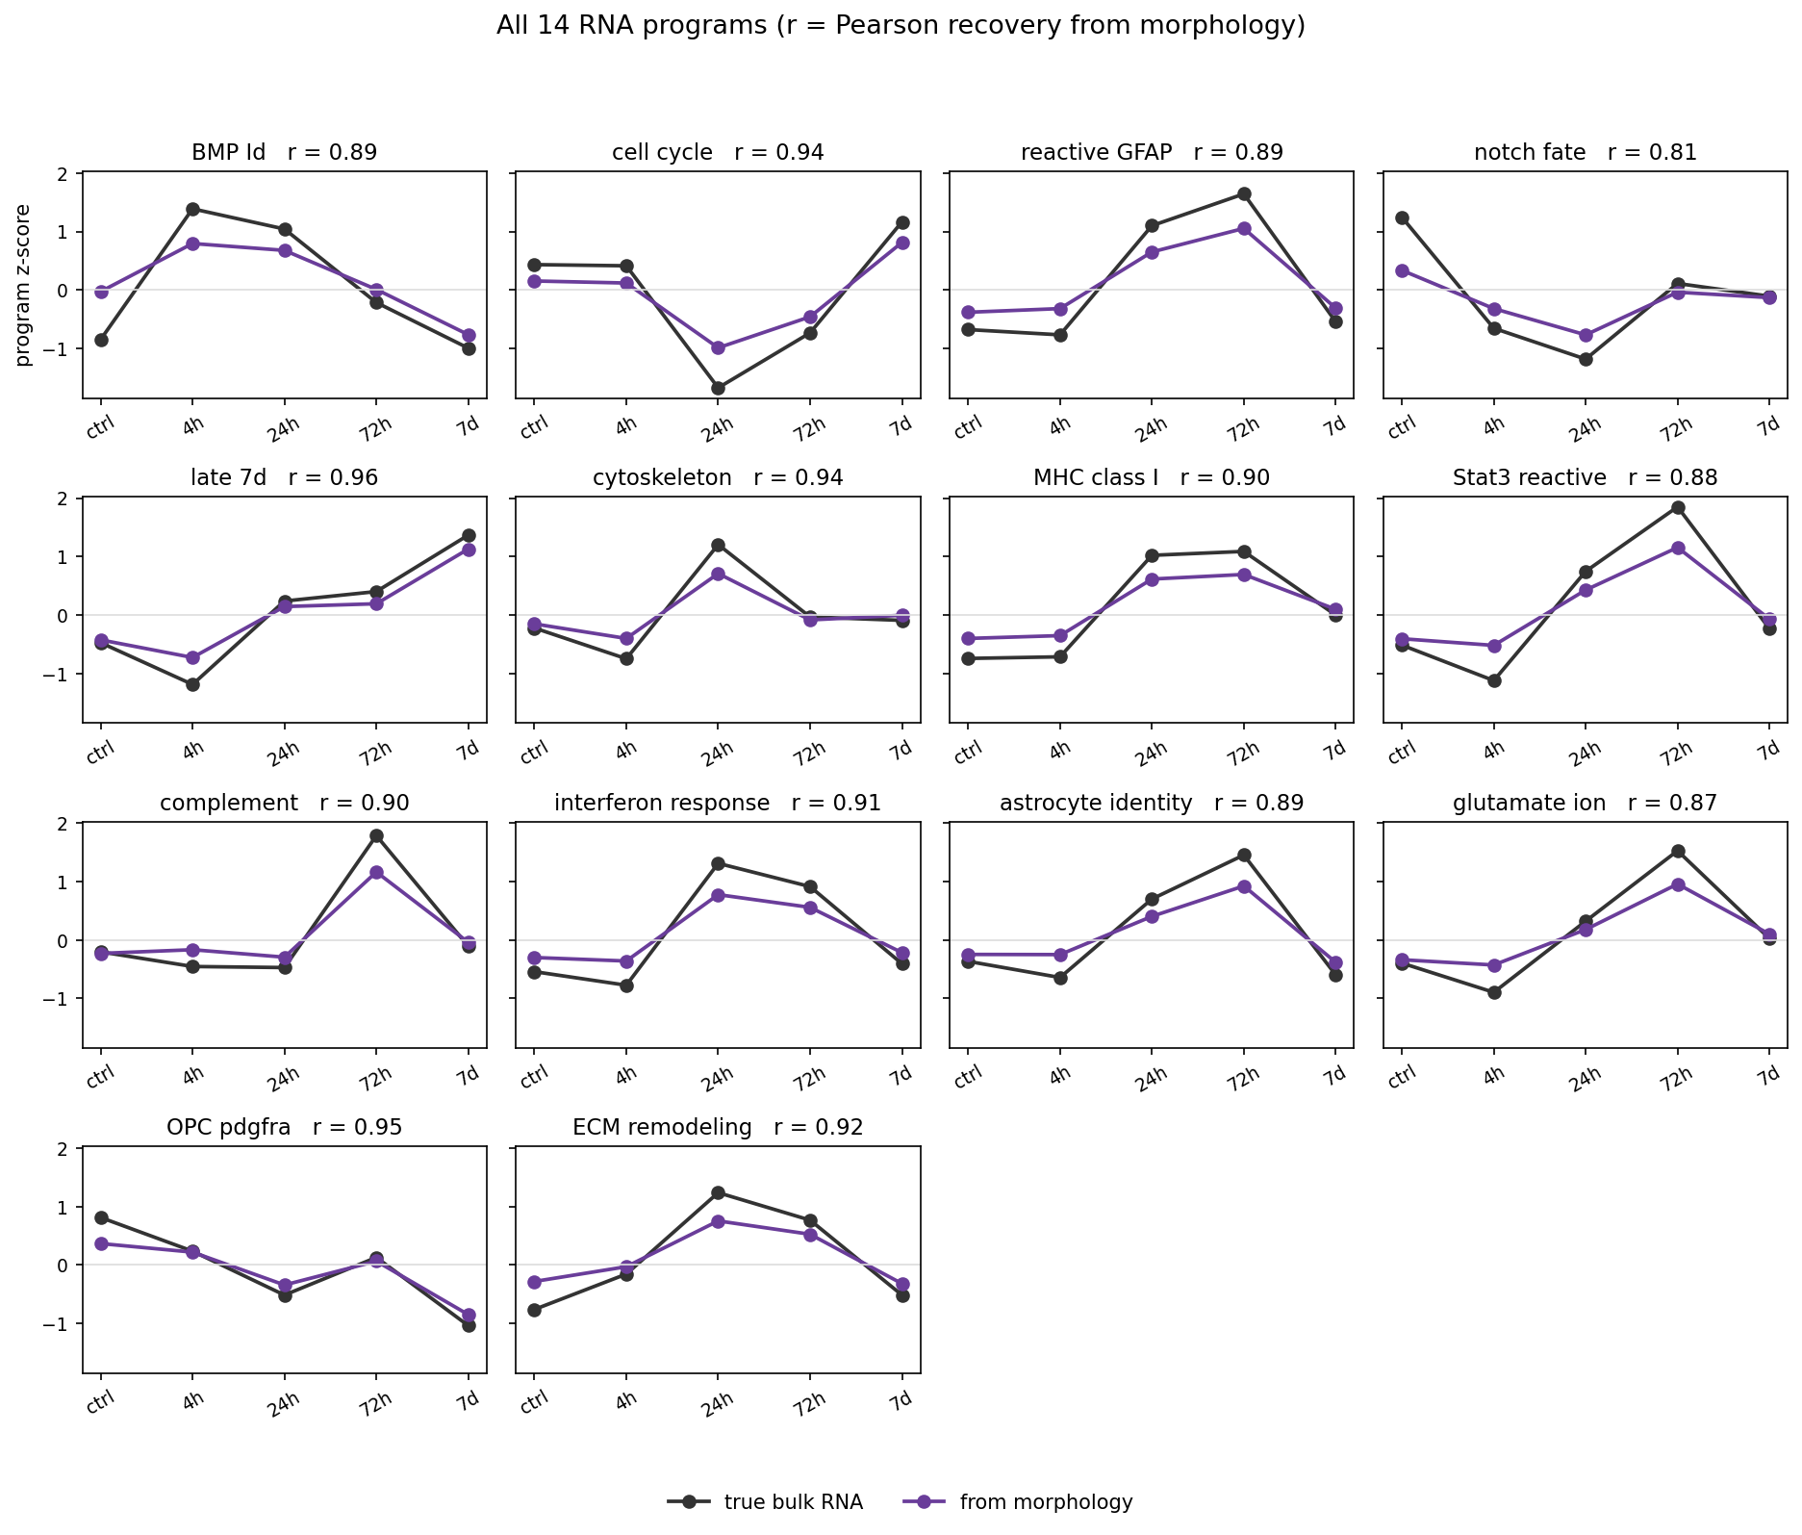
All 14 RNA programs (with r on each panel)
Mean recovery across programs r ≈ 0.90. Purple smoother than black is expected.

Slide 20
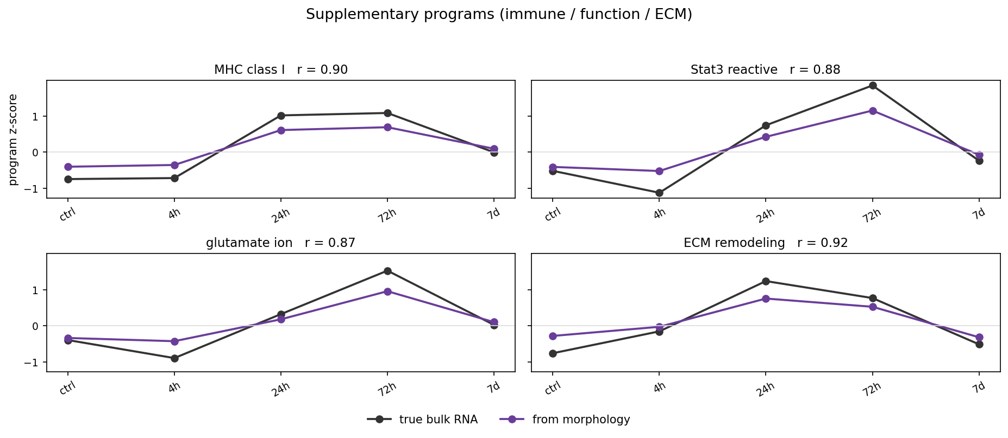
Supplementary programs — with r
• MHC_class_I r=0.90: antigen presentation genes track mid/late reactive window.
• Stat3_reactive r=0.88: IL-6–like signaling hub (not the same as GFAP structure).
• glutamate_ion r=0.87: uptake / K+ / gap-junction function.
• ECM_remodeling r=0.92: matrix genes (e.g. Col11a2 axis).
• These are secondary to the BMP→arrest→reactive→late core story, but recoverable from morph.

Slide 21
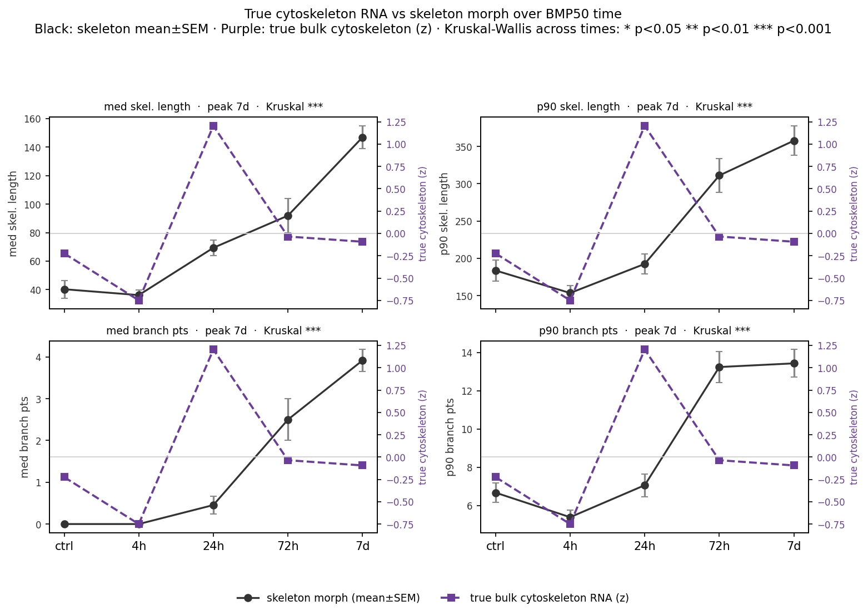
Skeleton morph vs true cytoskeleton RNA over time
True bulk cytoskeleton (purple) vs skeleton mean±SEM (black). Stars = Kruskal-Wallis across times.

Slide 22
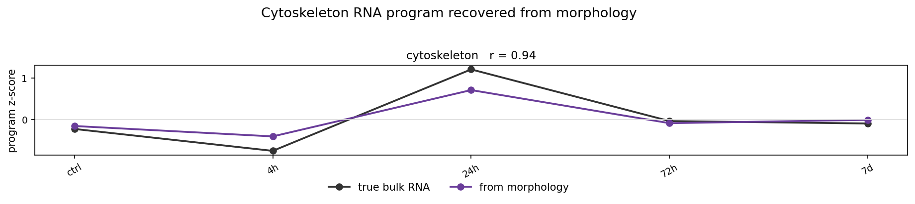
Cytoskeleton RNA program — recovered from morphology
Even though skeleton length ≠ cytoskeleton RNA, the cytoskeleton PROGRAM is still recovered via morph→time (r≈0.94).

Slide 23
Interpretation: program recovery vs direct skeleton correlation
• True cytoskeleton RNA peaks at ~24h and then falls; skeleton length / branch points keep rising into 7d.
• So there is no simple linear “longer skeleton ⇒ higher cytoskeleton transcription” relationship — they are out of phase.
• That does NOT mean morphology fails: the full morph feature set still predicts time, and therefore recovers the cytoskeleton gene program (r≈0.94).
• In words: morphology is a good state sensor for the transcriptional cytoskeleton package, but skeleton morphometrics alone are a late structural readout — not a substitute for that gene set.
• For the lab: use morph→program for RNA-state inference; use skeleton features to talk about process elaboration timing separately.

Slide 24
Take-home
• BMP50 drives a clear bulk RNA trajectory: early BMP pulse → mid cycle arrest / reactive shift → late maturation.
• We summarize that biology as curated RNA programs (gene-set scores), not as morph features.
• Astrocyte morphology (U-Net/CellProfiler pipeline → logistic time model) predicts time at ~92% (nested CV) and recovers 14 programs at mean r≈0.90.
• Purple predicted curves are smoother because they mix times — expected for this atlas design.
• Skeleton morph and cytoskeleton transcription both respond to BMP but peak at different times — related stories, not the same variable.
• Practical next step: new FOVs → morph CSV only → predict_rna_from_morph.py with the frozen bundle (no new RNA required).

