Slide 1

Soldiers Surf Free
Segev Olpak, Ofek Yabo, Dolev David, Guy Yehoshua

Slide 2

Landing Page & Poster
link https://segevolp.github.io/Soldiers-Surf-Free/
auto_stories
Public Memorial & Marketing
Dedicated to Ido Aviv, telling the story behind the project.
dashboard
Platform Showcase
Vision, hardware, team, architecture, and three user dashboards.
folder_special
Centralized Documentation
Hosts all documents (SRD, TDD, final report, demo video) in one place.
code
Open Source Access
Direct links to the live system and the open-source GitHub repository.
palette
Single-file responsive design with an ocean-inspired visual identity, hosted on GitHub Pages.

Slide 3
Borrow Flow Update
schedule
Reservation Mechanism
5-minute lock to prevent race conditions during concurrent borrow attempts.
verified_user
Enhanced Security Guards
Strict validation ensures users successfully complete every mandatory step.
Revised PDF Behavior Workflow
1. Download Phase
Fetch template
Inject user credentials
Upload to short-lived S3
Send pre-signed URL
2. Accept Phase
Record transaction in DB
3. Start Borrow Phase
Verify acceptance status
Download PDF from S3
Email signed PDF to user

Slide 4
Performance Optimizations
bolt
Added frontend route-level lazy loading for faster initial paint.
bug_report
Eliminated N+1 query behaviors to optimize backend processing.
swap_horiz
Streamlined API structure to minimize redundant DB I/O calls.
storage
Implemented DB Indexes for frequently queried data fields.
cached
Optimized asset delivery through frontend resource caching.

Slide 5
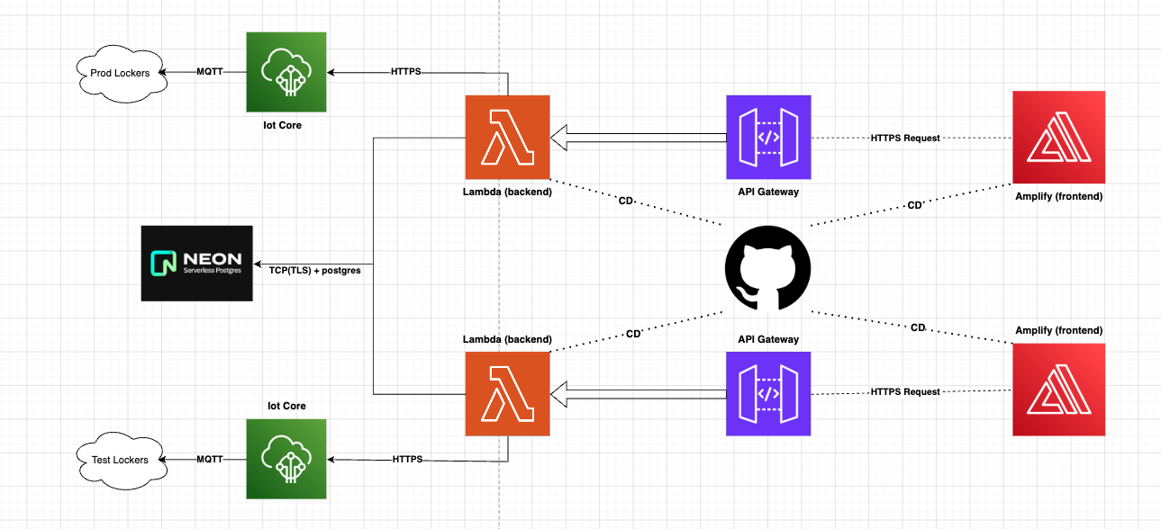
Development & Production Envs

Slide 6
Continuous Deployment (CD)
Dual-Pipeline Architecture
Automated split: Frontend managed by AWS Amplify and Backend via GitHub Actions.
Environment-Aware Routing
Smart branch mapping: 'development' deploys to Dev environment, 'main' to Production.
account_tree
alt_route
Backend Quality Gates
Pre-deployment validation: GitHub Actions spins up temporary PostgreSQL for full test suite execution.
Full Infra & DB Delivery
Beyond code: Automated Alembic DB migrations and infrastructure deployment via SAM tool.
security
settings_suggest

Slide 7
Continuous Integration (CI)
Code Quality
flake8 + mypy on the backend. No database, fails fast on lint/type errors.
Frontend Build
Node 22, npm ci, then npm run build to confirm the React/Vite app compiles.
spellcheck
code
spellcheck
Automated Testing
Spins up Postgres 16, runs pytest with ≥ 80% coverage. Uploads results as artifacts.
Traceability
Reports even on failure. Fails build if test_index.json is stale to ensure sync.
Frontend Build
Node 22, npm ci, then npm run build to confirm the React/Vite app compiles.
biotech
history_edu
code
Automated Testing
Spins up Postgres 16, runs pytest with ≥ 80% coverage. Uploads results as artifacts.
Traceability
Reports even on failure. Fails build if test_index.json is stale to ensure sync.
biotech
history_edu

Slide 8
Tests & Traceability
Structured Docstrings
Validated fields: TEST, LAYER, USE_CASE, INTENT, WHY_IT_MATTERS, FAILURE_MEANS, DEPENDENCIES, LAST_REVIEWED.
Full Traceability Chain
Test Use Case (UC-X.X) Requirement (REQ-XXX)
description
link
CI Traceability Job
tests.yml regenerates the index; fails build if test_index.json is stale or references unknown Use Cases.
Local Pre-commit Hook
Runs validation locally in ~2s. Catches sync issues before push without full test execution.
history_edu
speed

