Slide 1

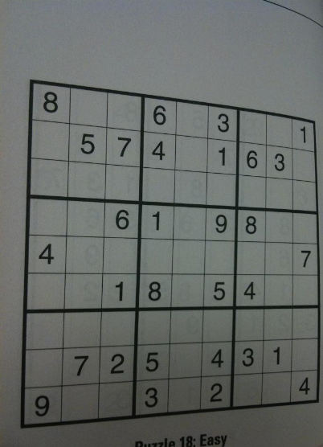
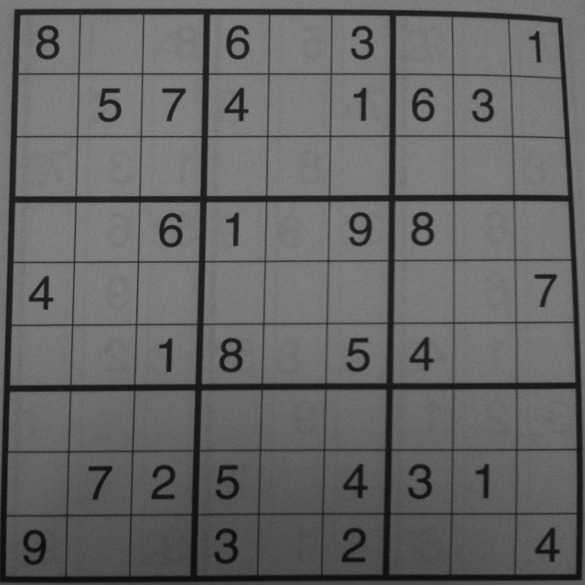




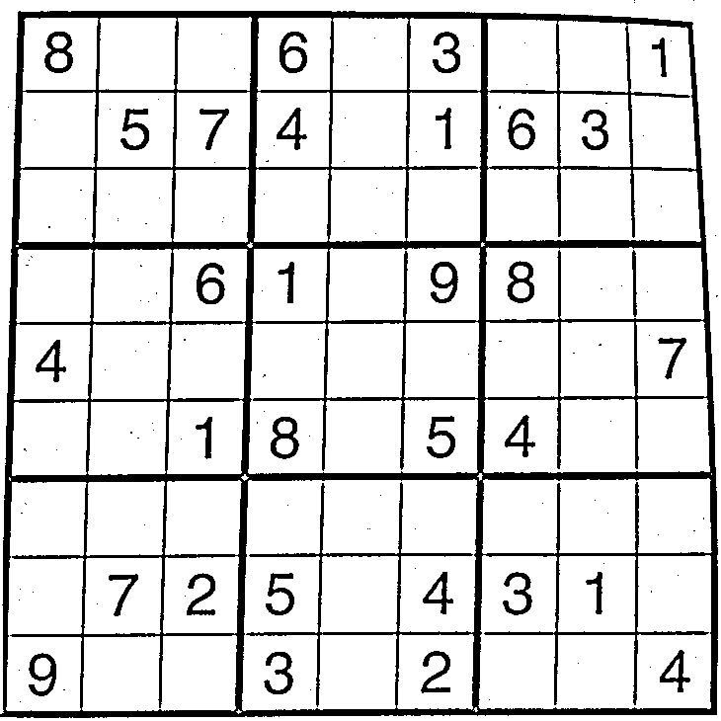




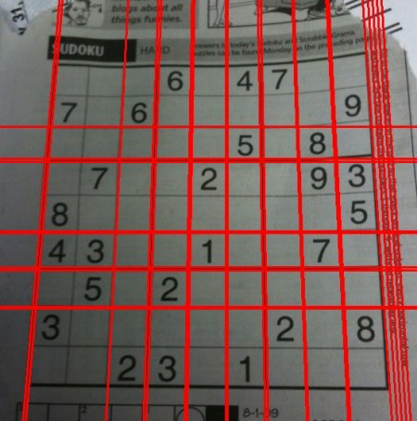
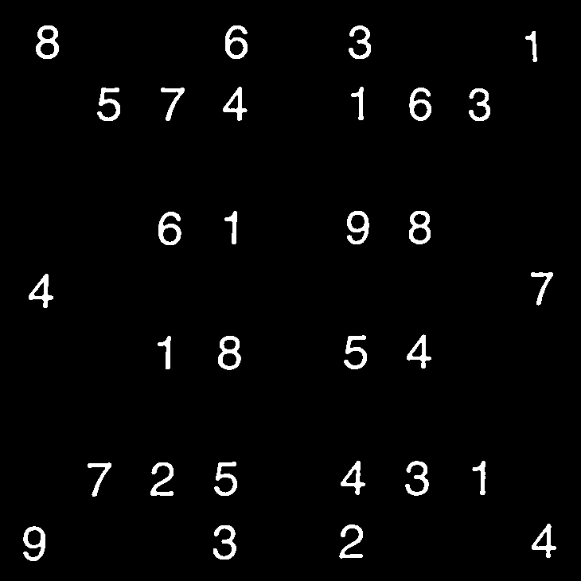
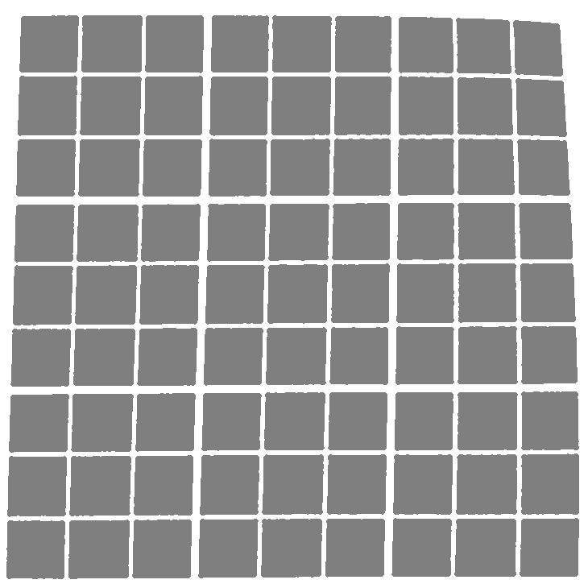

Sudoku Puzzle Solver (Grid & Digit Recognition)
Sammie Ghabra, Ma Chong
Abstract
Methods
Results
With computer vision, there can be a seamless method to allow computers to easily recognize and solve the Sudoku puzzle. We first took a picture of a 9 by 9 puzzle and straighten out the image. We then applied thresholding to remove noise from the image. We then detect the individual digits and the grid locations they correspond to using blob detection. Finally, we use neural networks to classify the digits. Once we have classified the image, it is simple to apply a Sudoku solver algorithm that can solve the puzzle.
Our first step in the puzzle solver was to resize the puzzle image from the user input. Next, we had to edge warp the square grid through a perspective transformation using the four corners of the image
We were successful in extracting the digits contained inside the puzzle and their respective coordinates in the puzzle.
Next we applied a Gaussian blur filter to reduce noise from the input image. We next applied an adaptive threshold to filter out the image into only black or white.
Background
The main challenges of this project is to be able to successfully detect the grid from the image and all of the associated numbers within the grid, and to recognize printed digits from an image.
/Users/Sammie/Downloads
The images above represent the digits that was extracted from the input image. We were able to verify each digit position through creating a 2-d vector and verifying that all of the correct images were located in the correct position, with reference to the input image. All empty cells were associated with a zero, and all non-empty cells were were associated with their respective digit image.
The next step was to locate all of the individual grids within the image, and to associate each number to a grid. We used Hough line transformation to detect the grid lines in the image, and once we detected the lines, flood filled the surroundings of the grid and the grid itself, so only the area inside the grid has a different color. Next, we used the assumption that the pixels associated with the numbers will be in the center of the grid, and classified those pixels as digit images.
To detect the grid and the numbers, we have been introduced to a variety of techniques in class such as blob detection, Gaussian Filtering (linear filters), and adaptive thresholding. All of these functions have been provided by OpenCV, an open software for image processing. In addition, we can use knowledge of the grid to know that the number will be in the center of an individual square grid.
Todo
To recognize the numbers in the image, we will be using convolutional neural network models that have a high accuracy, such as Tesseract.
Now that we have extracted the numbers and their respective positions within the grid, the next step is to recognize the digits using a Neural Network Model. We are interested in using a high accuracy model such as Tesseract, because if we misclassify one number, the algorithm solver will not work.

