Slide 1

Cleaning & Analysis of National Transportation Safety Board Data on Accidents
By sego mich

Slide 2
Business Overview
My company is expanding into new industries to diversify its portfolio and is exploring the purchase and operation of airplanes for both commercial and private use.
I have been tasked with identifying potential risks associated with aircraft and determining which options pose the lowest risk for this new business venture.
My findings will then be translated into actionable insights to guide the head of the new aviation division in making informed decisions about aircraft purchases.

Slide 3


Python Libraries Used
Data Manipulation
Numpy
Pandas
Data Visualization
Matplotlib
Seaborn

Slide 4
Objectives
Main objective
To help decide which aircraft to purchase and operate airplanes for commercial and private enterprises.
Specific objectives
To find a correlation and visualize between
make and mode and their risks
the type of aircraft category and their risks
The type of engine and no of engines and their risks.

Slide 5
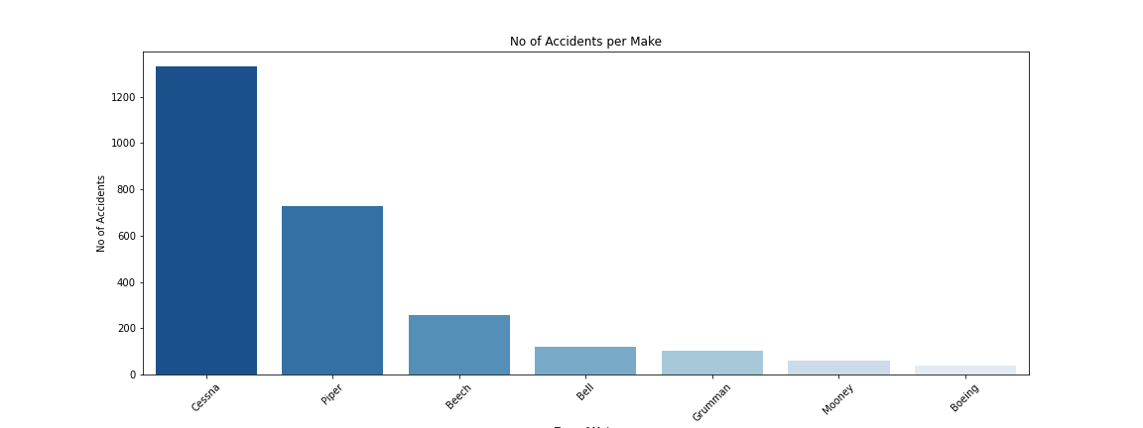
Number of Accidents per Make
Cessna has most accidents while Boeing has least

Slide 6
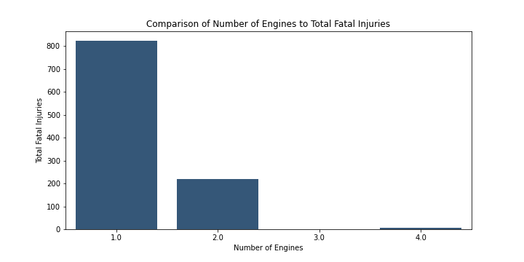
Comparison of Number of Engines to Total Fatal Injuries
Aircraft with number_of_engines = 1 is high risk and with 3 engines is low risk

Slide 7
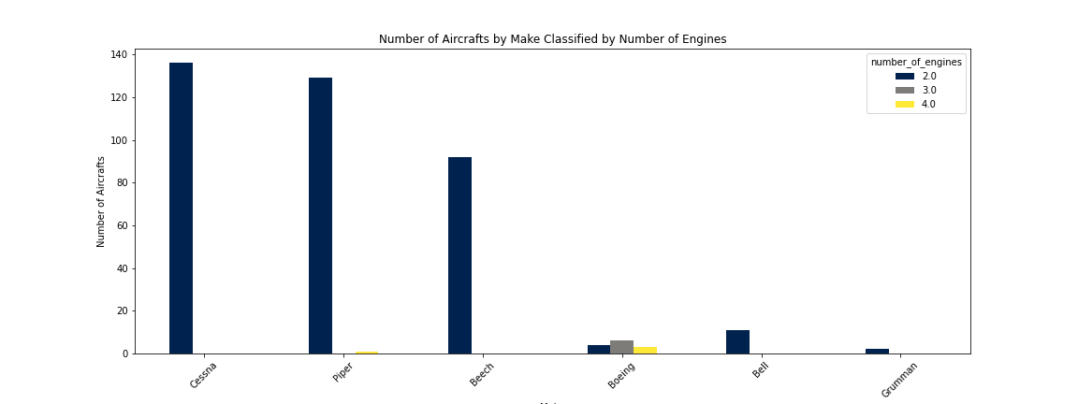
Number of Aircrafts by Make Classified by Number of Engines
Aircraft with Make recommended is either Cessna, Piper or Beech

Slide 8
Total Uninjured to Number of Engines
Engines with 2 injuries caused less harm.

Slide 9
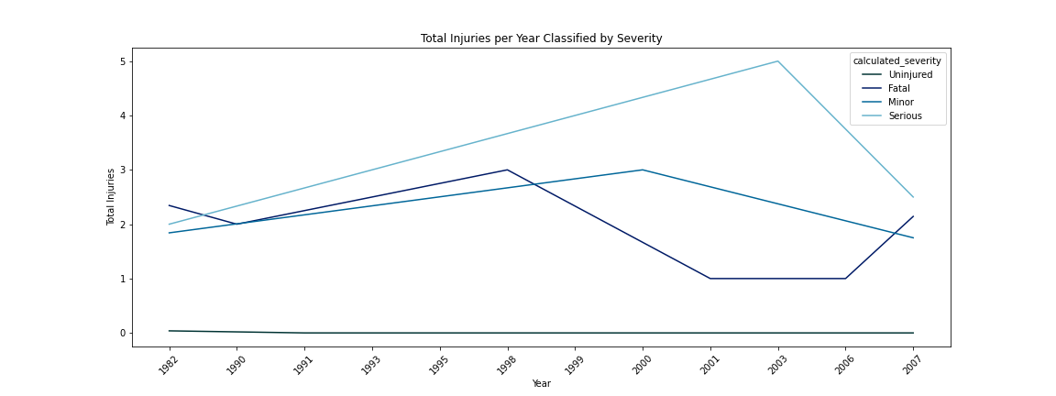
Total Injuries per Year Classified by Severity
There is increase of accidents over the years with severity getting worse

Slide 10
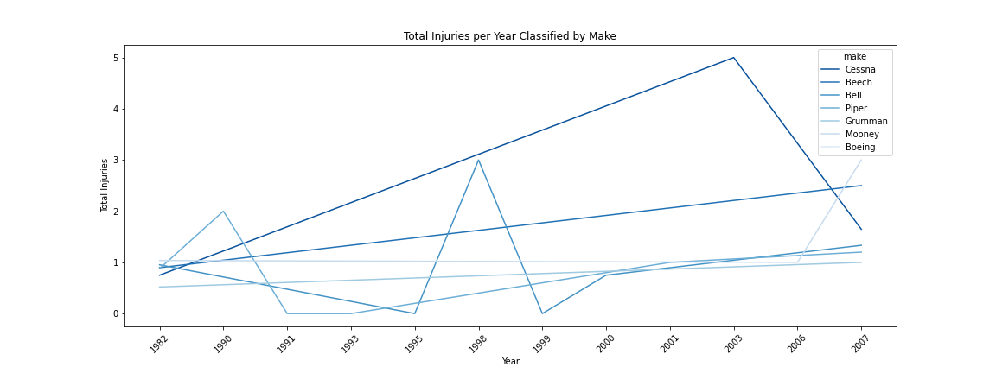
Total Injuries per Year Classified by Make
There is increase of accidents for all the aircraft make. Cessna has however from around 2003 has experienced a decline.

Slide 11
Recommendations/Next Steps
Cessna has the highest number of accidents, while Boeing has the fewest.
Single-engine aircraft pose higher risks, whereas three-engine aircraft are safer.
Aircraft from recommended makes include Cessna, Piper, and Beech.
Two-engine aircraft cause fewer injuries.
Accidents have been increasing over the years, with severity worsening.
Accidents have risen for all aircraft makes, but Cessna has shown a decline since around 2003.

Slide 12
Thank you
Questions?

