Slide 1

Cleaning & Analysis of National Transportation Safety Board Data on Accidents
By sego mich

Slide 2


Python Libraries Used
Data Manipulation
Numpy
Pandas
Data Visualization
Matplotlib
Seaborn

Slide 3
Objectives
Main objective
To help decide which aircraft to purchase and operate airplanes for commercial and private enterprises.
Specific objectives
To find a correlation and visualize between
make and mode and their risks
the type of aircraft category and their risks
The type of engine and no of engines and their risks.

Slide 4
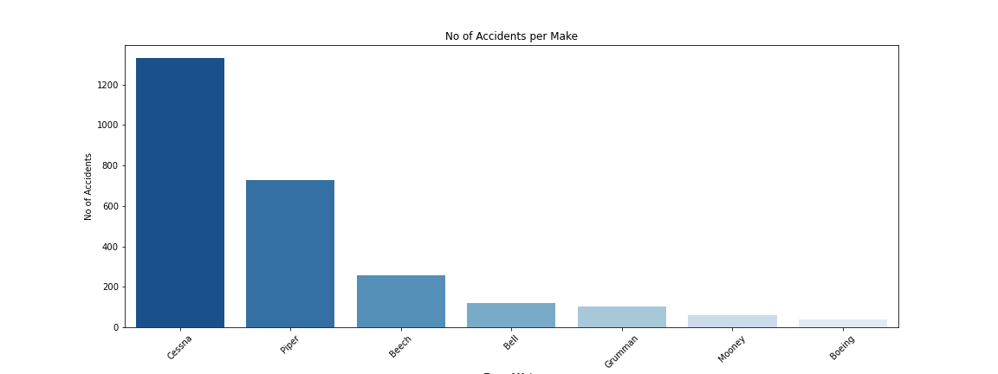
Number of Accidents per Make
Cessna has most accidents while Boeing has least

Slide 5
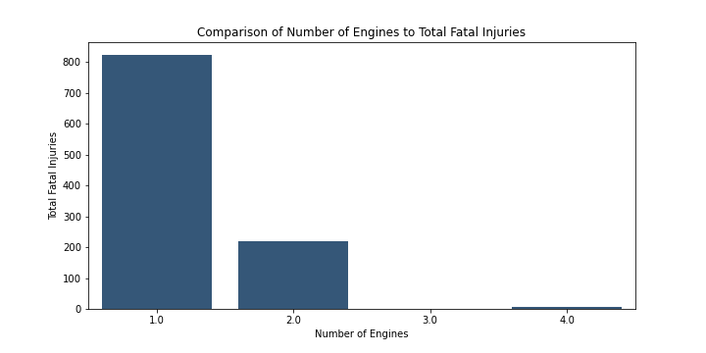
Comparison of Number of Engines to Total Fatal Injuries
Aircraft with number_of_engines = 1 is high risk and with 3 engines is low risk

Slide 6
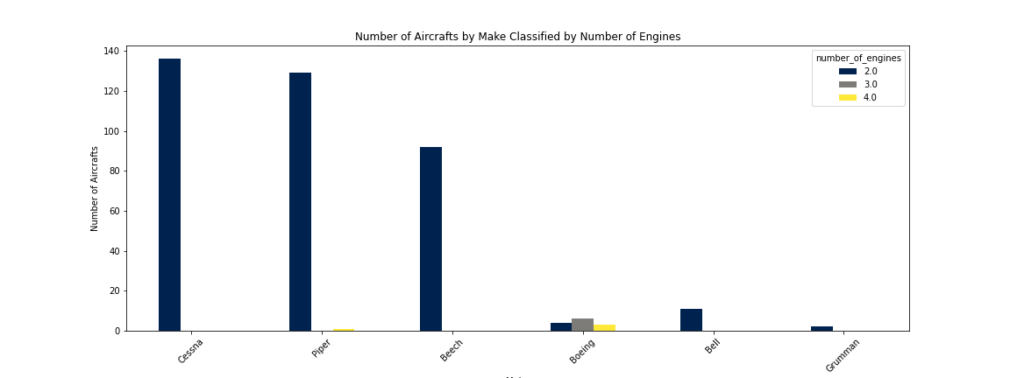
Number of Aircrafts by Make Classified by Number of Engines
Aircraft with Make recommended is either Cessna, Piper or Beech

Slide 7
Total Uninjured to Number of Engines
Engines with 2 injuries caused less harm.

Slide 8
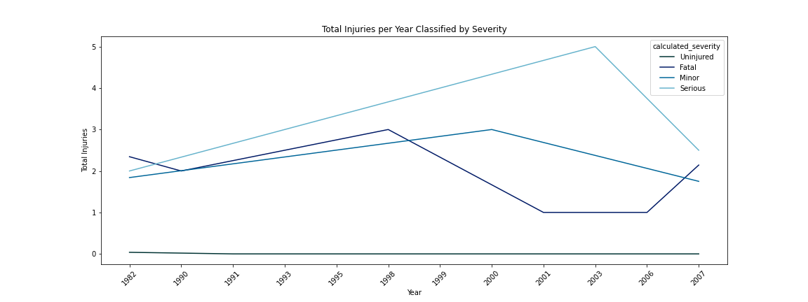
Total Injuries per Year Classified by Severity
There is increase of accidents over the years with severity getting worse

Slide 9
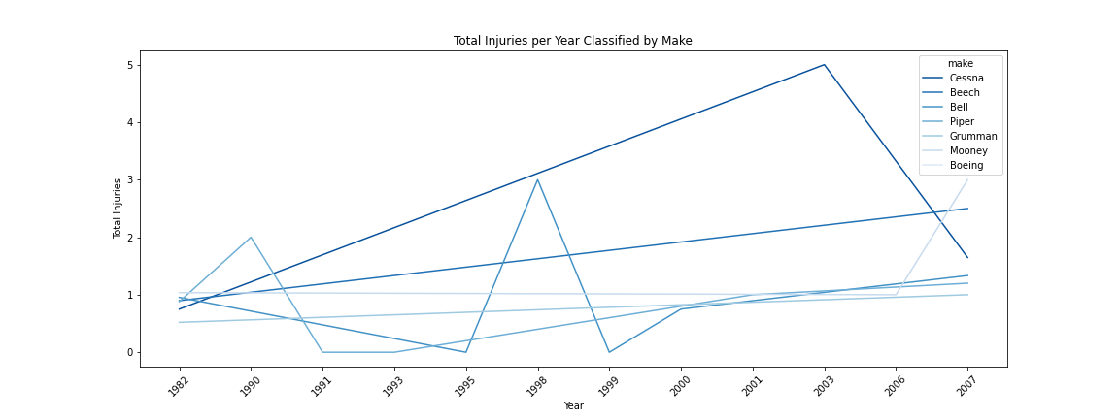
Total Injuries per Year Classified by Make
There is increase of accidents for all the aircraft make. Cessna has however from around 2003 has experienced a decline.

Slide 10
Thank you
Questions?

