Slide 1


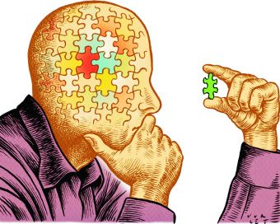
International Foundation Programme
CRITICAL THINKING, RESEARCH AND
ACADEMIC WRITING 1
2023

Slide 2
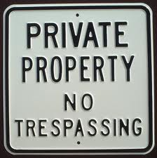
LECTURE 9 – REFERENCING
Lecturer: Daniel Kwami
Email: y.danielkwami@lancaster.edu.gh

Slide 3

REFERENCING - Definition
Referencing is a formal system of indicating when an author’s words or ideas have been used in academic writing.
When ideas or words of another individual are used, and is not referenced, this leads to Plagiarism – Lecture 1 ☺
Notes:
Here, explain what referencing is and why it is important.

Slide 4
WHY REFERENCE?
Acknowledging a source
Gives credit to the original author.
Makes it clear to the reader that you are NOT plagiarising!
Helps your readers find the original source.
Makes it easier for you to find the source later.
Gives your work credibility.
Notes:
- Acknowledging a source is courtesy to the person whose idea or words you have used or referred to.
- By giving the source you make it clear to the reader that you are not trying to pretend somebody else’s work is your own. (You are not plagiarizing!)
- The source helps your readers to find the original texts or web pages to read themselves should they wish.
- If you need to check something later, the reference will help you find it again more easily.
- People will have confidence in your assertions if they know where your information comes from. It also suggests you are thorough in checking your facts.

Slide 5
WHEN TO REFERENCE
Make sure you reference material that you use
As the source of a particular theory, argument or viewpoint
For specific information, such as statistics, examples, or case studies
For direct quotations (reproducing the writer’s exact words)
For information which you understand and write in your own words
Notes:
It’s important that students understand that they reference EVERYTHING! Words, thoughts, etc.

Slide 6

STYLES OF REFERENCING
There are several different styles of referencing around the world.
American Psychological Association (APA)
American Sociological Association (ASA)
Harvard
MLA
Chicago
Oxford, etc…
Notes:
Just a brief on the different styles.

Slide 7

APA REFERENCING
In some departments at Lancaster University, we use the APA referencing style.

Slide 8
ELEMENTS OF REFERENCING
There are two elements in a reference:
A citation inside the body of the text (in-text)
An entry in a reference list or bibliography at the end of the essay or report.
Notes:
Spend sometime explaining the two aspects. Where they come and their significance.

Slide 9
IN-TEXT CITATION
What to include:
If you have taken someone’s idea and have paraphrased it into your own words → Author (Surname) and Year
If you have quoted a text verbatim → Author (Surname), Year and Page Number, of the exact page you got the quote from.

Slide 10
IN-TEXT CITATION
Examples:
Early onset results is a more persistent and severe course (Kessler, 2003).
Kessler (2003) found that among epidemiological samples…
In 2003, Kessler’s study of epidemiological studies showed that…
Notes:
This is to demonstrate three different styles of in-text citation for one author.

Slide 11
IN-TEXT CITATION
More examples:
According to Theall (2017), “faculty evaluation and development cannot be considered separately… evaluation without development is punitive, and development without evaluation is guesswork” (p.91).
The practices that constitute modern programmatic faculty development have evolved from their humble beginnings to become a commonplace feature of university life (Lewis, 1996).
Recent research suggest that the usage of SETs in personnel decisions is still overwhelmingly common, though hard percentages are hard to come by, perhaps owing to the multifaceted nature of these decisions (Boring et al., 2017).
Notes:
This is to demonstrate three different styles of in-text citation for one author. Direct quotations o more than 40 words, quote as an indented block.

Slide 12
IN-TEXT CITATION – A Guide
Type of Citation | First Citation in Text | Subsequent Citations in Text | Parenthetical Format, First Citation in Text | Parenthetical Format, Subsequent Citation in Text
One Author | Walker (2007) | Walker (2007) | (Walker, 2007) | (Walker, 2007)
Two Authors | Walker and Allen (2007) | Walker and Allen (2007) | (Walker and Allen, 2007) | (Walker and Allen, 2007)
Three Authors | Bradley, Ramirez and Soo (1999) | Bradley et al. (1999) | (Bradley, Ramirez and Soo, 1999) | (Bradley et al., 1999)
Four Authors | Bradley, Ramirez, Soo and Walsh (2006) | Bradley et al. (2006) | (Bradley, Ramirez, Soo and Walsh, 2006) | (Bradley et al., 2006)
Five Authors | Walker, Allen, Bradley, Ramirez and Soo (2008) | Walker et al. (2008) | (Walker, Allen, Bradley, Ramirez and Soo, 2008) | (Walker et al., 2008)
Six or more Authors | Wasserstein et al. (2005) | Wasserstein et al. (2005) | (Wasserstein et al., 2005) | (Wasserstein et al., 2005)
Notes:
A handy guide. Please spend sometime explaining this.

Slide 13
Practice exercise
Construct your own sentence and cite (in-text APA)using the following details
AUTHOR(S) : Philip Kotler, Kevin Keller, Mairead Brady, Malcolm Goodman, Torben Hansen
YEAR: 2009
PAGE NUMBER: 56

Slide 14
REFERENCE LIST
Purpose:
The purpose of the reference list is to help a reader locate the source you have used. Thus, it should have as much information as possible.
All items cited in your essay MUST be listed in the reference list.
This list should be in alphabetical order of the Author’s surname (or first author’s surname if there are multiple authors).

Slide 15
REFERENCE LIST
What to include:
Author surname (or surnames) AND initials
Publication date (Year)
Title of the work
Publication data →, Issue, Volume Number, etc.
DOI –Digital Object Number

Slide 16
REFERENCE LIST
Example:
Anderson, A. K. (2005). Affective influences on the attention dynamics supporting awareness. Journal of Experimental Psychology: General, 154, 258–281. doi:10.1037/0096-3445.134.2.258
Eastwood, J. D., Smilek, D., & Merikle, P. M. (2001). Negative facial expression captures attention and disrupts performance. Perceptual Physiology, 65, 352–358.
Notes:
Just two examples. Please explain each item- titles, dates, DOIs, pages, Surname, Italics, etc…
DOI = Digital Object Identifyer

Slide 17
REFERENCE LIST
Formatting:
Use the hanging indent paragraph style for your reference list (as in the previous example)
Double-space the entire reference list
Notes:
Just some handy hints for reference list formatting.

Slide 18


EASY WAY OUT!
Notes:
At this stage, I usually open up MS Word on my PC and demonstrate it to the students. If you permit students to use MS Word for generating their references, please feel free to show them how.

Slide 19
EXERCISE
Book reference
TITLE : Marketing Management
AUTHOR(S) : Philip Kotler, Kevin Keller, Mairead Brady, Malcolm Goodman, Torben Hansen
PUBLISHER: Pearson Prentice Hall
YEAR: 2009
CITY: New Jersey
Notes:
All students need to write an in-text citation and a complete reference in class.

Slide 20
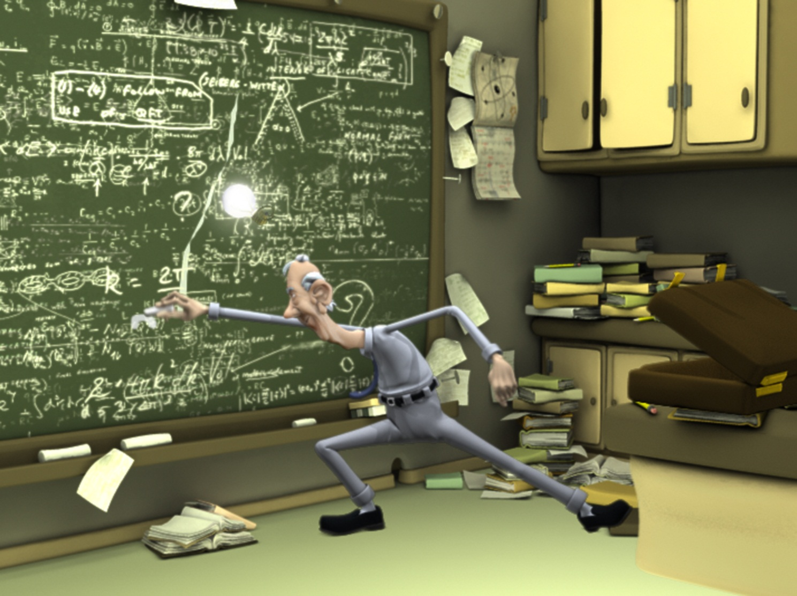
Practice Questions
Practice Questions from Handouts on Exercise 2.4
Any work not completed in class must be completed at home!
Notes:
Please refer them to the workbook for the exercises.
This is due on W3D1 as a graded component.

Slide 21

That’s it for today ☺
Tomorrow:
Quoting and Paraphrasing

