Slide 1
Network Security
Efforts by:
Dheeraj (2017044)
Sehaj Singh (2017099)

Slide 2
Public Key Distribution Authority Implementation

Slide 3
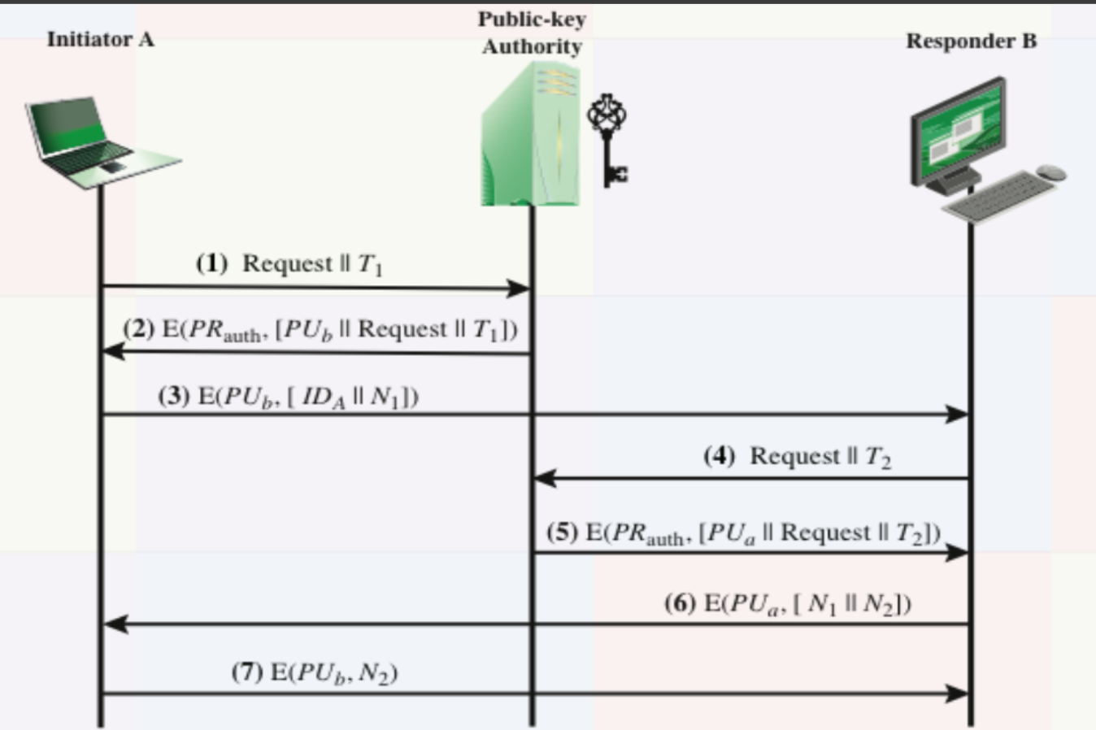
Public Key Distribution Authority
RSA Encryption

Slide 4
Implementation Details
The key pairs for both the clients and the public key distribution authority was generated in the beginning itself.
Socket programming is used for communication.
Requests sent to PKDA are not encrypted but all the other messages/replies are encrypted through RSA encryption.

Slide 5
How to run the files?
Open 3 separate terminals/powershells/command prompts
Execute PKDA.py in one of them and a socket will be opened by the authority to listen to requests from clients A and B.
Now execute ClientB.py and finally, ClientA.py
All the outputs will be generated in the three respective terminals.

Slide 6
Demonstration

Slide 7
Any Questions?

Slide 8
Thank You

