Slide 1
Network Security
Dheeraj [2017044]
Sehaj Singh [2017099]

Slide 2
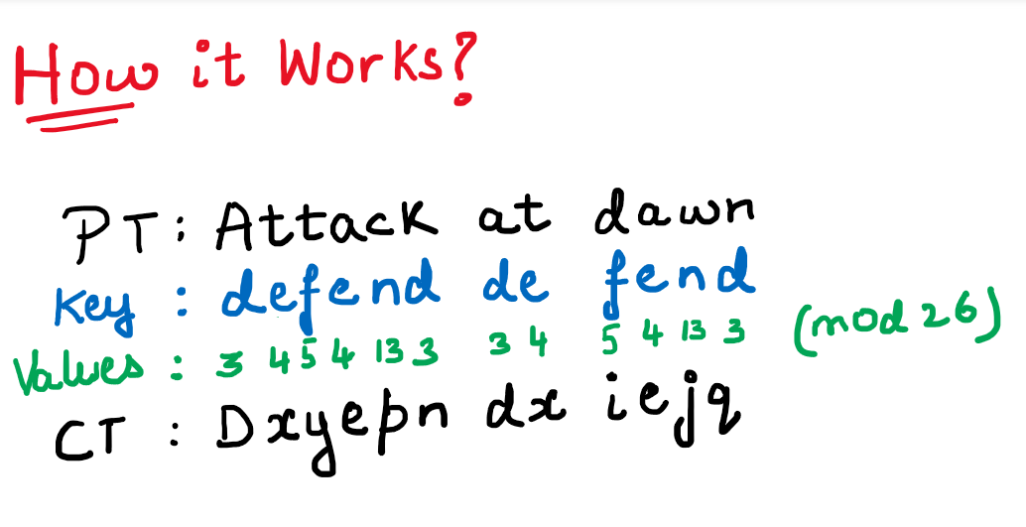
Polyalphabetic Cipher
(Vigenere Cipher)
An intelligent extension of Caesar Cipher
This cipher ensures that the letters of the plaintext are encoded differently due to its key and therefore makes frequency analysis difficult which is possible in monoalphabetic substitution.
For Example:
PlainText= “Attack at dawn”
Key= “defend”
CipherText = “Dxyepn dx iejq”
Values:{a=0, b=1, c=2,...., y=24, z=25}

Slide 3
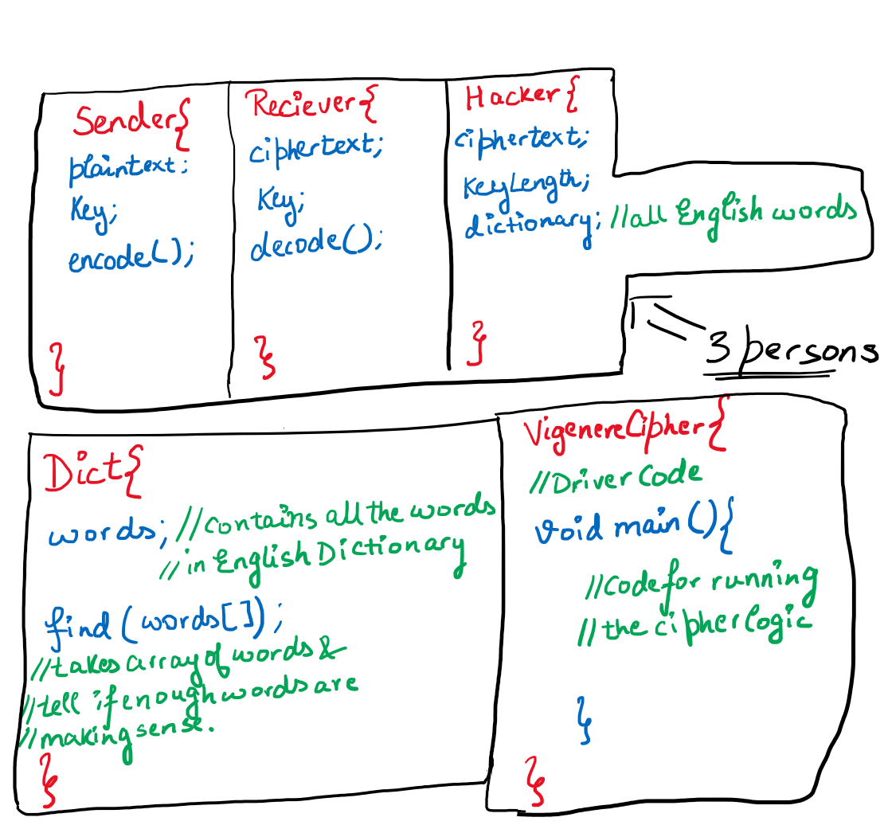
Brainstorming
5 Different classes needed for simplicity and neatness of the code.
The main driver code file is VigenereCipher.java. This will simulate the working of the whole scenario where a sender sends ciphertext to a receiver and the hacker get hold of that ciphertext from the exposed medium of communication.
The hacker will have access to a dictionary that contains all dictionary words.
These dictionary words will be extracted in the code through a text-file submitted (words.txt).

Slide 4


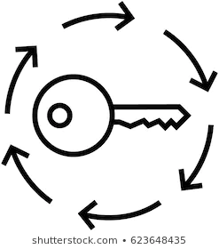
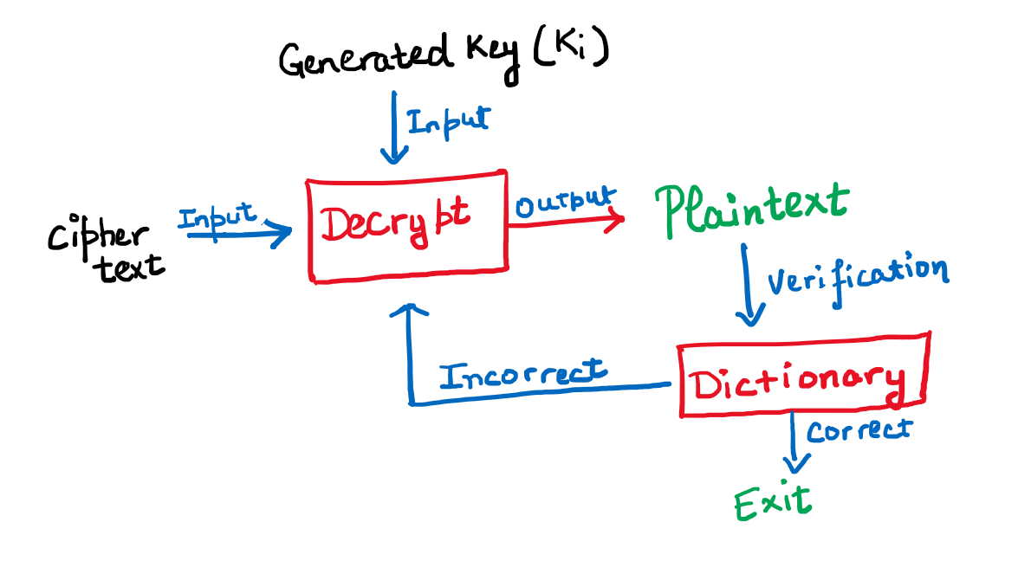
Crypt-Analyst’s Perspective
What does the hacker have?
How will he use these resources?
Dictionary
Key Generator

Slide 5
Additional Efforts
While the brute force attack executes, it checks all the key lengths from 1 to 6.
There is a prompt which asks if the plaintext makes sense (grammatically) or not, if yes then the program exits and if not, it will further search for more keys.
The hacker uses a dictionary to check if the words that are decrypted are present in the English dictionary or not.

Slide 6
Demonstration

Slide 7
Any Questions ?

Slide 8
Thank You

