Slide 1



Logic of Propositions and Predicates
Ivana Lucia Kharisma, M.Kom

Slide 2


Basic Logic
Logic propositional consists of sentences, especially abstract sentences (abstract sentences).
Propositions (statements) are the basic components of logical sentences (sentence) in propositional logic. The sentences are formed from propositions are called declarative sentences, namely sentences whose truth value can be determined, true or false, but not both at the same time. Also called a sentence or declarative sentence.
On the other hand, a sentence whose truth value cannot be determined is either true or false, it is called an open sentence (not a proposition).

Slide 3
Basic Logic
Proposition | Open Sentence
Yogyakarta is the capital city of Indonesia | Is there a test today?
➢ The population of Malaysia is more than the population of Indonesia | ➢ X+5>10
➢ Indonesia experienced 6 presidential changes | ➢ Herlya is divisible by 5
➢ 3 is the first prime number | ➢ The number 10 and number 100 already love each other
➢ 15 is divisible by 3 | Heri really loves the number 9
Sentences in propositional logic are built from propositions
by applying propositional connectives:
not, and, or, if-then, if-and-only-if, if-then-else

Slide 4

Sentences are formed according to the following rules:
➢ Each proposition, namely a symbol of truth or a symbol of a proposition is a sentence.
➢ If F is a sentence, then so is its negation (not F).
➢ if F and G are sentences, so are their conjunctions, namely (F and G), then F and G are called conjuncts and (F and G).
➢ If F and G are sentences, then so is the disjunction, i.e. (F or hereinafter F or G are called disjuncts and (F or G)).
➢ If F and G are sentences, so are their implications, i.e. (if F then G). Furthermore, F is called the antecedent and G is called consequent and (if F then G). Sentences (if G then F) are called converse and sentence (if F then G).
➢ if F and G are sentences, then so are their equivalences, namely (F f and onfy f G), hereinafter F is called the left-hand side and G called the right-hand side and (F if and only if G).
➢ If F, G and H are sentences, so are conditional it, namely (if F then G else H). Then F, G, and H respectively called if-clause, then-clause, and else-clauses and conditionals (if F then G else H).

Slide 5
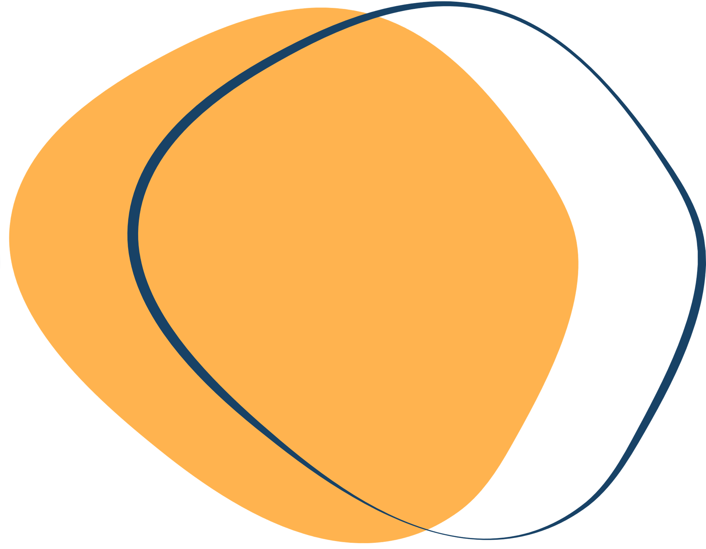

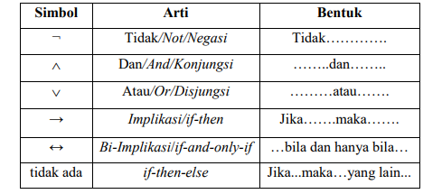
Notation
several sentences need to be combined to make a larger sentence
long

Slide 6


Interpretation
Interpretation is the assignment of a truth value (true or false) to
each propositional symbol of a logical sentence. For example, consider the sentence:
not p or q
One interpretation of the sentence above assigns a false value to p and a true value to p
The interpretation of the p and q values ​​can be written:
p ← false
q ← true

Slide 7

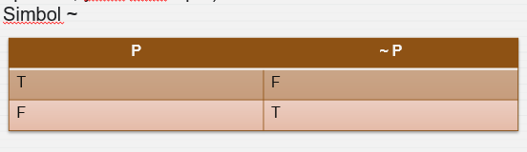

Semantic Rule
Negation (Not)
Uner operator (uner operation is an operation with only one operand, i.e. one input)
P : "It's raining today"
~ P : "Today is not raining"

Slide 8
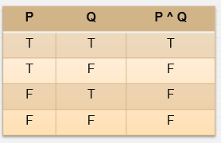
Semantic Rule
Conjunction (and)
Binary Operator (a binary operation is an operation with two operands i.e. two inputs)

Slide 9
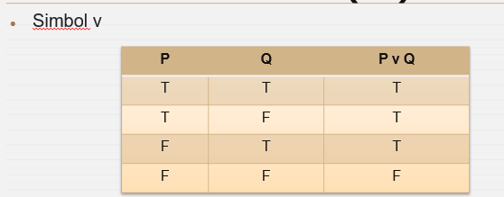
Semantic Rule
Disjunction (or)
Binary Operator (a binary operation is an operation with two operands i.e. two inputs)

Slide 10
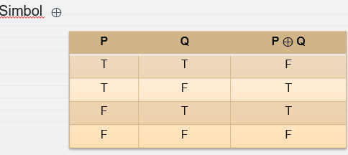
Semantic Rule
Exclusive or (xor)

Slide 11
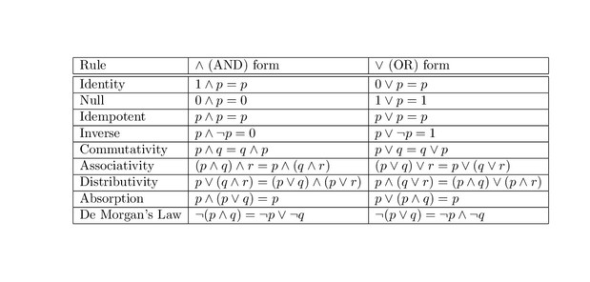
PROPERTIES OF LOGICAL ALGEBRA

Slide 12
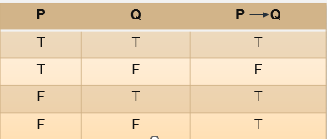
Semantic Rule -Implication (if -then)
Implication is a compound statement which is a series of two statements which is connected by the conjunction "if... , then...". implication two
the p and q statements are written p → q (read: if p, then q). The p statement is called the antecedent and the statement q are called the consequent.
The implication p q is a proposition that is false if p is true and q is false, and is true otherwise.

Slide 13
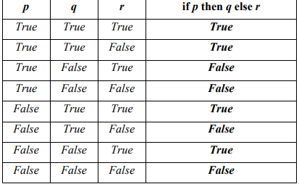
Semantic Rule -Conditional (if -then-else)
The truth value of the conditional (i.e. if p then q else r) is equal to the truth value of q (if the value of p is "true") and is equal to r (if p-value is “false”). In other words, if p is true q applies and if p is false then what applies is r

Slide 14
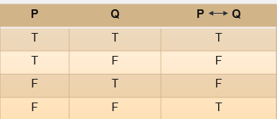
Semantic Rule
BiImplication (if and only if)

Slide 15
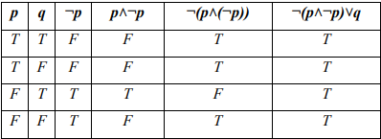
Table of Truth
The truth table is a method for determining the truth value of a logical sentence by interpreting each proposition symbol and using semantic rules.
2^ n : variabel
not (p and (not p)) or q

Slide 16
What is the validity of this sentence ? Use truth table
(if p then q) or (r and (not p))

