Slide 1
Web Engineering
Lab 4

Slide 2
What is CSS?
CSS stands for Cascading Style Sheets
CSS is a language that describes the style of an HTML document.
It can control the layout of multiple web pages all at once
External style definitions are normally saved in external .css files.

Slide 3
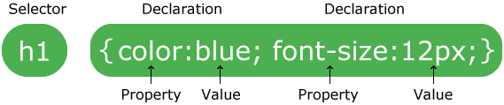
CSS Syntax
A CSS rule-set consists of a selector and a declaration block:
CSS selectors are used to select HTML elements based on their element name, id and class.

Slide 4
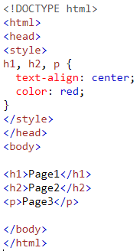
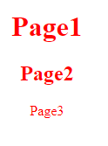
Grouping Selectors
To group selectors, separate each selector with a comma.

Slide 5
How To Insert CSS
Three Ways to Insert CSS
External style sheet
Internal style sheet
Inline style

Slide 6
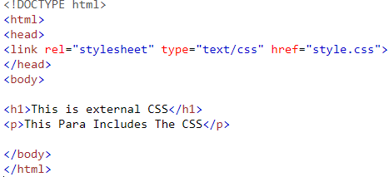
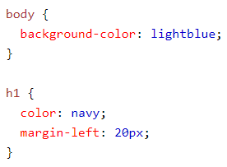
External Style Sheet
Each page must include a reference to the external style sheet file inside the <link> element. The <link> element goes inside the <head> section:
 | Style.css

Slide 7
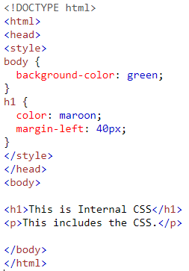
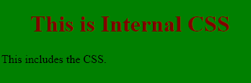
Internal Style Sheet
Internal styles are defined within the <style> element, inside the <head> section of an HTML page:

Slide 8
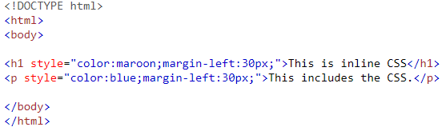

Inline Styles
An inline style may be used to apply a unique style for a single element.

Slide 9
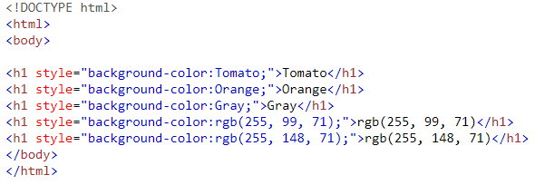
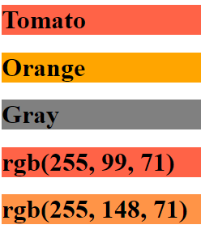
1- Background Color

Slide 10
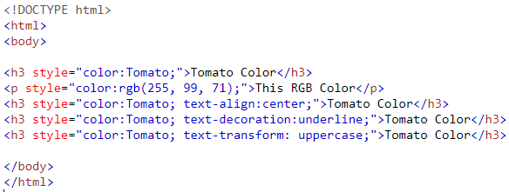
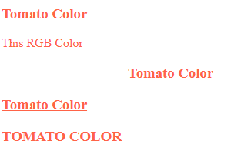
2- Text Color

Slide 11
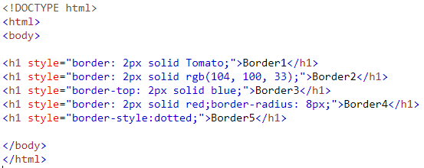
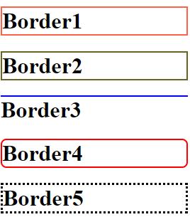
3-Border Color

Slide 12
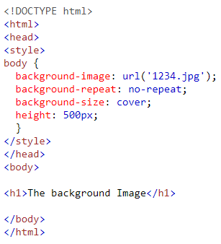

4-Backgroung Image

Slide 13
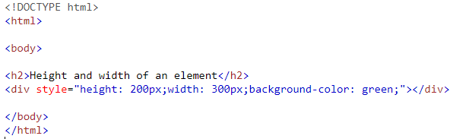
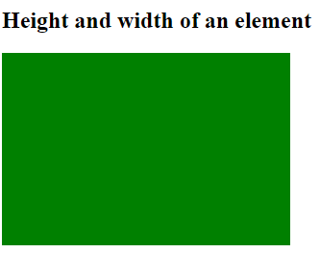
5-Height and Width

Slide 14
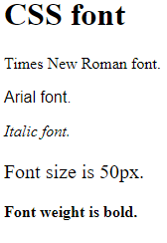
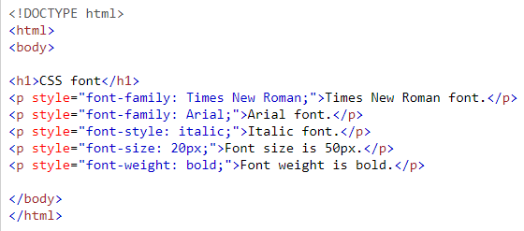
6- Fonts

Slide 15
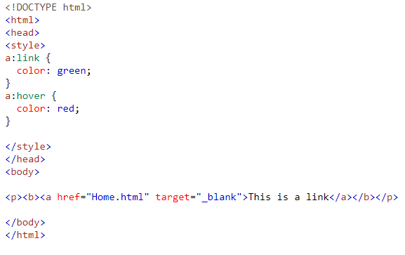

7- CSS Links

Slide 16
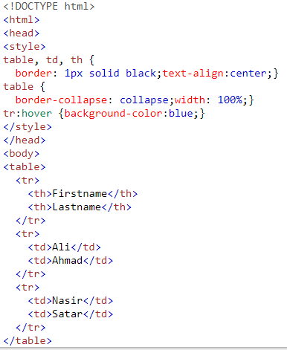


8- CSS Tables

Slide 17

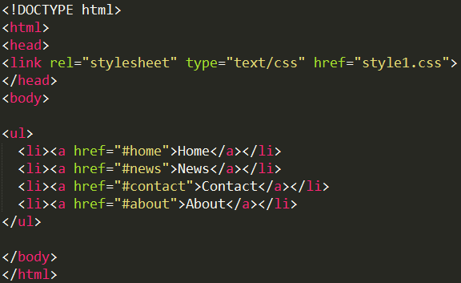
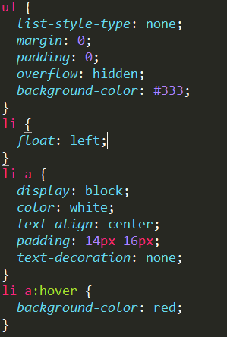
9-Navigation Bar

Slide 18
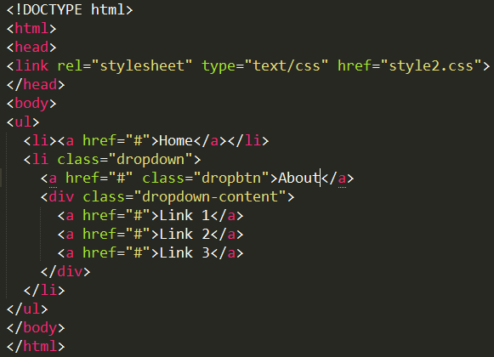
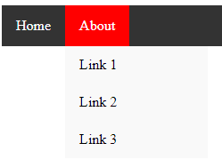
10-Dropdown Manu

Slide 19
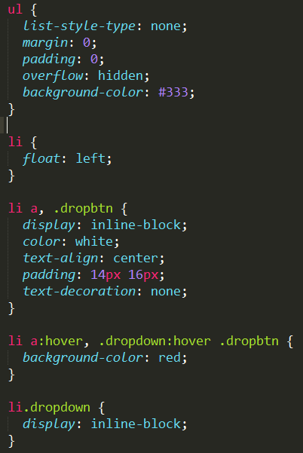
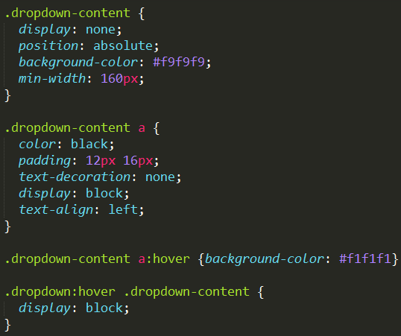
10-Dropdown Manu (CSS)

Slide 20
Questions

