Slide 1
Web Engineering
Lab 5

Slide 2
Semester Projects
Assignment No#4
Project Name
Introduction
Requirements
Basic Functionalities
Initial Mockup design
After due date……………………………………………………

Slide 3
What is Bootstrap?
Bootstrap is a free front-end framework for faster and easier web development
Bootstrap includes HTML and CSS based design templates for typography, forms, buttons, tables, navigation, modals, image carousels and many other, as well as optional JavaScript plugins
Bootstrap also gives you the ability to easily create responsive designs
Mark Otto and Jacob Thorton as an attempt to encourage Twitter’s engineering team to use the same framework to minimize those inconsistencies.

Slide 4
Bootstrap Versions
In August of 2011, the Bootstrap framework was released as an open-source project on Github.
In 2013 Bootstrap 3 was released. It is the most stable version of Bootstrap, and it is still supported by the team for critical bug fixes and documentation changes.
Bootstrap 4 is the newest version of Bootstrap; with new components, faster stylesheet and more responsiveness. However, Internet Explorer 9 and down is not supported.

Slide 5
Why Use Bootstrap?
Advantages of Bootstrap:
Easy to use: Anybody with just basic knowledge of HTML and CSS can start using Bootstrap
Responsive features: Bootstrap's responsive CSS adjusts to phones, tablets, and desktops
Mobile-first approach: In Bootstrap, mobile-first styles are part of the core framework
Browser compatibility: Bootstrap 4 is compatible with all modern browsers (Chrome, Firefox, Internet Explorer 10+, Edge, Safari, and Opera)

Slide 6
How to Get Bootstrap 4?
There are two ways to start using Bootstrap 4 on your own web site.
Include Bootstrap 4 from a CDN (Content Delivery Network)
Download Bootstrap 4 from getbootstrap.com
https://www.youtube.com/watch?v=RA_oqO3nFrA

Slide 7
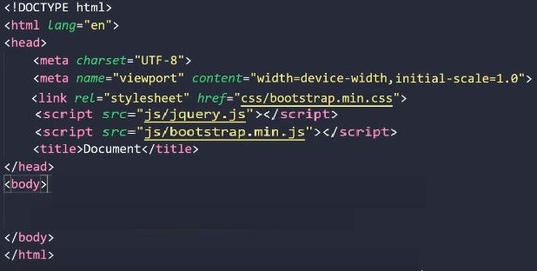

Create First Web Page With Bootstrap 4

Slide 8

Containers Classes
There are two container classes.
The .container class provides a responsive fixed width container
The .container-fluid class provides a full width container, spanning the entire width of the viewport
https://www.youtube.com/watch?v=ceeRn8MQzPw

Slide 9
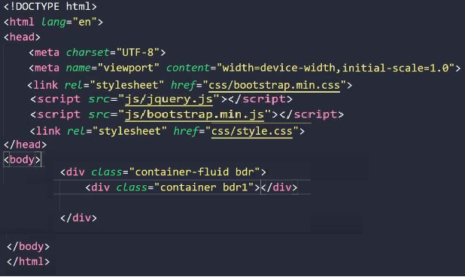
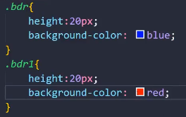

Slide 10
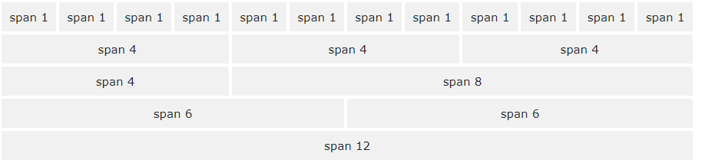
Bootstrap 4 Grid System
Bootstrap's grid system is built with flexbox and allows up to 12 columns across the page.
https://www.youtube.com/watch?v=dHmwopKe1xk

Slide 11
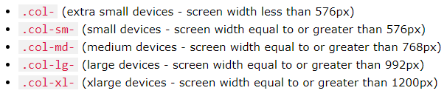
Grid Classes
The Bootstrap 4 grid system has five classes:

Slide 12
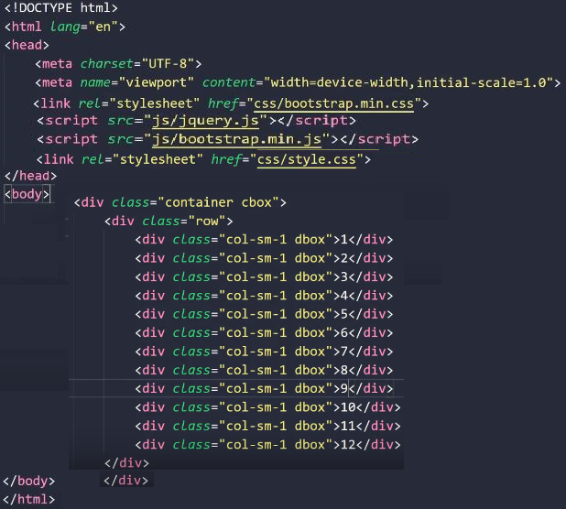
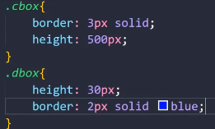
Bootstrap 4 Grid System

Slide 13
Assignment No#3
Bootstrap 4 Buttons
Bootstrap 4 Pagination
Bootstrap 4 Dropdowns
Bootstrap 4 Navs
Bootstrap 4 Navigation Bar
Bootstrap 4 Forms
Bootstrap 4 Tables
Bootstrap 4 Carousel

