Slide 1
Web Engineering
Lab 6

Slide 2
JavaScript Introduction
JavaScript is a lightweight, interpreted programming language.
JavaScript is a dynamic computer programming language.
Complementary to and integrated with HTML.
Open and cross-platform
JavaScript was first known as LiveScript, but Netscape changed its name to JavaScript, possibly because of the excitement being generated by Java. JavaScript made its first appearance in Netscape 2.0 in 1995 with the name LiveScript. The general-purpose core of the language has been embedded in Netscape, Internet Explorer, and other web browsers.

Slide 3
JavaScript is Case Sensitive
JavaScript is case sensitive.
Watch your capitalization closely when you write JavaScript statements:
All identifiers, keywords, variables, methods, properties, and functions are case sensitive.
A variable named myVariable, and a variable named MyVariable, are two different variables.
The function getElementById cannot executed by calling getElementbyID.

Slide 4
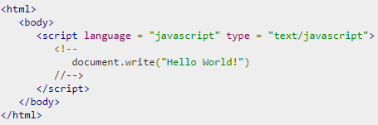
First JavaScript Code
In HTML, JavaScripts must be inserted within the <script>... </script> HTML tags in a web page.
JavaScripts can be put in the <body> and in the <head> section of an HTML page.
Notes:
<script> function myFunction() { document.getElementById("demo").innerHTML="My First JavaScript Function"; } </script>

Slide 5
JavaScript - Placement in HTML File
There is a flexibility given to include JavaScript code anywhere in an HTML document. However the most preferred ways to include JavaScript in an HTML file are as follows −
Script in <head>...</head> section.
Script in <body>...</body> section.
Script in <body>...</body> and <head>...</head> sections.
Script in an external file and then include in <head>...</head> section.

Slide 6
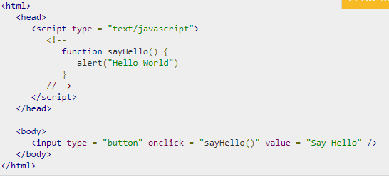

JavaScript in <head>...</head> section

Slide 7
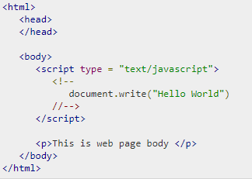
JavaScript in <body>...</body> section

Slide 8

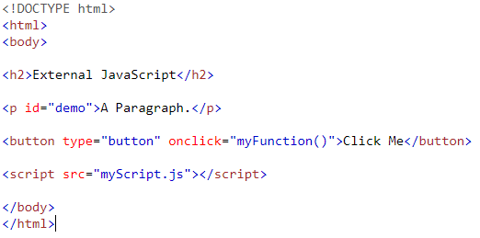
External JavaScripts
Scripts can also be placed in external files. External files often contain code to be used by several different web pages.
External JavaScript files have the file extension .js.
You can place an external script reference in <head> or <body> as you like.

Slide 9
JavaScript Comments
JavaScript comments can be used to make the code more readable. Comments can be added to explain the JavaScript, or to make the code more readable.
Single line comments start with //.
JavaScript Multi-Line Comments starts /* and end with */.
Using Comments at the End of a Line e.g.
var x=5; // Declare x and assign 5 to it var y=x+2; // Declare y and assign x+2 to it

Slide 10
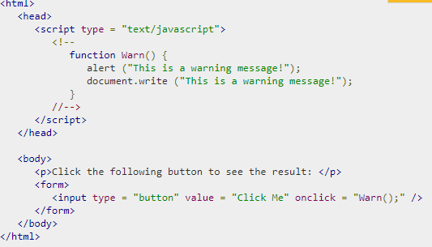
JavaScript - Dialog Boxes
Alert Dialog Box:
An alert dialog box is mostly used to give a warning message to the users. For example, if one input field requires to enter some text but the user does not provide any input, then as a part of validation, you can use an alert box to give a warning message.

Slide 11
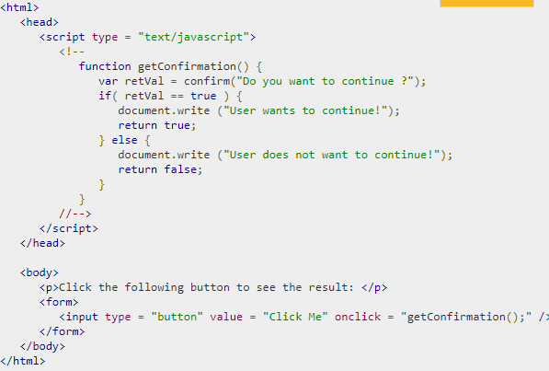
Confirmation Dialog Box:
A confirmation dialog box is mostly used to take user's consent on any option. It displays a dialog box with two buttons: OK and Cancel.

Slide 12
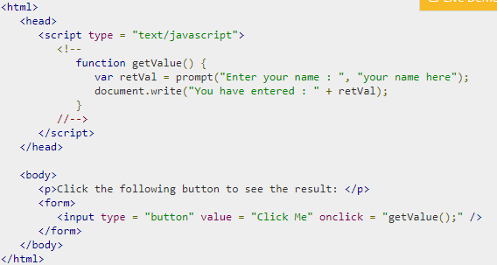
Prompt Dialog Box:
The prompt dialog box is very useful when you want to pop-up a text box to get user input. Thus, it enables you to interact with the user. The user needs to fill in the field and then click OK.

Slide 13
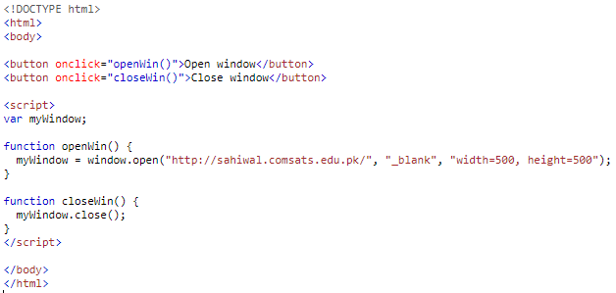
New Window Open/Close
.

Slide 14
Questions

