Slide 1
Language Theory and Finite
Automata
1

Slide 2
Evaluation Procedure
Activity | %
Quizzes Assignments | 25
Mid-term Examination | 25
Final Exam | 50
Total | 100
Note: Unannounced quizzes may come

Slide 3
Summary
Introduction
Formal and In-formal languages
Alphabets, Strings, Null string, Words
Valid and In-valid alphabets
Length of a string
Reverse of a string
Defining languages
Descriptive definition of languages
Theorem

Slide 4
Some Basic Languages
EQUAL, EVEN-EVEN, INTEGER, EVEN
{ a^{n} b^{n}}
{a^{n} b^{n} a^{n} }
Factorial
FACTORIAL
DOUBLE FACTORIAL
SQUARE
DOUBLE SQUARE
PRIME
PALINDROME

Slide 5
Introduction
What does automata mean?
It is the plural of automaton, and it means
“something that works automatically”

Slide 6
Alphabets
Definition (alphabet)
A finite non-empty set of symbols (called letters), is called an alphabet.
It is denoted by Σ (Greek letter sigma).
Example 1
1. Σ = {a, b}
Σ = {0,1} (important as this is the language which the computer understands)
Σ = {i, j , k} etc.

Slide 7
Strings
Σ (alphabet) includes letters, digits and a variety of operators including sequential operators such as GOTO and IF
Definition (Strings)
Concatenation of finite letters from the alphabet is called a string.
Example 2
If Σ = {a,b} then
a, abab, aaabb, ababababababababab

Slide 8
Strings
Empty string or null string
Sometimes a string with no symbol at all is used
It is denoted by small Greek letter Lambda λ
OR capital Greek letter Lambda Λ, called an empty string or null string.
The capital lambda will mostly be used to denote the empty string, in further discussion.

Slide 9
Words
Definition (Words)
Words are strings belonging to some language. Example 3
If Σ = {x} then language L can be defined as
L = {x^{n} : n =1, 2, 3, . . . } or L = {a, aa, aaa, . . . } Here a, aa, … are the words of L
Note:
All words are strings, but not all strings are words.

Slide 10
Valid/In-valid alphabets
While defining an alphabet, It may contain letters consisting of group of symbols
Example 4
Σ₁ = {B, aB, bab, d}. Example 5
If Σ₂ = {B, Ba, bab, d} then a string BababB can be tokenized in two ways
(Ba), (bab), (B) is identified as a string
(B), (abab), (B) is not identified as a string Ambiguous alphabets

Slide 11
Words
Which shows that the second group cannot be identified as a string defined over Σ
As when this string is scanned by the compiler (Lexical Analyzer),
First symbol B is identified as a letter belonging to Σ, while for the second letter the lexical analyzer would not be able to identify it
Hence while defining an alphabet it should be kept in mind that ambiguity should not be created

Slide 12
Remarks
While defining an alphabet of letters consisting of more than one symbols, no letter should be started with the letter of the same alphabet, i.e., one letter should not be the prefix of another.
However, a letter may be ended in a letter of same alphabet.

Slide 13
Valid and In-Valid Alphabets
Example 6
Σ₁ = {B, aB, bab, d} Σ₁ is a valid alphabet Example 7
Σ₂ = {B, Ba, bab, d}
Σ₂ is an in-valid alphabet.

Slide 14
Length of Strings
Definition (Length of Strings)
The length of string s, denoted by |s|, is the number of letters in the string.
Example 8
If Σ = {a, b} and s = ababa, then |s| = 5 Example 9
Σ = {B, aB, bab, d} and s = BaBbabBd then Tokenizing = (B), (aB), (bab), (B), (d)
And |s| = 5

Slide 15
Reverse of a String
Definition
Reverse of a string s denoted by Rev(s) is obtained by writing the letters of s in reverse order.
Example 10
If s = abc is defined over Σ = {a, b, c} then Rev(s) = cba
Example 11
Σ = {B, aB, bab, d} and s = BaBbabBd then Tokenizing = (B), (aB), (bab), (B), (d) Rev(s) = dBbabaBB

Slide 16
Defining Languages
The languages can be defined in different ways , such as
Descriptive definition,
Recursive definition,
Using Regular Expressions (RE) and
Using Finite Automaton (FA) etc.

Slide 17
Descriptive definition of language
The language is defined, describing the conditions imposed on its words.
Example 12
The language L of strings of odd length, defined over Σ = {a}, can be written as
L = {a, aaa, aaaaa, . . . } Example 13
Language L, defined over Σ = {a, b, c}, of strings that does not start with a, can be written as L = {Λ, b, c, ba, bb, bc, ca, . . . }

Slide 18
Descriptive Definition of Language
The language L of strings of length 2, defined over Σ = {0, 1, 2}, can be written as
L = {00, 01, 02,10, 11,12,20,21,22}
Mathematical Description L = {s : S | Length(s) = 2 }

Slide 19
More Examples
Example 14
The language L of strings ending in 0, defined over Σ = {0, 1}, can be written as L= {0, 00, 10, 000, 010, 100, 110, . . .}
Example 15
The language EQUAL, of strings with number of a’s equal to number of b’s, defined over Σ = {a, b}, can be written as
{Λ, ab, aabb, abab, baba,abba, . . . }

Slide 20
More Examples
Example 16
The language EVEN-EVEN, of strings with even number of a’s and even number of b’s, defined over Σ = {a, b}, can be written as
{Λ, aa, bb, aaaa, aabb, abab, abba, baab, baba, bbaa, bbbb, . . .}
Example 17
The language INTEGER, of strings defined over Σ = {-, 0, 1, 2, 3, 4, 5, 6, 7, 8, 9}, can be
written as INTEGER = {. . ., -2, -1, 0, 1, 2, . . }

Slide 21
More Examples
Example 18
The language EVEN, of stings defined over Σ = {-, 0, 1, 2, 3, 4, 5, 6, 7, 8, 9} is written as
EVEN = {. . ., -4, -2, 0, 2, 4, . . .}
Example 19
The language {a^{n}b^{n} }, of strings defined over Σ
= {a, b}, is {a^{n}b^{n} | n = 1, 2, 3, . . . } can be written as
{ab, aabb, aaabbb, aaaabbbb, . . . }

Slide 22
More Examples
Example 20
The language {a^{n}b^{n}a^{n}}, of strings defined over Σ
= {a, b}, is {a^{n}b^{n}a^{n}| n = 1, 2, 3,…}, can be written as : {aba, aabbaa, aaabbbaaa, aaaabbbbaaaa, . . .}
Example 21a
The language factorial, of strings defined over Σ
= {0, 1, 2, 3, 4, 5, 6, 7, 8, 9} is {1, 2, 6, 24, 120,
. . . }

Slide 23
More Examples
Example 21b
The language FACTORIAL, of strings defined over Σ = {a}, is
{a^{n!} | n = 1, 2, 3, . . . }, which can be written as
{a, aa, aaaaaa, . . .} Note:
It is to be noted that the language FACTORIAL can be defined over any single letter alphabet.

Slide 24
More Examples
Example 22
The language DOUBLEFACTORIAL, of strings defined over Σ = {a, b}, is
{a^{n!}b^{n!} | n = 1, 2, 3, . . .}, which can be written as {ab, aabb, aaaaaabbbbbb,…}
Example 23
The language SQUARE, of strings defined over Σ = {a}, is {a^{n2} n = 1, 2, 3, . . .}, and can be written as: {a, aaaa, aaaaaaaaa,. . .}

Slide 25
More Examples
Example 24
The language DOUBLESQUARE, of strings defined over Σ = {a, b}, is
{a^{n2} b^{n2} | n = 1, 2, 3, . . .}, which is written as
{ab, aaaabbbb, aaaaaaaaabbbbbbbbb, . . .} Example 25
The language PRIME, of strings defined over Σ = {a}, is {a^{p} | p is prime}, can be written as
{aa, aaa, aaaaa, aaaaaaa, . . .}

Slide 26
More Examples
An Important language PALINDROME
The language consisting of Λ and the strings s defined over Σ such that Rev(s) = s.
It is to be denoted that the words of PALINDROME are called palindromes.
Example 26 For Σ = {a, b}
PALINDROME = {Λ , a, b, aa, bb, aaa, aba, bab, bbb, . . .}

Slide 27
Theorem
Theorem
There are as many palindromes of length 2n as there are of length 2n-1.
Note
Before proving the above theorem, the following is to be noted
Analysis
Note that number of strings of length ‘m’ defined over alphabet of ‘n’ letters is n^{m}.

Slide 28
Examples: Theorem
Example 27
The language of strings of length 1, defined over Σ = {a, b} is
L = Σ = {a, b}
number of strings = 2¹ = 2 Example 28
The language of strings of length 2, defined over Σ = {a, b} is
L = Σ x Σ = {aa, ab, ba, bb} i.e.
number of strings = 2² = 4

Slide 29
Examples: Theorem
Example 29
The language of strings of length 3, defined over Σ = {a, b} is
L = Σ x Σ x Σ
= {aa, ab, ba, bb} x {a, b}
= {aaa, aab, aba, abb, baa, bab, bba, bbb}
Number of strings = 2³ = 8

Slide 30
Example 4: Theorem
Example 30 If Σ = {a, b},
Then all possible strings of length 4.
L = (Σ x Σ) x (Σ x Σ)
= {aa, ab, ba, bb} x {aa, ab, ba, bb}
= {aaaa, aaab, aaba, aabb, abaa, abab, abba, abbb, baaa, baab, baba, babb, bbaa, bbab, bbba, bbbb}

Slide 31
Example 31: Palindromes of length 2n, 2n-1
Procedure: Palindromes of length 2n
Compute all strings of length n
Find reverse of every string
Palindrome of length 2n = {sRev(s): s is string}
Procedure: Palindromes of length 2n-1
Compute all strings of length n-1
Find reverse of every string
Palindrome of length 2n-1 =
{saRev(s): s is string}  {sbRev(s): s is string}

Slide 32
Example 32: All palindromes of length 2, 4, 6
 | Strings S, Length n | Rev (S) | Palindromes Length 2n
n = 1 n = 2 n = 3 | a b aa bb ab ba aaa aab aba baa abb bab bba bbb | a b aa bb ba ab aaa baa aba aab bba bab abb bbb | aa bb aaaa bbbb abba baab aaaaaa aabbaa abaaba baaaab abbbba babbab bbaabb bbbbbb

Slide 33
Example 33: All possible palindromes of length 8
 | Strings S, Length n | Rev (S) | Palindromes Length 2n
n = 4 | aaaa aaab aaba aabb abaa abab abba abbb baaa baab baba babb bbaa bbab bbba bbbb | aaaa baaa abaa bbaa aaba baba abba bbba aaab baab abab bbab aabb babb abbb bbbb | aaaaaaaa aaabbaaa aabaabaa aabbbbaa abaaaaba ababbaba abbaabba abbbbbba baaaaaab baabbaab babaabab babbbbab bbaaaabb bbabbabb bbbaabbb bbbbbbbb
Muhammad Umar

Slide 34
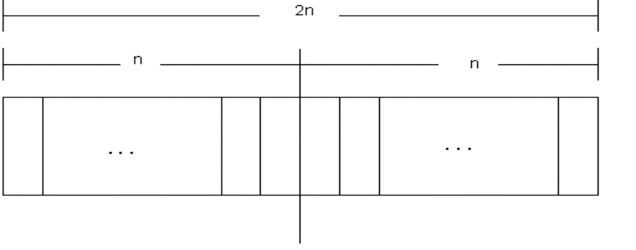
Proof
To calculate the number of palindromes of length(2n), consider the following diagram,
Muhammad Umar

Slide 35
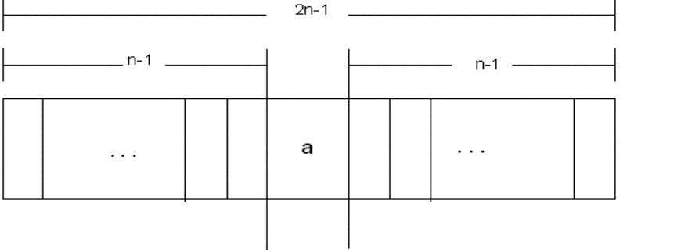
Proof
It shows that there are as many palindromes of length 2n as there are strings of length n i.e. the required number of palindromes are 2^{n}.
To calculate number of palindromes of length (2n-1) with ‘a’ as the middle letter, consider following diagram
Muhammad Umar

Slide 36
Proof
The above diagram shows that there are as many palindromes of length 2n-1 as there are strings of length n-1 i.e. the required number of palindromes are 2^{n-1}.
Similarly the number of palindromes of length 2n-1, with ‘b’ as middle letter, will be 2^{n-1} as well.
Hence the total number of palindromes of length 2n-1 will be =
2^{n-1} + 2^{n-1} = 2 (2^{n-1}) = 2^{n}, Proof is Complete
Muhammad Umar
37

