Slide 1
HACKATHON TECHNICAL PRESENTATION
RxGuard AI
AI-Powered Medicine Safety
and Intelligent Alternatives
A grounded decision-support platform that keeps verified regulatory data—not generative output—as the source of truth.
Verified Registry
Hybrid Search
Grounded AI
SAFETY DECISION FLOW
Safety status, provenance, recalls
Keywords + local embeddings + use
Constrained Gemini ranking with validation
Verify → Analyze → Recommend
Validate → Inform
Current implementation audit
RXGUARD AI
MEDICINE SAFETY • VERIFIED DATA • GROUNDED AI
01

Slide 2
TECHNICAL OVERVIEW
Medication safety is a data-and-workflow problem
People need a clear, traceable answer before they act on a medicine or prescription.
Uncertain medicines
Unsafe workflow gaps
Opaque recommendations
?
!
≈
A brand name alone does not reveal current regulatory or safety status.
Patients, clinicians, and administrators work from disconnected information.
Generic AI advice cannot be trusted without verified candidate controls.
Designed for the people who need an accountable safety decision:
PATIENT
Checks a medicine and stores prescription images.
DOCTOR
Creates patient files and checks typed prescriptions.
ADMIN
Maintains the registry, approvals, and audit trail.
RXGUARD AI
MEDICINE SAFETY • VERIFIED DATA • GROUNDED AI
02

Slide 3
TECHNICAL OVERVIEW
One safety layer across discovery, analysis, and follow-up
RxGuard combines registry evidence, deterministic checks, and a bounded AI reasoning step.
01
02
03
04
Verified registry
Hybrid discovery
Safety analysis
Grounded alternatives
Products, ingredients, notices, recall batches, provenance, and status history.
Keyword matching + local semantic vectors + verified therapeutic-use overlap.
Typed prescription lines are matched to products and classified by current status.
Gemini ranks only already-safe candidates; the database revalidates every output.
Core design principle
Generative AI may explain a choice, but it never creates the trusted candidate set or the final medicine record.
RXGUARD AI
MEDICINE SAFETY • VERIFIED DATA • GROUNDED AI
03

Slide 4
TECHNICAL OVERVIEW
A guided journey from input to accountable next step
The product supports search and typed prescription review while preserving an evidence trail.
1
ENTER
2
ANALYZE
3
EXPLAIN
4
ACT
Search a medicine
or type prescription text
Resolve product identity
and current safety status
Show verified safety
details and provenance
Offer validated safe
alternatives or block print
i
Prescription photos are supported as uploaded records. Safety analysis uses typed text; OCR/text extraction is not implemented.
Result: an explainable workflow that separates product identity, safety evidence, candidate retrieval, and AI-assisted ranking.
RXGUARD AI
MEDICINE SAFETY • VERIFIED DATA • GROUNDED AI
04

Slide 5
TECHNICAL OVERVIEW
System architecture: web client, REST API, registry, and bounded AI
The Express API coordinates application workflows while local embeddings and Gemini serve distinct roles.
LOCAL ML
EXPO WEB CLIENT
EXPRESS REST API
POSTGRESQL
Xenova
all-MiniLM-L6-v2
Expo Router
React Context auth
Fetch API client
Auth • medicines
prescriptions • history
admin • uploads
mediverify registry
rxguard workflows
JSONB embeddings
GENAI SERVICE
Gemini
constrained ranking
Boundaries
Embeddings are local inference; Gemini never searches the database and receives only verified, pre-filtered candidate data.
RXGUARD AI
MEDICINE SAFETY • VERIFIED DATA • GROUNDED AI
05

Slide 6
TECHNICAL OVERVIEW
Frontend architecture: route-aware, role-aware, resilient UI
Expo Router and shared client-side primitives provide a responsive web workflow.
Routing & shells
Session & API
Experience states
Expo Router file-based pages
React Context authentication state
Loading and API error handling
Authenticated (app) route group
Bearer-token Fetch API client
Prescription and medicine detail views
Role-protected dashboards
FormData support for image uploads
Patient, doctor, and admin workflows
SAME-ORIGIN WEB BUILD SUPPORTED
When Express serves the static frontend on port 3001, the API client uses /api; otherwise it reads EXPO_PUBLIC_API_URL.
RXGUARD AI
MEDICINE SAFETY • VERIFIED DATA • GROUNDED AI
06

Slide 7
TECHNICAL OVERVIEW
Backend architecture: Express modules enforce the safety workflow
The server hosts REST endpoints, database integration, uploads, local ML startup, and the built web client.
HTTP / middleware
dotenv • CORS • JSON body parsing • static web serving • Multer uploads
Route modules
auth • medicines • prescriptions • history • admin
Domain utilities
analysis • grounded alternatives • embeddings • medical-use vocabulary
Database access
Parameterized pg queries • PostgreSQL initialization • idempotent embedding columns
Startup behavior: initialize schema → attempt local embedding generation in the background → continue in keyword-only mode if embeddings are not ready.
RXGUARD AI
MEDICINE SAFETY • VERIFIED DATA • GROUNDED AI
07

Slide 8
TECHNICAL OVERVIEW
Database architecture: two schemas separate regulatory truth from workflows
PostgreSQL holds both the verified product registry and user-facing application records.
MEDIVERIFY
RXGUARD
Regulatory registry & provenance
Application workflow records
products: status, source text, JSONB embedding, model
prescriptions: typed details and uploaded-image metadata
ingredients and product_ingredients composition links
patient_files and doctor_prescriptions notepad
notices, recall_batches, sources, status history
search_history for every user role
users, roles, admin_events, approval state
backups and retailer records
Implementation fact: vectors are stored as JSONB and scored in Node.js; this project does not use pgvector or a database vector index.
RXGUARD AI
MEDICINE SAFETY • VERIFIED DATA • GROUNDED AI
08

Slide 9
TECHNICAL OVERVIEW
Hybrid semantic search balances name matching, meaning, and medical use
The ranking deliberately requires more than a fuzzy word match to protect relevance.
QUERY
KEYWORD
EMBEDDING
USE MATCH
RANK
Brand, generic,
or therapeutic phrase
Strict name
matching
384-D local
semantic vector
Verified medical-use
overlap
Return relevant
products
Final ranking composition
30%
semantic similarity
45%
verified use overlap
25%
keyword signal
Inclusion threshold: 0.30 (except strict keyword hits). Semantic candidates default to a 0.15 similarity threshold.
RXGUARD AI
MEDICINE SAFETY • VERIFIED DATA • GROUNDED AI
09

Slide 10
TECHNICAL OVERVIEW
Prescription safety analysis is typed-text matching—not OCR
Each entered line is normalized, matched against the registry, and assessed against its current safety status.
1
2
3
4
TYPE
NORMALIZE
MATCH
ASSESS
Enter prescription
text line by line
Remove numbering,
Rx and dosage prefixes
Exact / prefix / token /
bigram comparison
Active = safe; every
recognized item must be safe
Safe-to-print condition
Known boundary
all_safe = results.length > 0 AND every matched item is active
Photos can be uploaded, stored, and viewed; no OCR endpoint or text extraction pipeline is implemented.
Recognition threshold: 0.42. Unknown or unmatched lines are marked unsafe rather than silently passed.
RXGUARD AI
MEDICINE SAFETY • VERIFIED DATA • GROUNDED AI
10

Slide 11
TECHNICAL OVERVIEW
Gemini recommends only inside a pre-verified safe candidate set
AI contributes constrained selection and short reasoning; candidate discovery remains deterministic and database-grounded.
1
Retrieve
2
Filter
3
Rank with Gemini
4
Validate
Load safe products and score candidates against the unsafe product.
Keep active products only; require minimum 0.08 composite score; take at most 8.
Prompt with candidate IDs and structured JSON contract only.
Check ID membership, database existence, and active status again.
Candidate score = 50% ingredient Jaccard + 25% semantic similarity + 25% therapeutic-use overlap
Model compatibility chain: gemini-2.5-flash → gemini-3.6-flash → gemini-3-flash-preview
RXGUARD AI
MEDICINE SAFETY • VERIFIED DATA • GROUNDED AI
11

Slide 12
TECHNICAL OVERVIEW
Hallucination prevention is enforced in code, not delegated to a prompt
The final UI record is fetched from PostgreSQL after multiple hard validation gates.
✓
Verified retrieval
Candidate originates from the database retrieval step.
✓
Active-only filter
Unsafe or inactive products never reach the AI candidate list.
✓
ID membership
Returned recommended_medicine_id must be inside the supplied candidate set.
✓
Fresh database check
Backend confirms row existence and current active safety status.
✓
DB display source
Final medicine detail is loaded from PostgreSQL—not AI prose.
DATABASE REMAINS THE SOURCE OF TRUTH
RXGUARD AI
MEDICINE SAFETY • VERIFIED DATA • GROUNDED AI
12

Slide 13
TECHNICAL OVERVIEW
AI availability does not determine whether a safety workflow completes
The application makes failure explicit and falls back to a deterministic algorithmic ranking.
No GEMINI_API_KEY
Model/network failure
Malformed response
Candidate or DB validation failure
DETERMINISTIC FALLBACK
Return safe candidates with ai_powered: false
70%
ingredient overlap
20%
name similarity
10%
dosage-form match
The response distinguishes AI-powered output from algorithmic output, so the user interface never hides degraded capability.
RXGUARD AI
MEDICINE SAFETY • VERIFIED DATA • GROUNDED AI
13

Slide 14
TECHNICAL OVERVIEW
Role-specific workflows share the same safety foundation
Different roles see tailored actions while the security and registry rules remain central.
PATIENT
DOCTOR
ADMIN
Search verified medicines
Create patient folders
Approve doctor accounts
Upload and view prescription images
Write in the notepad
Maintain medicine registry
Access prescription history
Check typed prescription safety
Audit safety and admin events
Access control ties every workflow to authenticated identity, role checks, approval status, and ownership verification.
RXGUARD AI
MEDICINE SAFETY • VERIFIED DATA • GROUNDED AI
14

Slide 15
TECHNICAL OVERVIEW
Security and validation controls are practical, with explicit hackathon limits
The implementation protects key application boundaries while keeping limitations visible for reviewers.
IMPLEMENTED CONTROLS
LIMITS TO HARDEN NEXT
JWT authentication with 30-day expiry
Patient ownership checks for prescription images
bcrypt password hashing (10 rounds)
Image-only MIME filter and 10 MB upload limit
Role guard and doctor-approval middleware
Backend-only Gemini API key via .env
CNIC, email, and password validation
No dedicated API rate limiter yet
Parameterized PostgreSQL queries
Open CORS and a development JWT fallback require hardening
Safety limitation: the current code does not implement drug–drug interactions, dose-range checks, allergy/contraindication models, or clinical diagnosis.
RXGUARD AI
MEDICINE SAFETY • VERIFIED DATA • GROUNDED AI
15

Slide 16
TECHNICAL OVERVIEW
Reliability and portability: a runnable local stack with graceful degradation
The project is designed for repeatable setup while distinguishing optional AI enhancement from core behavior.
1
Configure
2
Initialize
3
Start
4
Warm up
.env for PostgreSQL, JWT_SECRET, and optional GEMINI_API_KEY
Run idempotent PostgreSQL schema and seed data
Express initializes API and can serve frontend/dist
Local model downloads on first use; semantic search becomes available
Graceful-degradation behavior
If embeddings fail to initialize, smart search continues in keyword-only mode. If Gemini is unavailable, alternatives use deterministic ranking.
Judge setup note: use a personal Gemini key in backend/.env for AI reasoning, or omit it to demonstrate the documented fallback. Never commit the key.
RXGUARD AI
MEDICINE SAFETY • VERIFIED DATA • GROUNDED AI
16

Slide 17
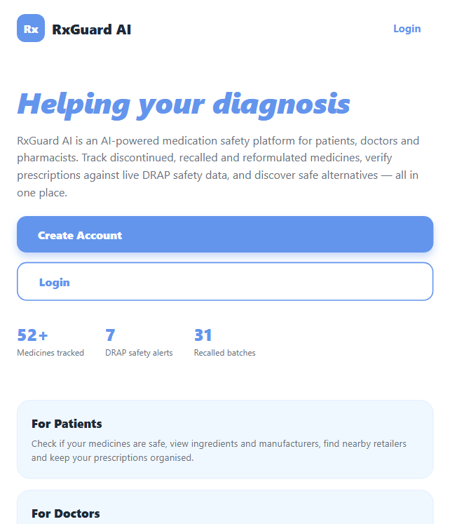
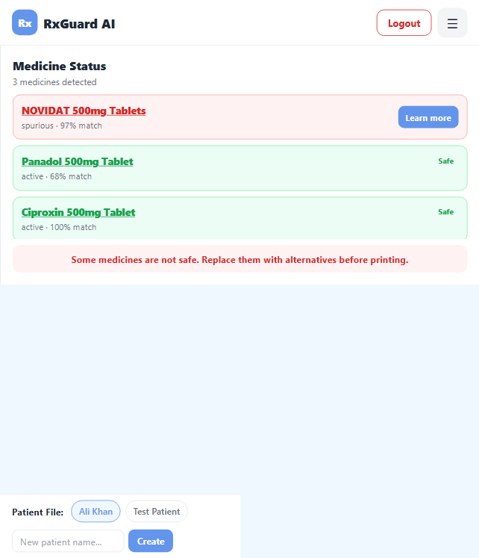
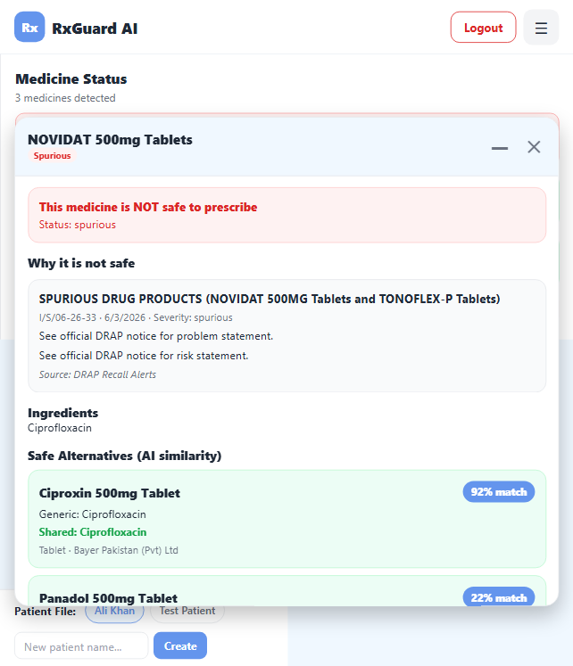
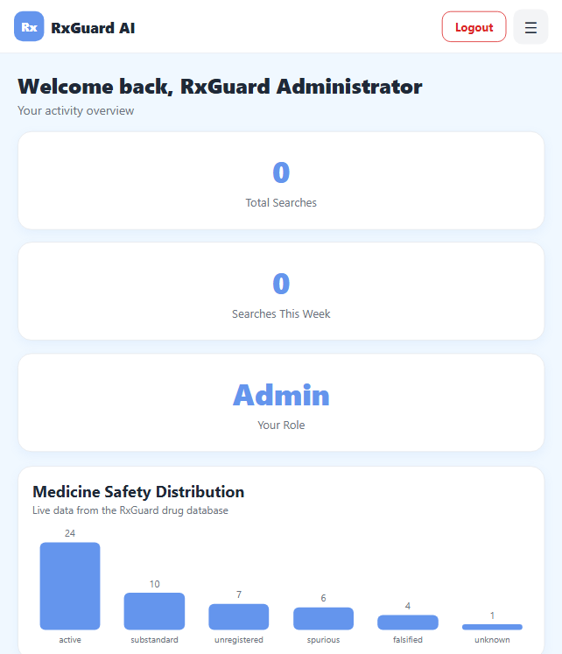
TECHNICAL OVERVIEW
Evidence from the working product
Curated existing screenshots show the implemented user experience; captions avoid claims beyond the current code.
Landing / discovery experience
Doctor notepad safety-check UI
Medicine safety notice UI
Admin management dashboard
Screenshots are product evidence only. The safety notice image is not presented as evidence of current Gemini reasoning; current AI behavior is verified from the backend pipeline.
RXGUARD AI
MEDICINE SAFETY • VERIFIED DATA • GROUNDED AI
17

Slide 18
TECHNICAL OVERVIEW
Differentiators today, responsible roadmap tomorrow
RxGuard is strongest where it combines workflow usability with verifiable control of AI-assisted decisions.
IMPLEMENTED DIFFERENTIATORS
FUTURE ENHANCEMENTS
Verified registry with safety provenance
OCR as a separately validated capability
Medical-use grounded hybrid search
Drug–drug interaction and dose checks
Typed prescription safety gate
Allergy and contraindication models
Gemini ranking constrained to safe candidates
pgvector / indexed semantic retrieval at scale
Deterministic and transparent fallback
Rate limiting, restrictive CORS, and key management
Thank you • Questions & technical discussion
RXGUARD AI
MEDICINE SAFETY • VERIFIED DATA • GROUNDED AI
18

