Slide 1
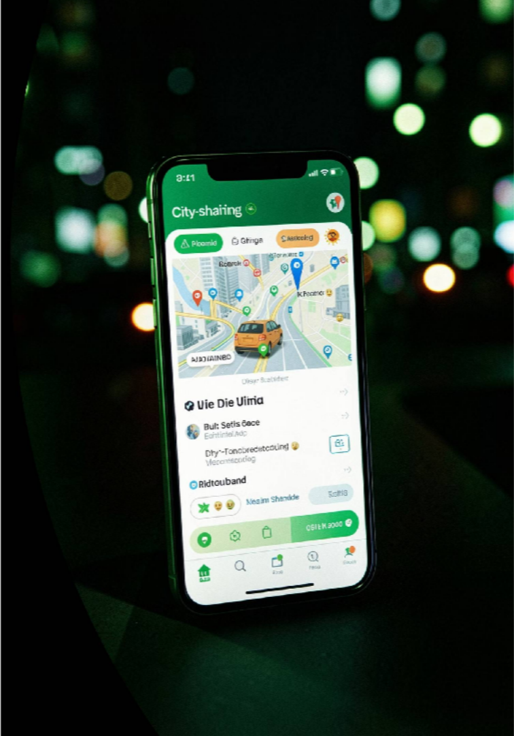
OLA Ride Analytics Dashboard
Power BI · SQL · Python · Excel

Slide 2

Project Overview
An end-to-end analytics project designed to analyze bookings, revenue, cancellations, and ratings — delivering actionable business insights through a unified Power BI dashboard built with SQL, Python, and Excel.

Slide 3




Business Objectives
Monitor Bookings
Track booking trends, volumes, and status breakdowns over time.
Analyze Revenue
Evaluate revenue by payment method, customer, and daily trends.
Evaluate Cancellations
Measure driver and customer cancellation rates and reasons.
Understand Ratings
Analyze customer and driver ratings across vehicle categories.

Slide 4
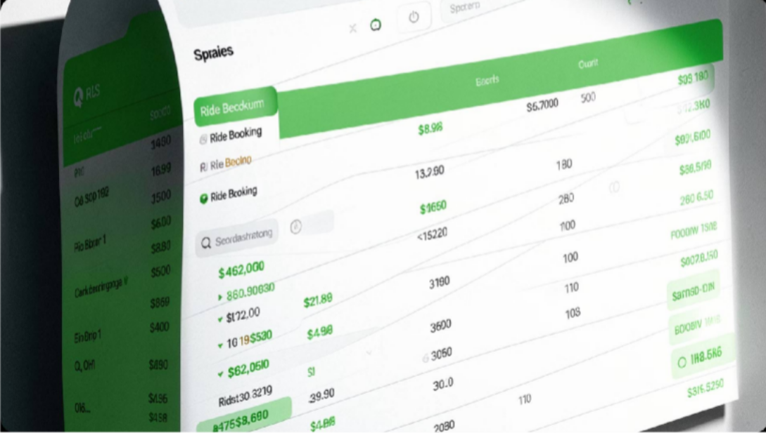





Dataset Overview
Fields Included
Booking ID & Customer ID
Vehicle Type & Booking Status
Payment Method & Booking Value
Ride Distance & Ratings
Cancellation Reasons

Slide 5
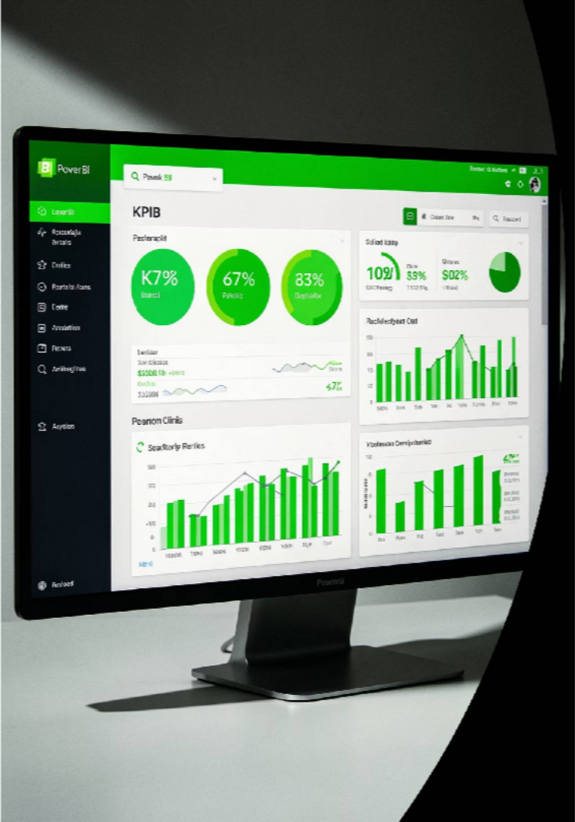

Overall Dashboard
Total Bookings
Aggregate count of all ride bookings across the platform.
Total Booking Value
Sum of all booking values, reflecting overall revenue potential.
Ride Volume Over Time
Trend analysis of booking volumes across time periods.
Booking Status Breakdown
Distribution of successful, cancelled, and pending bookings.

Slide 6
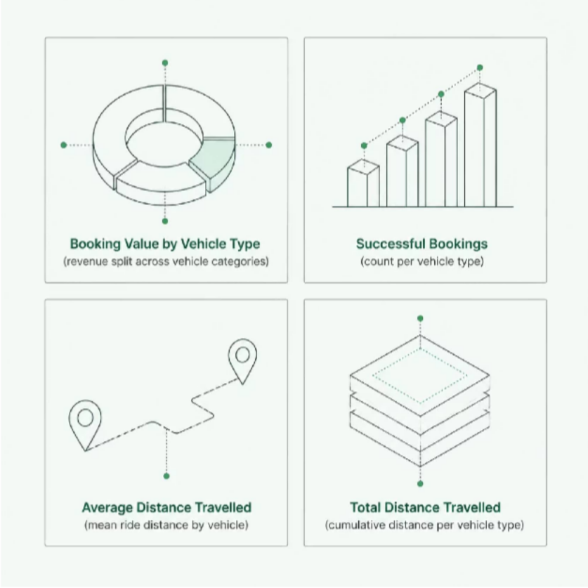
Vehicle Type Dashboard
Vehicle Performance
This dashboard breaks down key metrics by vehicle type — including booking value, successful bookings, and distance travelled
— enabling comparison of performance across the fleet.

Slide 7
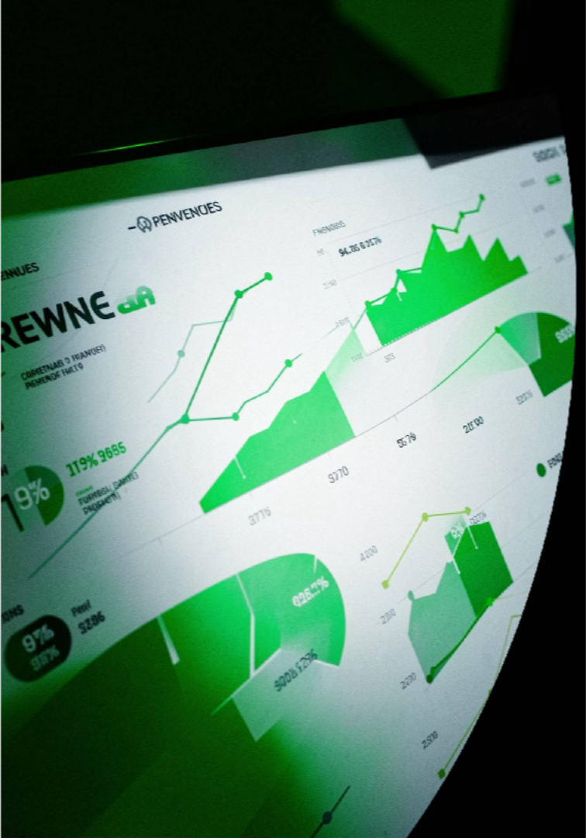



Revenue Dashboard
Revenue by Payment Method
Breakdown of total revenue segmented by payment type.
Top 5 Customers
Ranking of highest-value customers by total booking spend.
Daily Revenue Trend
Day-by-day revenue fluctuations to identify peak periods.

Slide 8

Cancellation Dashboard
Cancellation Metrics
Customer Cancellation Rate
Percentage of bookings cancelled by customers.
Driver Cancellation Rate
Percentage of bookings cancelled by drivers.
Cancellation Reasons
Breakdown of the primary reasons behind cancellations.

Slide 9

Ratings Dashboard
Customer Ratings
Average ratings given by customers across all rides.
Driver Ratings
Average ratings received by drivers, measuring service quality.
Vehicle-wise Rating Comparison
Rating breakdown segmented by vehicle type for performance benchmarking.

Slide 10
Key Insights & Recommendations
01
Improve Driver Availability
Address gaps in driver supply to reduce wait times and cancellations.
03
Focus on High-Performing Vehicles
Prioritize investment in vehicle categories with strong booking and rating performance.
02
Reduce Cancellations
Target top cancellation reasons with operational improvements.
04
Improve Customer Retention
Leverage top customer data and ratings to build loyalty programs.

