Slide 1


OGTIP
INTERNSHIP
PROJECT1
Statistical analysis on stock prices of US major companies to study the behavior of stock
PRESENTED BY:
Sehrish Hammad
PRESENTED TO:
Minakshi Gautam

Slide 2

Project stages
01
Descriptive statistics to get better insight of data
02
Visual representation of findings using charts
03
Including summary of statistics
04
Making Regression model to see the trends of stock prices
05
Comparing the value of beta and identifying risk value involved

Slide 3
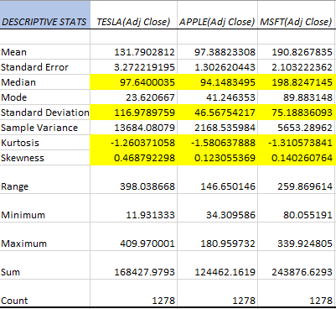
Descriptive Stats of all Stocks
Central tendency measure will be median for all three companies as the values of kurtosis for all records are less then 3 indicating the distribution platykurtic with lighter tails The MSFT has highest mean as compared to other two companies indicating peaked stock prices According to the STD we can see Tesla stock prices are more deviated from the median making it unreliable for investment Skewness of all three records showed that data is positively skewed as value is greater then 0 Range showed the highest prices for Tesla as prices are more dispersed one comparatively

Slide 4
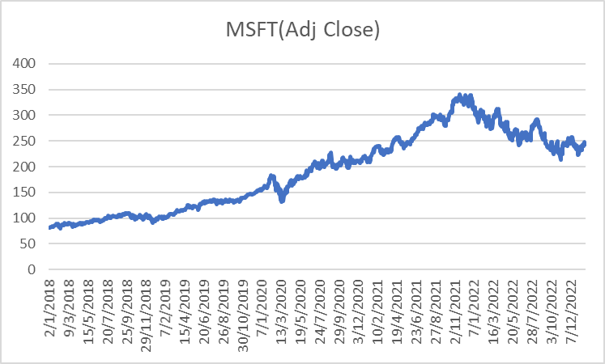
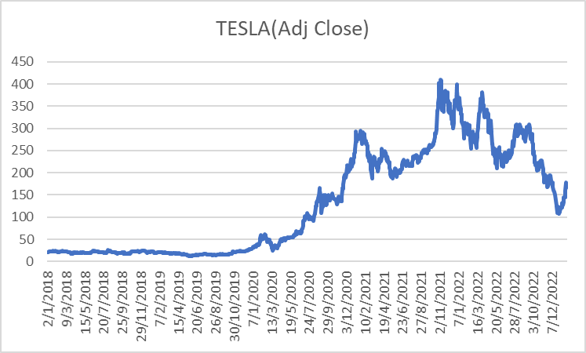
Line graph wrt time
The line graph shows the steady increase in stock prices of MSFT during 2018 to 2020 that went to the peak during 2021 to 2023 The line graph of Tesla shows an instant increase from 2020 to 2021 and values are showing higher fluctuation as it is falling and raising from2022 to 2023

Slide 5
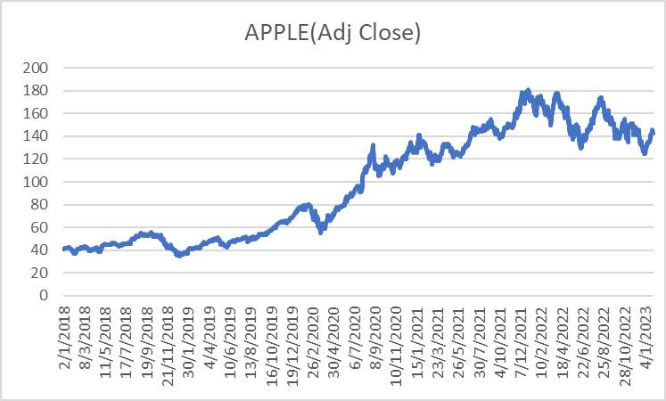
Line graph
The line graph of Apple shows a steady increase in stock prices from 2020 to 2023 .The values are not fluctuating much as compared to MSFT and Tesla.
Jupiter is a gas giant and the biggest planet in our Solar System. It’s the fourth-brightest object in the sky

Slide 6
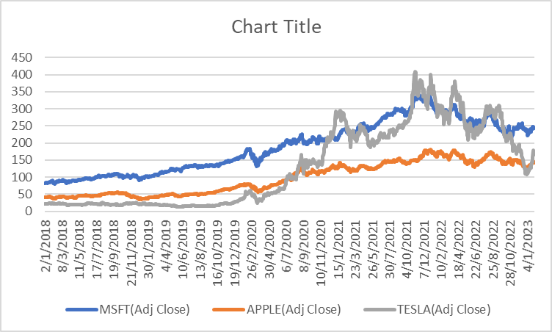
Comparison of all three stock prices wrt time
The all three companies stock performance shows that Tesla has highest STD and MSFT has highest median as its prices were increasing averagely but the Apple is showing the most stable record with lowest STD , median and mean

Slide 7
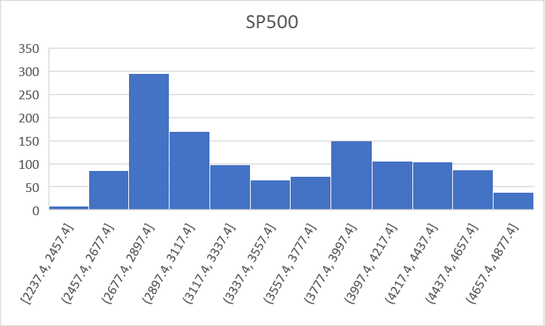
Line graph
The stock price of the 500 countries is showing the stable record and deviation in data. The distribution is positively skewed

Slide 8
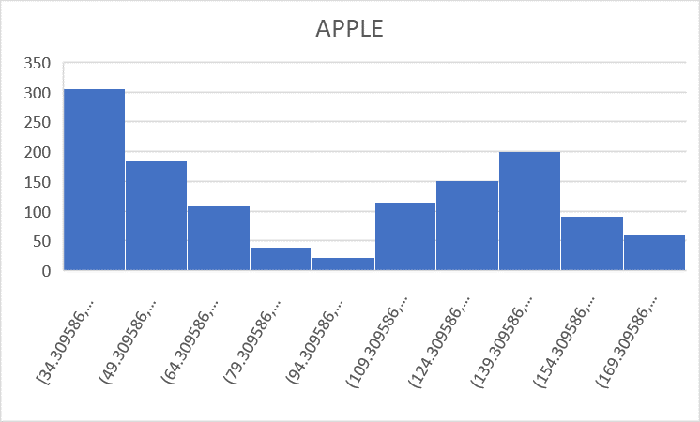
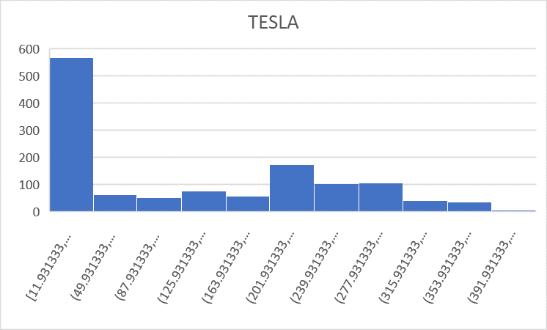
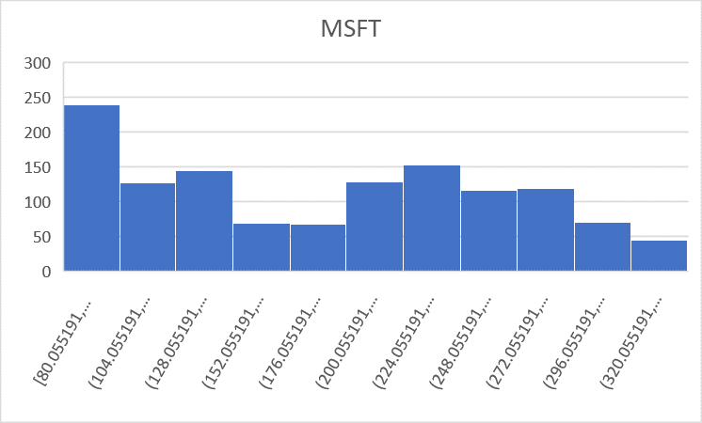
Histogram
The histogram shows that however , all companies data is normally distributed but the Tesla is having more outliers as compared to Apple and MSFT. MSFT has highest median indicating increase in prices on average

Slide 9
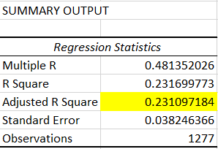
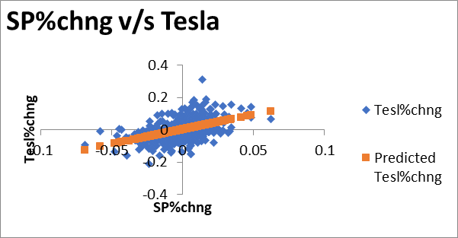
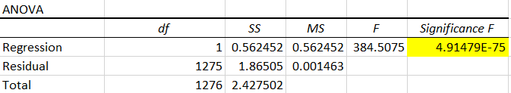
REGRESSION (TESLA)
The regression line fit plot shows the weak relationship between the variables as adjusted r square is nearly 0 that is 0.23 . The intercept is 0.0019 if we talk about the slope or beta value while keeping in mind how much change can we expect from the trend the Tesla is showing 1.83 that means we can have highest turnover in short time but with the instability as of fluctuating stock values

Slide 10
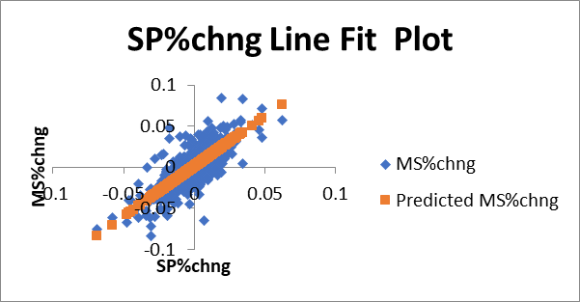
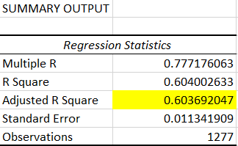
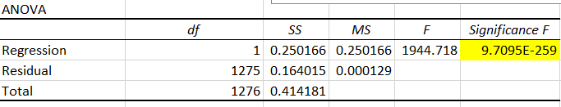
REGRESSION (MSFT)
The line fit plot for MSFT shows the adjusted r 0.603 that is indicating it a good relationship the significance F is also very small . If we talk about the value of beta or slope it is giving us a change of 1.22 less then Apple and Tesla and positively influenced with the turnover . It is not showing any risk as compared to Tesla thus, it is giving good relationship with stable trend.

Slide 11
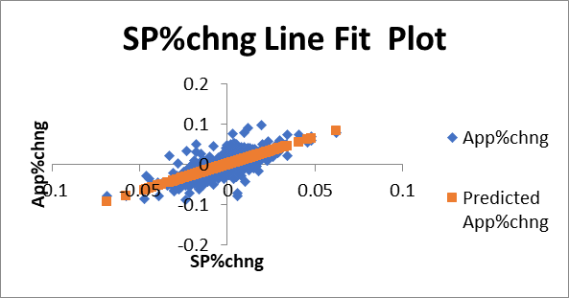
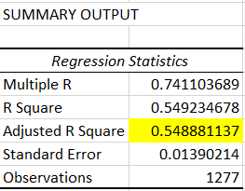
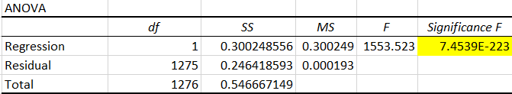
REGRESSION(APPLE)
The plot and findings are showing the Apple company has less deviating stock prices the adjusted r is 0.5 the significance F is also very small and value of beta is showing change of 1.33 that is very subtle thus making it a good choice for investment

Slide 12
CONCLUSION
The stock prices of all three companies with respect to time are all normally distributed . However, some have potential risk of fluctuating values giving higher chances of profit or loss like Tesla. The other two companies like APPLE and MSFT are giving relatively moderate results with less fluctuation in prices but median of MSFT is higher comparatively giving it a rise in average. Increase of values

Slide 13
Thank you
The link to excel Project1.xlsx

