Slide 1







prompt
response
Large Language Model

Slide 2
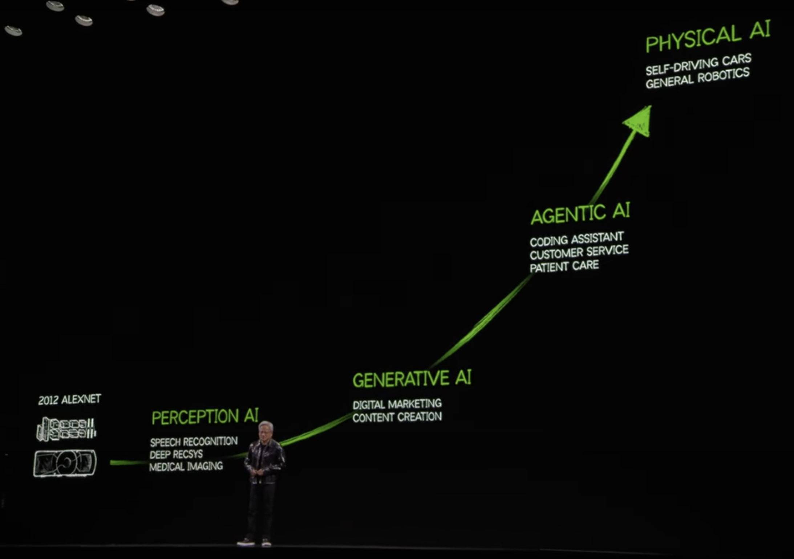

Slide 3
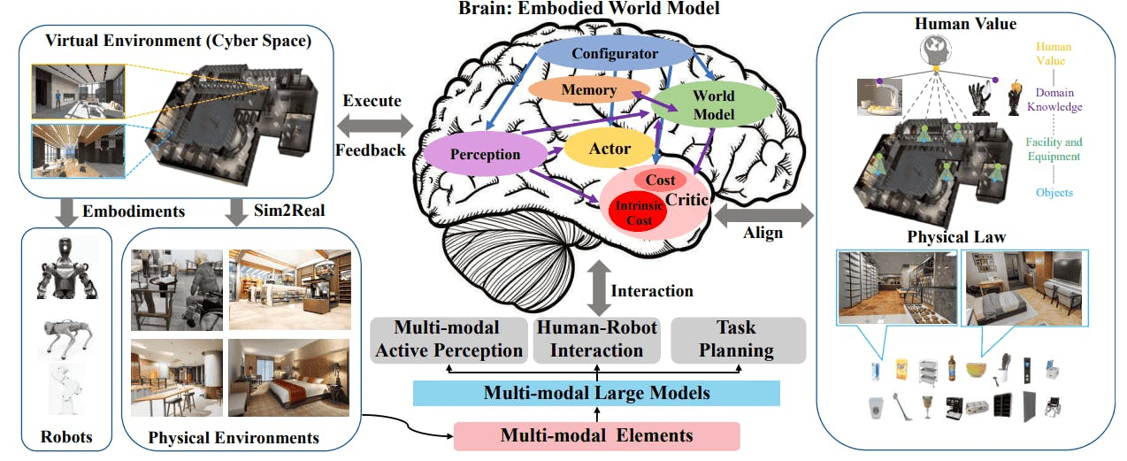

Slide 4



Slide 5
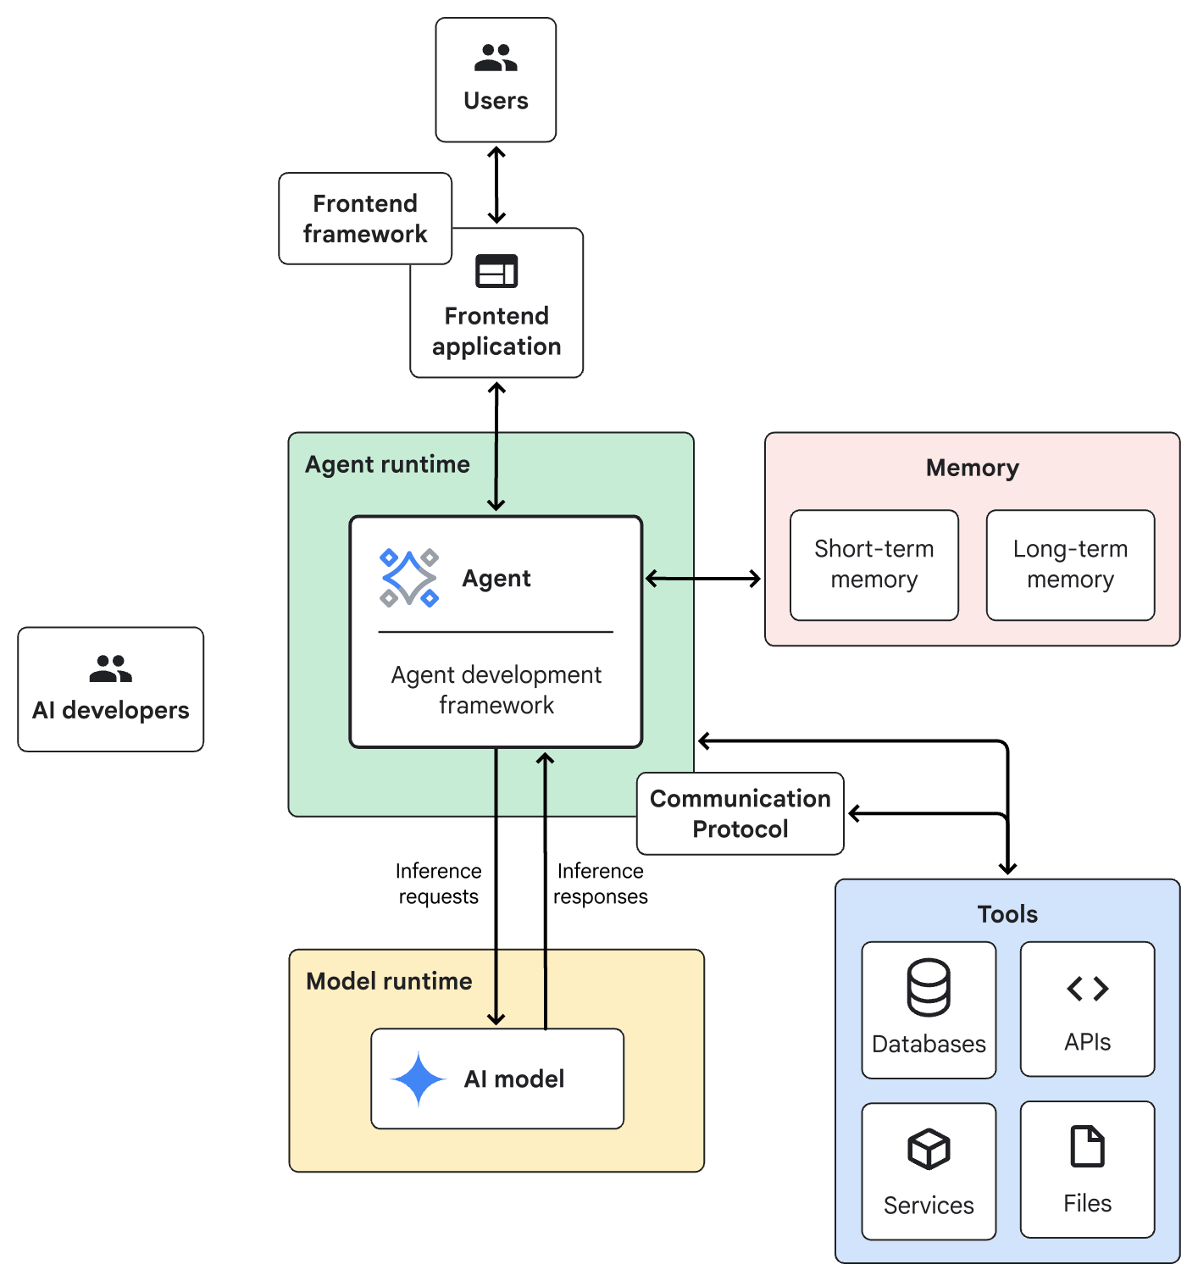

Slide 6

