Slide 1
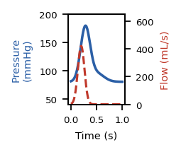
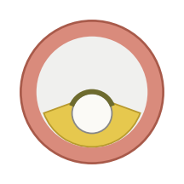
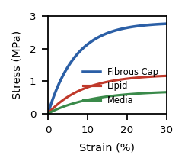
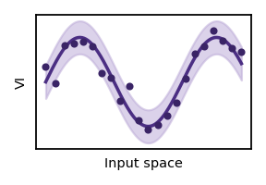
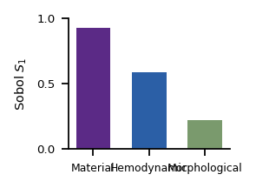
1
Dataset Generation
2
Vulnerability Index Selection
3
Surrogate Model &
Sensitivity Analysis
Input Parameters
6 VI candidates
GPR surrogate model
Hemodynamic
Pressure/Flow
Plaque
Morphology
Material
Stress-Strain
Map input parameters → VI
VI
VI = stress / strength
● Hemodynamic
● Morphological
● Material
σ
stress = {PSS, ΔPSS}
α
α = {0.0, 0.5, 1.0}
Cost-effective FSI simulation
7-criterion clinical screening
Sobol sensitivity analysis
→ 1,000-sample dataset
• Sign-agreement test
[ FSI result image ]
Outputs:
• PSS (peak systolic stress)
• ΔPSS (change in PSS)
Select two final indices:
VI₁
VI₁ = ΔPSS / E_{FC}^{0.5}
VI₂
VI₂ = ΔPSS / E_{FC}^{1.0}
★ Material > Hemodynamic > Morphological

